Slide 1
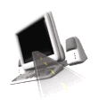

T H E D R I V E R S E D G E
I N T E R A C T I V E
slides and videos
Partial lesson
21 of 76 slides
Unit 6 – 2 Lane Rural Driving

Slide 2

2 lane driving
Strategies and
Rules of Road
40% more fatal crashes occur on rural roads than urban roads.
Rural roads may be narrow and surfaced with gravel or asphalt.

Slide 3
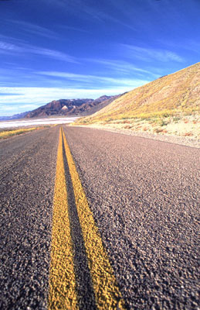
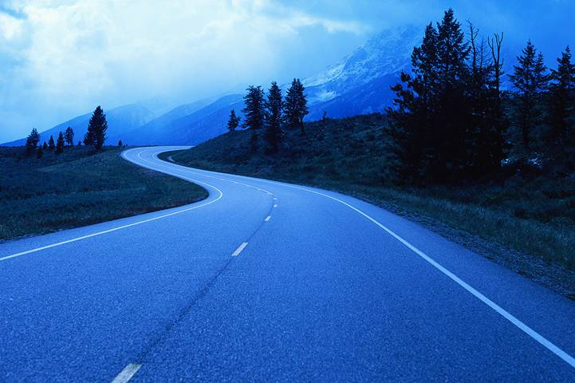
2 lane driving
Strategies and
Rules of Road

Slide 4
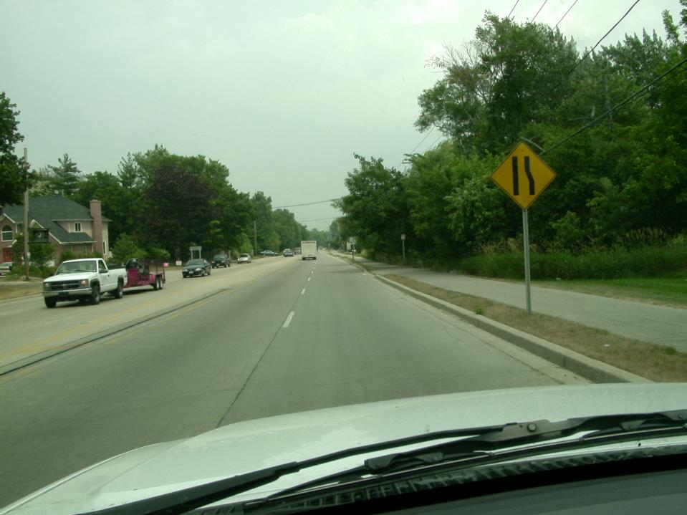
One of the most important signs along the road.
One of the few signs directing you to do something
rather than just being warned.
What must you do in this situation?
Lane change, it’s becoming a 2 lane road

Slide 5
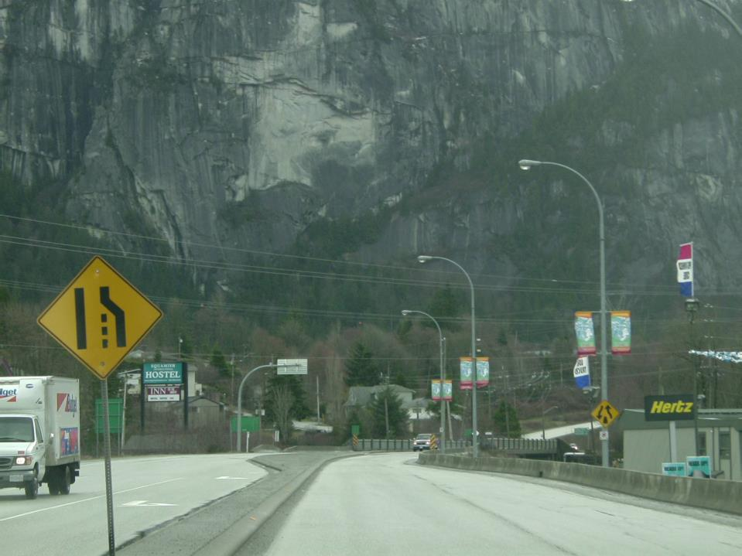
Is anyone passing on the right?
After changing lanes, what should you check?
Head check over right shoulder
Developing this habit will
minimize risks

Slide 6
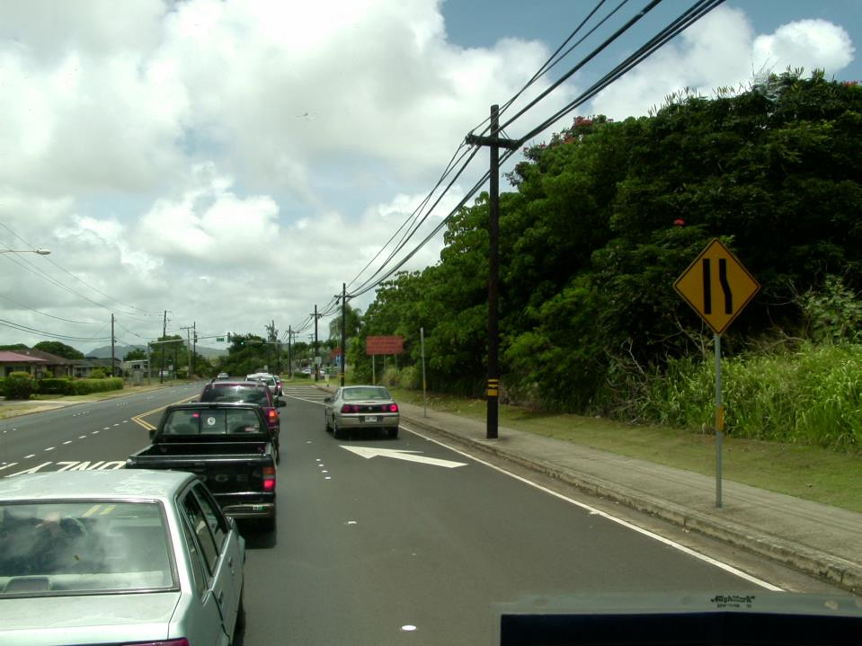
Some drivers seem to be unaware that their lane is ending…
Don’t be one of them… get over ASAP

Slide 7
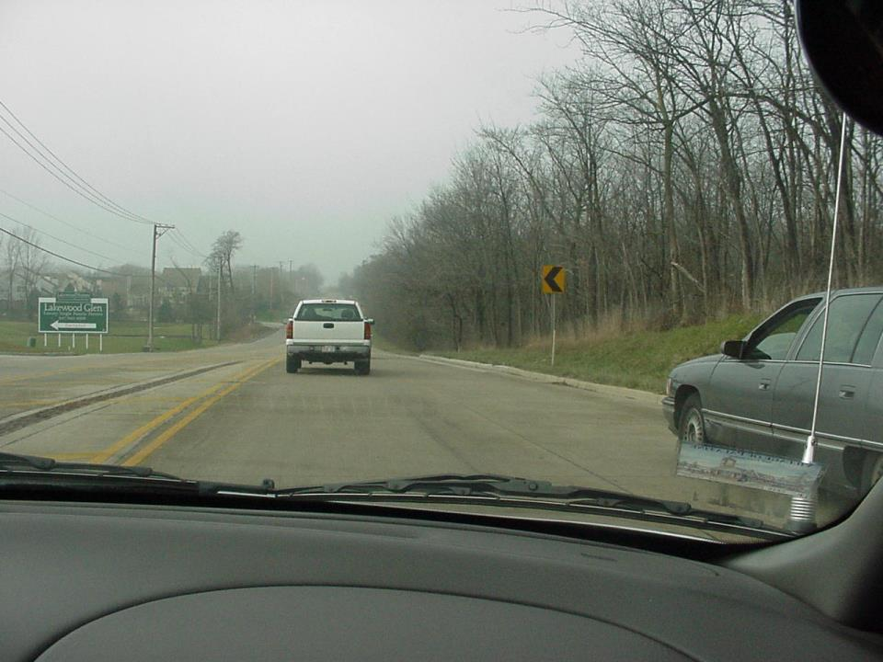
This vehicle is passing us on the right, (their lane is ending) what should you do?
DROP BACK AND LET THEM IN
STOP
and
THINK
There are
a lot of aggressive
drivers like this.
There are also
drivers who have
no idea their
lane is ending
Instead
of getting
upset with
these drivers,
just let them be.
There’s no way
you can change
them anyway.

Slide 8
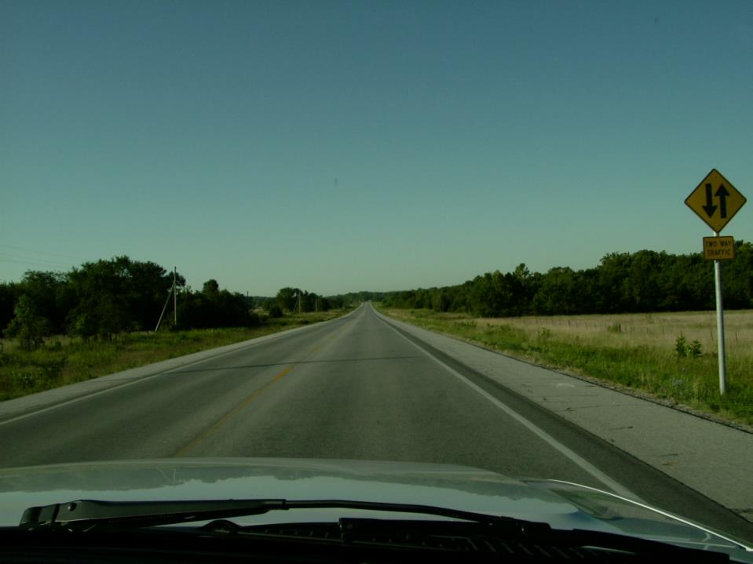
After the 4 lane road ends you will often see this sign that indicates:___________
2 Way Traffic

Slide 9
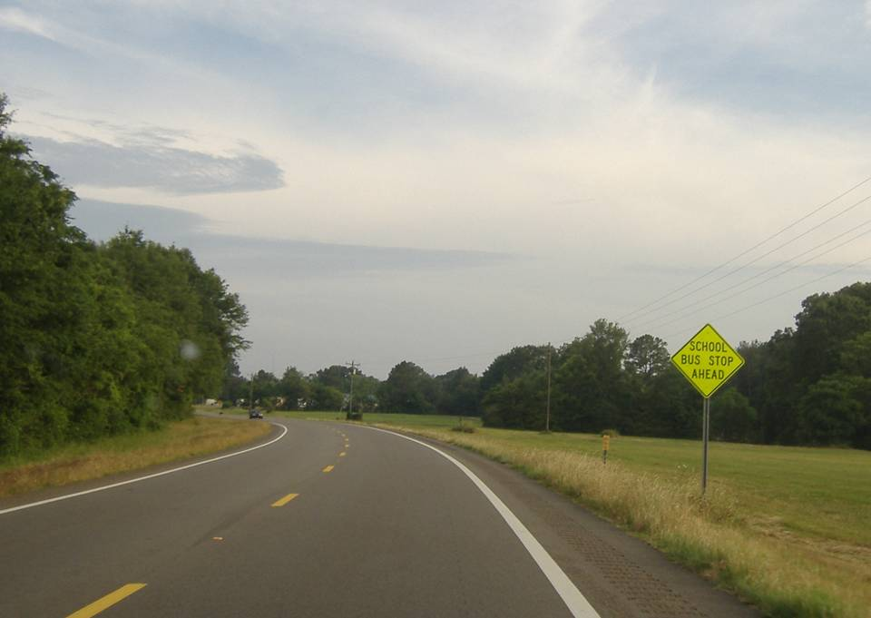
While thinking about rural areas, be aware that curves and hills may obscure your visibility…

Slide 10
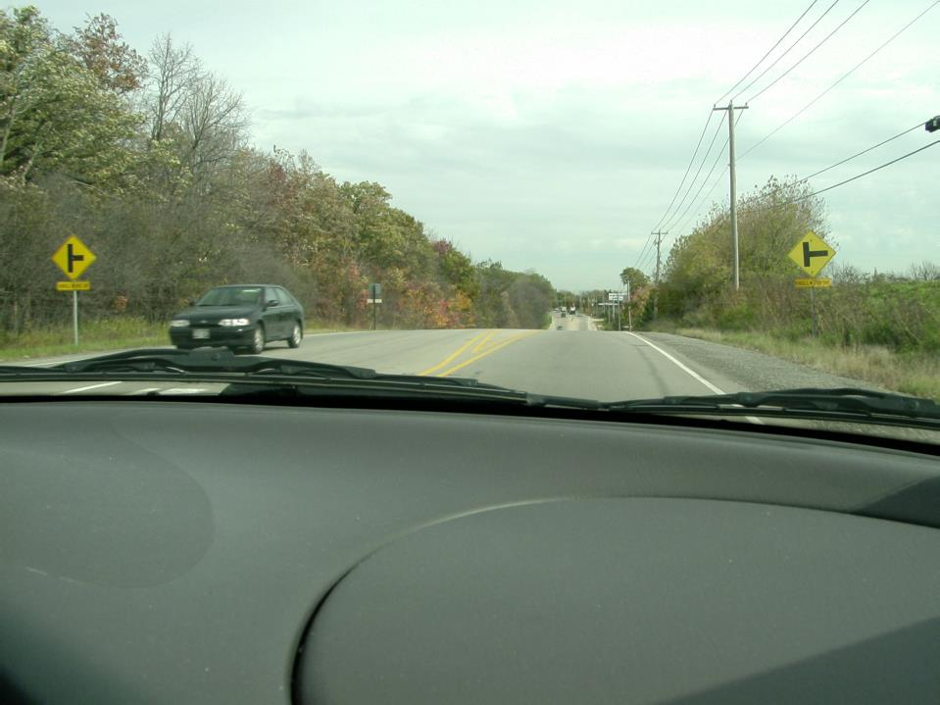
Frequently, intersection signs are provided because
visibility of the intersection is obstructed by a hill.
What should you be thinking about as you go over this hill?
Will a car be pulling out of the side road?

Slide 11
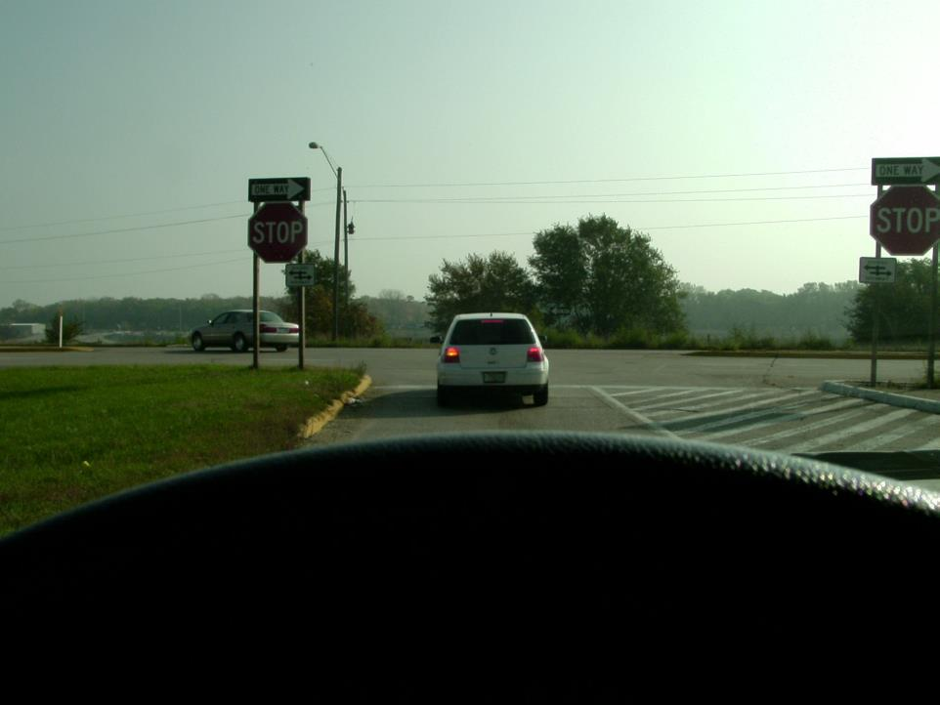
Frequently, in rural areas you will encounter divided roads
with large median areas - be sure you turn left into
the proper direction of traffic!

Slide 12
Frequently, in rural areas you will encounter divided roads
with large median areas - be sure you turn left into
the proper direction of traffic!
On other side
of median
Divided
Highway

Slide 13
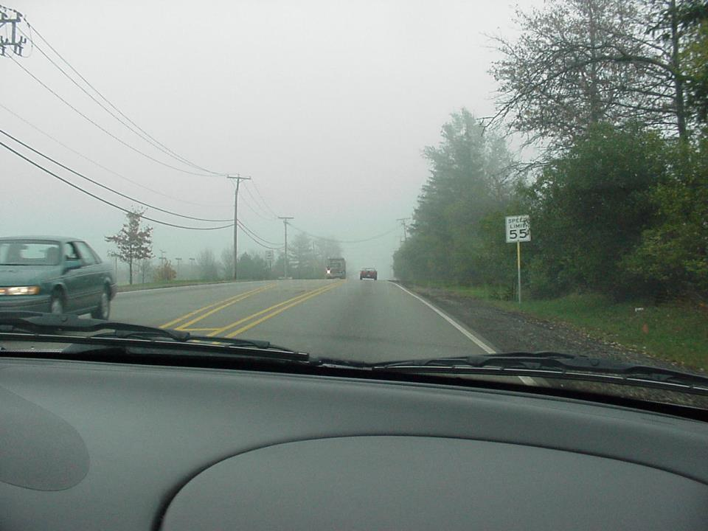
Why would exceeding the speed limit be especially dangerous on higher speed, two lane roads?
Higher speeds increase stopping distance in the event that cars pull out of blind corners or over hills.

Slide 14
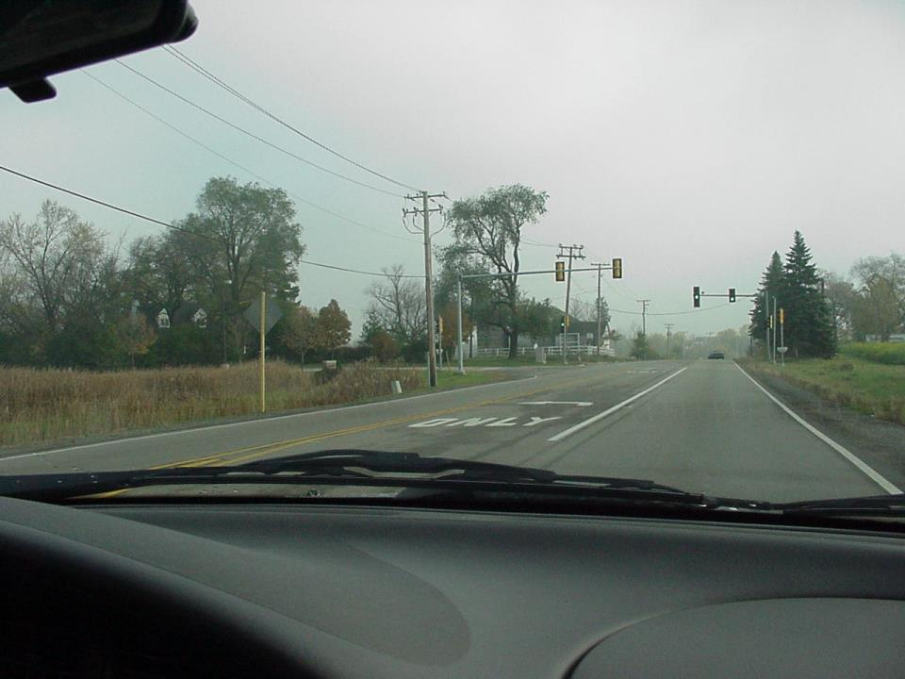
YES…there is no one on the side street to trip the light sensors.
Will this traffic light probably stay green?

Slide 15
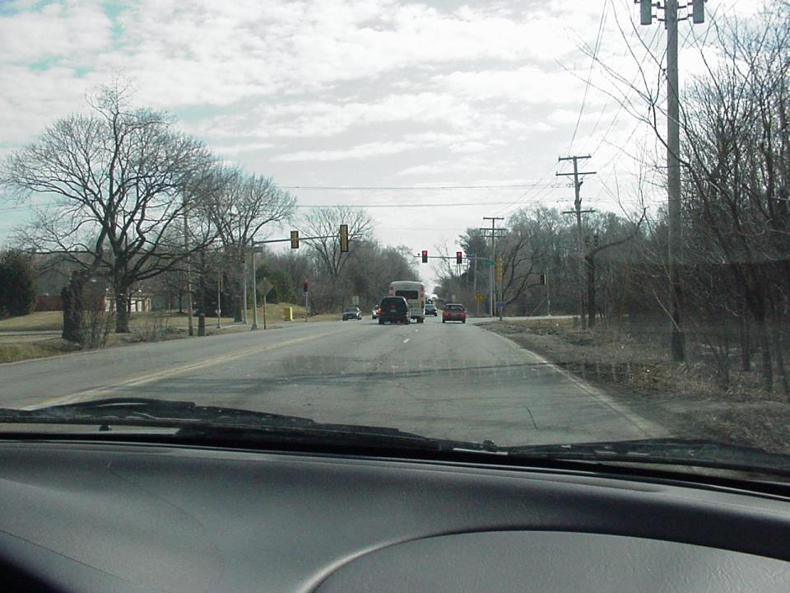

You intend to go straight, why was it a good idea to move to the right lane in this situation?
The left turner…and no protected arrow.

Slide 16
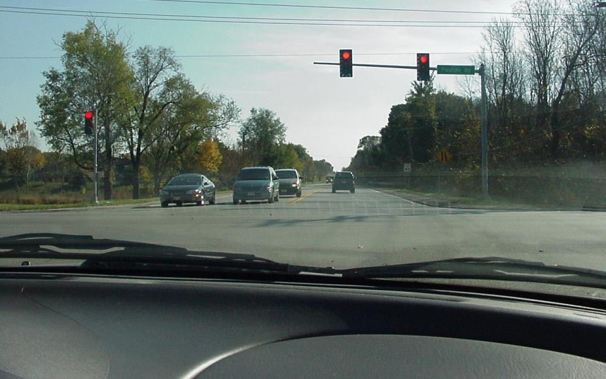
You’re going straight at this intersection, what have you identified and what should you do?
The right lane is ending, check to see if someone will be passing you on the right.

Slide 17
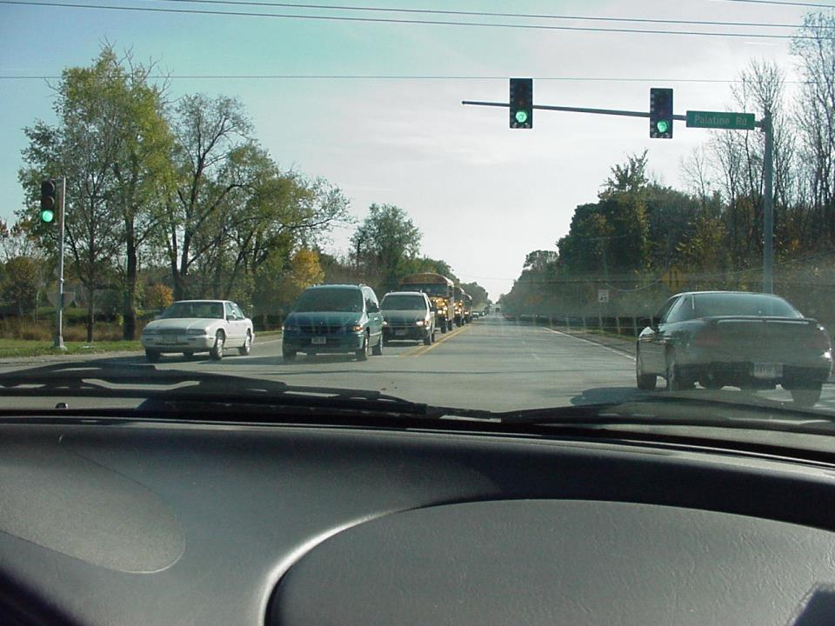
- same intersection
Continue checking for additional cars that might be passing. (right shoulder head check)

Slide 18
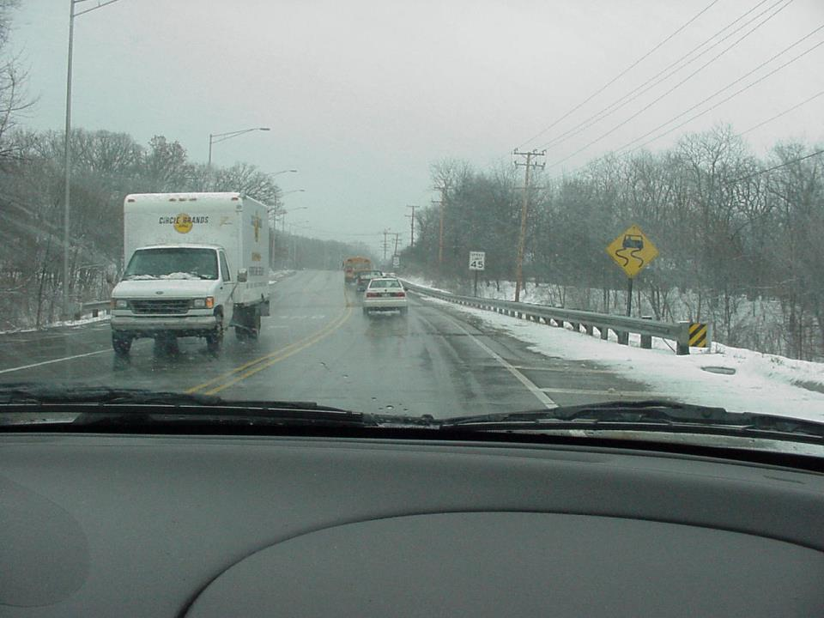
When we see this sign, there is usually a bridge ahead.
What is the meaning of this sign?
Slippery when wet

Slide 19
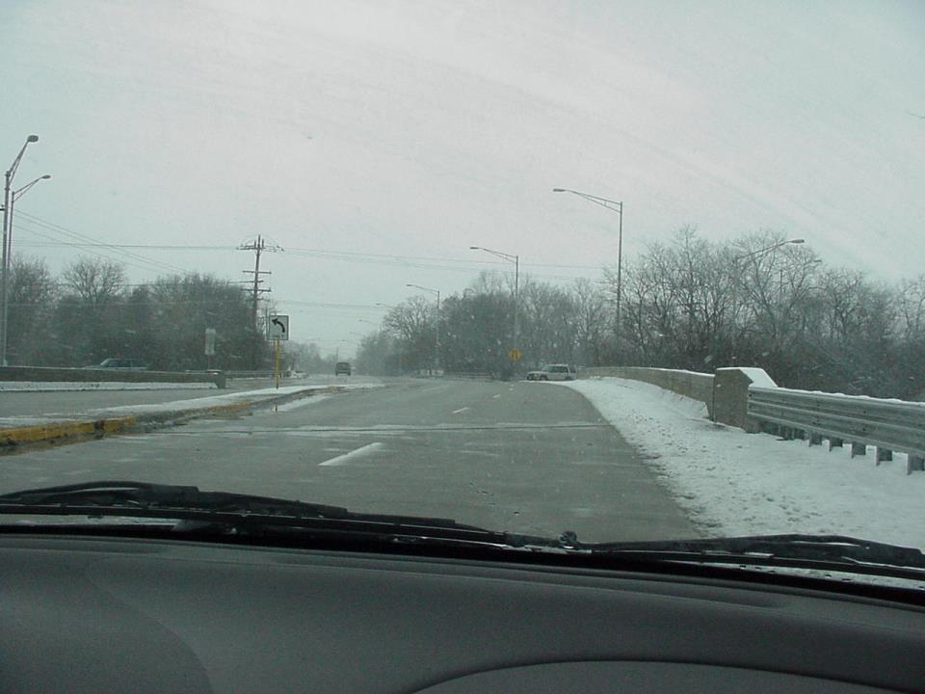
¼ mile later…the bridge. It’s about 32 degrees and the
road surface is more than just wet, it is also icy.

Slide 20
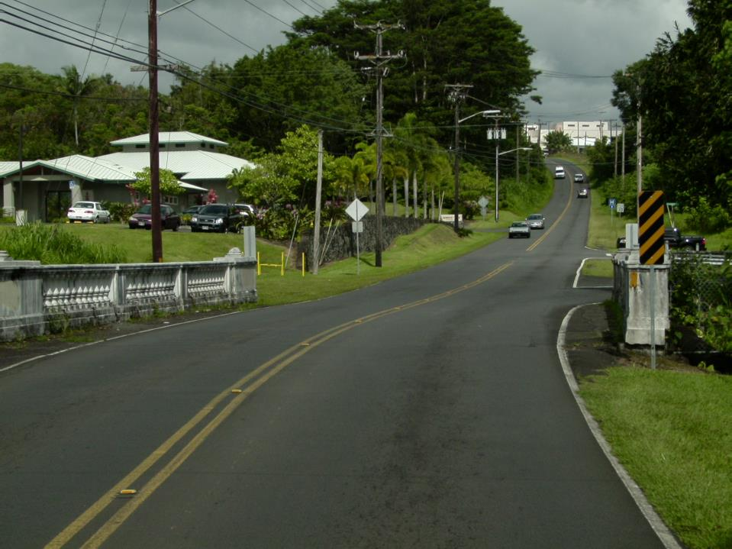
What do these yellow and black stripes mean?
FIXED IMMOVABLE HAZARD! A high speed collision with this bridge could be fatal.

Slide 21
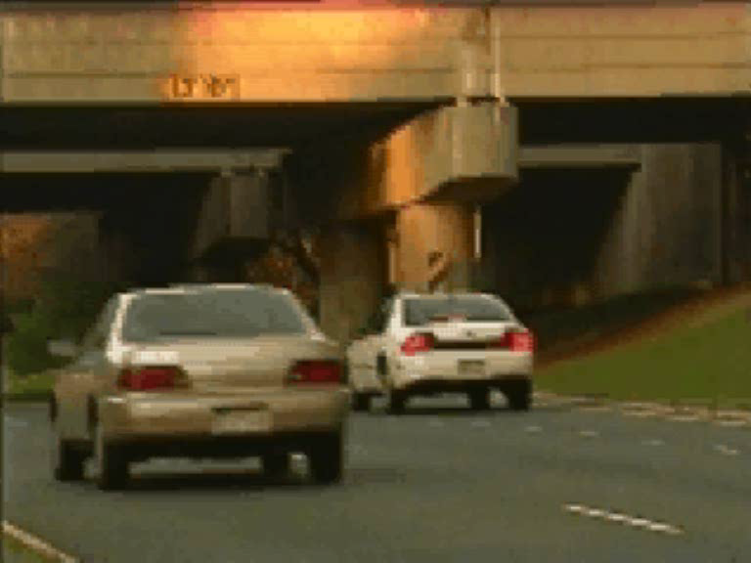
Roadside Hazards

