Slide 1
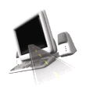

T H E D R I V E R S E D G E
I N T E R A C T I V E
slides and videos
Partial Lesson
first 20 out 65 slides
Unit 3 – 4 Lane Driving

Slide 2

4 Lane Strategies and Rules of the Road

Slide 3
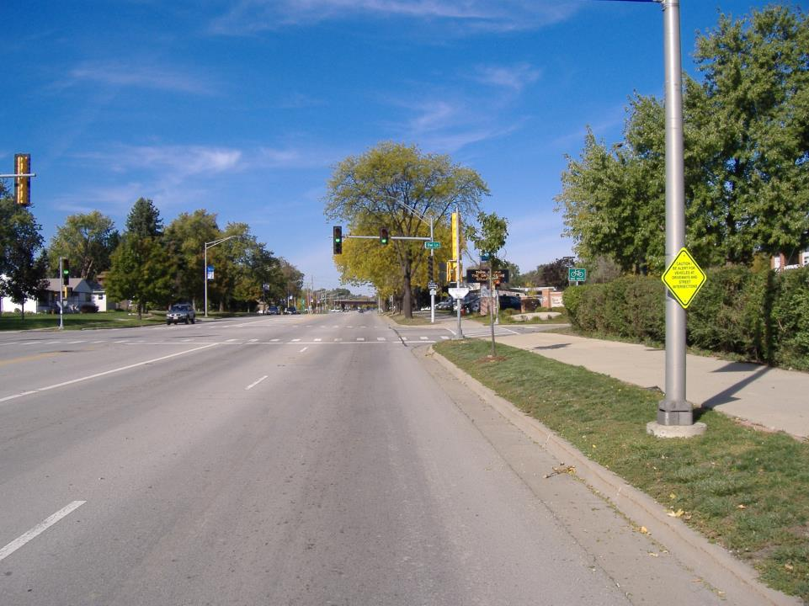
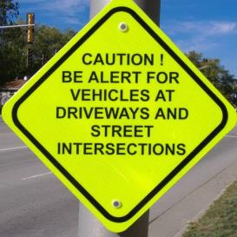
True
True or False: On 4 lane roads, most collisions occur at intersections.

Slide 4
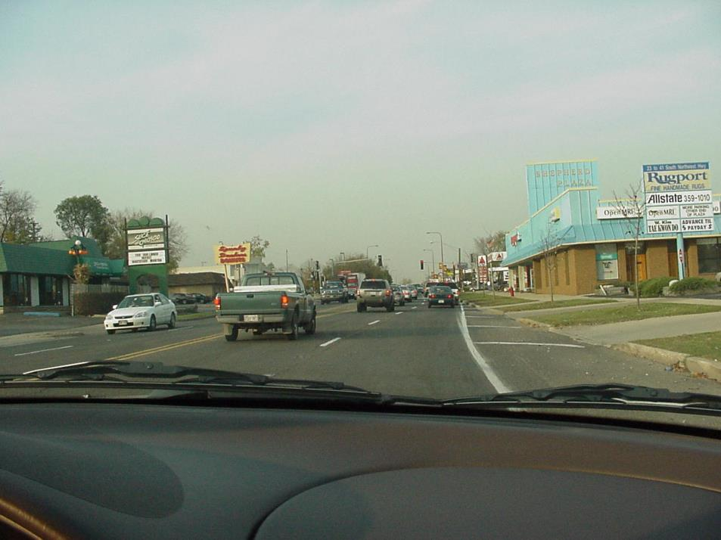
Let's now examine
4 lane driving strategies . . .
With this traffic situation, what should you already be doing?
Braking, this will also alert drivers behind you.

Slide 5
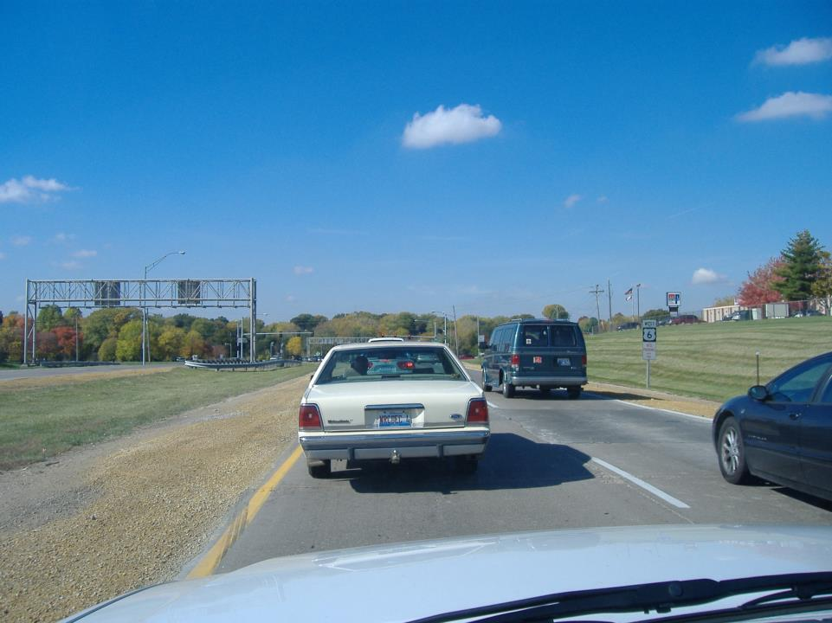
Some 4 lane roads (multilane) are divided, some are not.
Get in habit
of looking
through their
back window
Traffic light ahead
Brakes lights on second
vehicle ahead . . .
No brake lights
on this vehicle
Give 2 reasons why you should be slowing down?

Slide 6
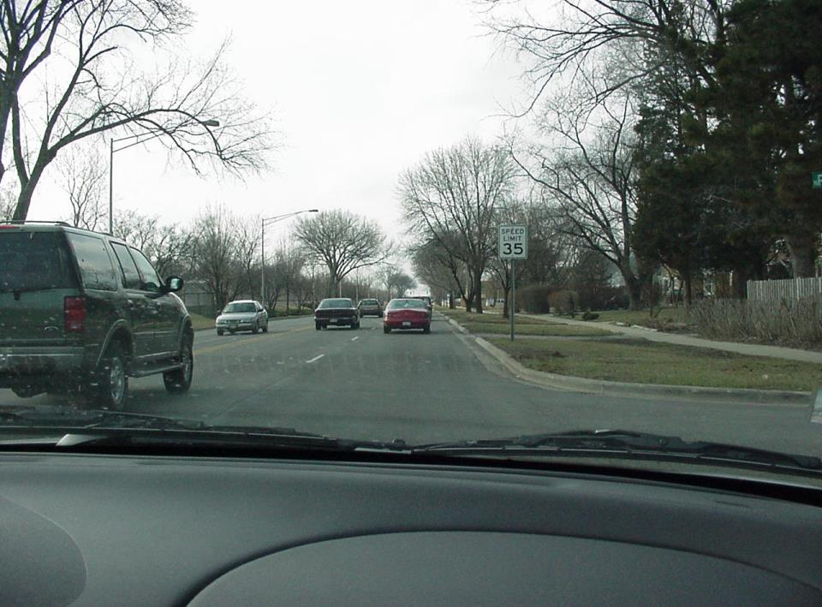
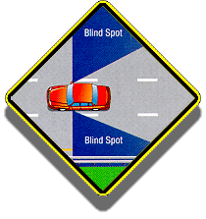
Are you in this driver’s blind spot?
Almost (nearly half of all drivers do not
make blind spot head checks when lane changing)

Slide 7
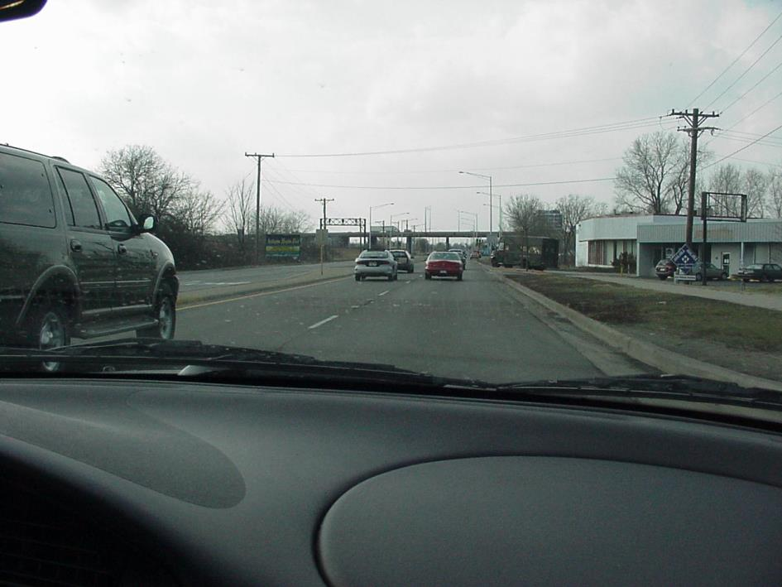
If they do not
check their
blind spot before
lane changing…
possible crash!
STOP
and
THINK
What is the
danger of
lingering in
their blind spot?
Now, depending upon how they adjusted
their mirror, you may in their blind spot.

Slide 8
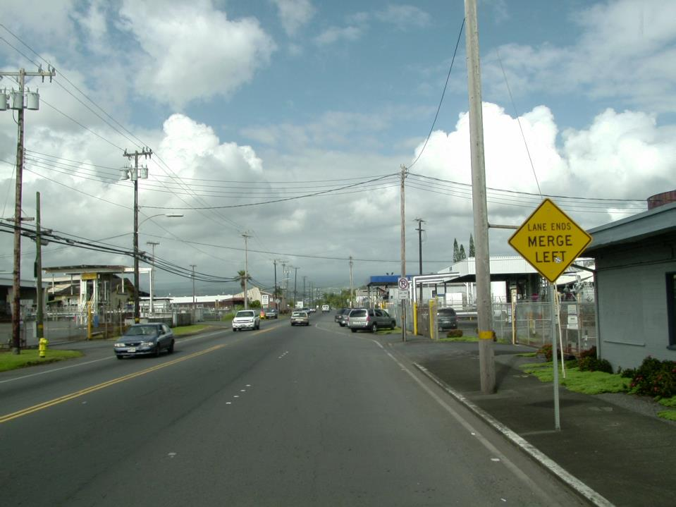
What other sign means the same thing?

Slide 9
Lane changing
Check traffic situation
Signal
Check mirrors again
Head check (covers blind spot)
COMMON MISTAKES
- dropping your speed
- drifting during head check
- forgetting to cancel signal
- moving car over too quickly

Slide 10
Proper Lane changing
some examples . . .
Movie will play

Slide 11
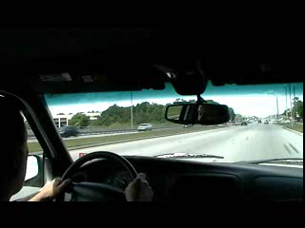
Lane change to the left

Slide 12
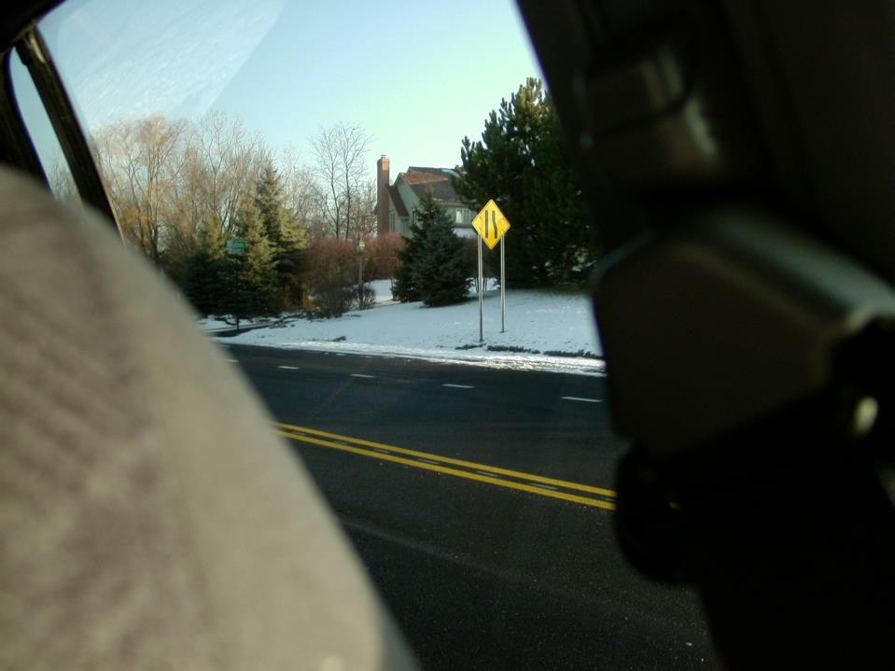
There is no need to look further back
After checking both inside and left outside mirrors,
the proper left shoulder blind spot head check:
Again, look out back seat side window.

Slide 13
Lane change - Right
an example . . .

Slide 14
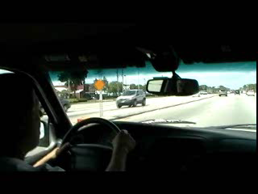
Lane change - Right

Slide 15
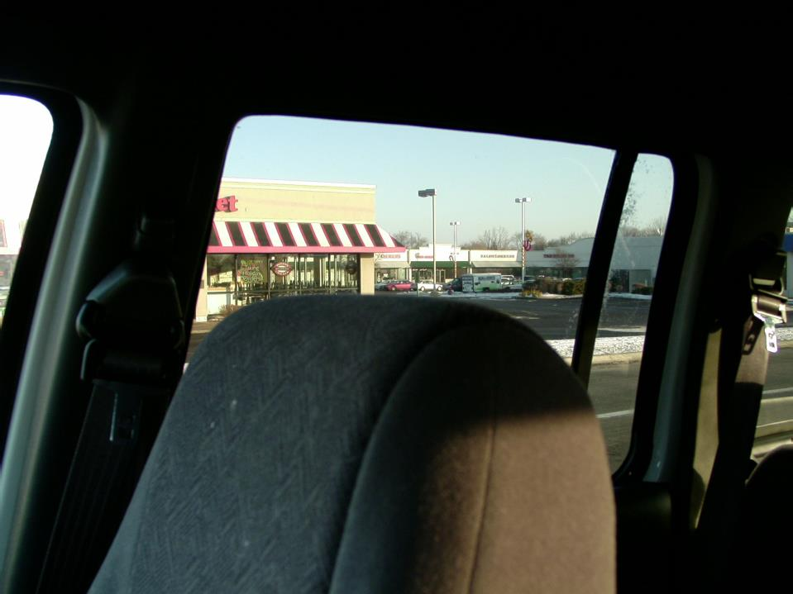
There is no need to look further back
After checking both inside and right outside mirrors,
the proper right shoulder blind spot head check:
Look out back seat side window.

Slide 16


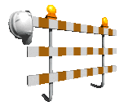


Often, lane changes must be made because of lane closures during construction.

Slide 17
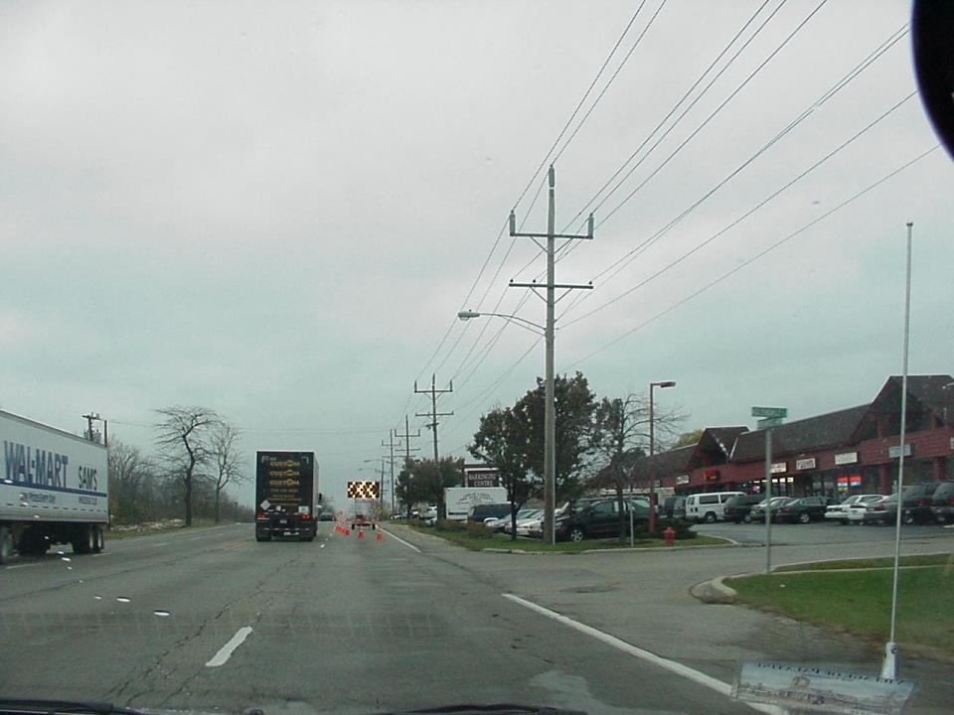
What must you do in this situation?
LANE CHANGE LEFT

Slide 18
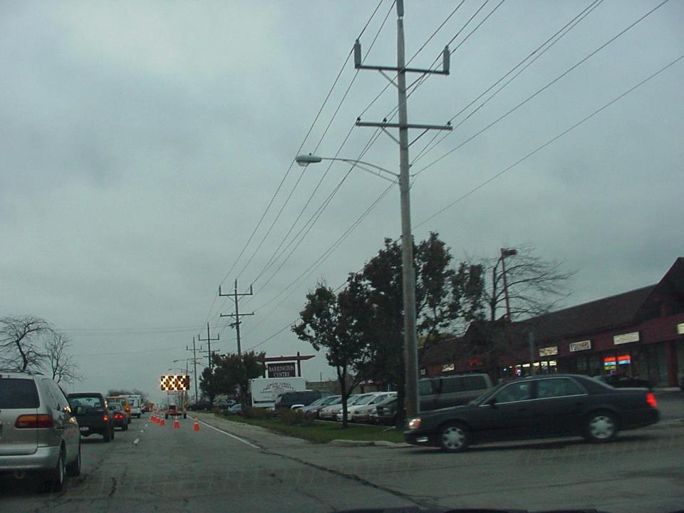
…but do not wait until you almost run out of space!

Slide 19
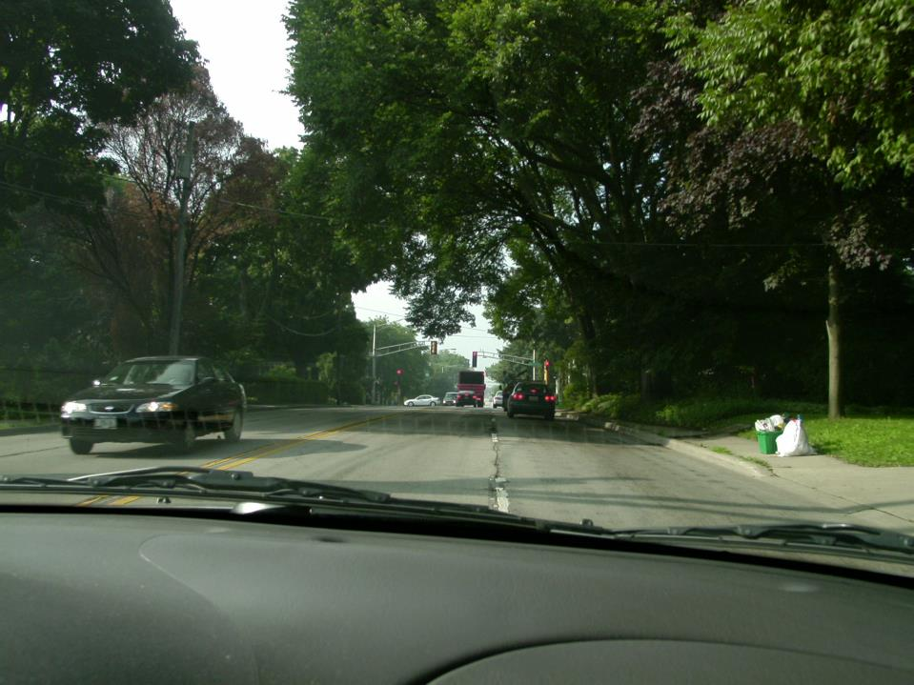
No, plan and
execute your lane
changes well in
advance of
any turn.
STOP
and
THINK
If you need
to turn right
at the light,
should you have
waited this
long to
lane change?
Some lane changes require you to brake. Watch for brake lights when moving over.

Slide 20
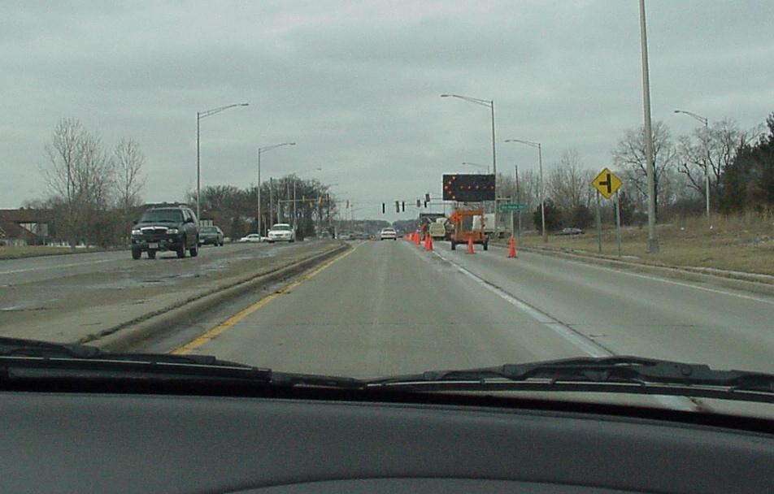
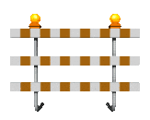
What would it be wise to check right now?
Right rear blind spot with head check.

Slide 21
Lane changing review- what are the steps?
Check traffic situation (mirrors)
Signal
Check mirrors again
Head check (covers blind spot)
Thought Question: Why should you still head check even if you know there are no vehicles behind you?
- - you do not want to lose the habit of head checking. If you stop doing it, it won’t develop into a habit.
(Safe driving is all about developing safe driving habits)

Slide 22
Lane Strategy
Let's now consider
determining the safest and most efficient lane to drive in
Good lane strategies (planning ahead) will result
in safer and less stressful driving.

Slide 23
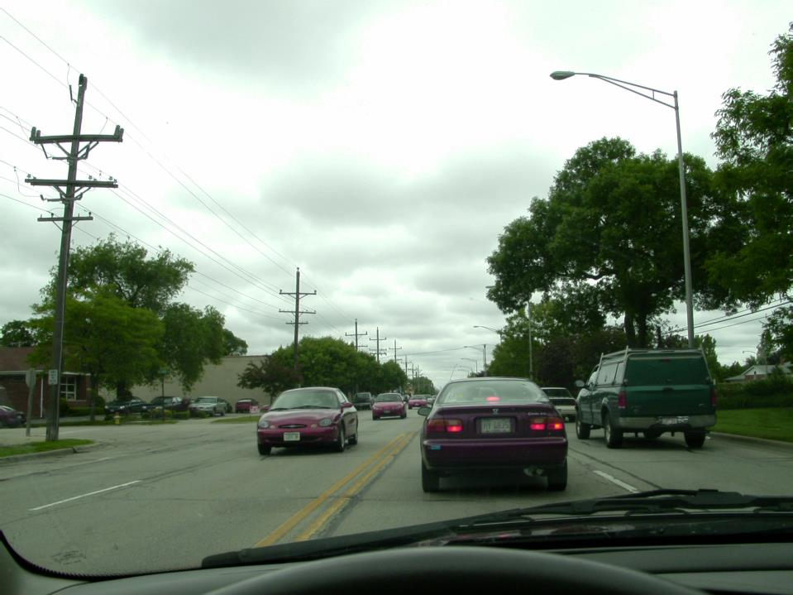
Why is the left lane of a 4 lane road not as safe or as efficient as the right lane?
Closer to oncoming cars
Escape paths are minimized
Can be delayed behind left turners

