Slide 1
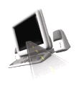

T H E D R I V E R S E D G E
I N T E R A C T I V E
slides and videos
Partial lesson
15 of 71 slides
Unit 8– Adverse / Emergency Situations

Slide 2




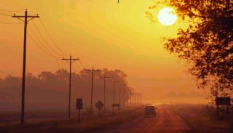

Emergency situations
Adverse conditions

Slide 3
Sun glare

Slide 4
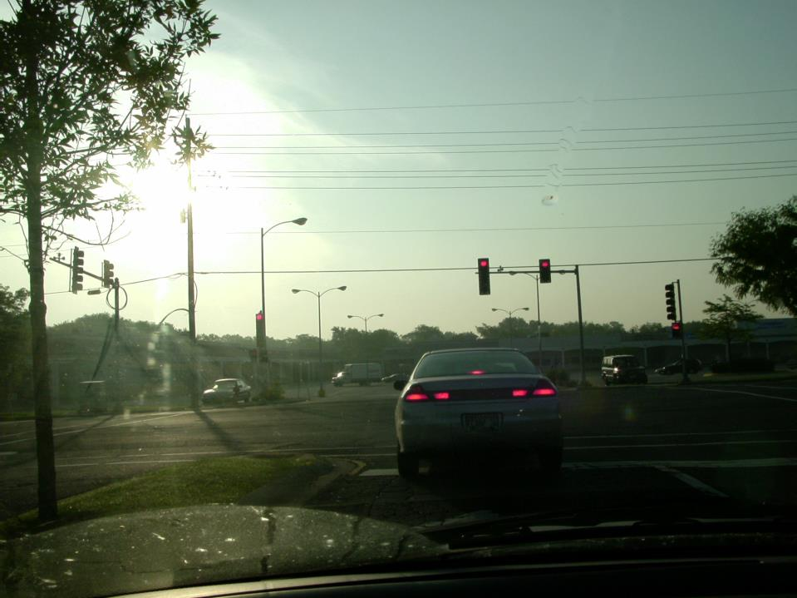
What are some problems associated with sun glare?
Everything is harder to see.
STOP
and
THINK
What effect
would a dirty
windshield
have with
sun glare?
It would make
everything much
harder to see

Slide 5
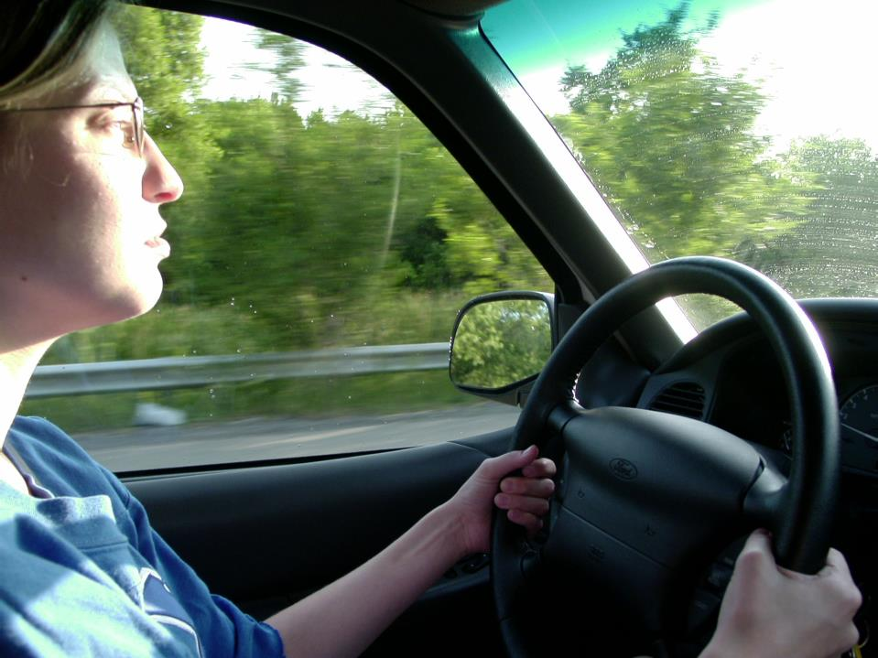
What could she do to minimize
the direct sun glare?

Slide 6
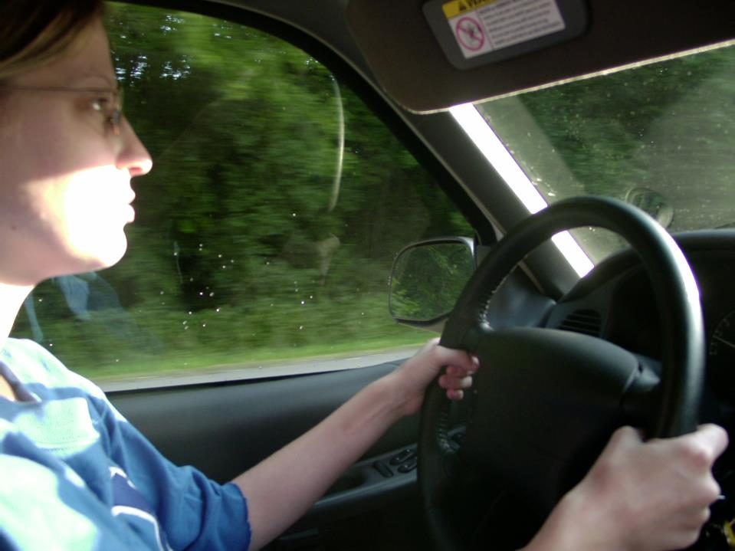
Drop the sun visor.

Slide 7
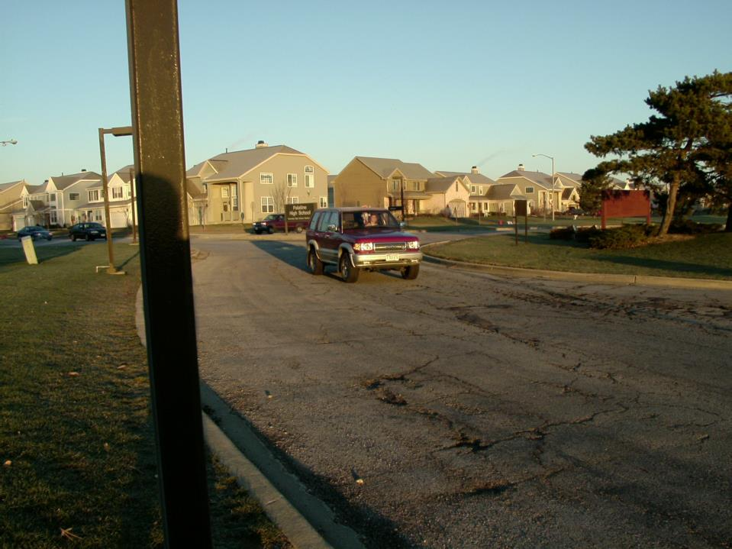
Also, be aware of sun glare upon drivers when you are a pedestrian. It’s likely this driver would have a hard time seeing you if you were to begin crossing the street.

Slide 8
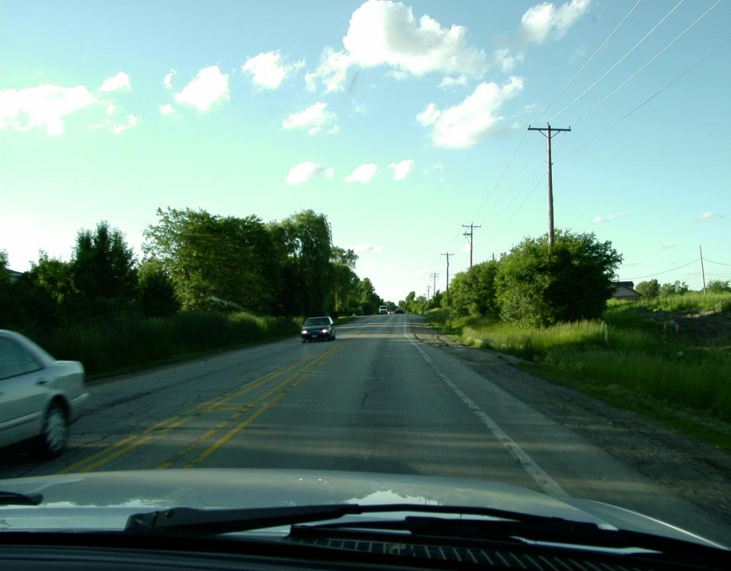

As the sun begins to set, don’t forget
to________________________.
turn on low beam headlights

Slide 9
Driving in Rain

Slide 10
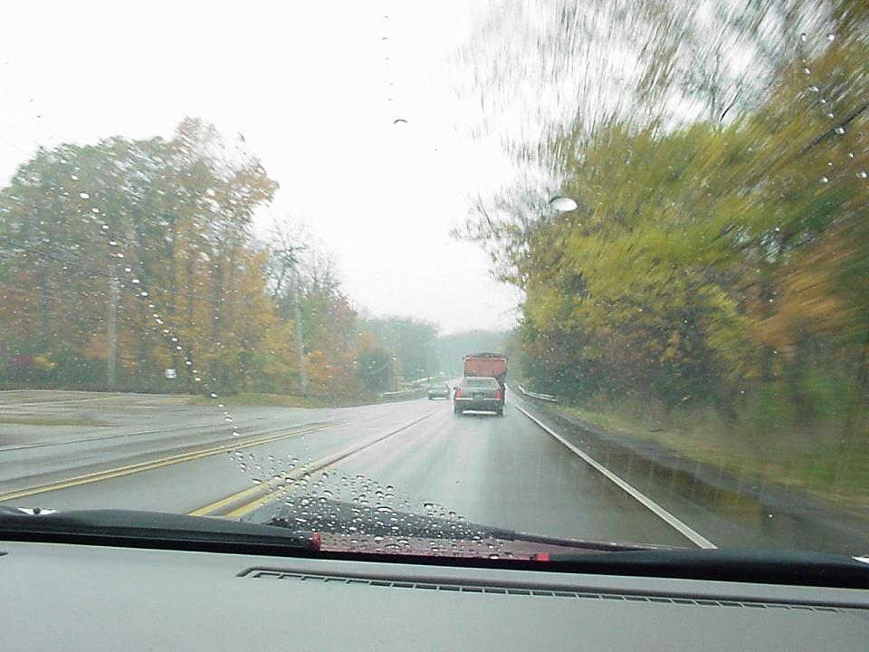
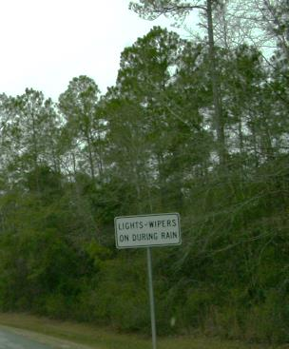
Double or triple it.
Also, in rainy weather you must
use your __________.
low beam lights
What about your following distance in rainy weather?

Slide 11
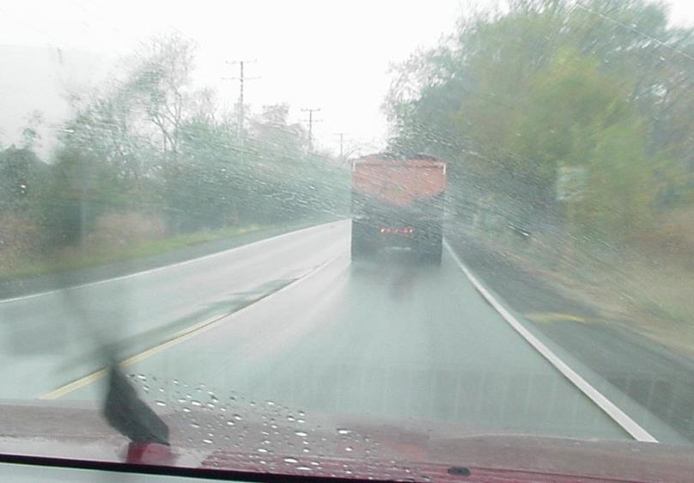
What is a problem following
large trucks in rainy weather?
Their large tires throw it all on our windshield. Be sure you have a good supply of window washer.

Slide 12
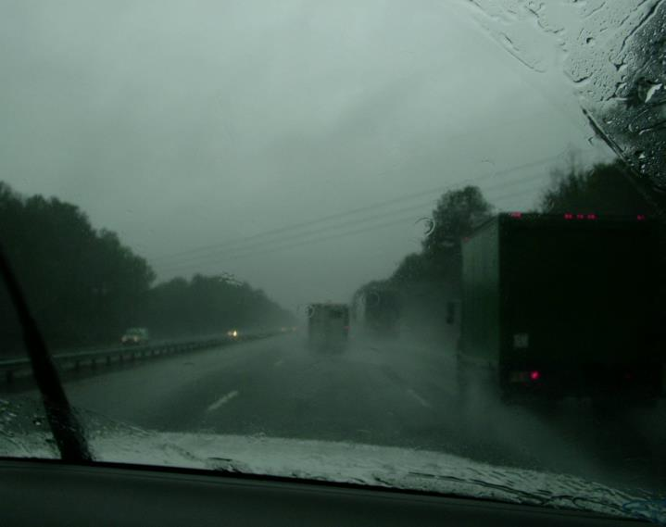
What is a problem following
large trucks in rainy weather?
Sometimes it can really be difficult to see!

Slide 13
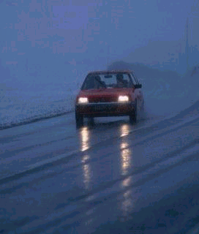
Roadways are most slippery when it: ___________________
first begins to rain
Roads accumulate dirt and oil which mix with the first few minutes of a rain causing a pasty gooey substance that is very slippery. After some heavier rain, this “summer ice” is washed away.
Be careful of sudden movements with the steering wheel, quick acceleration, or hard braking.

Slide 14
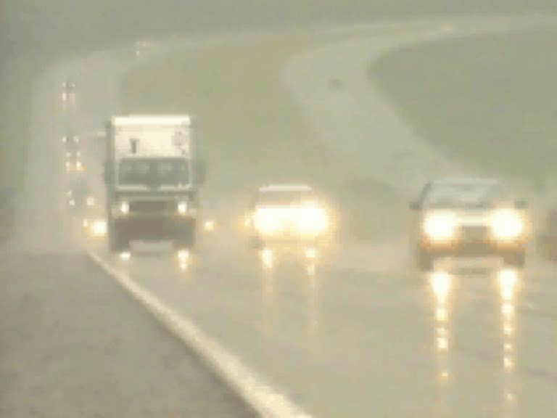
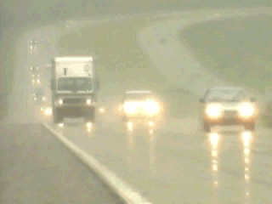
Driving in Rain

Slide 15
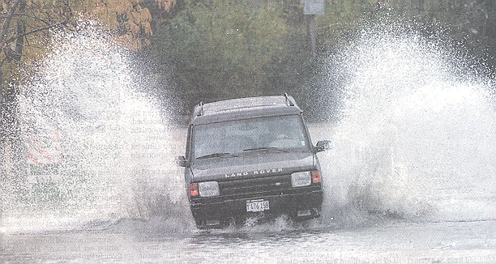
What is important to remember when going through shallow water?
Hydroplaning is possible.
Keep moving slowly.

Slide 16
What is important to remember when going through deeper water? (only if other cars are also successfully getting through)
Keep moving slowly
Dry your brakes when through the deep water
How do you dry wet brakes?
- one foot on gas…one foot applying pressure to brake

Slide 17
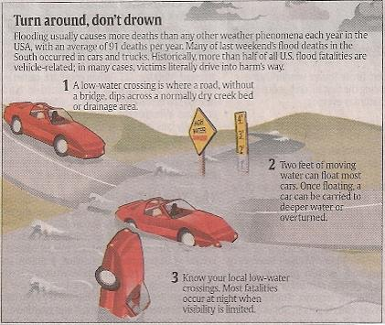
What is important to remember when you are not sure how deep the water is?
Turn around – Don’t Drown
Flooding causes more deaths than any other weather phenomena averaging over 90 deaths per year.
1) A low water crossing is where a road without a bridge dips across a normally dry creek bed or drainage area.
2) Two feet of moving water can float most cars. Once floating a car can be carried into deeper water.
3) Know your local low water crossings. Most fatalities occur at night when visibility is poor.

Slide 18
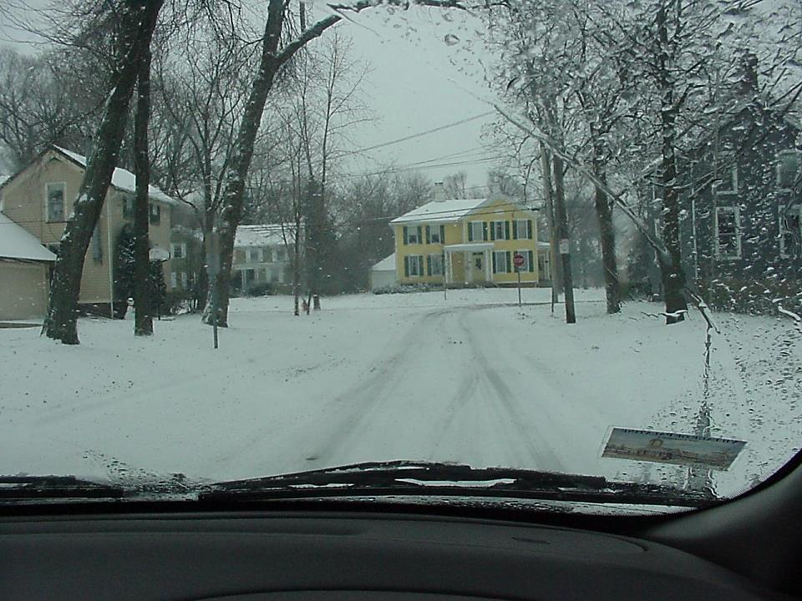
Strategies in the Snow
The most important thing about driving in snow is to: _________________________
slow down & brake sooner.

Slide 19
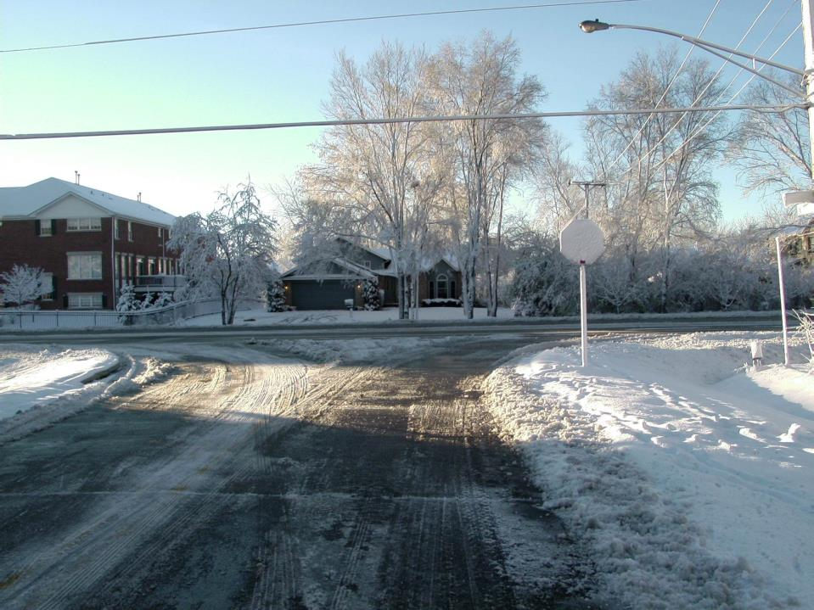
STOP
Also be aware that snow storms may obscure traffic signs. What is this?

Slide 20
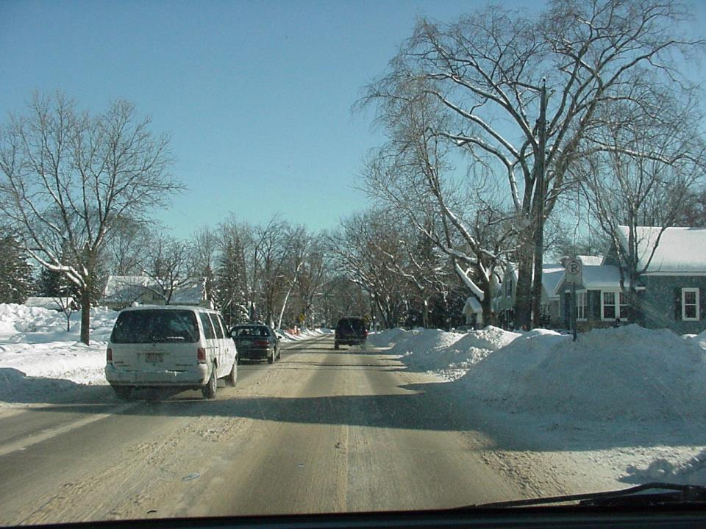
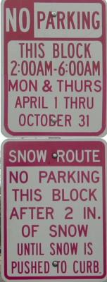
On this one way street what are you searching for?
Cars or pedestrians obscured behind large snow piles.
Also be aware of possible parking restrictions . . .

Slide 21
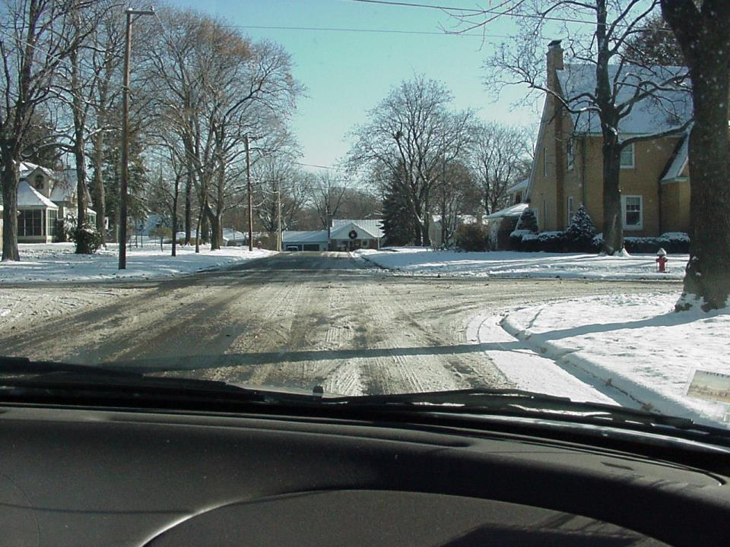
You’re turning right at the intersection.
What is a concern that you have?
The slippery turning surface.
Also, is another car coming?

Slide 22
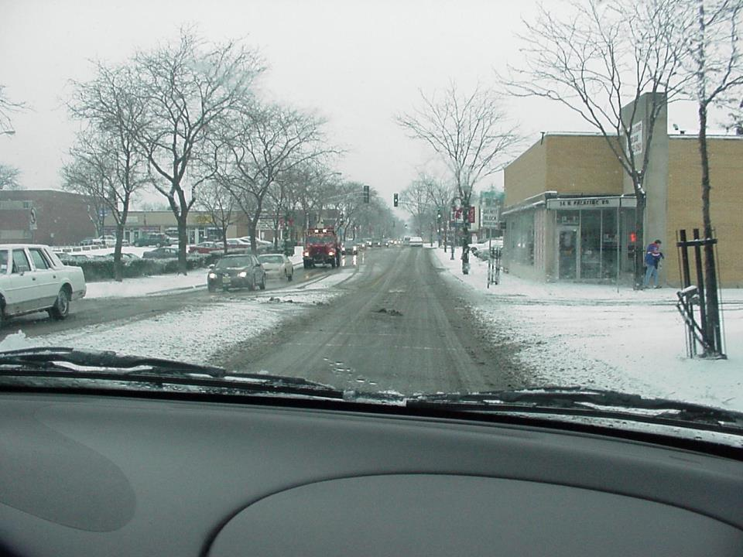
Slow down before the turn, more than you feel is necessary.
Then, coast around the turn (stay off gas and brake).
Do not accelerate until you straighten out.
What are three important things you must do to make this right turn safely?

Slide 23
Proper turns in snow
an example . . .

Slide 24
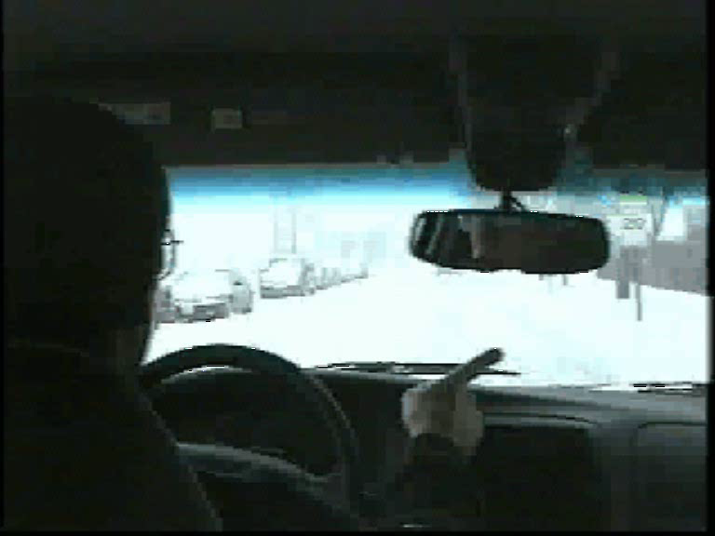
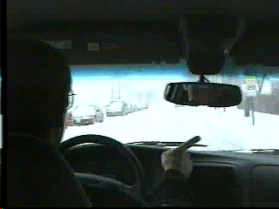
Proper turns in snow

Slide 25
Turns in the snow
Too much speed & braking
an example . . .

Slide 26
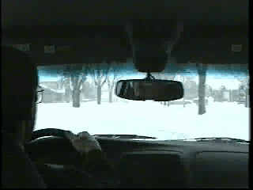
Turns in the snow
Too much speed & braking

