Slide 1


T H E D R I V E R S E D G E
I N T E R A C T I V E
slides and videos
Partial lesson
Unit 7 – Alcohol lessons: day 2

Slide 2
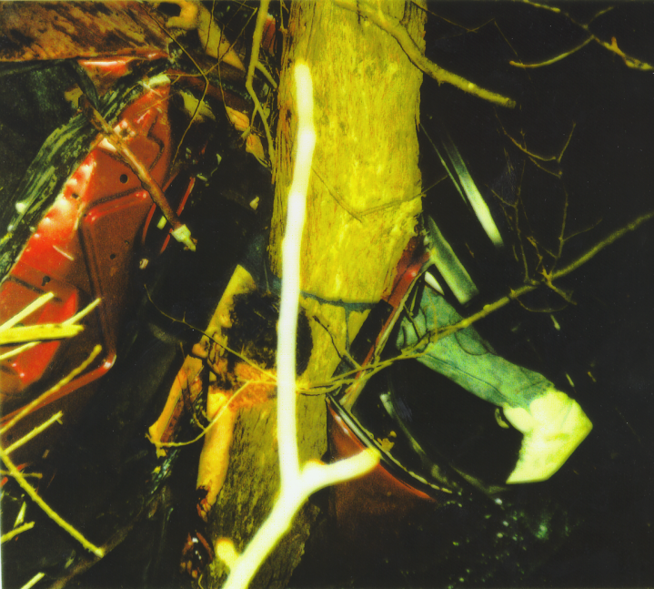
This 19 year old had a BAC (blood alcohol concentration) of over .20
DRINKING
SPEED

Slide 3
Alcohol survey questions 1-2
Alcohol is a drug which acts upon the body as a depressant in the central nervous system (brain).
TRUE
Let’s now notice some facts about
the process of intoxication...
Alcohol slows brain functions
Alcohol is a stimulant to the central nervous system (brain).
FALSE – although at lower BAC levels it does act as a stimulant.

Slide 4
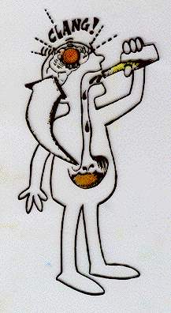
What determines how fast a person becomes intoxicated?
SIZE OF PERSON (body weight)
METABOLISM (how fast the body works)
TYPE OF BEVERAGE CONSUMED
RATE OF DRINKING
FOOD IN STOMACH
Let’s now explore the
progression of intoxication

Slide 5
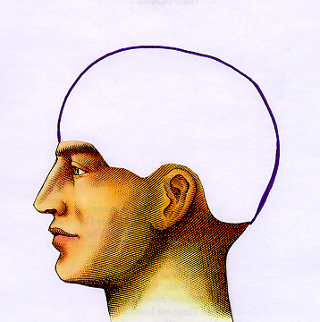
The progressive effects of intoxication
Once in the stomach...
…it proceeds through the stomach wall lining… ...directly into the blood stream.
Within a few minutes, alcohol affects the brain reducing the normal flow of oxygen to the brain.
We’ll trace the flow of alcohol from the time one starts to drink until complete intoxication

Slide 6
Alcohol survey questions 3-4
The reason drinking and driving can be dangerous is that alcohol prevents the brain from doing those normal functions required for driving?
TRUE
Again, the reduction of oxygen and the direct
effect of the alcohol impairs the brain’s functions
The cerebrum is affected by alcohol first before other parts of the brain are affected?
TRUE

Slide 7
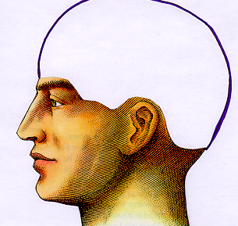
CEREBRUM
- thinking and reasoning processes slow down
(takes 2-3 times longer to decide what to do)
- memory affected
- judgment impaired
(driver takes risky chances)
within
10-20
minutes

Slide 8
Alcohol survey question 5
5) Drinking tends to make a person feel more self-confident even though his or her skills may be decreasing.
TRUE
A false sense of self-confidence
is experienced as the euphoria
intensifies in the Brain Stem.

Slide 9
BRAIN STEM
- Euphoria sets in (the high) results in a false sense of overconfidence
- Inhibitions are released
silly, loud, depressed, obnoxious
- Emotions intensified
- also controls heart beat and breathing
within
10-20
minutes
another
10-20
minutes
How can stronger emotions affect driving? (give some examples)

Slide 10
Alcohol survey question 6
When people drink alcoholic beverages, they lose their muscular coordination before they lose their reasoning and judgmental abilities?
FALSE
If drinking continues, the next
part of the brain affected
is the cerebellum

Slide 11
10-20
min.
10-20
min.
CEREBELLUM
controls muscle coordination
Large muscles: arms & legs; then smaller muscles: eyes and tongue
slurred speech
blurry vision
Driver has major difficulty controlling vehicle
TOTALLY INTOXICATED
10-20
min.
30-60
minutes total time

Slide 12
HOW IS THIS INFORMATION IMPORTANT?
10-20
min.
10-20
min.
TOTALLY INTOXICATED
You or a friend
who is driving
you…may be
in STAGE 2
(not showing
any physical
coordination
problems
as of yet…
you may think
it is safe to
drive or ride
with that person)
10-20
min.
…but in a short time the alcohol
will begin to affect the muscular
coordination and vision.
30-60
minutes total time

Slide 13
ONE WAY
ONE WAY
Speed
Limit
40
Speed
Limit
40
STOP
STOP
After several drinks a driver may see multiple images

Slide 14
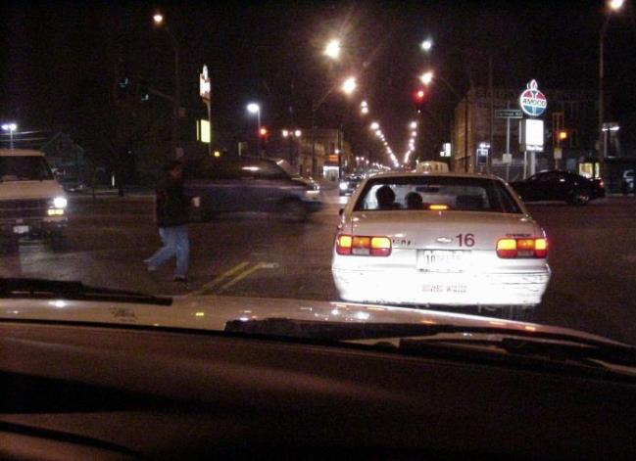
A driver in an advance stage of intoxication would have difficulty seeing this pedestrian
Night vision is significantly reduced after drinking.

Slide 15

Under Construction: The Teenage Brain

