Slide 1


T H E D R I V E R S E D G E
I N T E R A C T I V E
slides and videos
Partial lesson
15 of 39 slides
Unit 8– Buying a new / used car

Slide 2

Buying a New / Used Car
Since most first time buyers purchase pre-owned cars, we’ll consider used cars first...

Slide 3
Thinking about your needs:
Buying a New / Used Car
What do you need it for?
- Passenger and cargo considerations:
Basic transportation for 4-5 passengers?
OR
Will you have cargo carrying needs as well?

Slide 4
Thinking about your needs:
Buying a New / Used Car
What do you need it for?
- Larger or smaller vehicle
What are advantages
of smaller, lighter vehicles?
better gas mileage
easier to maneuver (parking)
less expensive price and lower insurance costs

Slide 5
Thinking about your needs:
Buying a New / Used Car
What do you need it for?
- Larger or smaller vehicle
What are disadvantages
of smaller, lighter vehicles?
less protection in a collision
not as comfortable as larger cars
less passenger and cargo capacity

Slide 6
Thinking about your needs:
Buying a New / Used Car
What do you need it for?
- Larger vehicles
greater protection in a collision
usually more comfortable
greater passenger and cargo capacity
more costly to operate and insure
greater protection in a collision
usually more comfortable
greater passenger and cargo capacity
more costly to operate and insure
greater protection in a collision
usually more comfortable
greater passenger and cargo capacity
more costly to operate and insure

Slide 7
Thinking about your needs:
Buying a New / Used Car
What do you need it for?
What do you need it for?
What do you need it for?
Cindy’s
Auto Parts
- school, business, pleasure?
- school, business, pleasure?
- school, business, pleasure?
What options would
you consider a necessity?
What are some other factors
concerning your needs?
Will you be making short or long trips?
The expected mileage per year?
How long do you expect to keep the vehicle?

Slide 8
Choosing a Used vehicle:
Buying a New / Used Car
Usually the first thing you will observe about a car is it’s_________________ appearance.
exterior
Check for dents, scratches, and rust, and differences in paint shades, do body panels line up properly? (what might this mean?)
Examine tires for even tread wear, cracks in sidewalls
What are the basic
exterior checks
you should make as
you walk around the
vehicle the first time?
Open and close doors, try locks, windows and trunk (trunk should be clean with a secure spare tire)

Slide 9
Choosing a Used vehicle:
Buying a New / Used Car
Other checks will include getting down on your hands and knees to look____________the vehicle.
beneath
Check for fluid leakage on pavement (oil, transmission, coolant, brake fluid)
Look for leakage by brake lines (near inside of tire)
Most people
(especially young people)
do not have the expertise
to properly assess the
condition of used vehicles
…bring experienced
help with you
What are the basic
checks you should make
beneath the vehicle?
Look for holes or heavy rust in exhaust pipes, muffler

Slide 10
Choosing a Used vehicle:
Buying a New / Used Car
Besides the overall exterior appearance…what about the
_________________ condition under the hood?
mechanical
Again, most people
have limited knowledge
of the mechanical aspects
of the soundness of an engine
…bring experienced
help with you …but some
things are obvious
Inspect the belts. (are they worn or frayed?)
What are the
engine checks that
should be made?

Slide 11
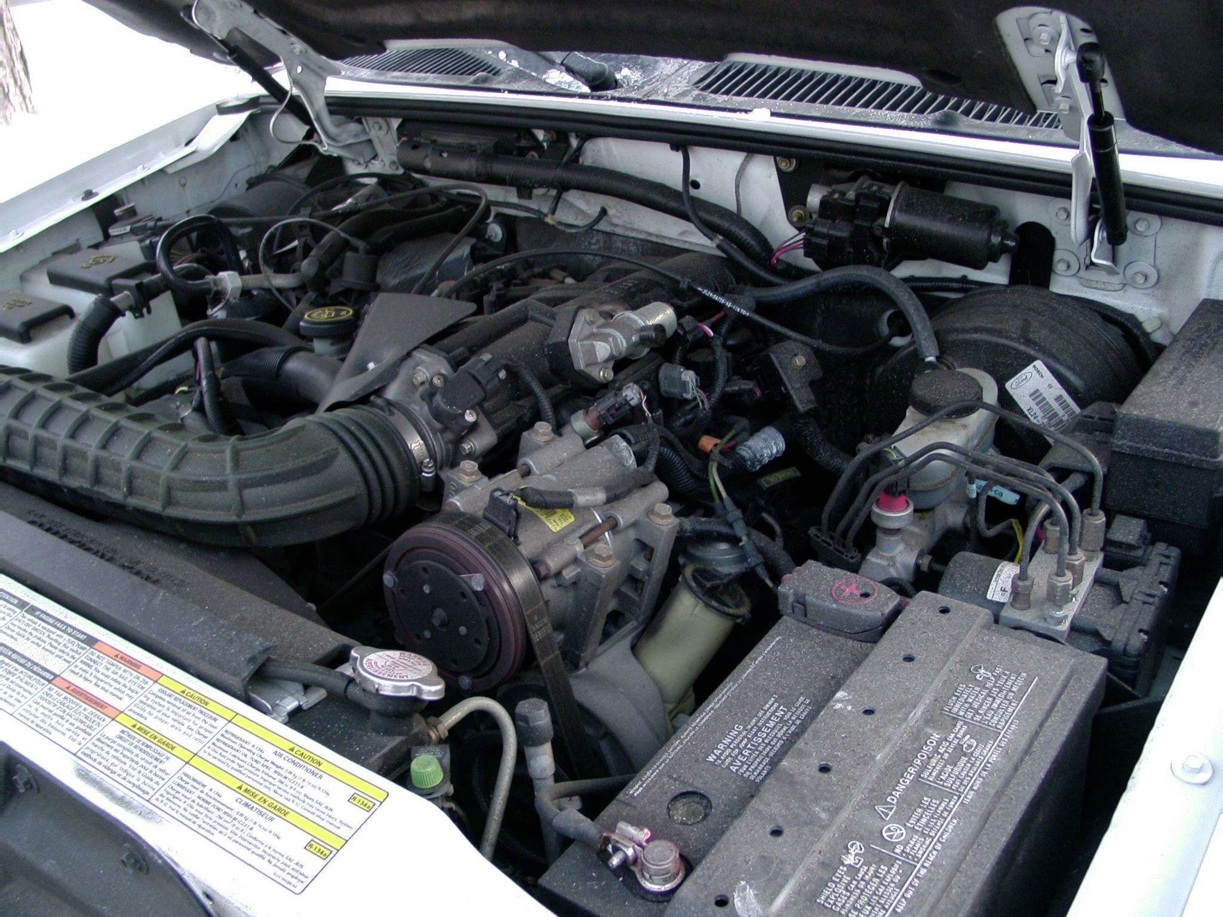
Belts: are they worn or frayed?

Slide 12
Choosing a Used vehicle:
Buying a New / Used Car
Does the oil have
a burnt smell?
…if so there could be a serious engine problem
Besides the overall exterior appearance…what about the
_________________ condition under the hood?
mechanical
Inspect the belts. (are they worn or frayed?)
What are the
you checks
should make?
Check the oil dipstick to see if the oil is dirty (very dark)
The electrical wires should be dark without cracks and hoses soft

Slide 13
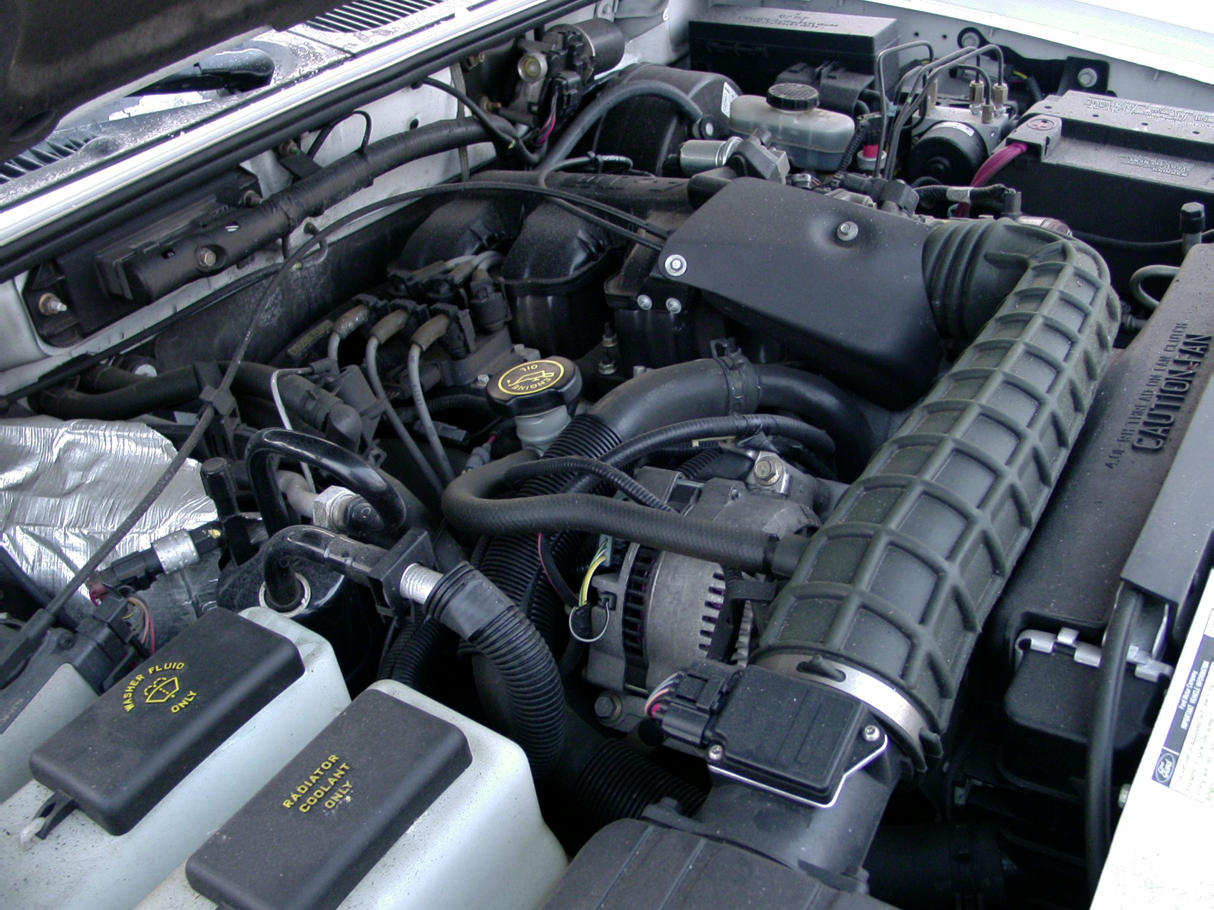
The electrical wires should be dark and hoses soft
Signs of oil leakage around manifold covers?

Slide 14
Choosing a Used vehicle:
Buying a New / Used Car
Besides the overall exterior appearance…what about the
_________________ condition under the hood?
mechanical
Again, most people
have limited knowledge
of the mechanical aspects
of the soundness of an engine
…bring experienced
help with you…but some
things are obvious
What are the
you checks
should make?
Other things . . .
Inspect battery and cables for corrosion

Slide 15
Check coolant level and color (should be bright green – not brownish)
Also check for any evidence of a collision (bent fan, damaged radiator, etc)
Inspect battery and cables for corrosion

Slide 16
Choosing a Used vehicle:
Buying a New / Used Car
Besides the overall exterior appearance…what about the
_________________ condition under the hood?
mechanical
Are there loud knocking or pinging sounds?
Is there excessive vibration (shaking of engine)?
Are there leaks from hoses or radiator?
What should be
checked after
the engine starts?

