Slide 1
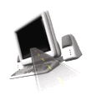

T H E D R I V E R S E D G E
I N T E R A C T I V E
slides and videos
Partial lesson
18 of 64 slides
Unit 5 – City Driving Complex

Slide 2

Other City/Suburban Strategies and Rules of the Road

Slide 3
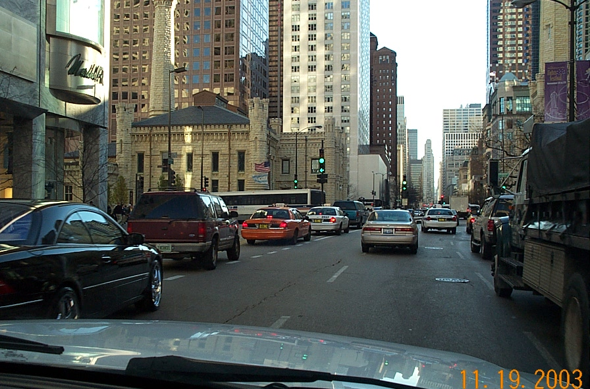
Other City/Suburban Strategies and Rules of the Road

Slide 4
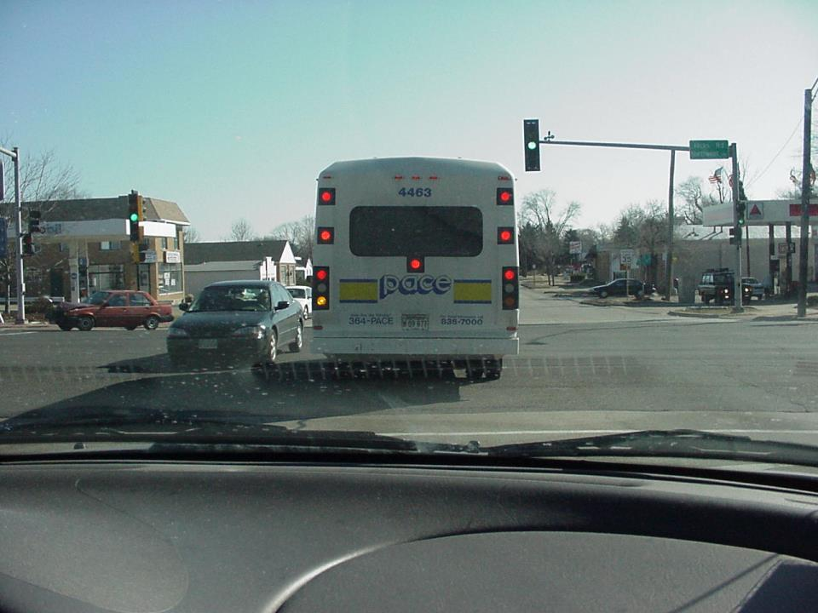

Like the bus in the intersection, you want to turn left…

Slide 5
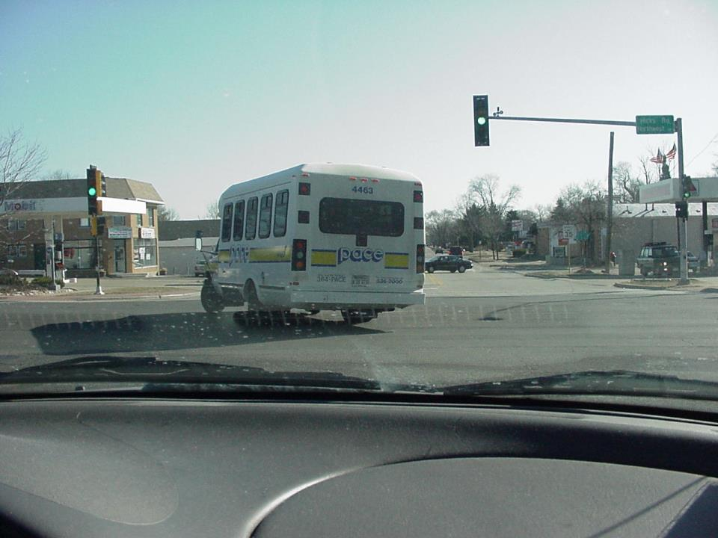
Why not?
The arrow is not on and you have poor visibility.
…will you now follow this bus and complete your turn?
No !

Slide 6
If pedestrians are crossing at these corners, would the drivers have to yield to them?
- -
- -
- -
- -
_______
_______
_______
_______
Yes, pedestrians have the right of way.
- -
- -
- -
- -

Slide 7
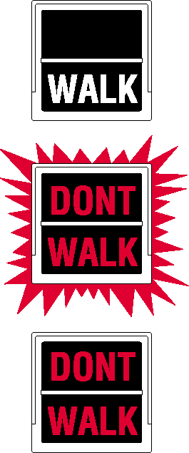

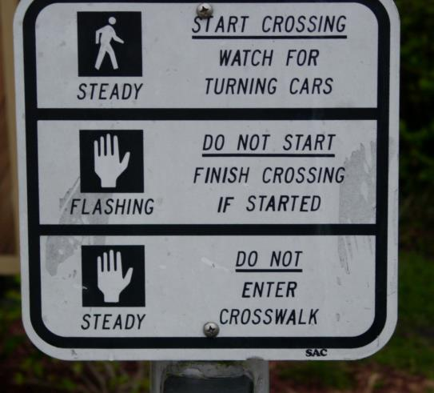


2 Pedestrain signal systems

Slide 8
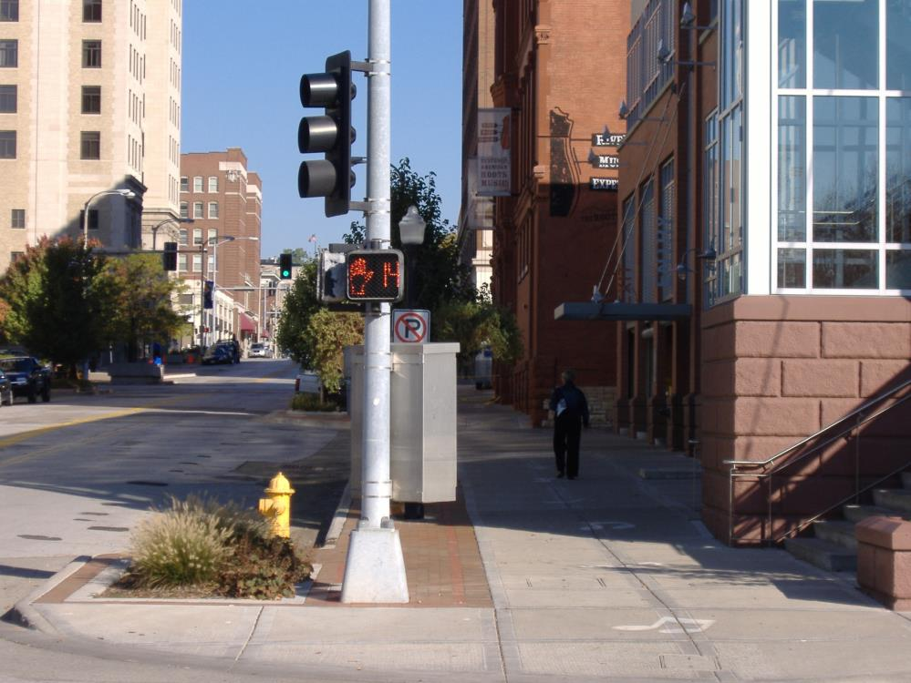



Some pedestrian crossing signals will count down the seconds before the light changes.

Slide 9
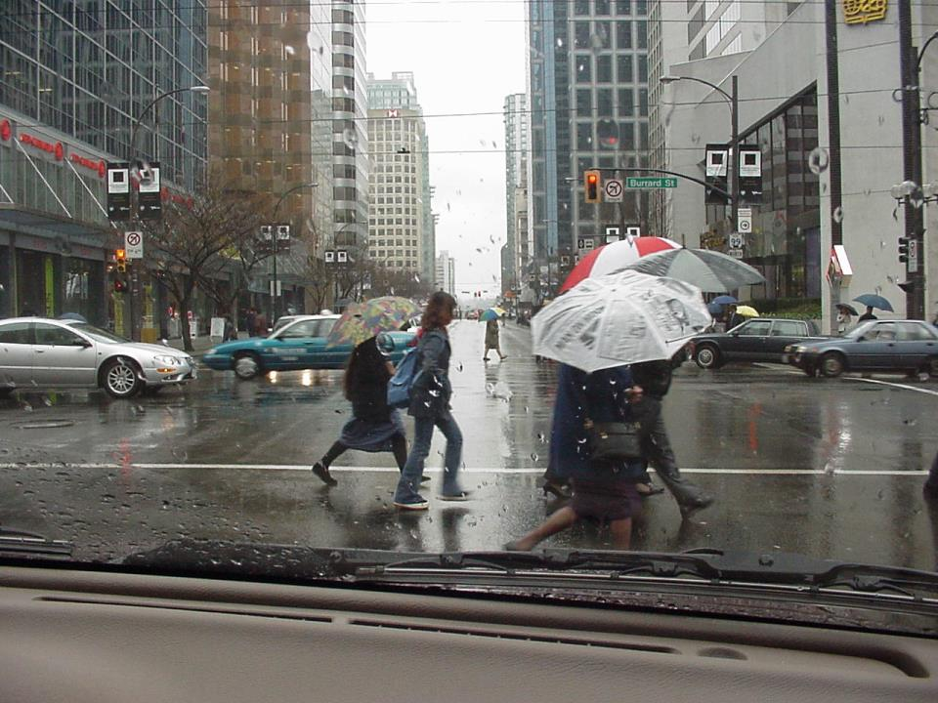
In the rain, pedestrians may rush across the street, and, have difficulty seeing you. Watch for them!

Slide 10
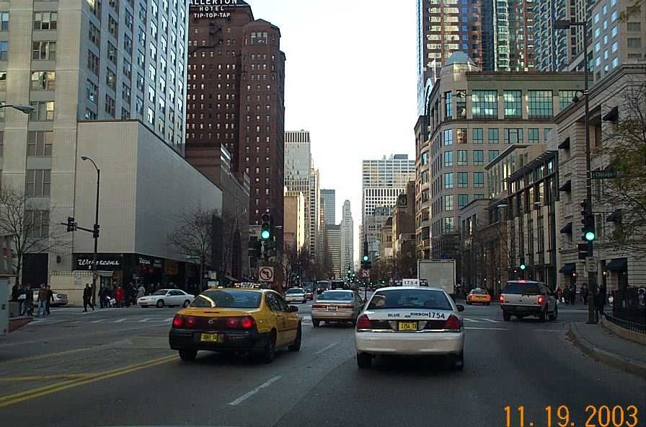
Also, what is not allowed at
this intersection?
NO
TURN
ON
RED
Especially watch for pedestrians if turning right they have the right of way if they have are still in the crosswalk. Watch for them!

Slide 11
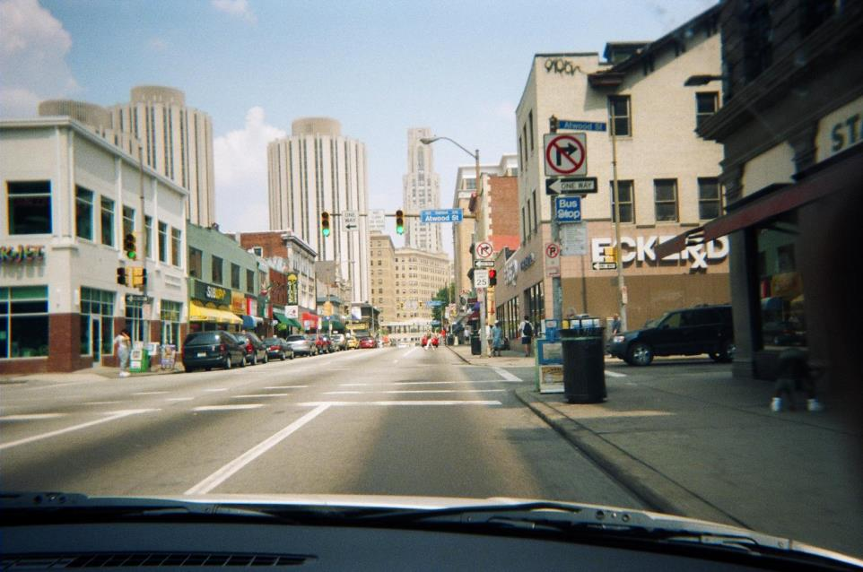
With many traffic signs, city driving can be very confusing. Especially watch out for one way streets and pedestrians. Lower your speed down to have more time to process these demanding situations.

Slide 12
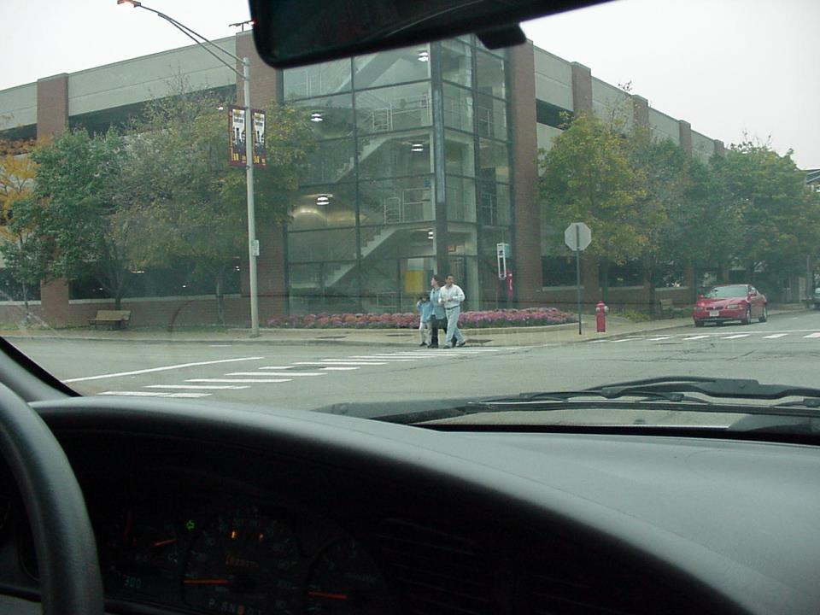
Even if these crosswalk lines
were not painted at this
corner, it is still designated as
a pedestrian crosswalk.
You want to turn left here. You’ve stopped before the red car.
Can you now proceed?
NO, once pedestrians are off the curb we must yield to them.

Slide 13
Pedestrians and drivers
should try to make eye
contact with drivers…and as
drivers, waving them across
is a good communication
confirmation.
Also, pedestrians should look all directions when crossing ...looking for motorist who may not be stopping!

Slide 14
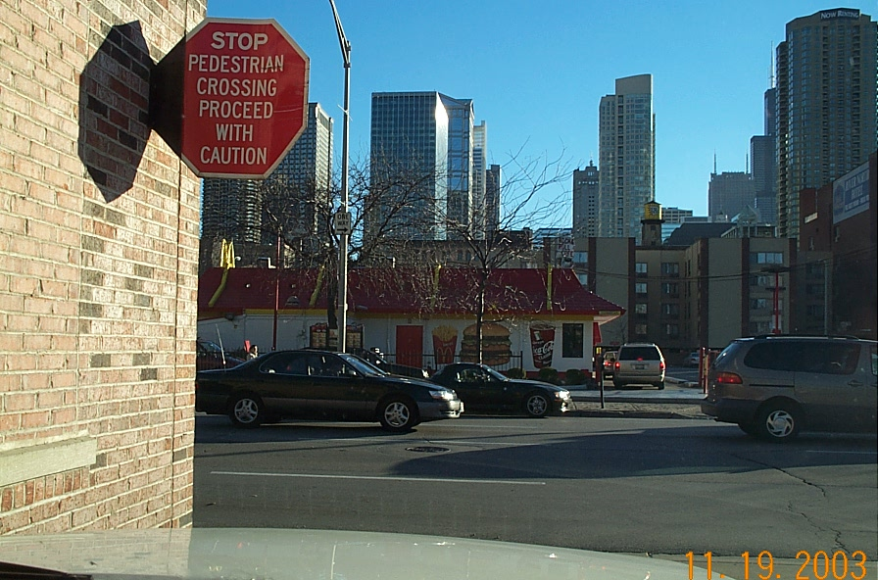
What should
you do before
pulling out
into this street?
When exiting an city alley, first stop…then keep foot over the brake when easing up toward the street looking for pedestrians who may not be looking your way!

Slide 15
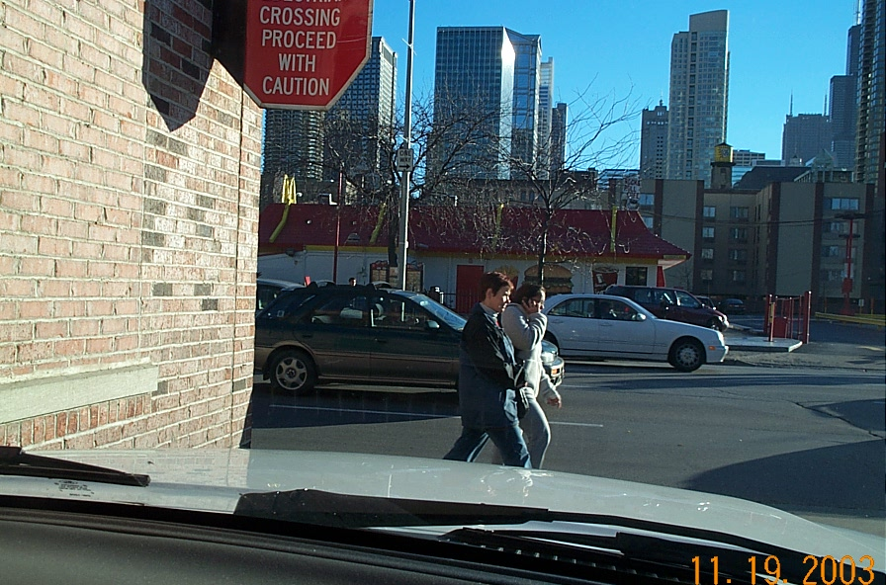
Many pedestrians will be distracted or pre-occupied

Slide 16
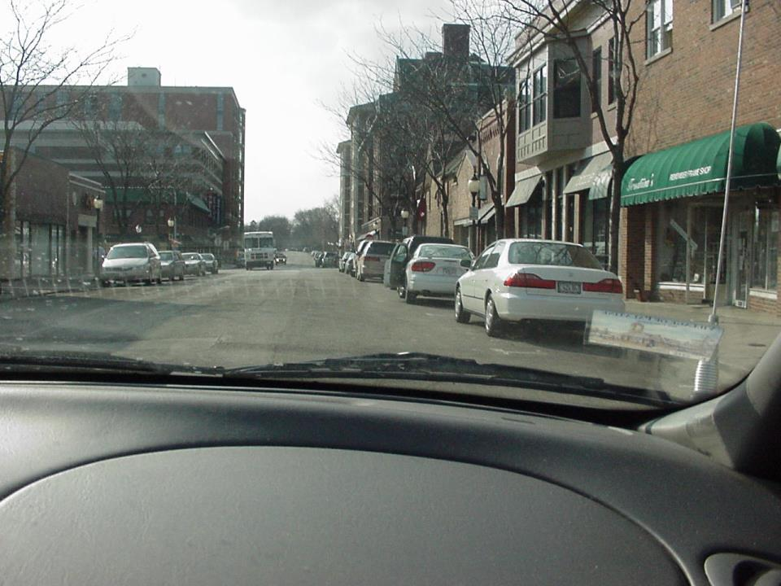

Drivers may open car doors on the side traffic
is moving only when it can be done safely
without interfering with traffic.
What have you identified here?

Slide 17
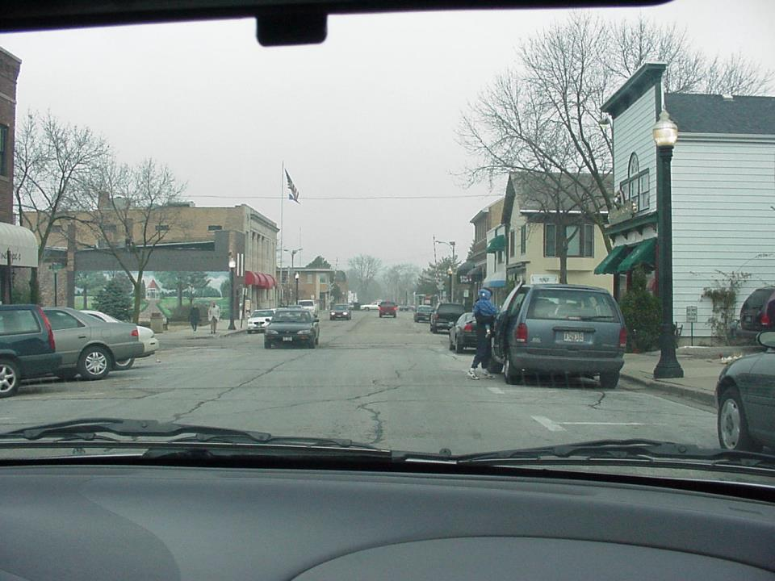
What should you do in this situation?
Slow down or stop and wait
for the hazards to separate.

Slide 18
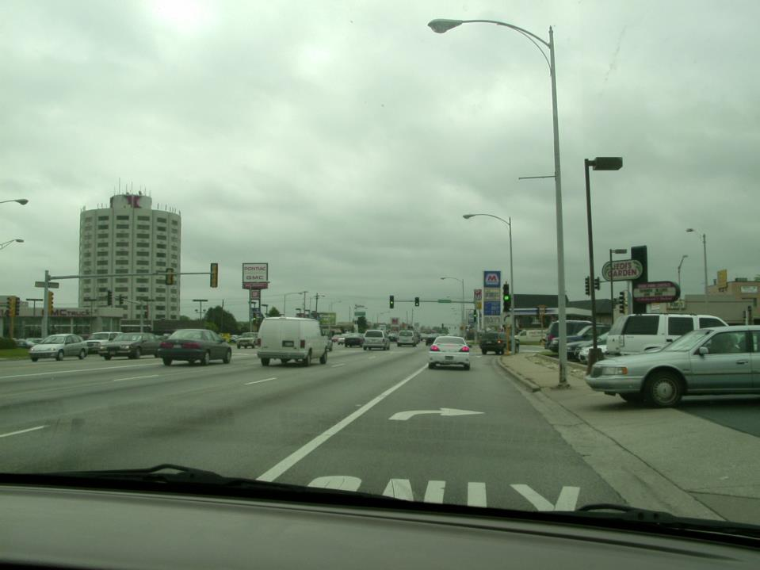
Why are you delaying your turn signal for your turn at the traffic light?
The car in the driveway may misread it.

Slide 19
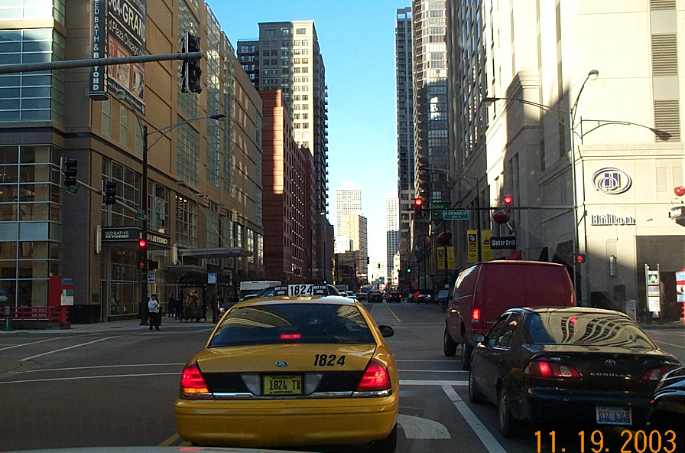
When stopping at a red light, how far back should you be from the car in front of you?

Slide 20
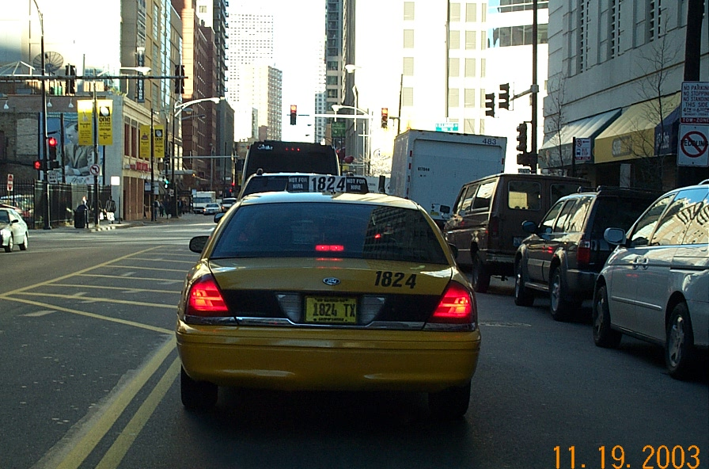
Far enough
back to see
the tires
of the vehicle
in front of you.
When stopping at a red light, how far back should you be from the car in front of you?

