Slide 1


T H E D R I V E R S E D G E
I N T E R A C T I V E
slides and videos
Partial Lesson
first 20 out 55 slides
Unit 4 – City and Parking

Slide 2

City and Parking
Strategies / Rules of Road

Slide 3
Angle Parking
an example . . .

Slide 4
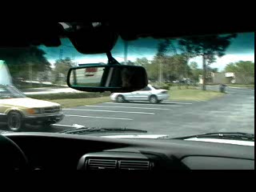
Angle Parking

Slide 5
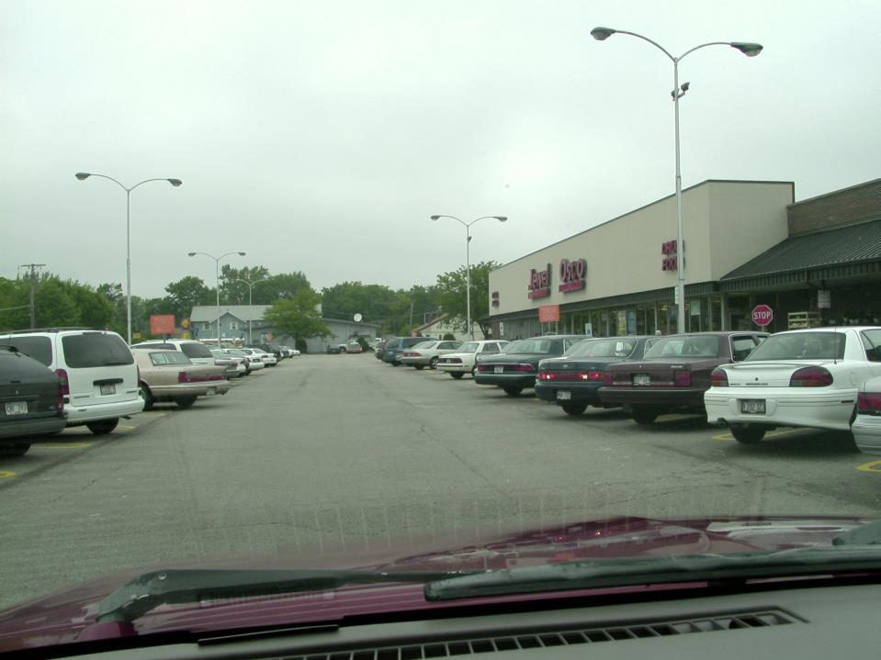

Since you see backup lights it would be wise to:
You’d like to park in the space past the white van on the left, but what important thing must you first deal with?
TAP YOUR HORN –
or you could just wait...

Slide 6
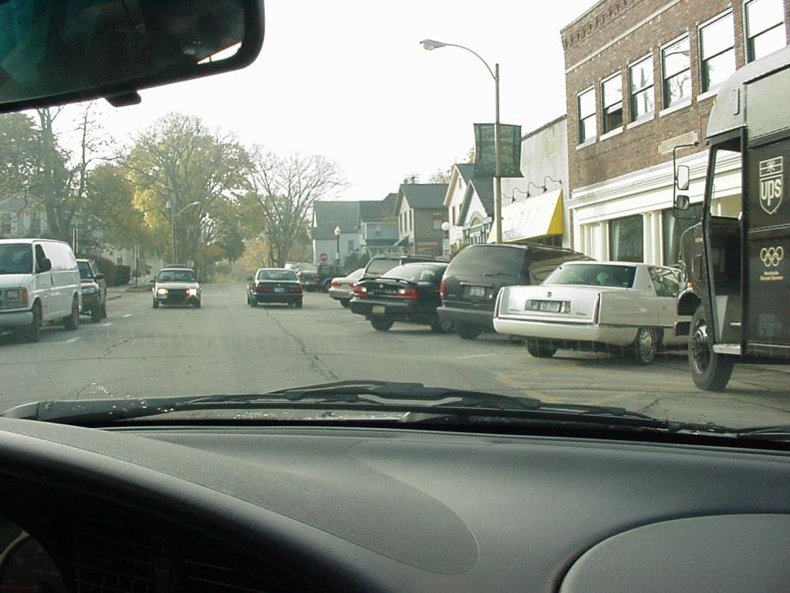
No horn, just wait for them to back out.
You want to park where that car is backing up.
What should you do?

Slide 7
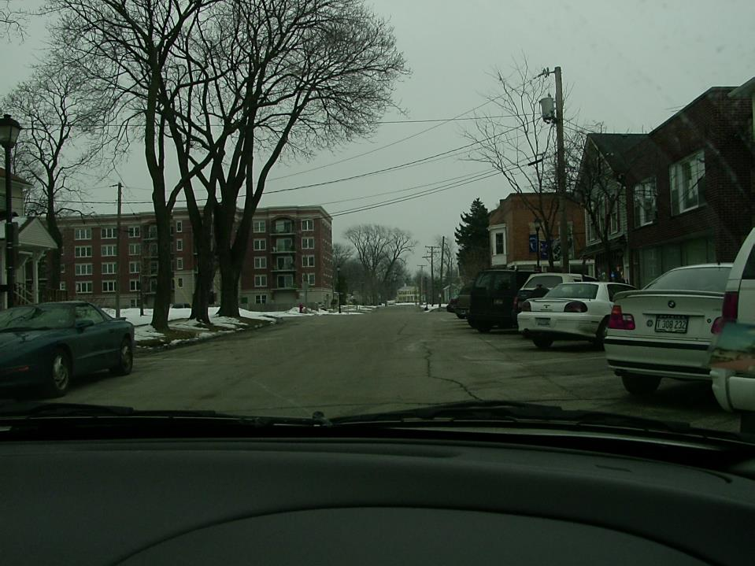
When should you turn your steering wheel to get into this space?
When your front end just passes this first car.

Slide 8
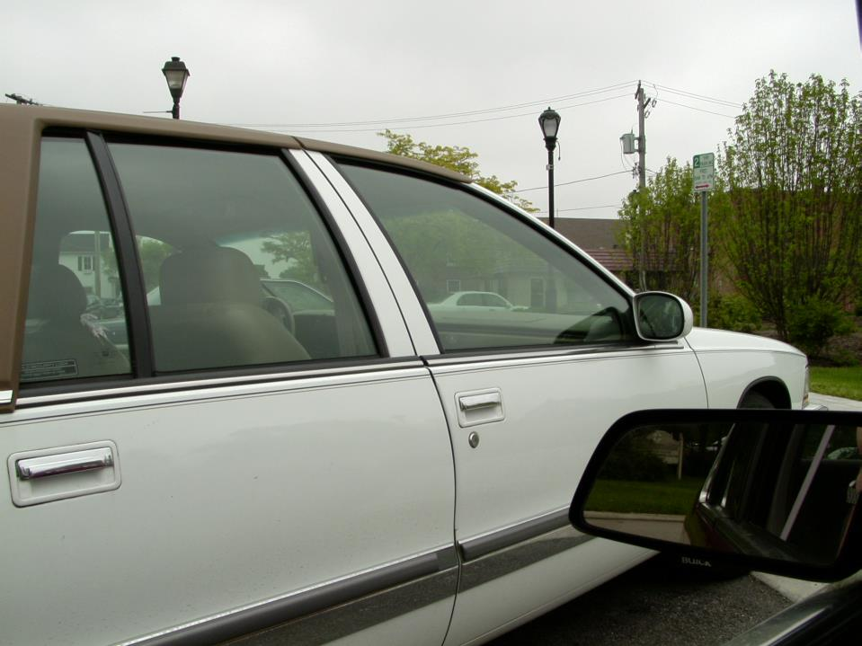
Which way will you turn the steering wheel when backing out of this parking stall and when?
To the right, when your front end clears their back end.
You are
angle parked
next to this
white car

Slide 9
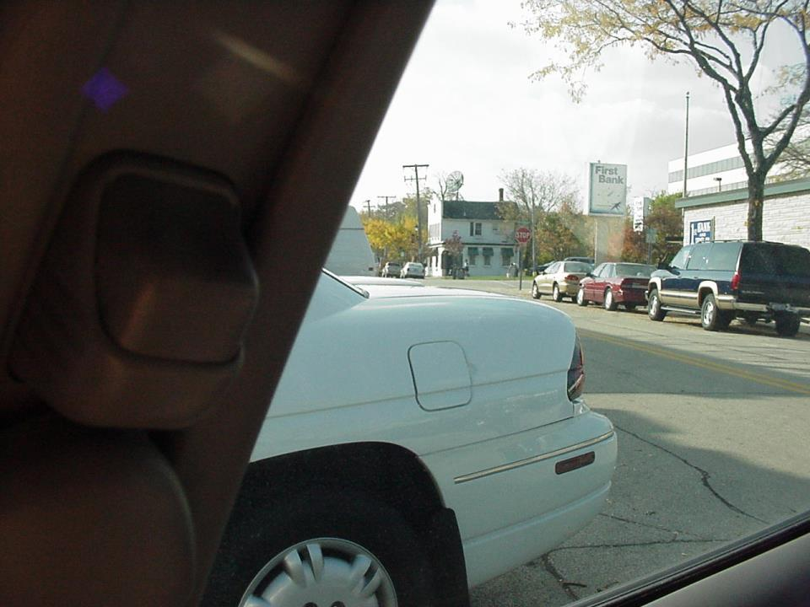
Let’s see if you remember…
You are backing out of an angle parking space. Before turning the wheels to the _______ you must you check for ___________and be sure that you have __________________________
right
traffic
cleared the car on your left

Slide 10
Straight-in parking
an example . . .

Slide 11
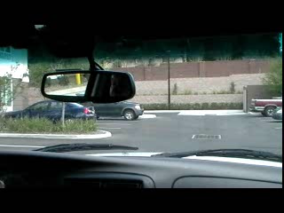
Straight-in parking

Slide 12
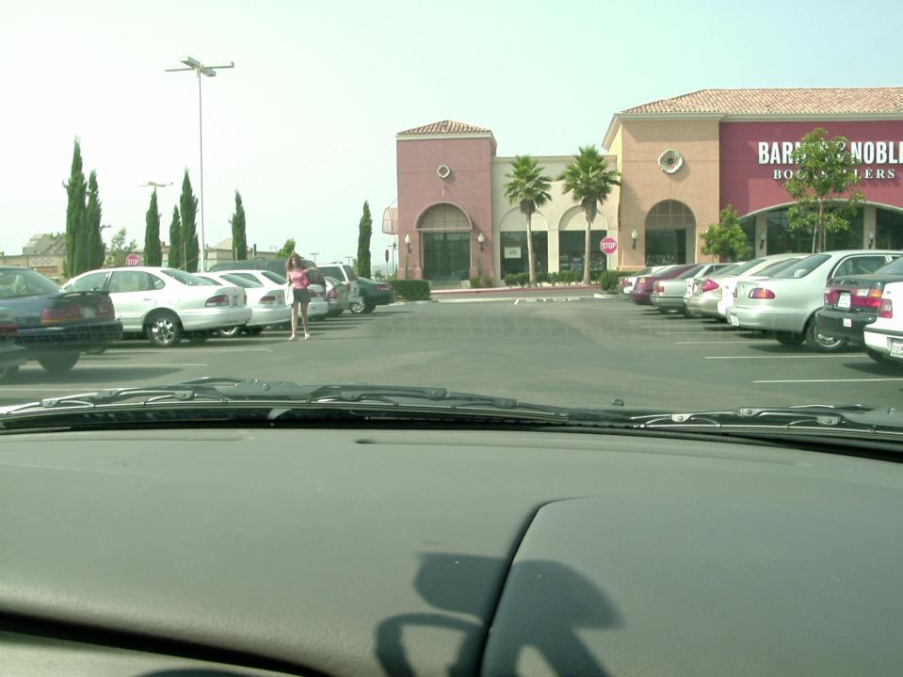
For you to properly park your car between the blue and white vehicles (after lady passes). What should you now be doing?
After signaling, swing out to the right side.
Let's review. . .

Slide 13
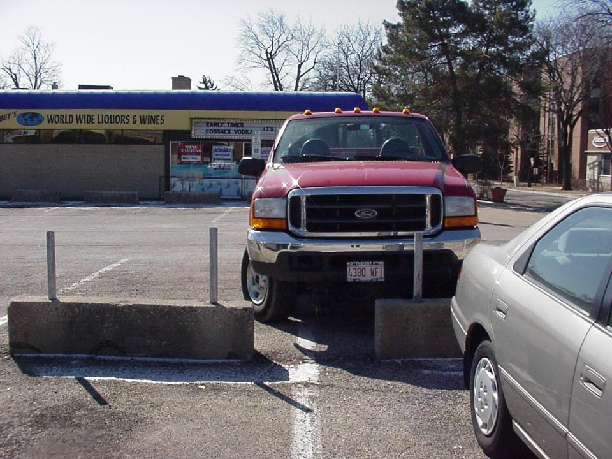
What would happen if this driver started backing up right now?
Crooked tires!

Slide 14
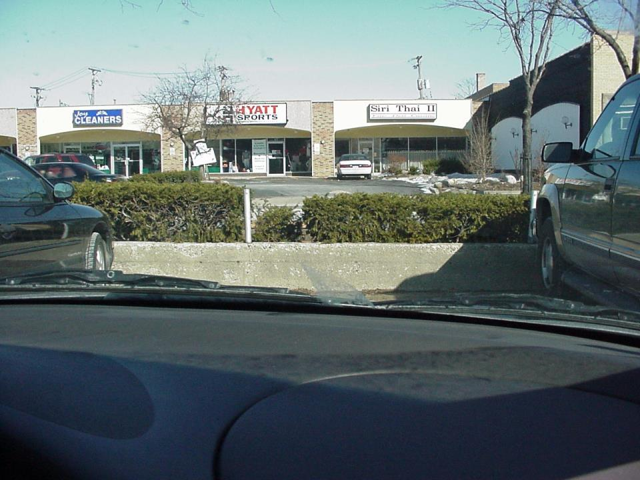
Let's review . . .
When backing out of a straight-in space, you can back out facing ______direction. If you want to end up facing to the right, you must turn your wheels to the ____.
either
left

Slide 15
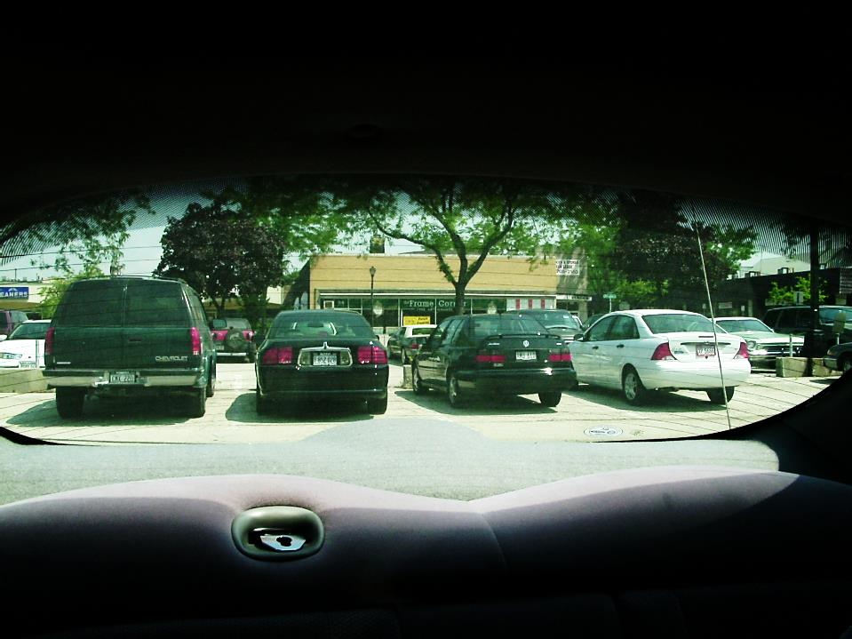
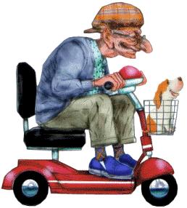
Also, when backing out of any parking space, check for cars behind you that may also be backing out and pedestrians.
. .

Slide 16
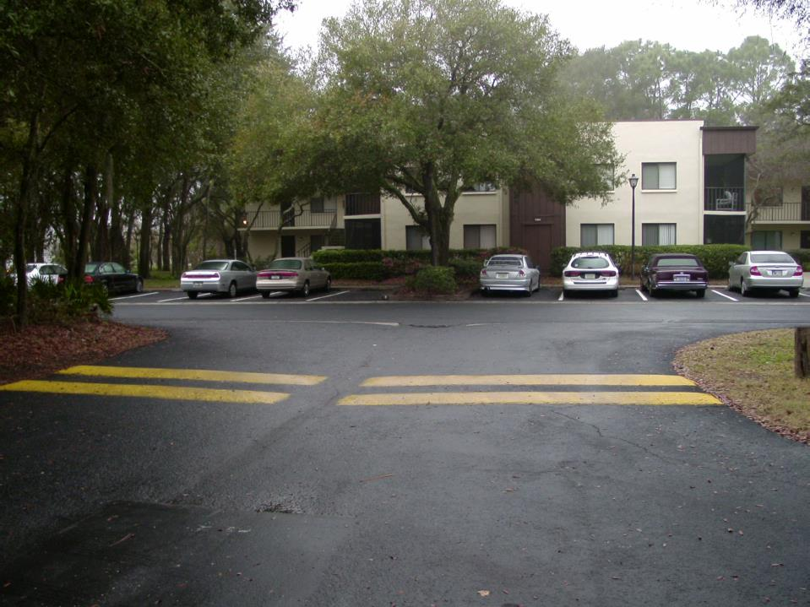
Also, be sure to go slow in parking lots as there may be speed bumps (this a double bump).

Slide 17
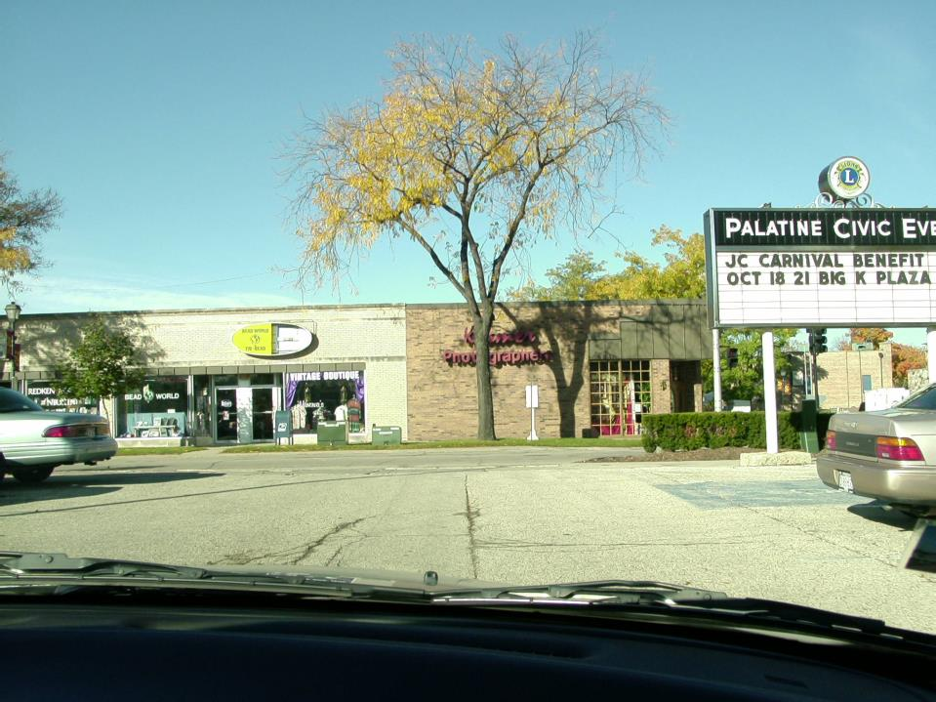
The right side...WHY?
You’ll be turning left as you leave this straight-in parking lot. Which side of the driveway will you exit?

Slide 18
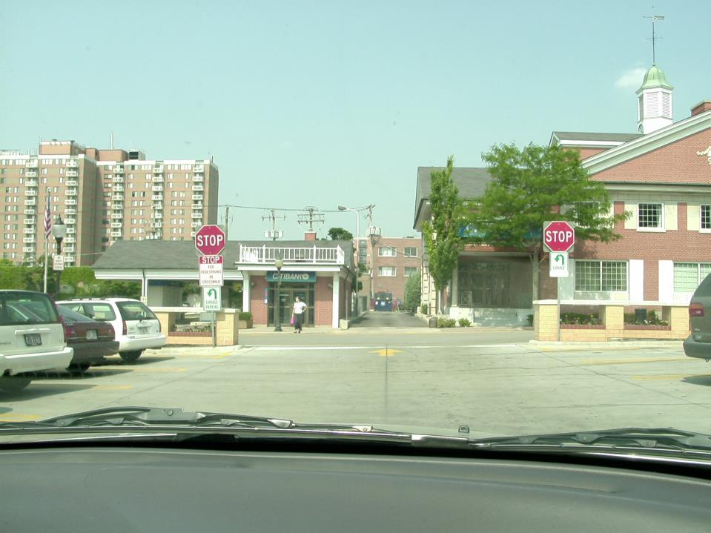
...however some parking
lots are different
The left side. This is
an exit only driveway.
In this angle parking lot, you want to turn left, after stopping, which side of the driveway will you be on?

Slide 19
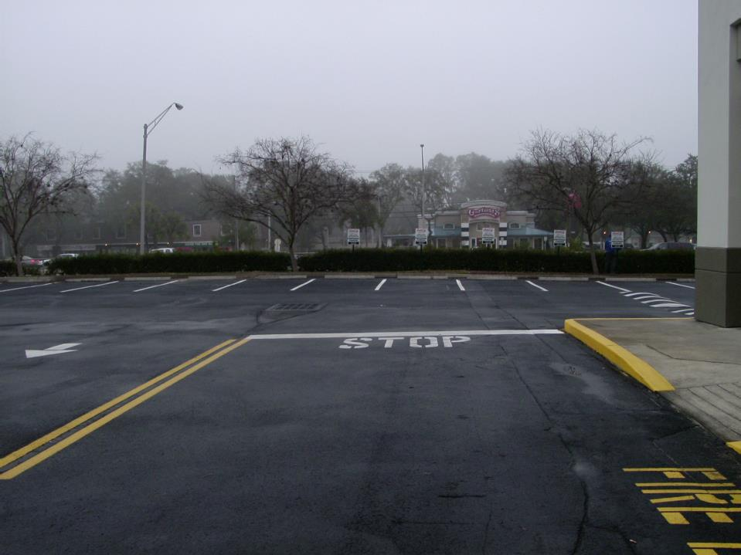
...however some parking
lots are different
In this parking lot, there is no stop sign, just the word STOP painted on the pavement. Be sure to stop!

