Slide 1
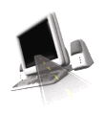

T H E D R I V E R S E D G E
I N T E R A C T I V E
slides and videos
Partial Lesson
first 20 out 53 slides
Unit 3 – Driver Psychological Fitness

Slide 2

Psychological Issues
of Driving

Slide 3
The Psychological Nature of the Driver
Part two --
Having the physical ability to operate a motor vehicle is really only half the picture.
Being in the right psychological state - that is, having the right attitudes, traits, and motivation is also essential to driving safely, being courteous, and avoiding accidents and traffic citations.
Let's think about some statistics
that show a need to deal with the
psychological issues of driving

Slide 4
The Psychological Nature of the Driver
Part two --
Some statistics
Drivers 15 to 19 have very high traffic accident, injury, and conviction rates.
Drivers under 18 are 2.5 times more likely to have a fatal accident than the average driver.
Nearly half of drivers who start driving before they are 20 are convicted of a traffic violation within the first year of driving.
Teenage drivers have total accident rates which are twice that of adults and traffic accidents are the leading cause of death.
Why is this the case?

Slide 5
The Psychological Nature of the Driver
Part two --
Some statistics
Young drivers’ over-involvement in traffic
accidents stems from a lack of:
Driving experience, exposure to accident risk, alcohol / drug consumption, perceptual abilities, inexperience in identifying and handling hazardous situations, personality structure, internal and external influences, poor judgment, excessive speed, and attitudinal factors such as risk-taking propensity.
What about your parents in this matter?
Many of these things
are attitude related. . .
Why is this the case?

Slide 6
What about
your parents?
Psychological causes of
various driving behaviors
Can the way your parents drive have an effect upon your driving?
If you have parents who tend to drive aggressively or are inattentive, you should take steps to make sure you do not pick up their poor driving habits.
Some characteristics are passed genetically or through modeling others’ behaviors and only through proper training and practice can you overcome poor traits that may be passed on from your parents.
Also, friends and family may not be good drivers; avoid using
them as role models if they do not practice safe driving!

Slide 7
The Psychological Nature of the Driver
Part two --
Psychological causes of
various driving behaviors
Driver education
will help you think
about good
attitudes and behaviors
Proper training through driver education and training on the road will make you more comfortable with driving. When you first begin, you will likely be nervous about your ability level.
As good driving behaviors and attitudes become automatic through practice, you will better enjoy driving. When you see others just learning how to drive, be courteous and remember how nervous you were when you first started behind the wheel.
Let’s now think about attitudes essential to good driving

Slide 8
The Psychological Nature of the Driver
Part two --
Attitudes essential
to good driving
Courtesty - Consideration for others
Alertness - using good judgment
Acting responsibly and foresight . . .
Being ready to drive involves more than just checking your vehicle equipment and having a license. You have to be mentally prepared for different traffic conditions and have gained all the necessary knowledge, skills, and abilities through practice and training courses. To drive safely you have to have readiness, which is to be completely focused on the task at hand.
You also have to be motivated to learn and apply safe driving attitudes

Slide 9
The Psychological Nature of the Driver
Part two --
Being
Motivated
Starts with learning how to be a safe driver in driver education and training, and then be motivated to apply what you’ve learned to actual driving situations.
Not all drivers will drive as safely as you do, but you have to be motivated to have a safe attitude regardless of others.
Let's next consider attitudes and habit patterns. . .

Slide 10
The Psychological Nature of the Driver
Part two --
Attitudes and habit patterns
Young drivers are more willing to take risks compared to other drivers; they are more likely to perceive hazardous situations as less dangerous than they really are.
Although drivers under the age of 25 have the fastest reaction times, they respond to hazards more slowly than do mid-age drivers, suggesting that they frequently fail to recognize situations as being potentially hazardous.
In addition...young drivers over-estimate their abilities. . .

Slide 11
The Psychological Nature of the Driver
Part two --
Attitudes and habit patterns
Drivers 18-24 perceive themselves as being less likely than other drivers their age to be involved in an accident.
How did that happen?
In addition...young drivers over-estimate their abilities. . .

Slide 12
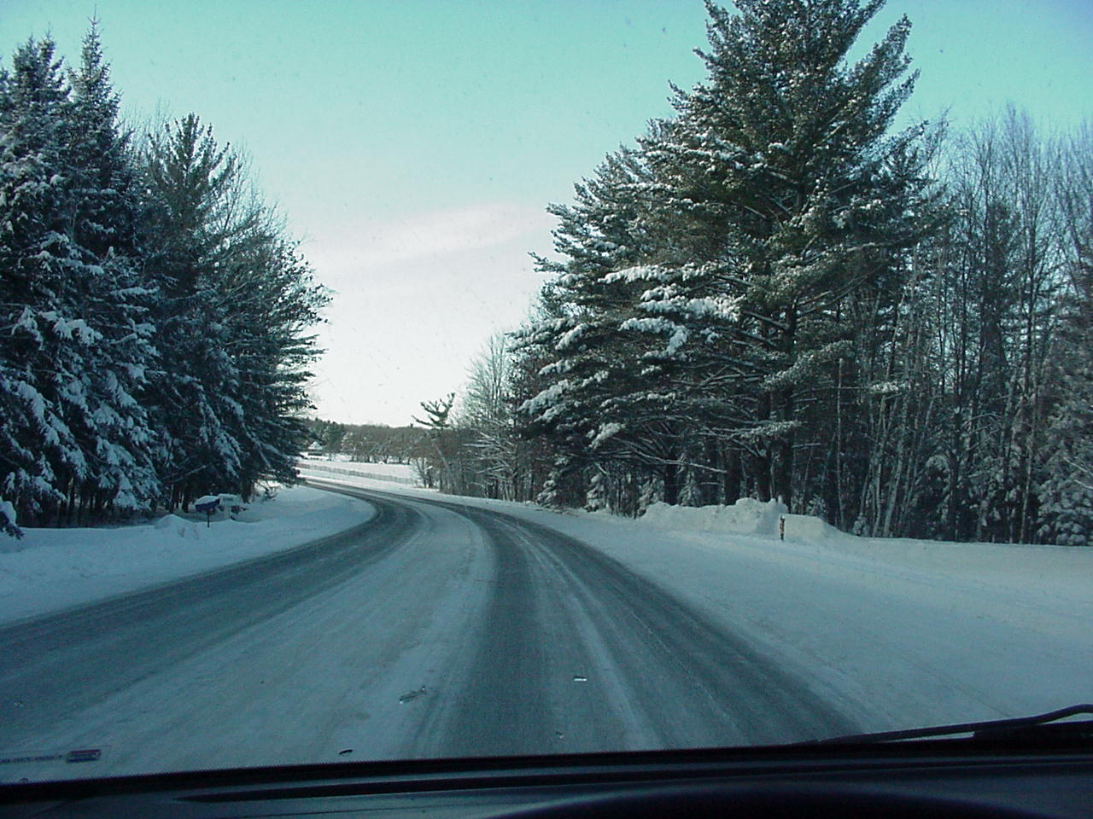
The Psychological Nature of the Driver
Part two --
Attitudes and habit patterns
Young drivers rate certain traffic situations as less risky than do mid-age and older drivers, especially situations involving darkness, graded or curved roadways, intersections, adverse conditions and rural environments…
…and teenagers tend to underestimate the danger in high-risk situations

Slide 13
The Psychological Nature of the Driver
Part two --
Attitudes and habit patterns
Do not do a good job of judging their skill level or the dangerousness of driving situations.
It is important that you and the people who teach you how to drive analyze and identify the problem attitudes and behaviors you may exhibit while driving and help you become aware of them.
All these things we have
considered so far
demonstrate that most teens:
…and you need to constantly monitor yourself when you are driving to identify poor driving habits and attitudes…and have the willingness to correct them!
Let's now think about correcting poor attitudes . . .

Slide 14
The Psychological Nature of the Driver
Part two --
Attitudes and habit patterns
Correcting
poor attitudes
and habits
Once you identify a poor driving habit or attitude you need to change it by substituting the proper point of view until it becomes automatic.
For example, if you notice you are forgetting to make the blind spot head check…you need to catch yourself and correct it until it becomes an automatic habit every time.
Let’s now think
about psychological
causes of various
driving behaviors
Also remember that good habits can deteriorate over time unless you keep checking yourself. You must continue to practice the good habits you are taught and strive for the best possible attitude when driving to maintain these things in the future.

Slide 15
The Psychological Nature of the Driver
Part two --
Psychological causes of
various driving behaviors
Your emotional
state influences
your ability to
concentrate, stay
alert, be courteous,
think clearly and
rapidly, contain
anger, and
aggressiveness, and
control tendencies
to “show off.”
There are a number of characteristics that can affect your psychological ability to focus on the driving task, and react safely and courteously. These characteristics include:
(a) emotional tension
(b) environmental conditions
(c) heredity of behaviors
(d) physical condition of your body, and
(e) the amount of training and practice you’ve accumulated as a driver

Slide 16
The Psychological Nature of the Driver
Part two --
Psychological causes of
various driving behaviors
Safe driving requires all of your concentration. If you are preoccupied with your emotions, you will not be able to focus on safe driving. Therefore, you should not drive if you are under severe tension, emotionally distressed, depressed or angry.
One of the greatest psychological stresses is being late…

Slide 17
The Psychological Nature of the Driver
Part two --
Psychological causes of
various driving behaviors
Being late
for an
appointment
Being late causes many people to become stressed and drive unsafely. Being late is not an excuse for poor driving. The few minutes you may make up by weaving through traffic and speeding will not likely make a difference.
Accept the fact that you will be late and try to plan better the next time.
One of the greatest psychological stresses is being late…

Slide 18
Psychological causes of
various driving behaviors
Bill had to work late. Just before 5 pm his boss gave him another task to finish before leaving. He’s feeling stressed because he has concert tickets for his first date with Rachel…
Bill finally finishes, but knows he’ll be15 minutes late picking up Rachel. He hurries to his car…
What can he do to minimize his stress?
Try to call her and explain the situation.
Being late will often cause many drivers to become IMPATIENT

Slide 19


impatience
a restless eagerness
to do something
or go somewhere
Frequently a
personality trait…
…but often being
late will cause
it to surface
in many drivers
Let’s get moving…I’m running late!

Slide 20
impatience
In addition to horn honking what are some other ways drivers are impatient?
If we do not learn how
to cope with the frustrations
of today’s traffic, our impatience
may become something worse
Studies have shown that
impatient drivers who do
these things do not reach
their destinations any sooner
- speeding
- tailgating
- rolling stop signs
- frequent lane changing
A N G E R
Allow yourself more time when driving
Learn to "chill out" and save your nerves

Slide 21
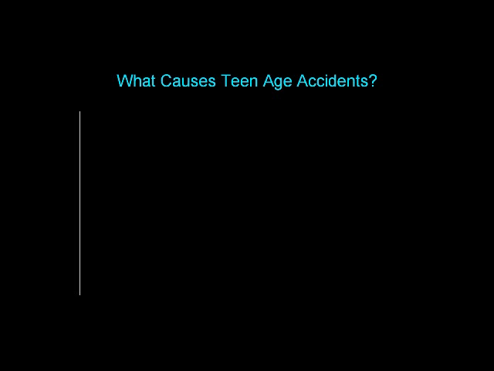
Irresponsible Driving
Speeding is the Big Thing
(video will play)

