Slide 1


T H E D R I V E R S E D G E
I N T E R A C T I V E
slides and videos
Partial lesson
20 of 45 slides
Unit 6 – Driving Distractions

Slide 2

Driving
Distractions
The National Highway Traffic Safety Administration
estimates that driver distraction is involved
in at least 30% of vehicle crashes and about 68%
of all rear-end crashes.

Slide 3
Driving
Distractions
Give a definition of a distraction
Distraction: anything that draws the mind
away in another direction

Slide 4

Driving
Distractions
Give a definition of a distraction
Distraction: anything that draws the mind
away in another direction
For example,
what could
cause this
male driver
to be
distracted?

Slide 5

Driving
Distractions
Give a definition of a distraction
Distraction: anything that draws the mind
away in another direction
For example,
what could
cause this
male driver
to be
distracted?
…and if he looks too long, what could happen?

Slide 6
Driving
Distractions
Basically there are three types:
Those outside the vehicle
Those inside the vehicle
Those inside our mind
(unrelated to driving)
Distractions could also be
classified as visual,
mechanical or cognitive
I wonder what Bessy is planning for my birthday?
The purpose of this lesson is to become aware of the many distractions that could divert our attention away from the driving task and learn some strategies to minimize or defuse them.
Let’s begin with
some that are
outside the vehicle
There are many different distractions…

Slide 7
Driving
Distractions
First some generalities:
Some may affect you…others may not
Some are worse than others
Distractions in your life will probably change as you get older
Strategies for dealing with them will depend upon the situation
. . . outside the vehicle
Let’s start with the outside distraction:
other people we see

Slide 8
First, a question for girls…

Slide 9
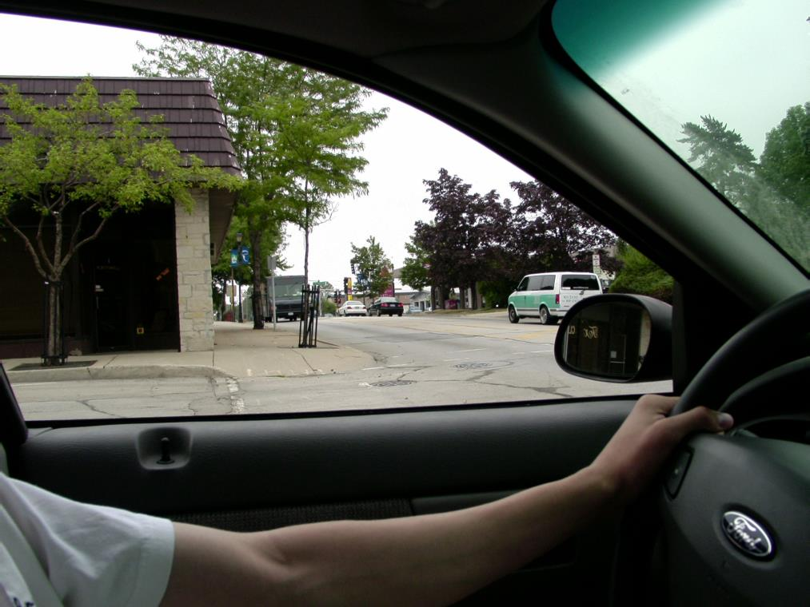
Girls…you are waiting for a break in traffic, would you be distracted here?
What about now?
Guys, what about you?
How would you deal with it?

Slide 10

Here’s both a guy and girl…what could happen if you get overly distracted looking at them?

Slide 11
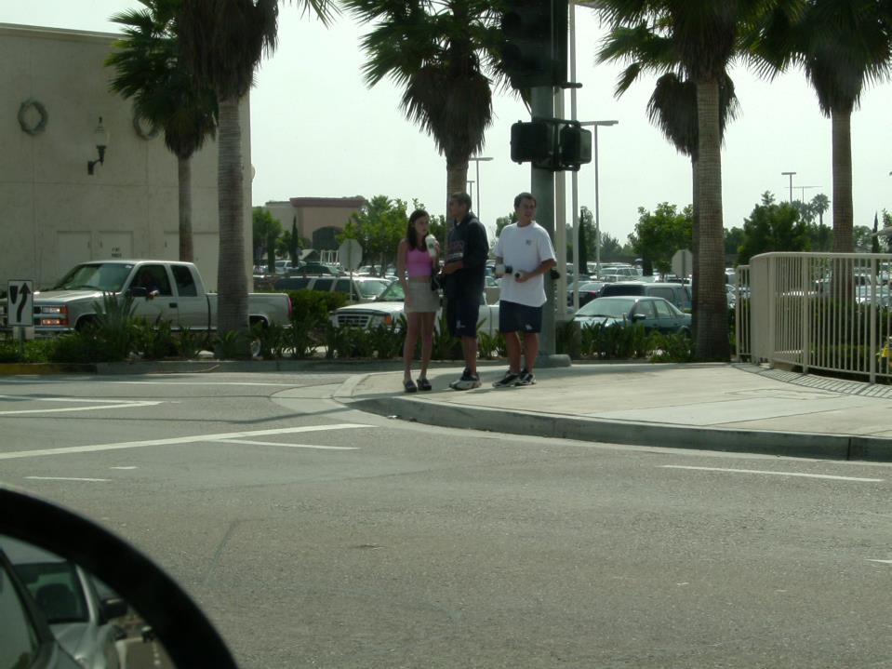
…or here you are sitting at a red light watching these people…if you get overly distracted you may not notice the __________________
light changing

Slide 12
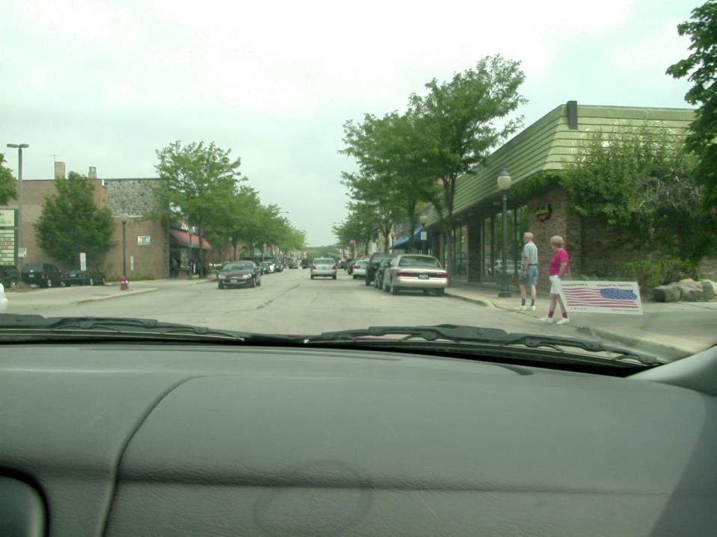

Would any of these older people
be a distraction to you?
Who might they be a distraction to?
Older people ???

Slide 13

Driving
Distractions
Let’s notice some other people and animal distractions

Slide 14
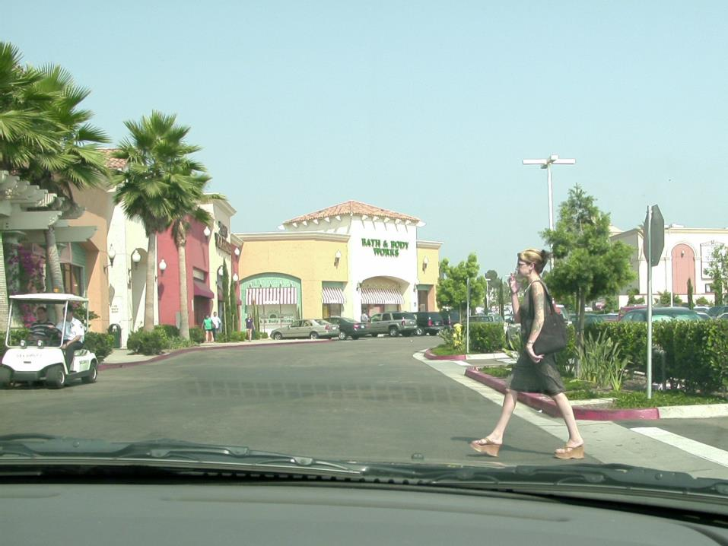
What might be distracting about this woman?
Her tattoos?
Her shoes?
Is this distraction a driving concern?

Slide 15
Guys…would you be distracted here?
How would handle this distraction?
What is
distracting you?

Slide 16
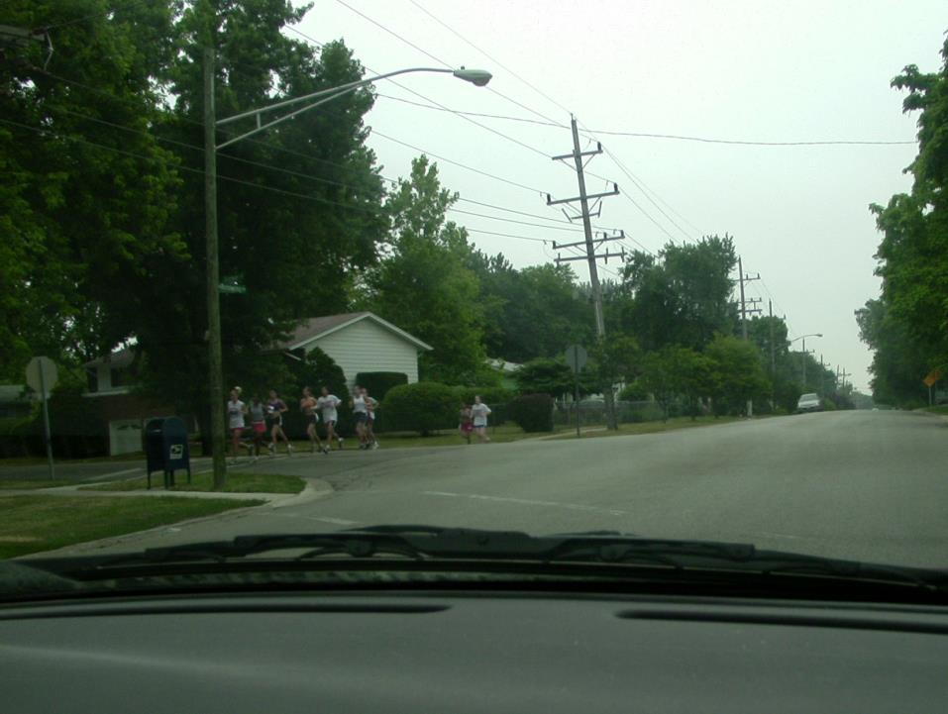
Especially with young people…seeing your friends while driving could be a major distraction.
You may run
the stop sign
Here you are approaching a 4-way stop sign.
You know most of those joggers…what is a danger here?
How should you deal with this distraction?

Slide 17
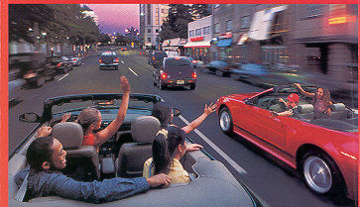

Especially with young people…seeing your friends while driving could be a major distraction.
Especially with other teens in the vehicle.
What could happen in this scene?

Slide 18
Even more distracting
is attempting to dial a
number…this often will
take your eyes off the road
for a couple of seconds.

Slide 19
Even more distracting
is attempting to dial a
number…this often will
take your eyes off the road
for a couple of seconds.
Jack, this is Al, mind if I call you back?
What is the law
in your state?

Slide 20
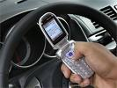

What do you think about TEXTING and driving?
texting slows reaction time by 35%
Let’s
notice…
video
Shocking new statistic: 28% of traffic collisions
occur while the driver is talking on a cell phones or texting.
That’s 1.6 million crashes a year!

Slide 21

Let’s
notice…
video

