Slide 1
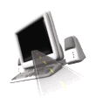

T H E D R I V E R S E D G E
I N T E R A C T I V E
slides and videos
Partial lesson
25 of 86 slides
Unit 7 – Interstate / Expressway Driving

Slide 2

EXPRESSWAY

Slide 3
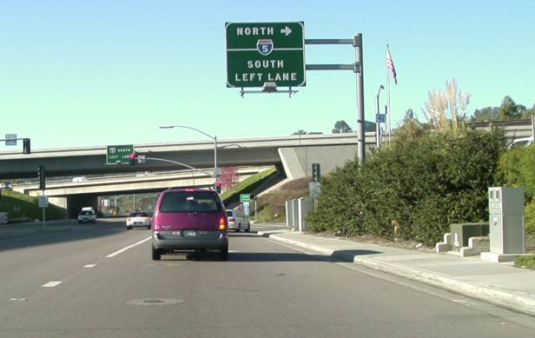
Freeway / Expressway Driving
Freeway entrances are identified with signs. In most cases, once an on-ramp is entered you must proceed onto the freeway.
Let’s now notice
a typical merge
On-ramps may have special posted cautionary
speed signs which should be obeyed as
they are there for a reason. (extreme curves)
.

Slide 4
Merging
Movie will play – merge video
Listen carefully to the procedures concerning this merge.

Slide 5
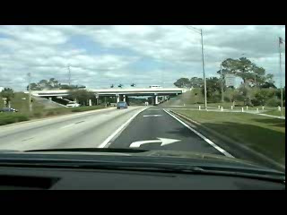
Merging

Slide 6
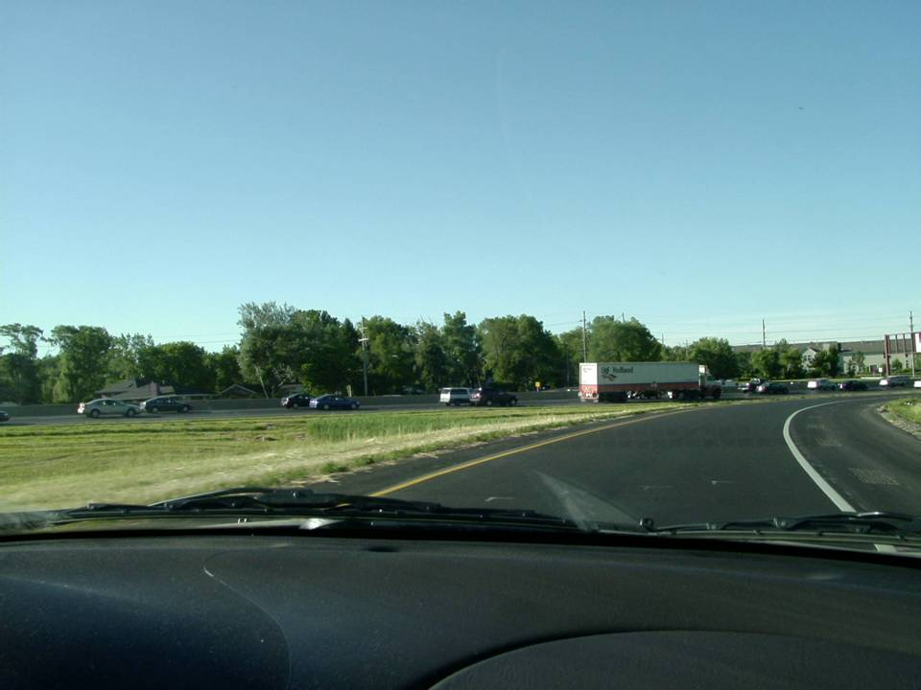
What is the purpose of the first head check early on ramp?
Check the volume and speed of traffic.
(so you’ll know how fast to accelerate)
If the traffic is heavy, be alert to
sudden stops by traffic already
on the freeway and be prepared
to slow as you merge.

Slide 7
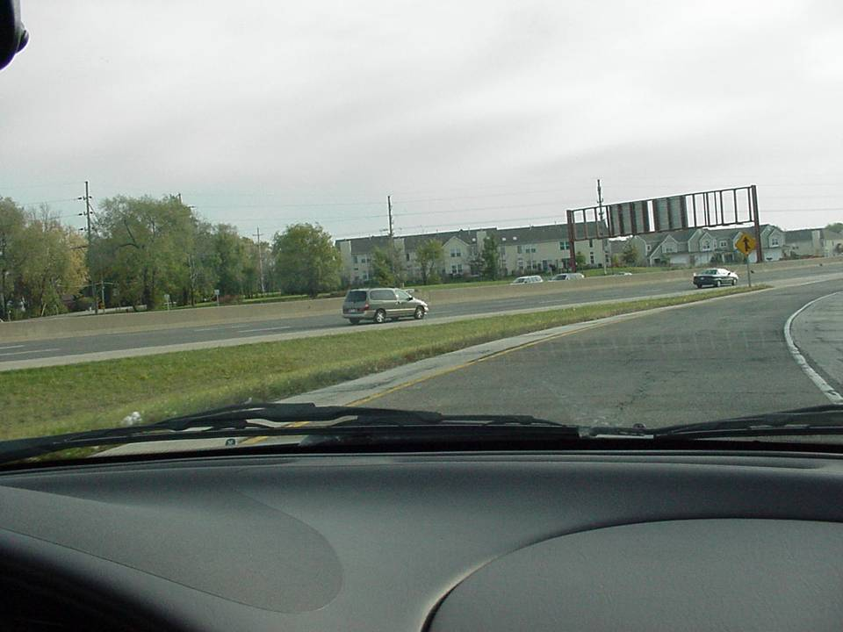
Begin looking for a space to merge. Also, quickly accelerate.
What is the purpose of the second head check as the ramp begins to straighten?

Slide 8
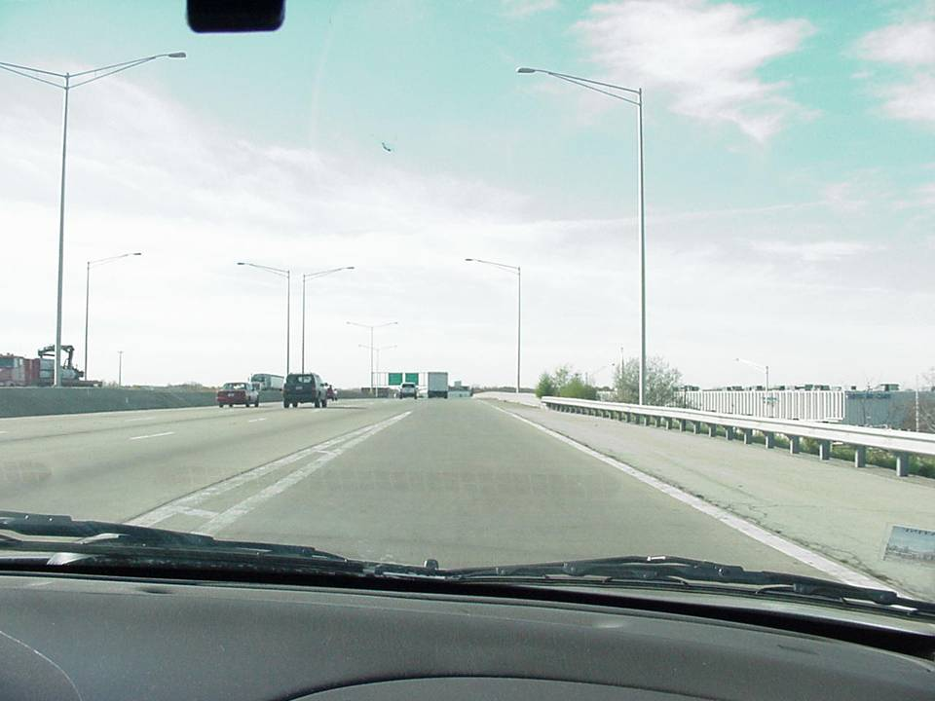
What should you do as you are now building up speed?
Enter the freeway at approximately
the same speed as traffic.
Signal, check outside mirror, and make a final head check to the left.

Slide 9
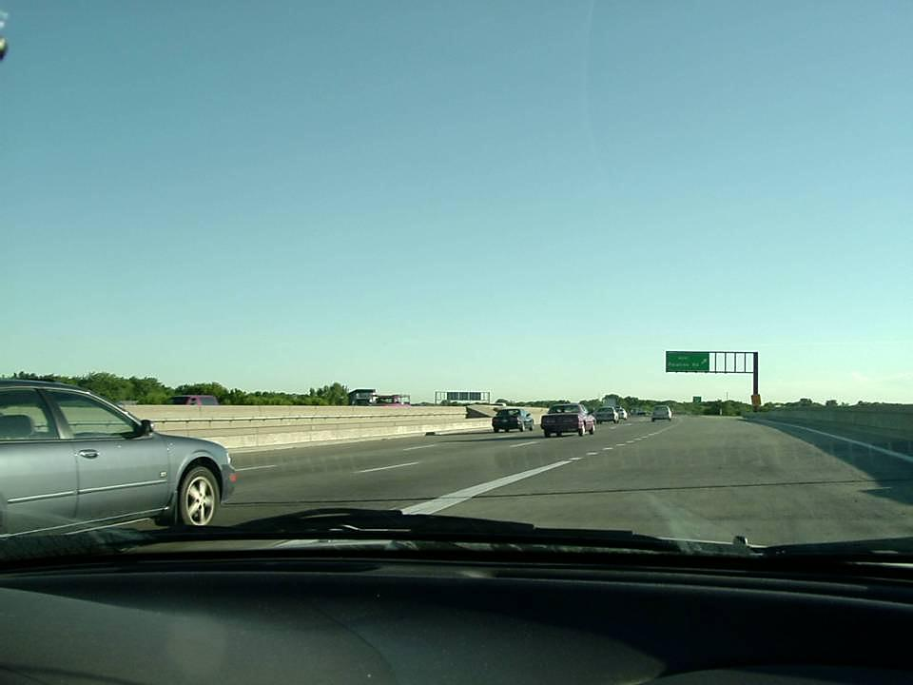
Make necessary speed adjustments. (speed up or slow down) Do not try and squeeze into a gap that is too small.
However, what will you do if you can not get over because other vehicles are preventing your merge?
Do not stop in the acceleration
lane. (unless due to traffic
congestion) Traffic will not
expect you to stop and you
could cause an accident.

Slide 10
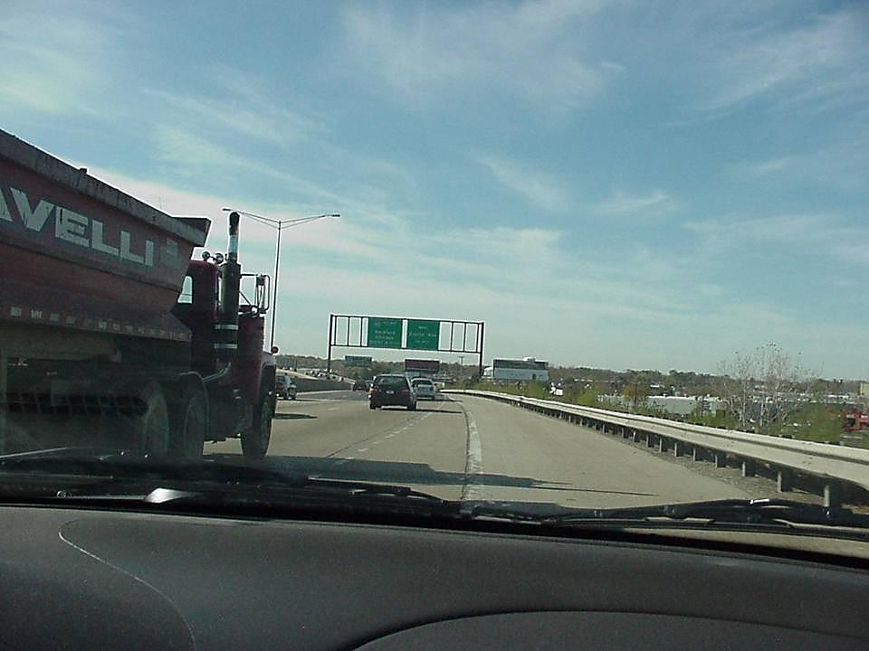
If you still cannot get in, you may have to USE PART OF THE SHOULDER until traffic opens up.
Do not force yourself over and do not brake hard.
(you could cause a rear-end crash)

Slide 11
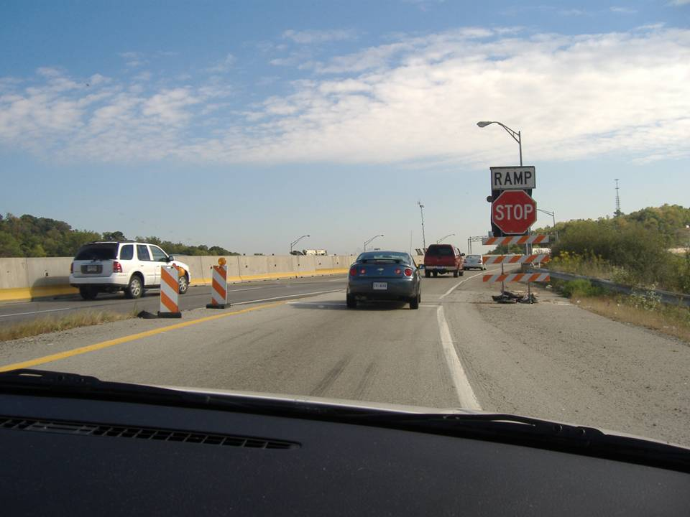
Be prepared for unusual merging situations ...especially during construction.
Also . . .

Slide 12
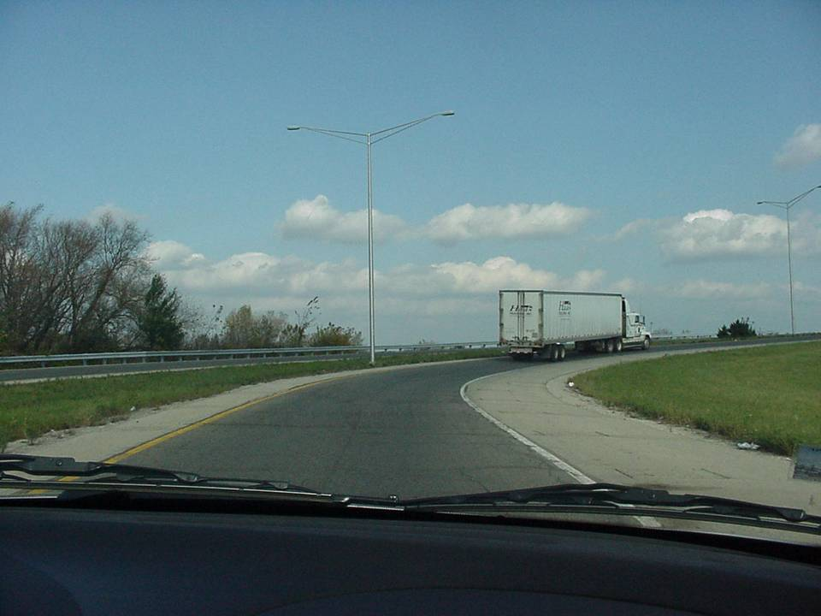
What should you do if there is a slow moving truck in front of you on the merge ramp?
Stay back and let him merge; then you can quickly accelerate and complete your merge.

Slide 13
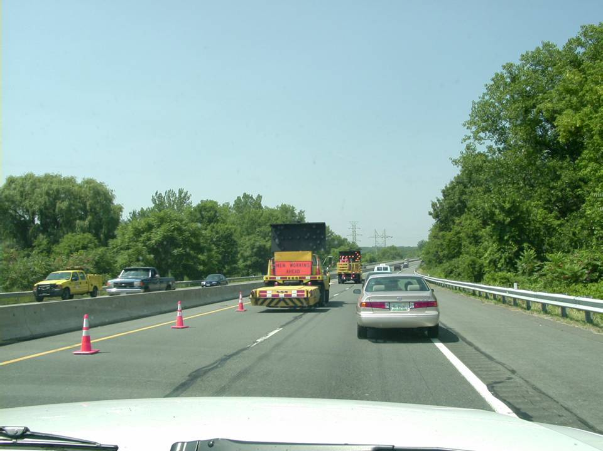
Remember, speeding in a construction work zone, the $$$ fine will ___________.
double

Slide 14
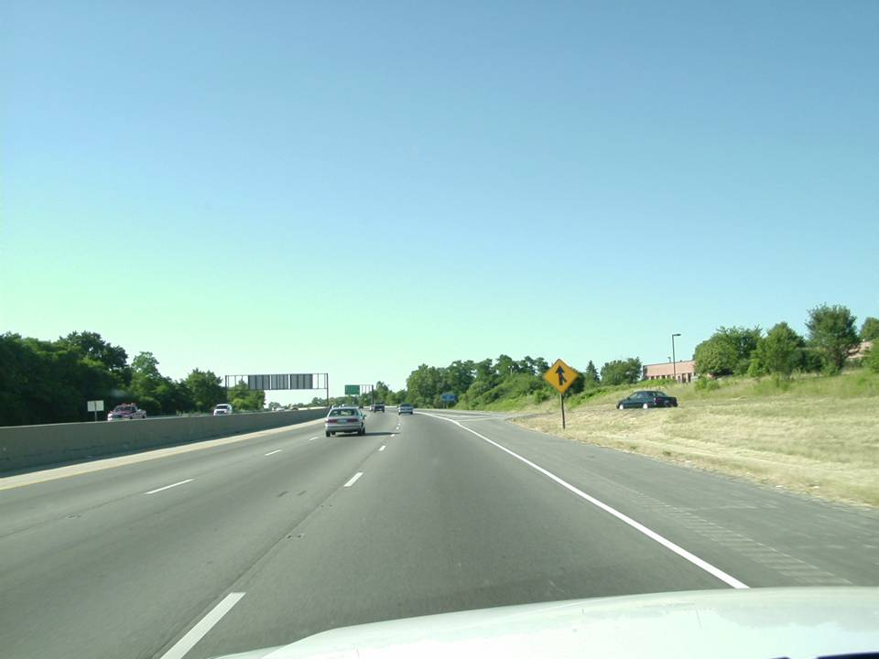
You predict a conflict with this merger. What should you do to avoid the conflict?
Change lanes or brake.

Slide 15
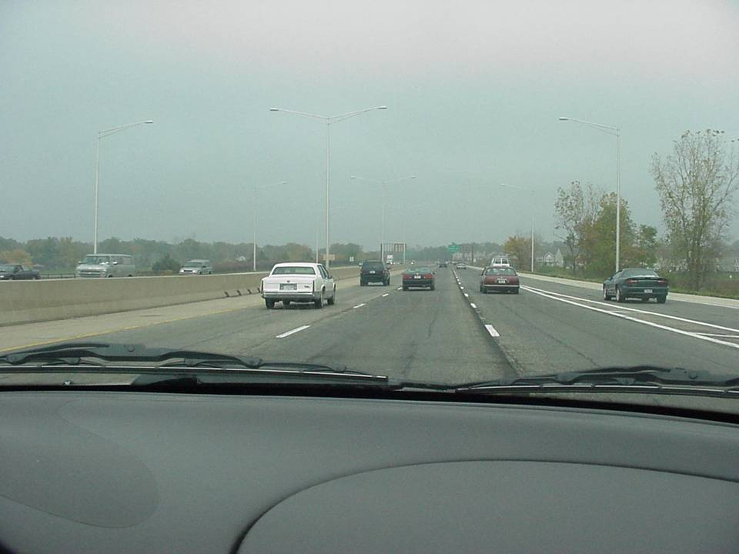

To avoid conflicts with mergers.
If you are moving with the flow of traffic,
why is it usually best to drive in the center lane?

Slide 16
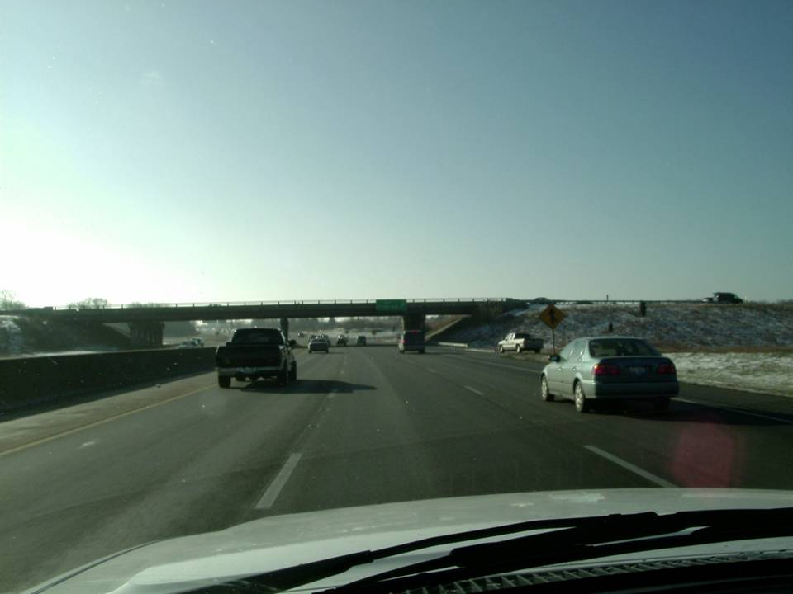
You notice the merger and this car will have a conflict. In addition, the van is slowing to exit. What is your concern?
The vehicle to our right may lane change into
our lane as we approach it’s blind spot.
(better stay back in case this occurs)

Slide 17
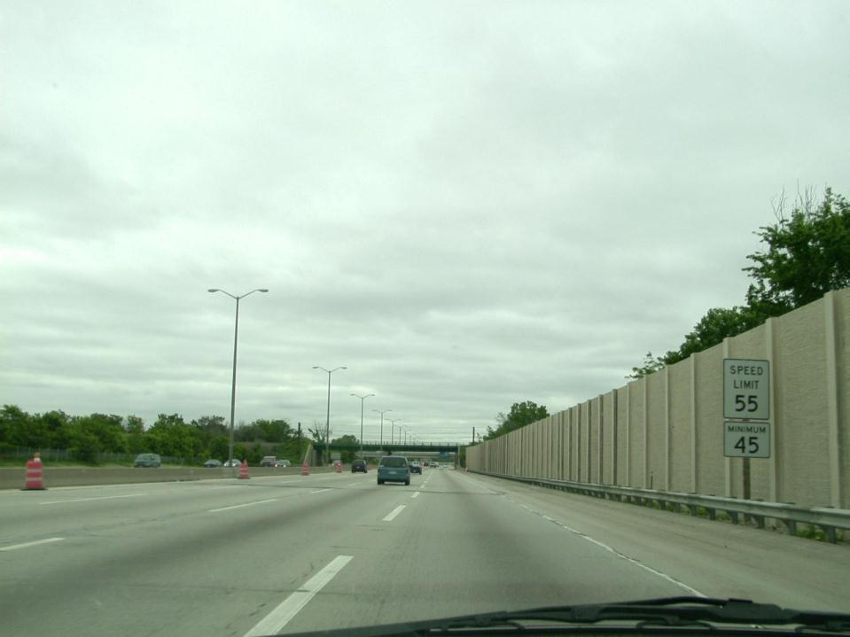
In many urban areas, what
is the maximum freeway speed limit?

Slide 18
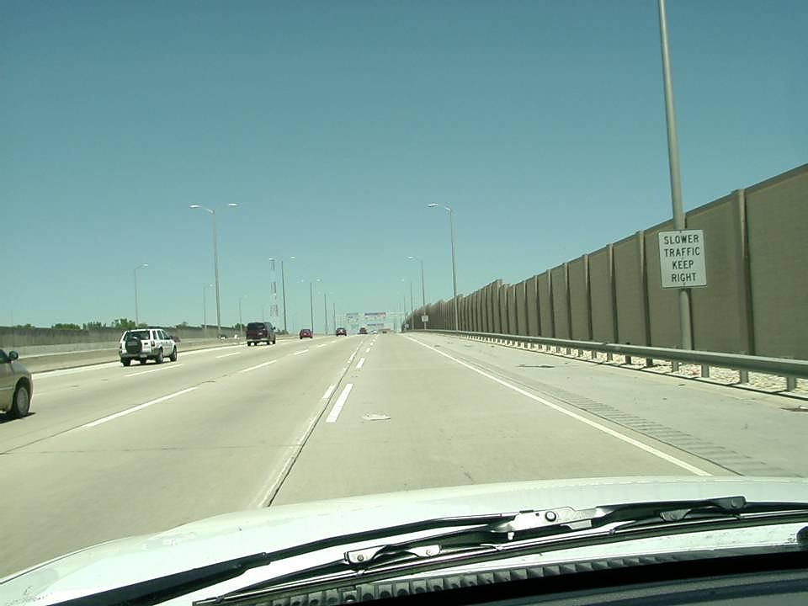
So faster traffic can move safely.
Left lanes should
be used for passing
slower vehicles. Buses,
large trucks, and vehicles
towing trailers must use
the right lane or specially
marked lanes for these
slower moving vehicles.
Some slower vehicles must
observe a 55 mph limit.
Why is it best for slow drivers to stay in the right lane?

Slide 19
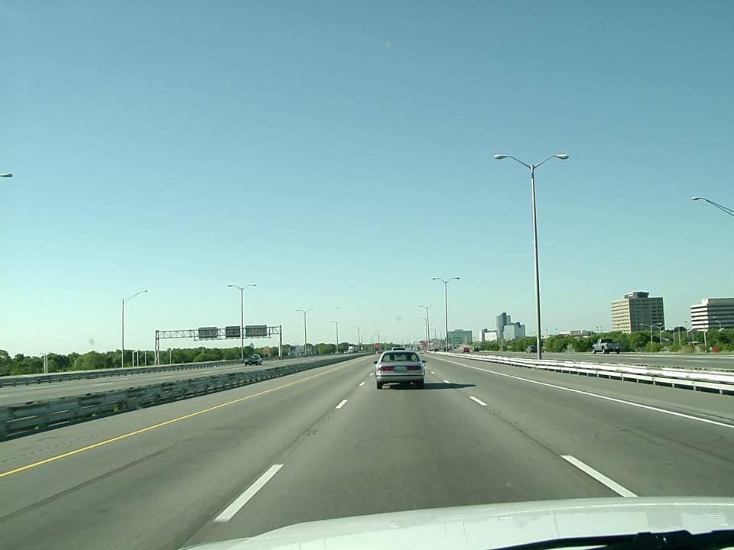
At 55 mph do you think you are 3 seconds behind this vehicle?
NOT REALLY! (notice when the car in front passes a white dash on the pavement to start calculating your 3-second interval)
Count…
1001
1002
1003

Slide 20
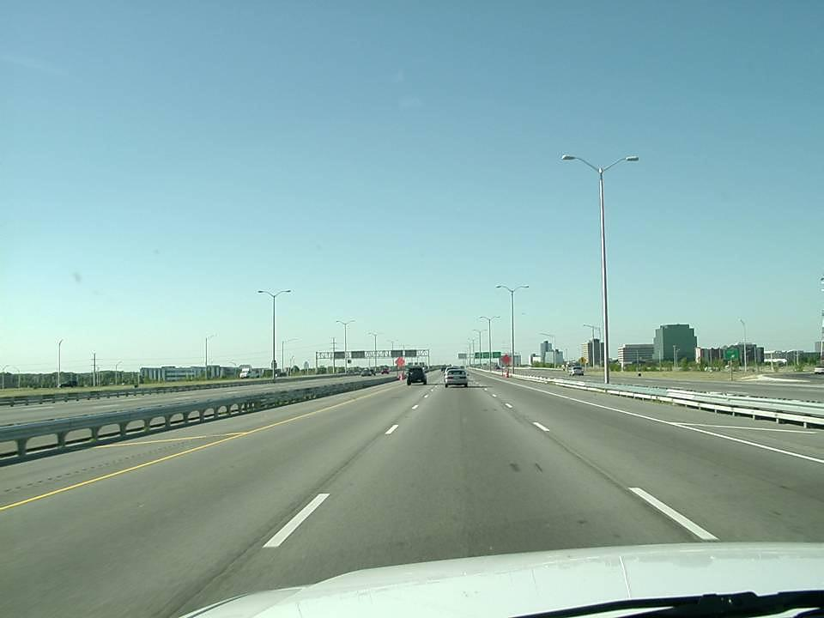
This is much better!

Slide 21
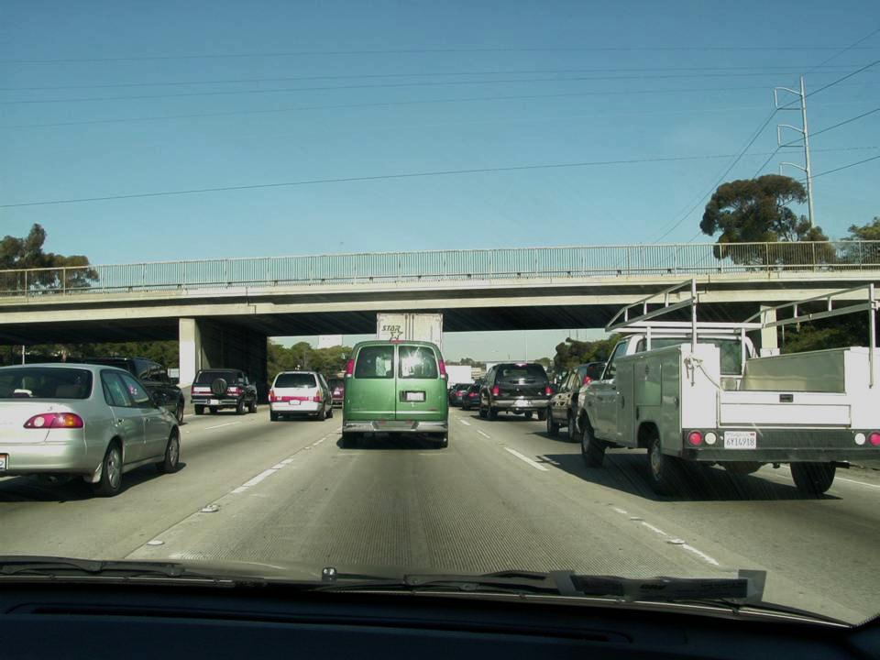
What is danger of following too closely here?
It is against the law to tailgate other drivers.
You could be cited with a traffic ticket.
A quick stop
up ahead.
Sometimes, a 3-second following distance does not work effectively in heavy traffic. Stay alert for brake lights several cars ahead.

Slide 22
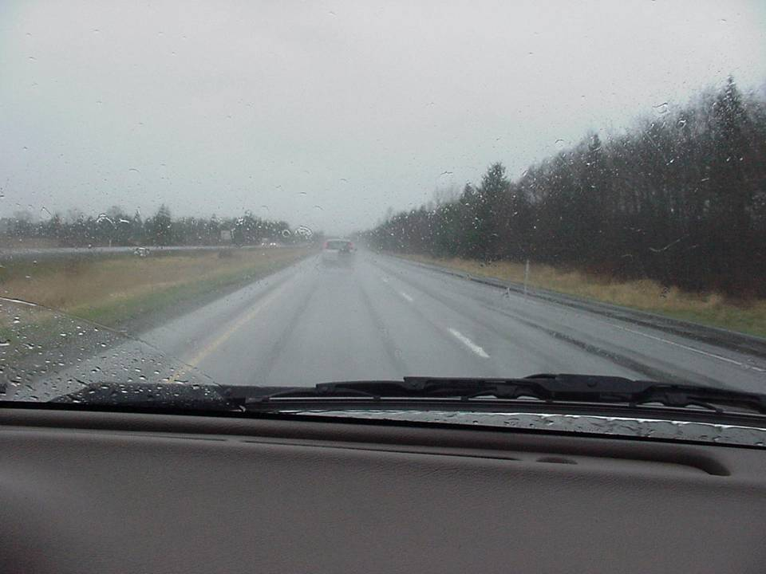
In heavy rain, why is it best to drive in the tire wipes of the vehicle in front of you?
It reduces the possibility of hydroplaning.

Slide 23
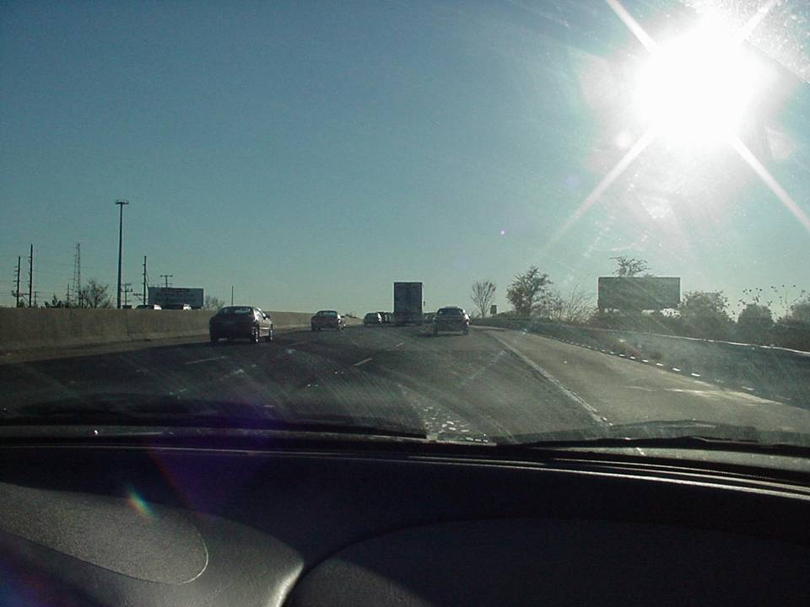
On expressways, what are some problems associated with sun glare?
In sun glare, brake lights and traffic signs are hard to see. This is especially dangerous at higher speeds.

Slide 24
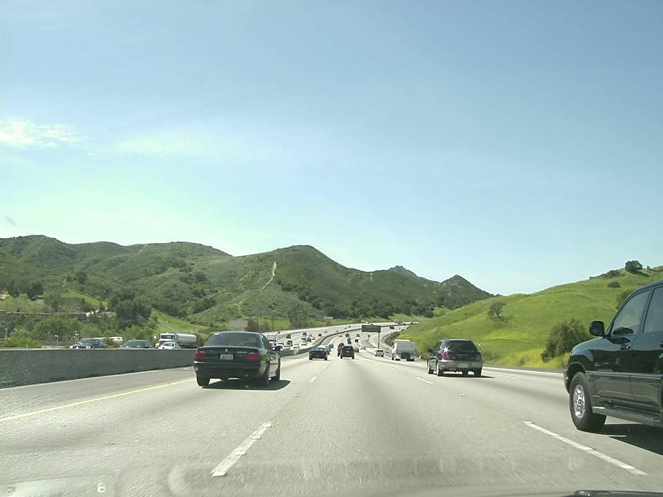
You will be soon entering this vehicle’s ____________
blindspot

