Slide 1


T H E D R I V E R S E D G E
I N T E R A C T I V E
slides and videos
Partial Lesson
first 18 out 33 slides
Unit 4– Personal Security

Slide 2

Staying Safe . . . Personal Security

Slide 3
Staying Safe . . . Personal Security
When driving, especially in questionable neighborhoods scan the situation ahead:
- Look for suspicious individuals at corners
- If possible, try to time the light to avoid stopping at that intersection. (be sure doors are locked and windows are up)
- If you have to stop…stop while you can still see the back tires of car in front of you (so you will have an escape path if needed)
Some neighborhoods
especially in large urban
areas are noted for crime
and assault on motorists.
What are some strategies
for staying safe in these areas?

Slide 4
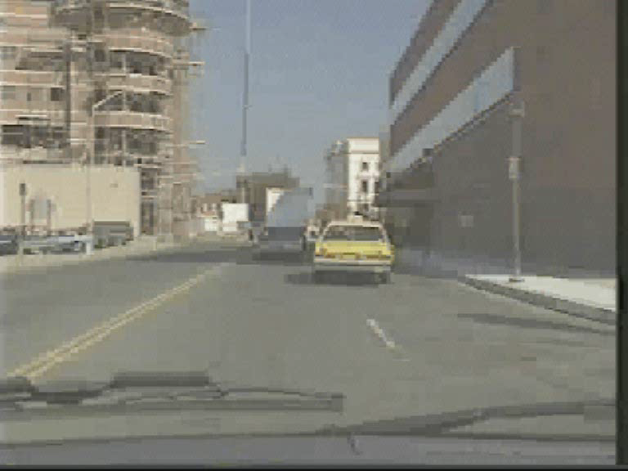
Staying Safe . . . Personal Security
When driving, especially in questionable neighborhoods scan the situation ahead:
- Look for suspicious individuals at corners
- If possible, try to time the light to avoid stopping at that intersection. (be sure doors are locked and windows are up)
- If you have to stop…stop while you can still see the back tires of car in front of you (so you will have an escape path if needed)
Courtesy of: AAA Foundation for Traffic Safety
Look for
suspicious situations

Slide 5
Staying Safe . . . Personal Security
If you think they intend harm… Be ready to quickly drive off while sounding horn repeatedly.
What should you do if you
suspect an approaching person
intends to victimize you?
Be alert to carjackers…even people who are well-dressed and appear to be business men.

Slide 6
Staying Safe . . . Personal Security
Intentionally bumping your car from behind… (hoping you’ll get out to discuss “the accident” then they’ll rob you or highjack your car)
What might be some other
“creative ways” carjackers
could get you out of your car?

Slide 7
Staying Safe . . . Personal Security
Intentionally bumping your car from behind… (hoping you’ll get out to discuss “the accident” then they’ll rob you or highjack your car)
Be ready to drive off if you suspect this…motion them to follow you and drive to a police station.

Slide 8
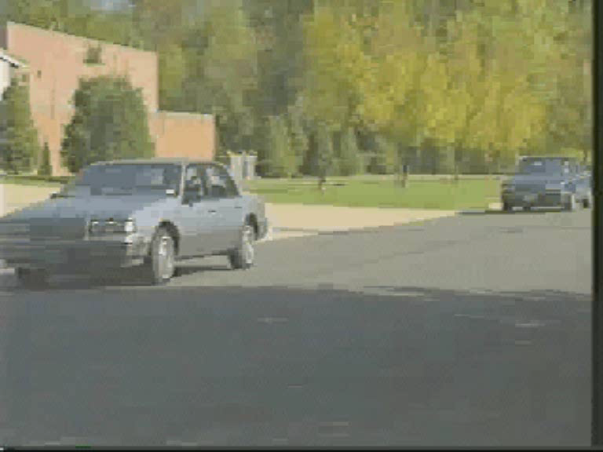
Staying Safe . . . Personal Security
Intentionally bumping your car from behind… (hoping you’ll get out to discuss “the accident” then they’ll rob you or highjack your car)
VIDEO WILL SOON PLAY
Courtesy of: AAA Foundation for Traffic Safety
Be ready to drive off if you suspect this…motion them to follow you and drive to a police station.

Slide 9
Staying Safe . . . Personal Security
OTHER PLOYS:
Unauthorized use of lights or sirens (pretending to be a police officer) to pull motorist over and rob them.
What might be some other
“creative ways” these criminals
could victimize you?
If suspicious, do not get out of your car (ask to see ID, keeping window up) …if you have a cell phone call the emergency number for the real police.

Slide 10
Staying Safe . . . Personal Security
Pretending to have a roadside emergency (hood up) hoping a good-hearted motorist will stop to help…then they try to overpower you.
Any other ploys these criminals
might use to victimize you?
If you have a cell phone call the
roadside emergency number
in that area…other options?
What should you do if you feel
someone really is having car
trouble…how could you help?

Slide 11
Staying Safe . . . Personal Security
If you have a flat tire in a dangerous area…do not get out of the car…drive to a well lighted service station for assistance.
What if you have a vehicle
problem (like a flat tire) in a
questionable neighborhood?
X
Do not attempt to fix it there.

Slide 12
Staying Safe . . . Personal Security
Let’s think about some strategies
for prevention of problems
What would be some things to consider
when trying to find a safe parking space?

Slide 13
Staying Safe . . . Personal Security
When parking your car, select a well lit area close to building entrances if possible.
What seems safe in day time may be dangerous at night.
What about parking
in a parking garage?

Slide 14
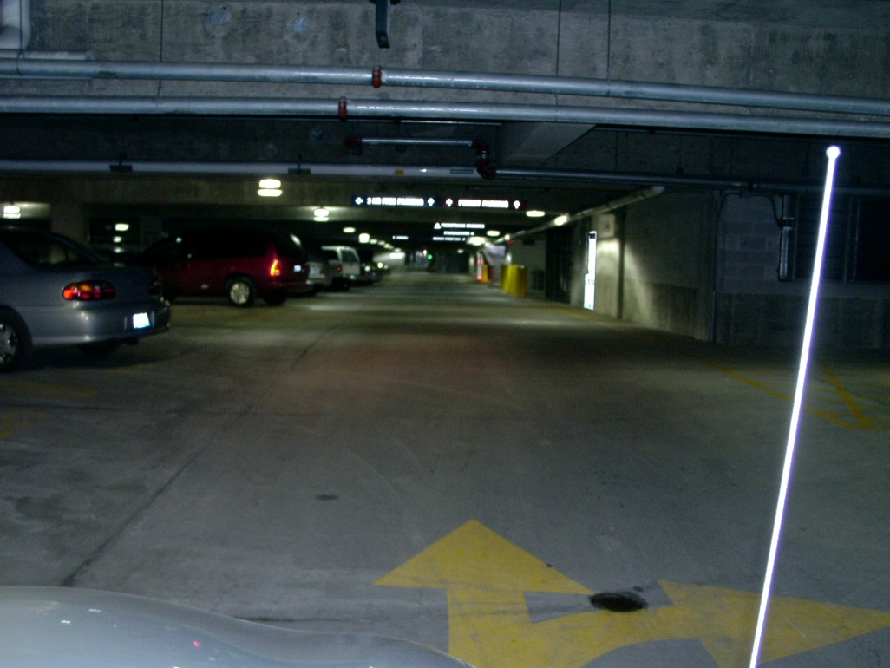
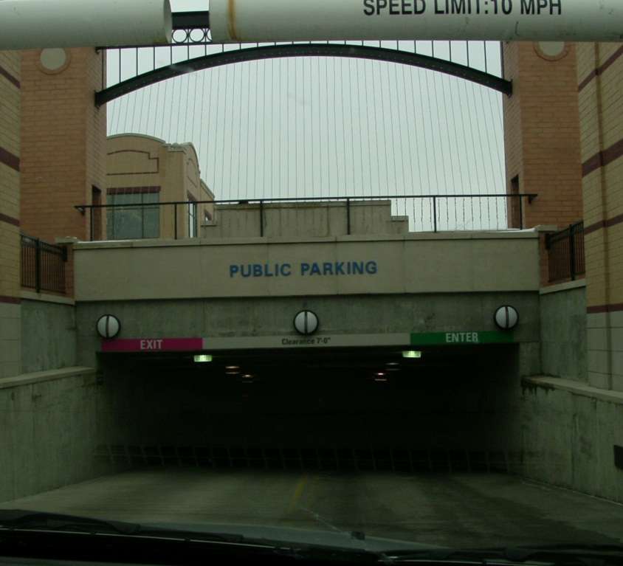
Staying Safe . . . Personal Security
If parking in a garage area, choose a place near a light and if possible on the ground level as to avoid stair wells and elevators.
Note your location, so you are not wandering around – if wandering around, you will be less alert and more of a target. Also, be sure doors, windows and sunroof is locked.
Is there any way to
prevent yourself from being
locked out of you car?
(leaving the keys in the ignition)
What about parking
in a parking garage?

Slide 15

Staying Safe . . . Personal Security
- To prevent your car from being stolen:
- park in a well lit area near a store entrance if possible.
- be sure doors and windows are locked.
What can you do
to reduce the
chance that your
vehicle will
be stolen?
Anti-theft
steering wheel devices
will discourage thieves.
Car theft is a very big problem all over…
- activate any anti-theft devices you might have
- use the parking brake (it will delay a thief who intends to tow your car)
About 40% of stolen vehicles had at least one unlocked door!

Slide 16
Staying Safe . . . Personal Security
When walking to your car, scan the area. If you see suspicious people, cross the street or go around the block. Project a confident image by walking briskly with a sense of purpose.
Have your keys ready… but if you see a suspicious person by your car, keep walking and go for help.
What are some important things to remember when walking to your car in a questionable neighborhood?

Slide 17
Staying Safe . . . Personal Security
If possible, walk in groups to your cars for safety.
As you approach your car (especially in questionable areas) look around it, in the back seat area and even under the car for someone who may be waiting for your arrival to rob you or steal your car.
Other strategies when approaching your car?

Slide 18
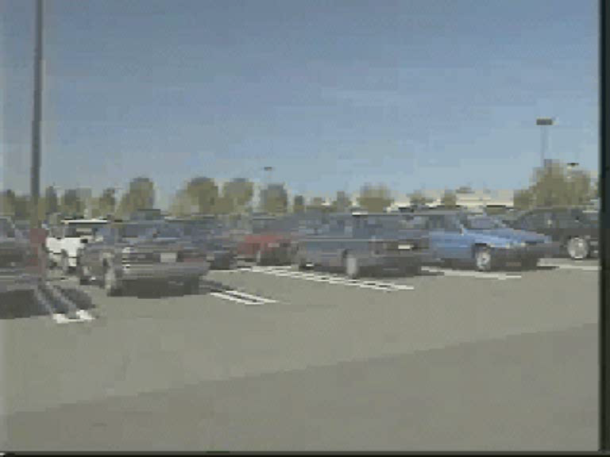
Staying Safe . . . Personal Security
Courtesy of: AAA Foundation for Traffic Safety

Slide 19
Staying Safe . . . Personal Security
When leaving the parking lot (other people with you) wait for all vehicles to start moving before going.
If attacked don’t try to fight them…give them what they want, (purse, wallet, keys) but note as many identifying personal characteristics as possible & call police.

Slide 20
WHAT SHOULD YOU DO IF YOU KNOW YOU ARE BEING FOLLOWED?

Slide 21
WHAT SHOULD YOU DO IF YOU KNOW YOU ARE BEING FOLLOWED?

Slide 22
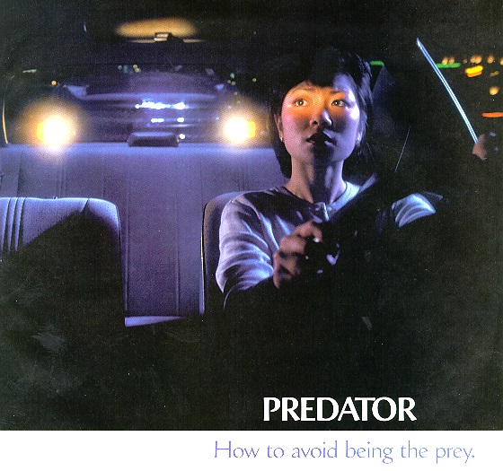
Dial cell phone emergency #
Drive to the nearest police station, or other options ???
Courtesy of Shell Oil Company
WHAT SHOULD YOU DO IF YOU KNOW YOU ARE BEING FOLLOWED?

