Slide 1
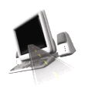

T H E D R I V E R S E D G E
I N T E R A C T I V E
slides and videos
Unit 2 – Residential – part 1

Slide 2


Residential
Residential Driving – part 1

Slide 3

Getting started

Slide 4
Also inspect the tires, noticing if any appear to low.
Pre-Driving checks – outside of vehicle
(2 most important)
Walk around vehicle checking that nothing or no one is nearby.
Let’s now consider the inside Pre-Driving steps

Slide 5
Inside Pre-driving: Starting Procedure
1) Key the ignition
2) Lock doors
3) Adjust seat
4) Adjust mirrors
5) Fasten seatbelt (check passengers)
6) Foot on brake, start vehicle
7) Shift to Drive, release parking brake
8) Signal if pulling away from curb
9) Check mirrors
10) Shoulder check…proceed
Let's notice . . .

Slide 6
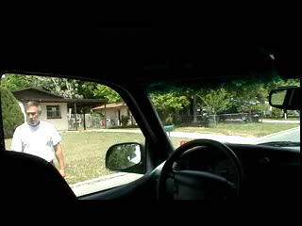
Inside Pre-driving: Starting Procedure
Let's notice . . .

Slide 7
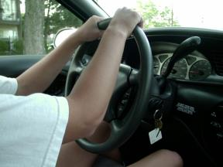
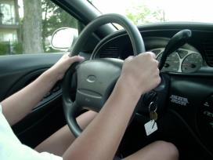
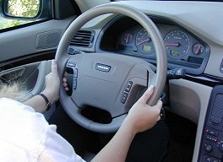
Potentially dangerous if airbag deployed: possible injuries to hands, arms, chest and face.
Let’s consider various hand placements on the wheel
What do you think is the potential danger of this hand position on the steering wheel ?
9 o’clock and 3 o’clock
Let’s think more about the
8 and 4 o’clock position
8 o’clock and 4 o’clock

Slide 8
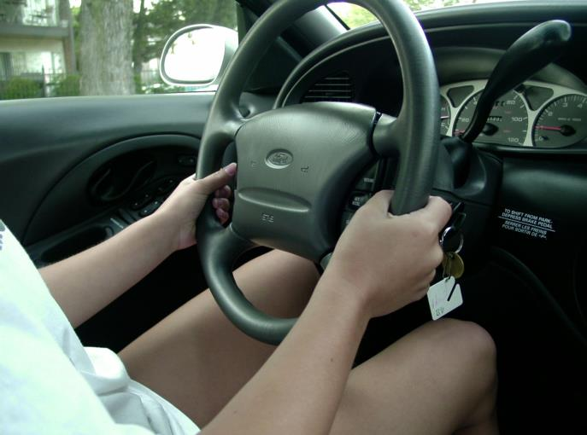
4 and 8 is now recommended – This is the location of the hand holds on the wheel.
This will afford
protection in case
of air-bag
deployment (200 mph)
Sit at least 10 inches away
WHY?
Let’s now notice some
different turning techniques.

Slide 9
Proper turns - there are many different techniques.
Hand-over-Hand: This is the most common form of steering. It is comprised of a series of short pulls with the hands alternating from the top of the wheel in the direction of the turn. It is a smooth easy way to turn. However, a potential problem is if the airbag deploys while turning it could force the hands and arms into the face, causing injury.
The cross-arm approach:
The hands grip the wheel on the opposite sides, about 9 and 3 o’clock. The wheel is turned half a turn in either direction until the arms cross, before the hands change grip.
The Push-pull Method:
The hands grip the wheel on opposite sides at the same height, usually 10 to 2. The hands alternate the grip, moving up and down the wheel at the same height. One hand pulls the wheel down to the bottom where it meets the other hand at 6 o'clock position. Changing grips, the opposite hand pushes the wheel to the top where the hands touch at 12 o'clock, ready to change again for the pull down; etc.
When the steering is turned to the desired amount, both hands hold the wheel opposite and at the same height as each other. To straighten the wheel, reverse the procedure. The last hand to 'feed in' is the first hand to 'feed out'.

Slide 10
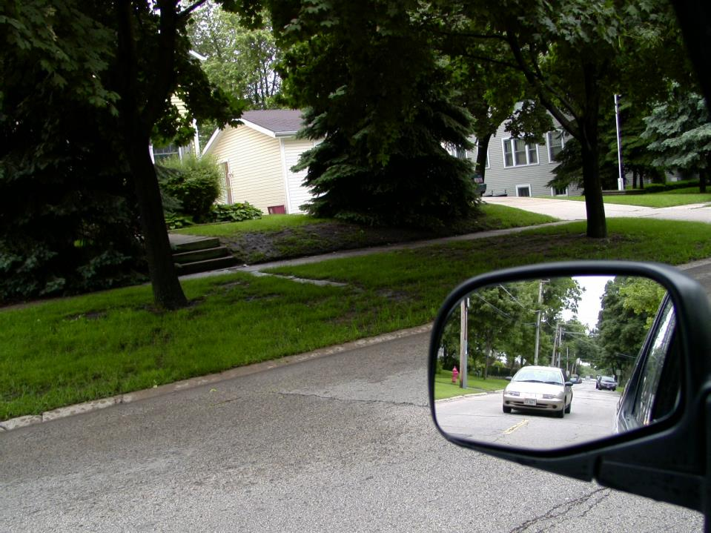
You want to pull away from the curb. You have signaled and you are checking this outside mirror. After this car passes, what must you still do?
STOP
and
THINK
Why
should you
do this?
Develop
this habit to
cover the
blind spot
Left shoulder head check

Slide 11
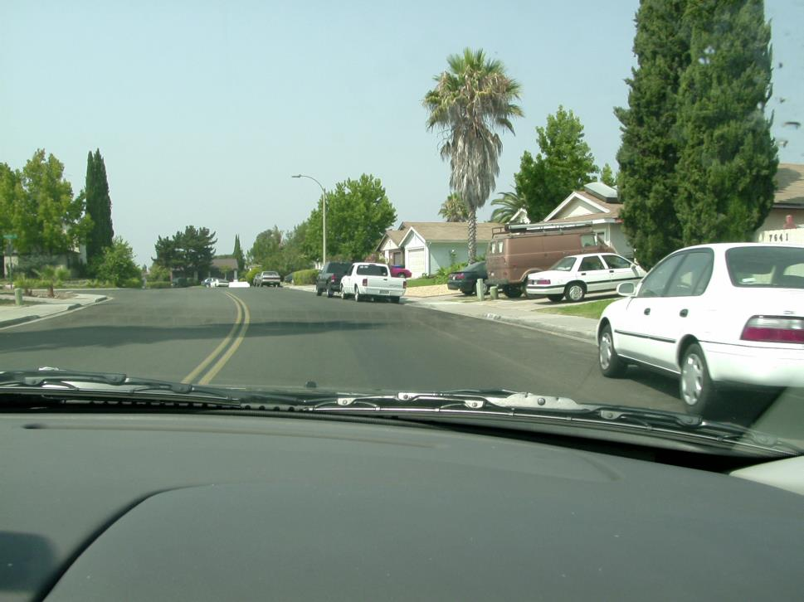
Tracking
An essential skill for the beginning driver is “tracking ability.” This is being able to keep the vehicle centered in the lane without drifting to either side. The best way to learn this skill, is to primarily look well up the road in the center of your lane. Of course, you’ll also need to focus your attention on closer objects at various times.

Slide 12
Checking and Analyzing Intersections

Slide 13
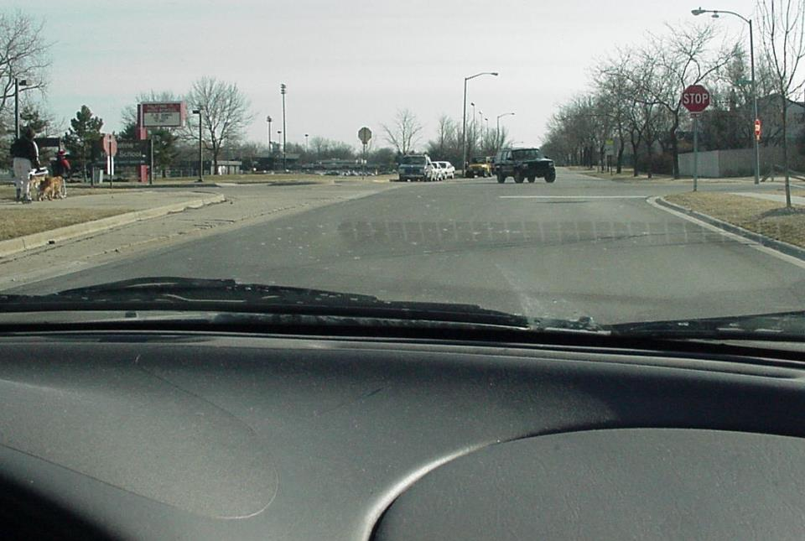
How many stop signs do you see at this intersection?
It’s a 4 -way stop. These are easy to see, but some are more difficult to analyze.

Slide 14
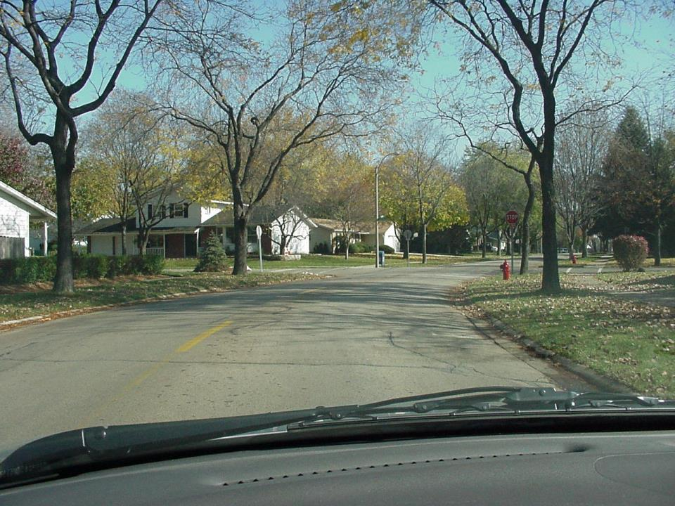

How many stop signs do you see at this intersection?
We clearly see 3 stop signs,
But, the one on the right is harder to see.

Slide 15
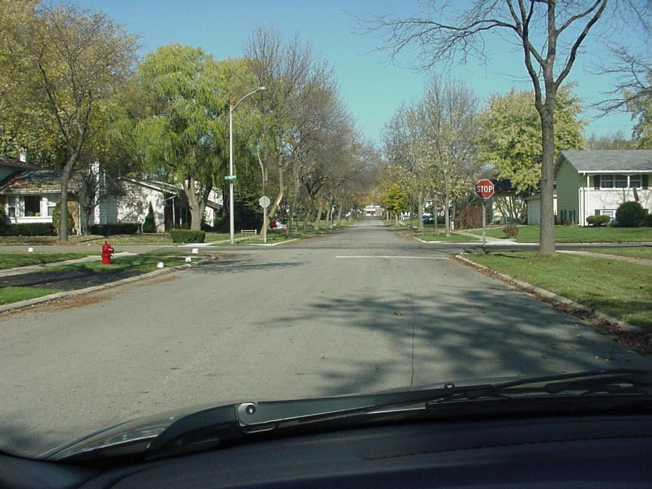
Try to analyze every residential intersection
at least 50 feet before it.
2 stop signs. We stop they (crossing vehicles) do not.
How many stop signs have you analyzed at this intersection?

Slide 16
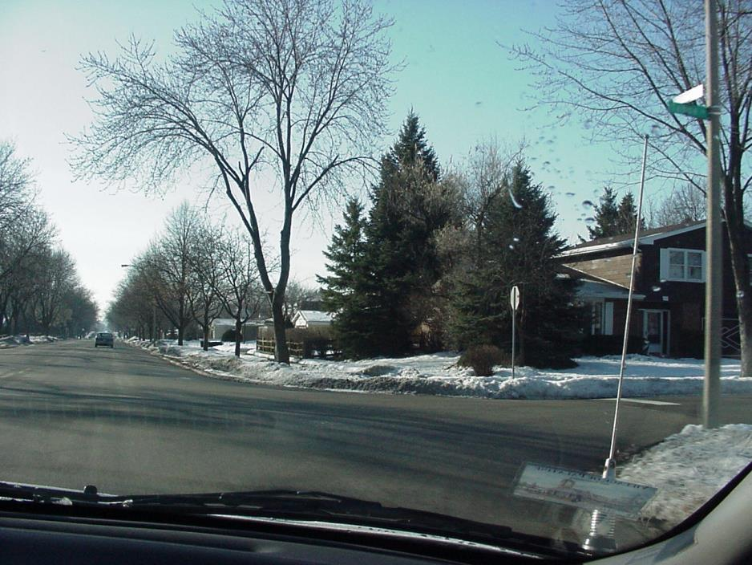
What have you analyzed about this intersection?
They stop we don’t

Slide 17
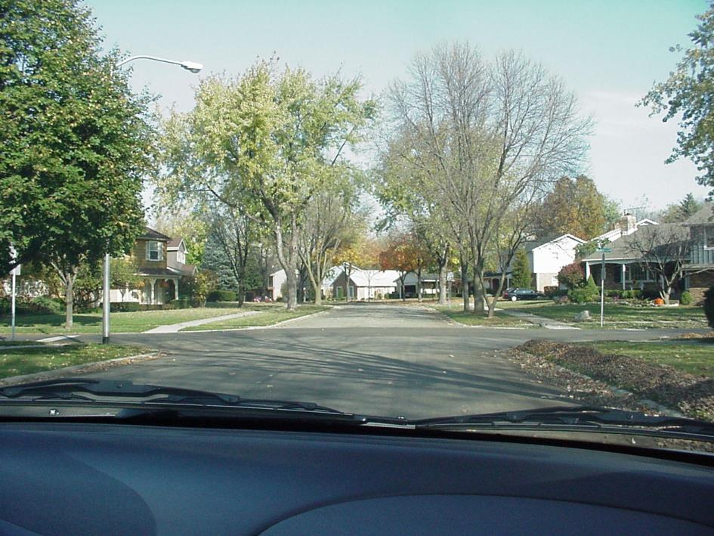
At this intersection they stop, we do not.
What should you do as you proceed through it?
Develop
the habit of
checking every
intersection.
STOP
and
THINK
“T” crashes
from side impacts
kill more people
than head-on
collisions
EASE OFF THE GAS, COVER THE BRAKE and CHECK IT ANYWAY. Expect people to run stop signs

Slide 18
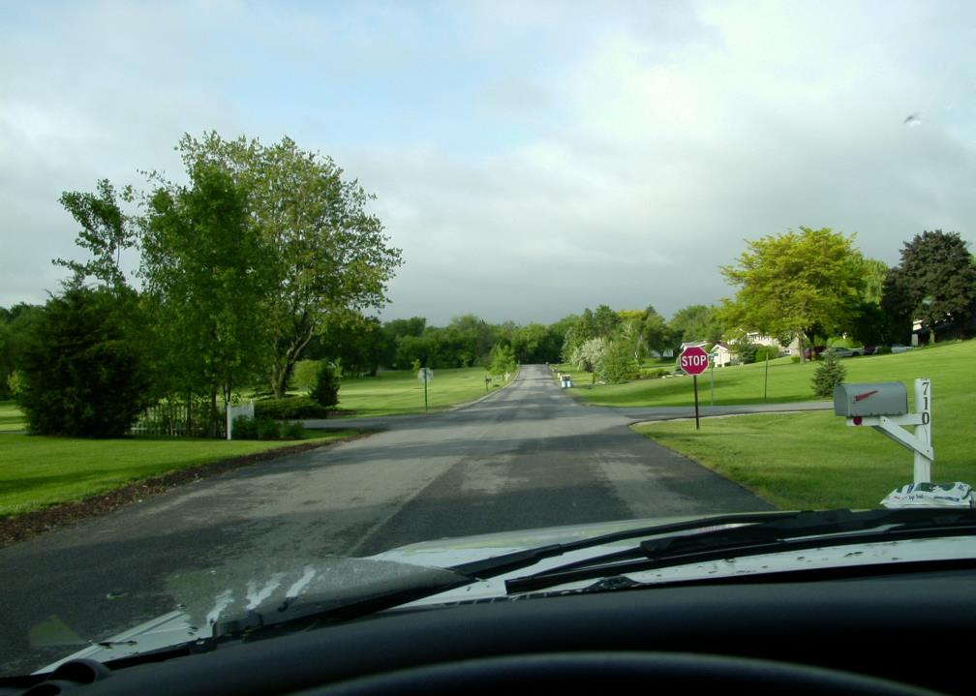
How many feet before your turn must you signal in a residential area?
100 feet
But, in some states it’s 5 seconds before the intersection turn.

Slide 19
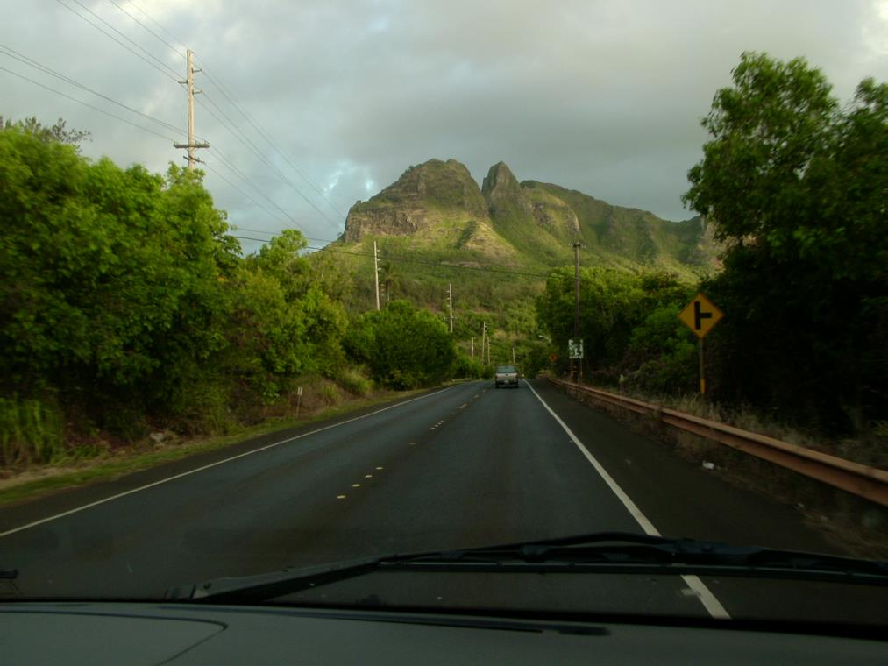
How many feet before your turn
must you signal in a rural area?
STOP
and
THINK
Why
double the
distance?
Rural roads
have higher
speeds. You’ll
need to give
an advanced
warning.
In most states, 200 feet.

Slide 20
HAND SIGNALS
You never know when a bulb or a fuse will burn out.

Slide 21
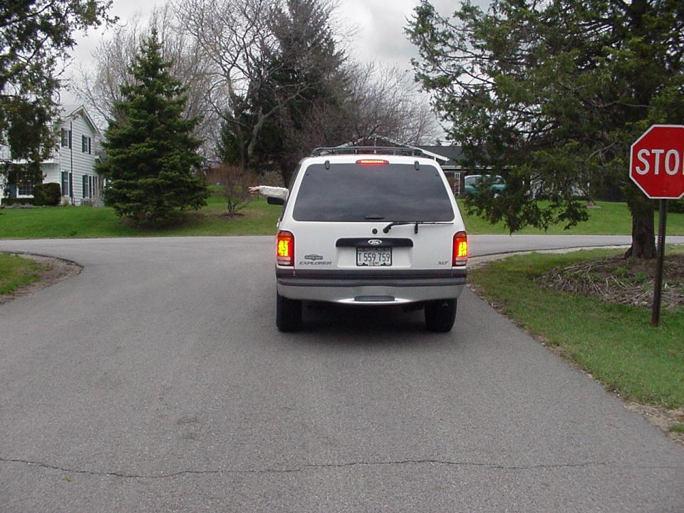
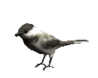
Signaling a _____________
left turn

Slide 22
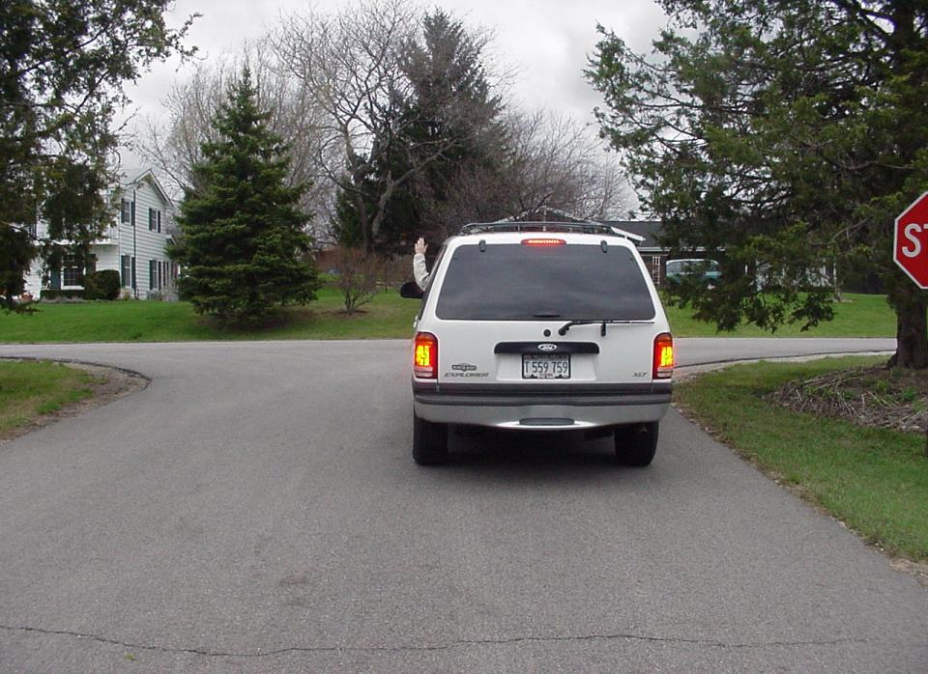
Signaling a _____________
right turn

Slide 23
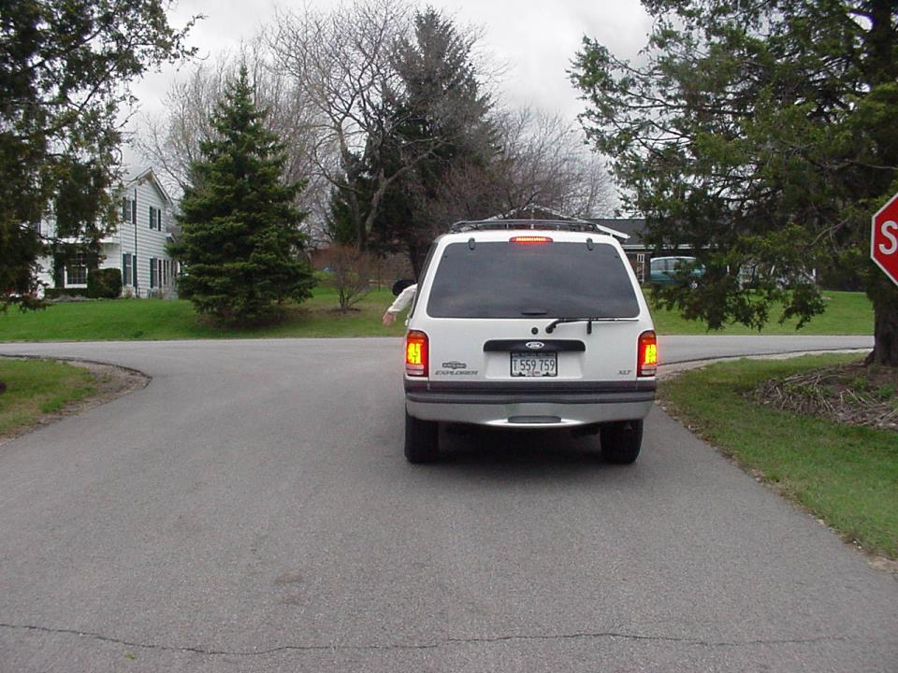
Signaling a _____________
S T O P

Slide 24
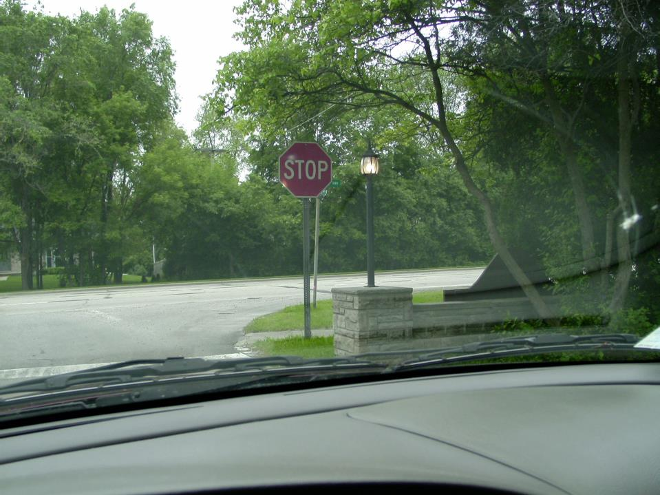
What must you do at this blind intersection?
EASE UP TO SEE BETTER.

Slide 25
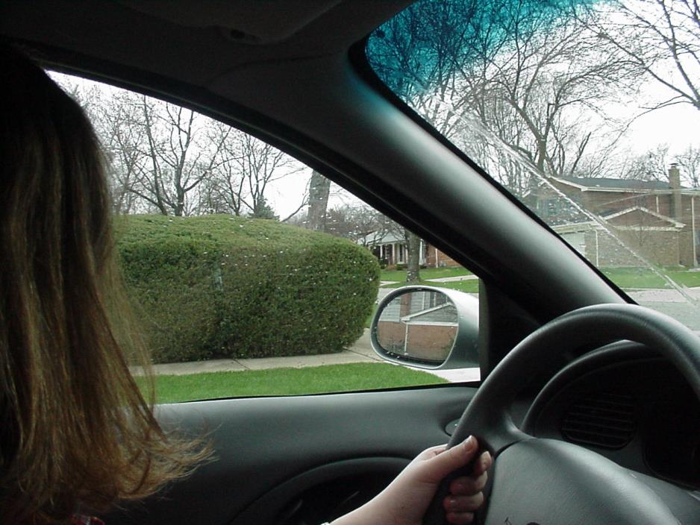
Easing up to see better
Where should your right foot be while easing up?
On the brake; controlling the speed
as you slowly move forward.

Slide 26
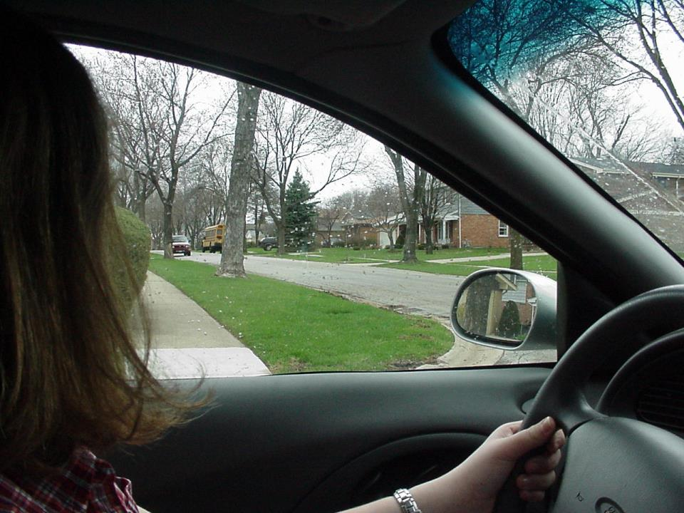

Easing up to see better
See at least 1 full block down the street.
Let's notice this again . . .

Slide 27
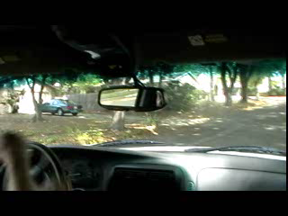
Easing up to see better
See at least 1 full block down the street.

Slide 28
More checking and
Analyzing Intersections

Slide 29
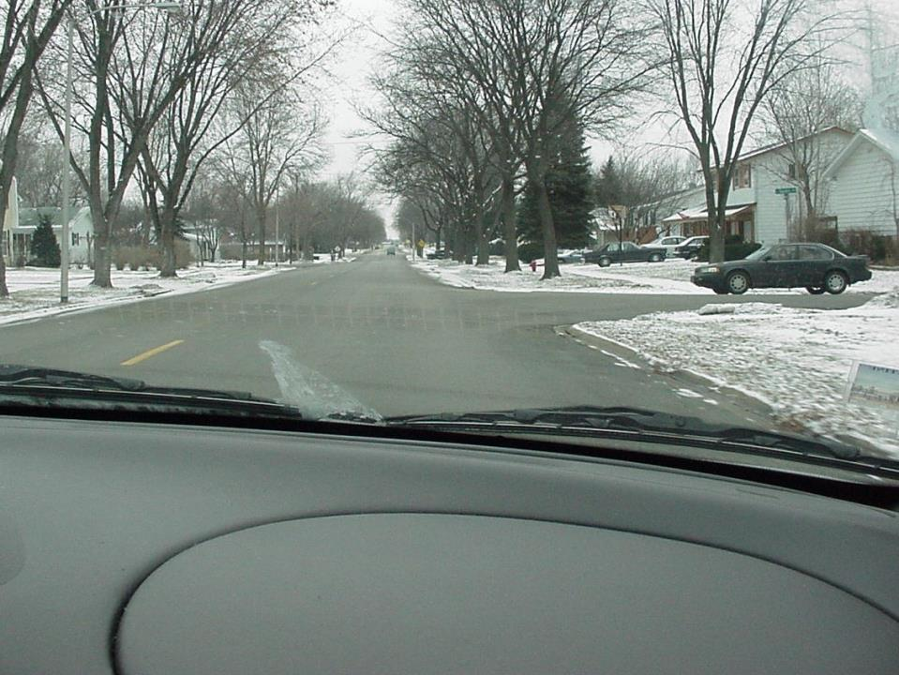
Why should you still check down these side streets?
Not all vehicles stop!
Some larger residential streets are sometimes called through streets. They usually have yellow dashes and side streets have stop signs.

Slide 30
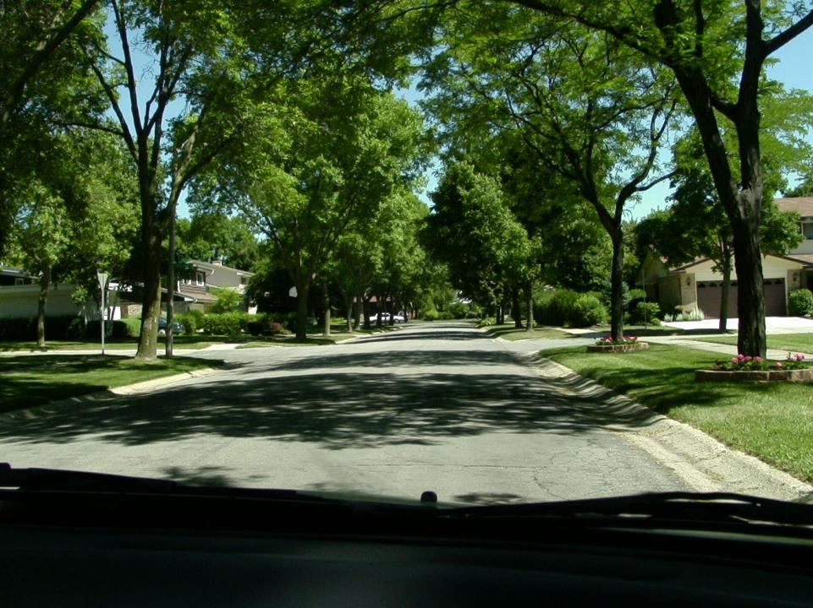
What should you be doing?
Even though they yield; coast, cover brake and check.
YIELD SIGNS
What sign do you see at this intersection?

Slide 31
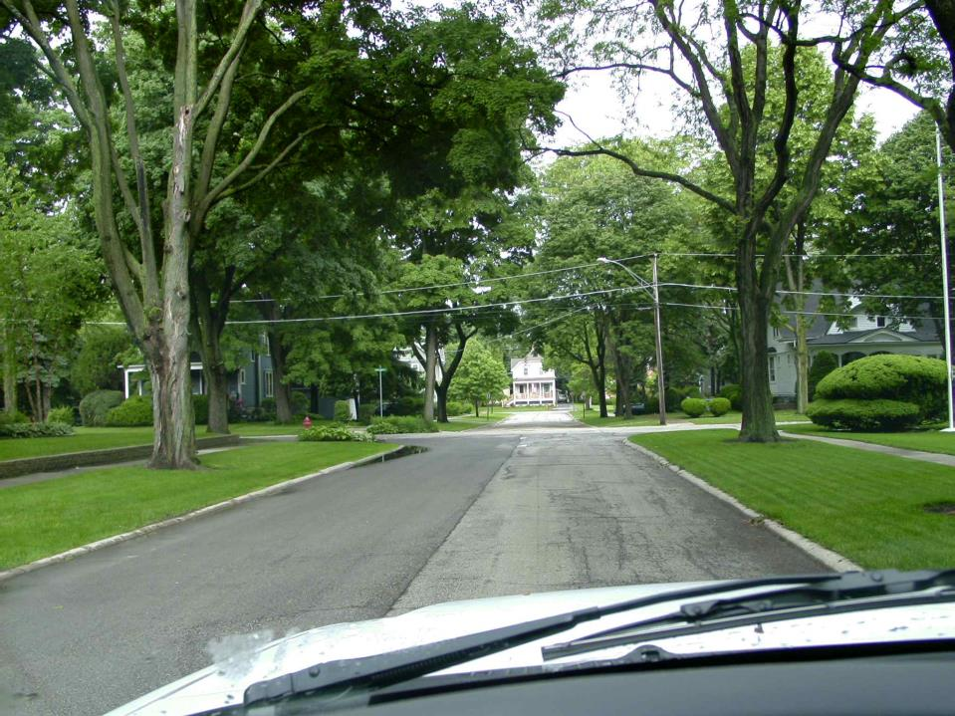
What have you analyzed about this intersection?
IT’S AN UNCONTROLLED INTERSECTION!
There are no stop or yields signs.
STOP
and
THINK
Why
should you
do this?
If both you and
a crossing car
do not slow
down…crash!
What will you do as you approach it?
Slow down and check both ways.
It’s also a blind
Intersection.

Slide 32
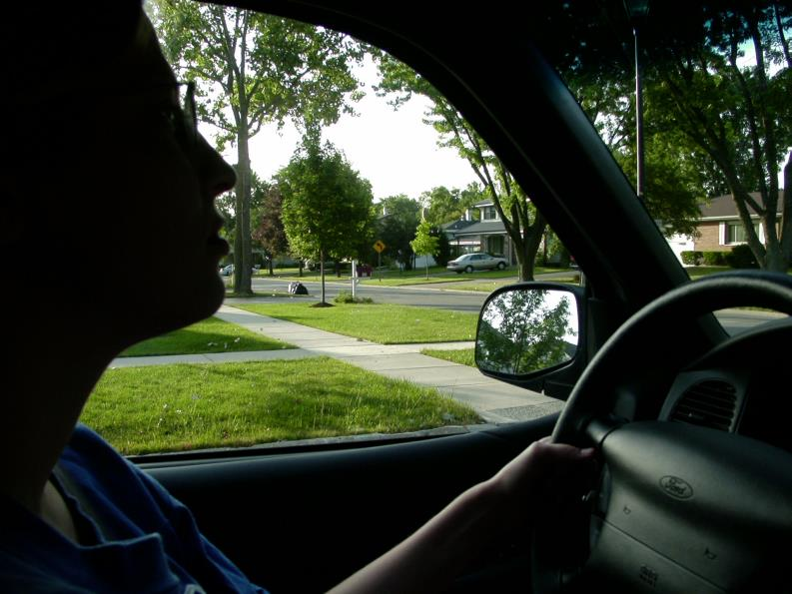
She has already analyzed the intersection;
(uncontrolled) but, what else should she be doing?

Slide 33
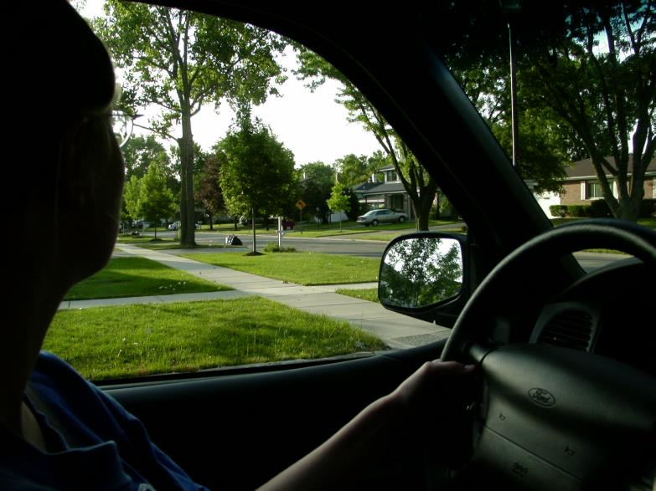
Begin the second check of the intersection.

Slide 34
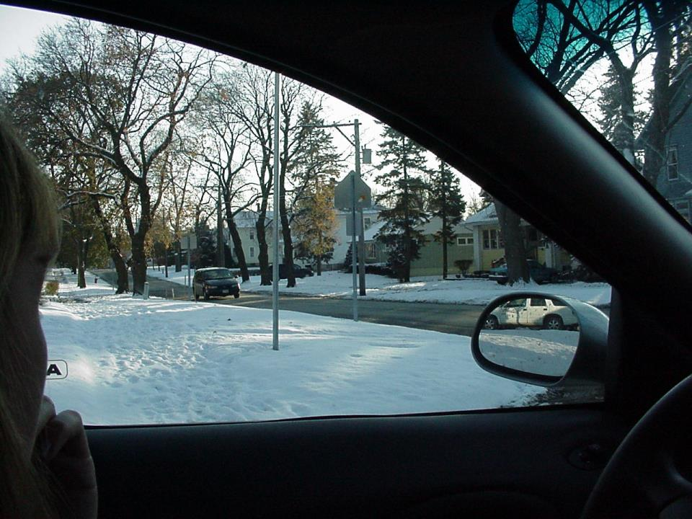
We are at a stop sign intending to turn left, does that van have to stop at the intersection?
STOP
and
THINK
What if you
thought it
was a
stop sign?
You might have
pulled out…crash!
Each shape has
a special meaning.
No, that is a school sign!

