Slide 1
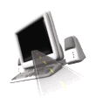

T H E D R I V E R S E D G E
I N T E R A C T I V E
slides and videos
Unit 2 – Residential – part 2

Slide 2


Residential – part 2

Slide 3
RAILROAD
SITUATIONS

Slide 4
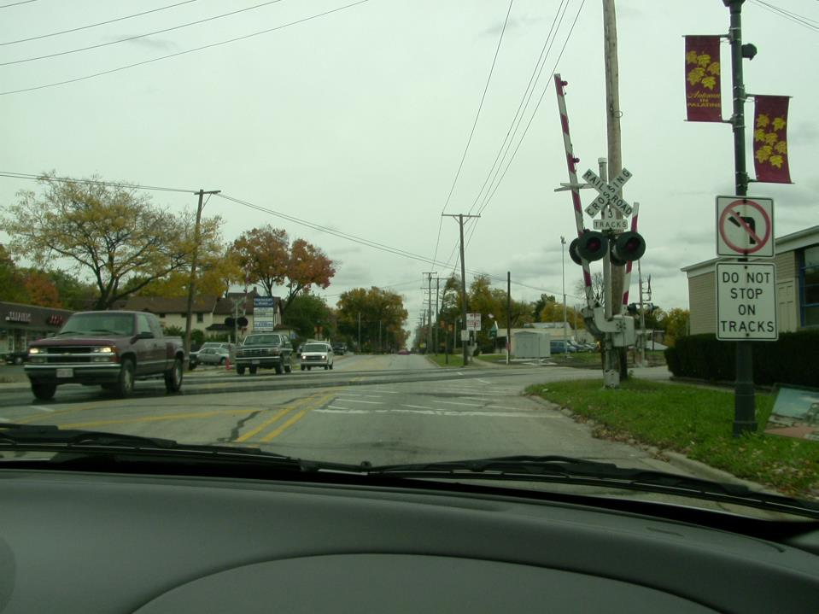

What must you do at all railroad crossings?
Slow down and check both ways.

Slide 5
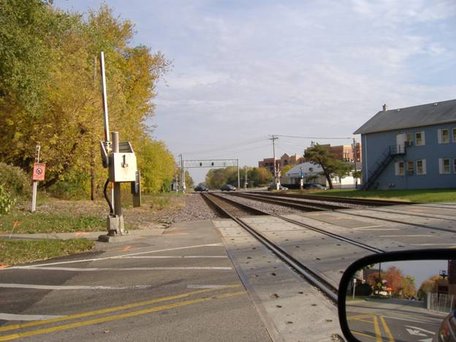
Slow down and check both ways.

Slide 6
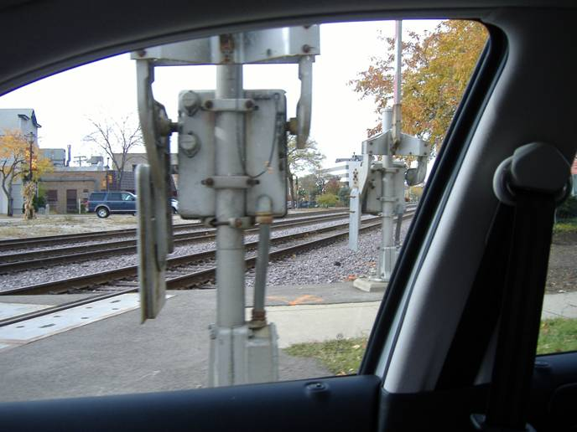
Slow down and check both ways.

Slide 7

What must you do at this railroad crossing?
You must stop when
the lights begin flashing

Slide 8
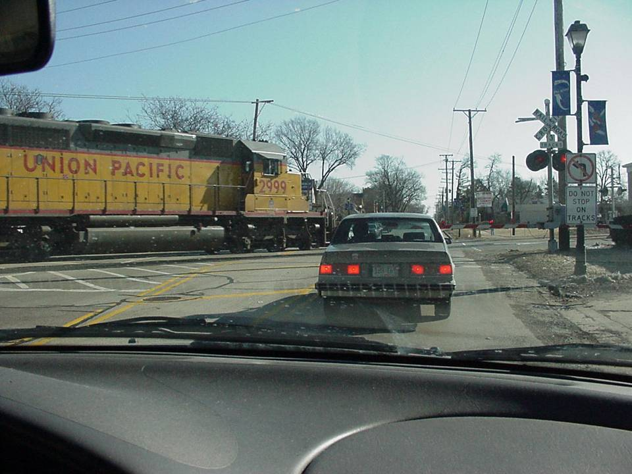
Any idea what type of
train this might be?

Slide 9
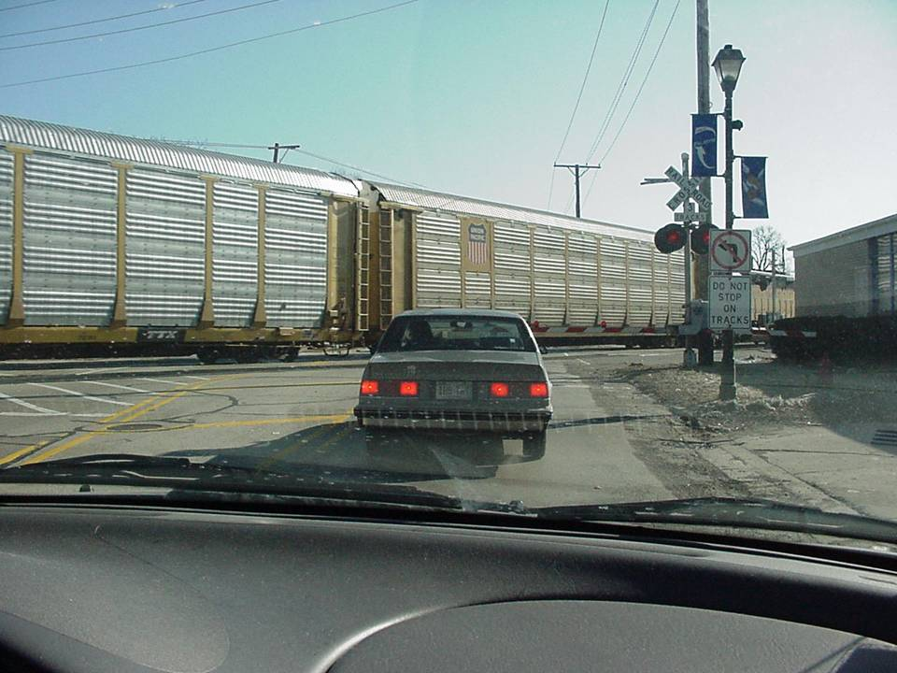
Freight Train…Shift to park and relax your foot…after a car stops behind you.
Your wait here could be several minutes.

Slide 10
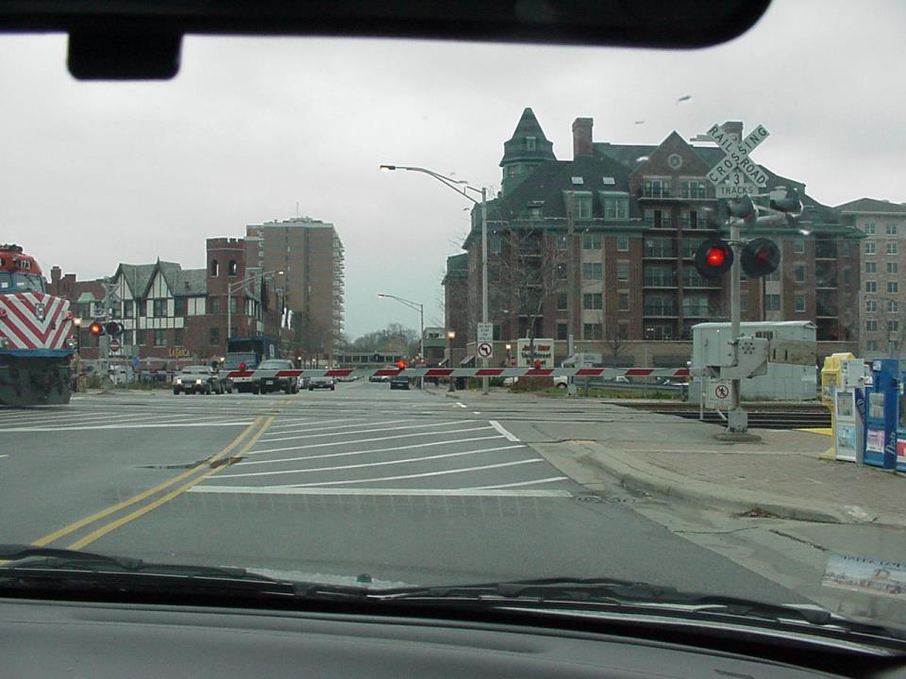
On this multiple track crossing, this stopped train may obscure your visibility of another_______train
moving
STOP
and
THINK
If you took
a chance going
around the
lowered gate,
would you
survive a
collision?
Never do it!
Your life is
worth more
than saving
a couple
of minutes.

Slide 11
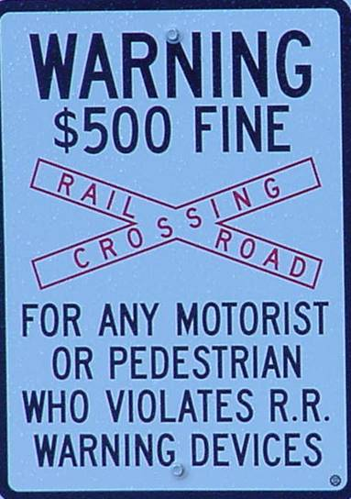
What is the fine for going around a lowered crossing gate either as a pedestrian or a vehicle?

Slide 12
Watch for that second train
Movie will play – RR crossing

Slide 13
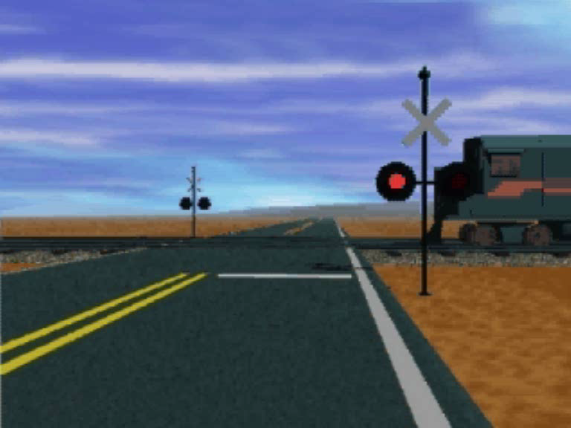
Watch for that second train

Slide 14
Pedestrians, cyclists and other hazards

Slide 15
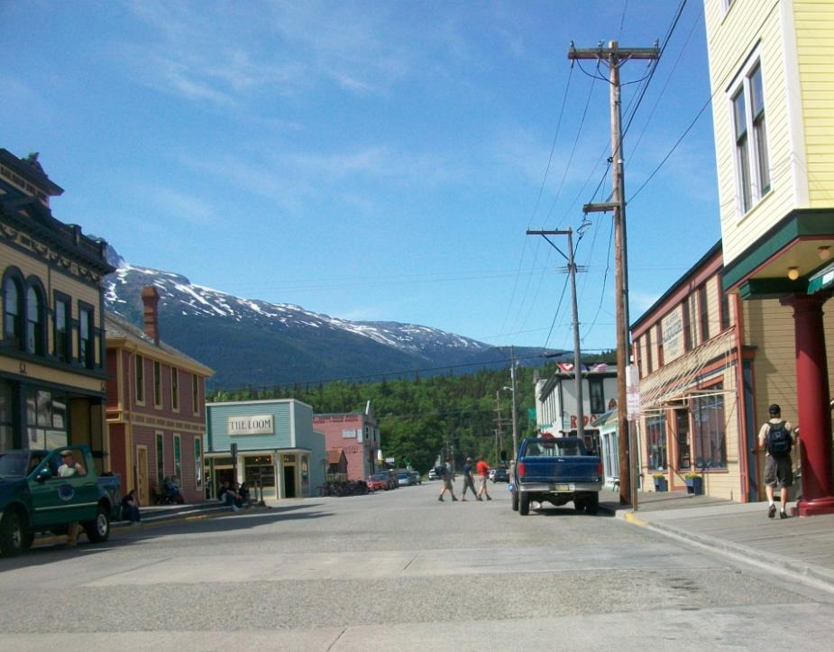
What should you be noticing in this scene?
Get in the habit of looking in, around
and beneath parked vehicles.
SOMEONE STANDING ON OTHER SIDE OF PICK-UP TRUCK!

Slide 16
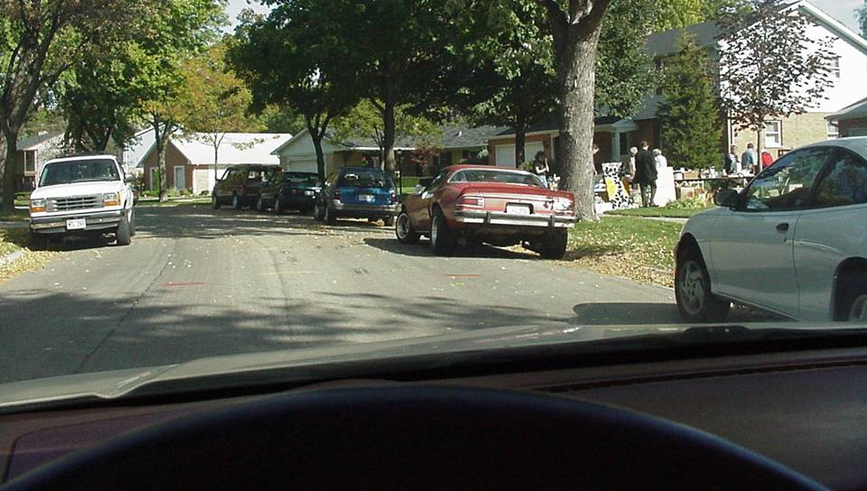

Obviously, you should go very_________.
slow
WHAT ARE SOME HAZARDS AT GARAGE SALE SITES?
car doors opening
distracted shoppers crossing the street
children

Slide 17
What about joggers ?

Slide 18
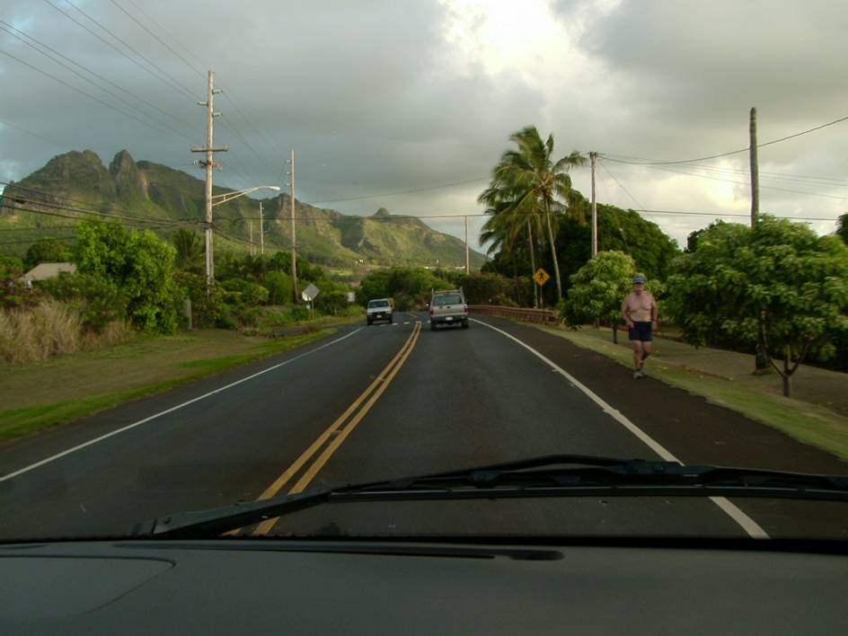
YES, always face traffic.
Is this man jogging on
the proper side of the roadway?

Slide 19
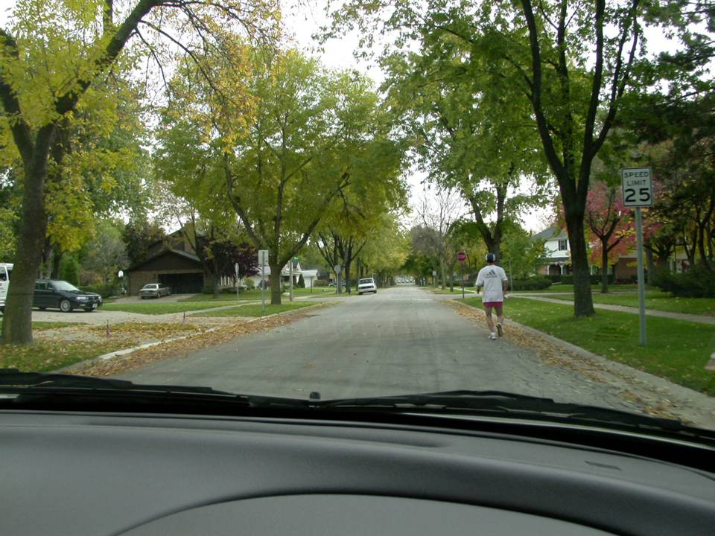
Why is this dangerous?
THIS JOGGER CANNOT SEE
VEHICLES APPROACHING.

Slide 20
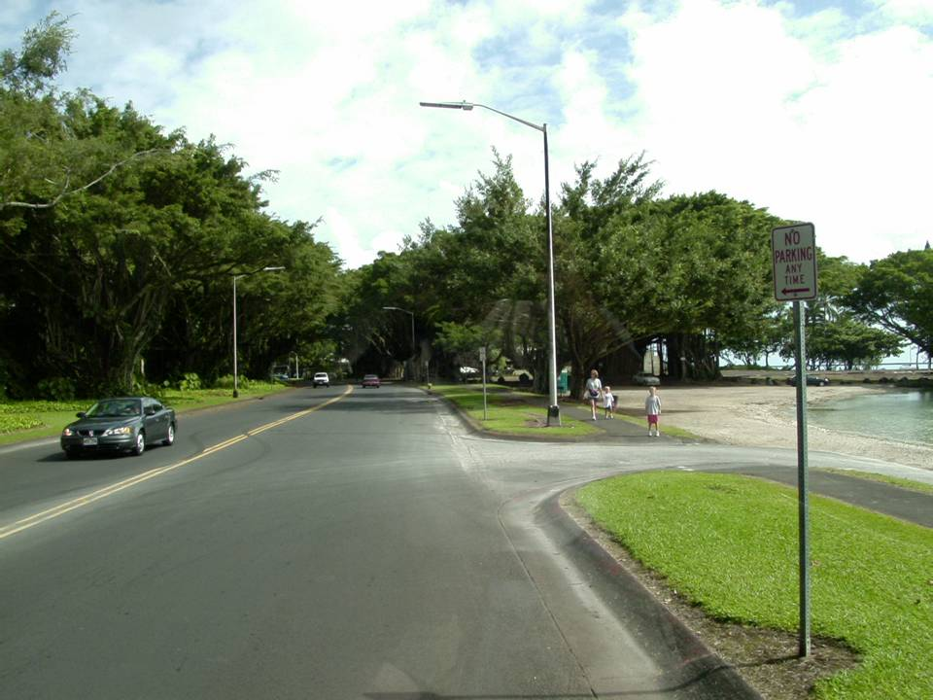
Stop and wait!
You want to turn right, what are you concerned about? What will you do here?

Slide 21
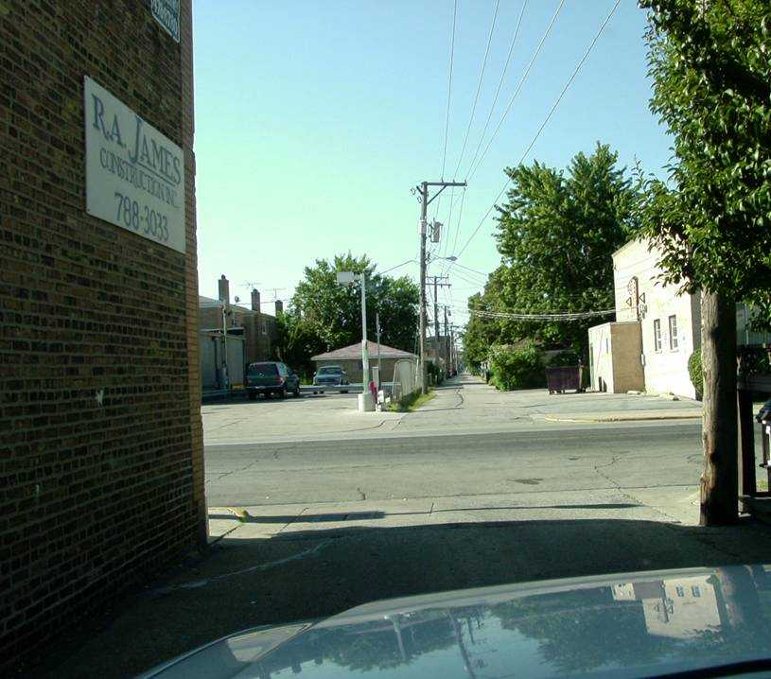
Also, when leaving an alley, building, private road or driveway, you must ________ before the crosswalk. You must then yield to all traffic and pedestrians.
stop

Slide 22
Commentary Driving
A good practice to develop your scanning ability.
an example of it

Slide 23
Commentary Driving
Movie will play

Slide 24
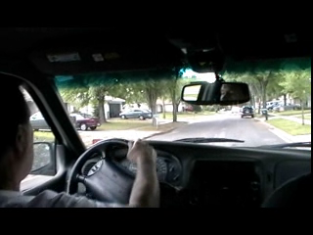
Commentary Driving
Commentary Driving

