Slide 1
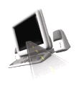

T H E D R I V E R S E D G E
I N T E R A C T I V E
slides and videos
Partial lesson
18 of 47 slides
Unit 5 – Safety Restraints

Slide 2

Seatbelts
Child Restraints
Airbags

Slide 3
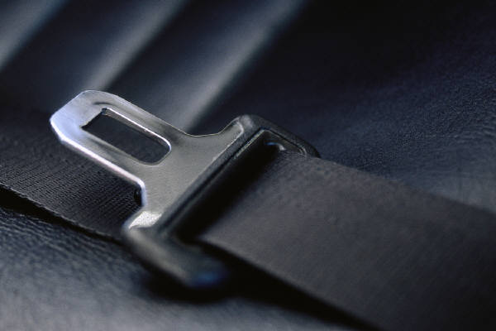
Seatbelts:
a definition . . .
A restraining device, consisting of anchored straps that buckle across the hips, to protect a seated passenger from abrupt jolts, as in a collision.
In the U.S. alone seatbelts save more than 10,000 lives a year and over 200,000 serious injuries.
If you are wearing a shoulder-lap belt during a crash, your risk of being killed is reduced by 50% and risk of serious injury by 70%.

Slide 4
Seatbelts:
a definition . . .
A restraining device, consisting of anchored straps that buckle across the hips, to protect a seated passenger from abrupt jolts, as in a collision.
You are four times more likely to die in a car crash if you are not wearing your seat belt.
Nearly every state has laws requiring the driver and front seat passengers to wear safety belts.
There
are two
types of
restraints
Deaths of unbelted occupants have occurred at speeds as low as 12 miles per hour.

Slide 5
Seatbelts:
a definition . . .
A restraining device, consisting of anchored straps that buckle across the hips, to protect a seated passenger from abrupt jolts, as in a collision.
active restraints and passive restraints
What is the difference
between an active restraint
and a passive restraint?
Active restraints requires the connection and adjustment.
Passive restraints operate without action by occupants.

Slide 6

Seatbelts:
How to properly wear them
After closing and locking the door…
Adjust the seat to a comfortable upright position…be sure the belt is not twisted and the metal fittings snap into place.
The lap belt should be worn across the hip bones. (including expectant mothers)
It should never be positioned across the stomach or soft part of the abdomen.
It could slide
up over the
pelvis and injure
the abdomen
in a crash!
What could happen if
the belt is too loose?
What do you know about
adjusting the shoulder strap?

Slide 7
Seatbelts:
How to properly wear them
The shoulder strap should be snug, but still allows the driver to reach important controls.
Adjust the shoulder strap so that it is comfortable and does not cross the body at or near the neck or face.
The shoulder belt should go over the shoulder and across the sternum.
What about wearing the shoulder
strap tucked behind the back?
This is dangerous
and can cause
severe internal
or spinal injuries.

Slide 8
Seatbelts:
How to properly wear them
The shoulder strap should be snug, but still allows the driver to reach important controls.
Adjust the shoulder strap so that it is comfortable and does not cross the body at or near the neck or face.
The shoulder belt should go over the shoulder and across the sternum.
Also, do not forget to
adjust the head-restraint
For most people it
should be all the way up…
If not adjusted,
what type of injury
can be suffered?
Painful whiplash
…this is a
serious injury!

Slide 9
Seatbelts:
How safety belts work
and protect us in crashes. . .
The newer safety belts feel so comfortable you may not think they work, but they do. Many belt systems are activated only when the vehicle stops suddenly. The belt has a tiny pendulum connected to a locking mechanism. In the event of a sudden stop, the pendulum activates the locking device, which keeps you firmly in your seat.

Slide 10
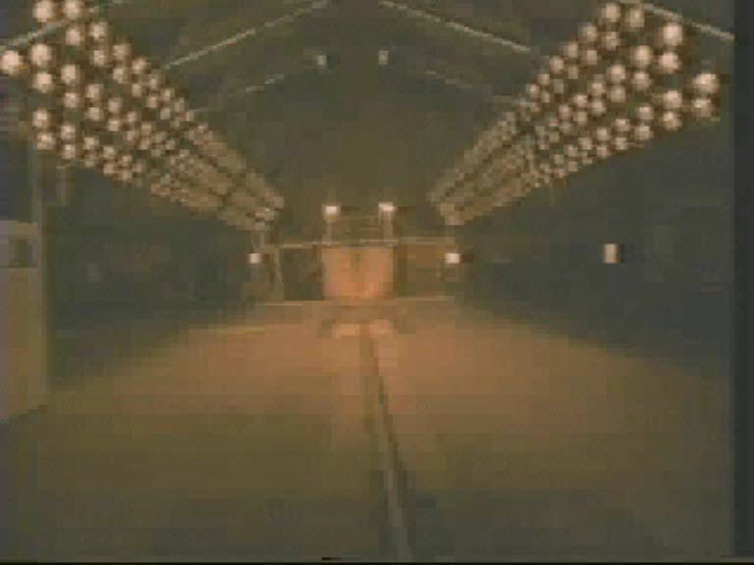
Seatbelts:
How safety belts work
and protect us in crashes. . .
There are 2 crashes:
1) vehicle hitting the wall.
2) unbelted people hitting steering wheel, dashboard or windshield.
Courtesy of: US Dept. of Transportation
The 2nd crash is
the deadly one . . .

Slide 11
Seatbelts:
How safety belts work
Since safety belts are
proven to be
very effective…
why do some people
still not wear them?
Let’s examine
common objections
people give for
not wearing them...

Slide 12
Seatbelts:
Objections people raise
for not wearing them
“We better
buckle up!”
“Yeah, you’re right.”
“We don’t need safety belts, we’re just driving around town.”
How would you answer this?
3 out of 4 collisions occur less than 25 miles from home.
More than 80% of all collisions occur at speeds less than 40 mph.
2/3 of all teens killed in car crashes are unbelted!

Slide 13
Seatbelts:
Objections people raise
for not wearing them
“That makes
sense to me!”
“Me too.”
“If I wear a safety belt, after a crash, I might be trapped in a burning or submerged car!”
How would you answer this?
With a safety belt fastened you have a much better chance
of staying conscious in a crash – so you’ll have the
presence of mind to unfasten it and get out.

Slide 14
Seatbelts:
Objections people raise
for not wearing them
“We’re strong, but not that strong.”
“Wow!”
“I’m a good driver, I’ve never had an accident…and I drive at slower speeds, I can brace myself.”
How would you answer this?
Even at these low speeds, strong
arms are like “wet noodles”
Research shows that the impact of a
30 mph crash is like jumping off a 3 story building.
A 25 mph crash is like pedaling your bicycle
full speed into a brick wall.
The crash may not be your fault…but statistically
most people are involved in traffic
collisions during their lifetime.

Slide 15
Seatbelts:
Objections people raise
for not wearing them
“That doesn’t appeal to me, let’s buckle up!”
“I hear you!”
“It takes too much time, and is uncomfortable.”
How would you answer this?
1001
1002
1003
It only takes a
few seconds, and
most safety belts
are comfortable.
You’ll be a lot more
uncomfortable
spending a lot of time
in the hospital or in rehab.

Slide 16
Seatbelts:
Objections people raise
for not wearing them
“Many also feel that seatbelts will wrinkle their clothing or it’s just a short dive to school.

Slide 17

Seatbelts:
Objections people raise
for not wearing them
“Many also feel that seatbelts will wrinkle their clothing or it’s just a short dive to school.
No Excuses

Slide 18
Seatbelts:
Objections people raise
for not wearing them
“That makes sense to me!”
“Get them on!”
“If I get hit from the side, I am better off being thrown across the car, away from the direct impact of the crash.”
How would you answer this?
You also need to stay in the driver’s seat after the
initial impact so it might be possible to steer or brake.
Research shows the impact of you flying across the
car (the interior collision) will probably be a lot
worse than if you remained securely in your seat.

Slide 19

Seatbelts:
In a crash, any unbelted passenger is a danger not only to himself but to the other people in the vehicle, as he can crash into them causing injury.
Be sure all passengers in your car all buckled!
Be sure all passengers in your car are buckled!

Slide 20
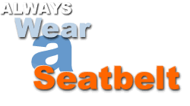
Seatbelts:
Be sure all passengers in your car are buckled!
Safety belts are also your best defense against drunk drivers.

