Slide 1
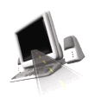

T H E D R I V E R S E D G E
I N T E R A C T I V E
slides and videos
Unit 1 – Signals and Roadway Markings

Slide 2


Signs, Signals and Road Markings

Slide 3
Signs, Signals and Road Markings
Purpose: To become acquainted with the purpose and meaning of traffic signals and road markings.
Part two - Traffic Signals
and Road Markings

Slide 4
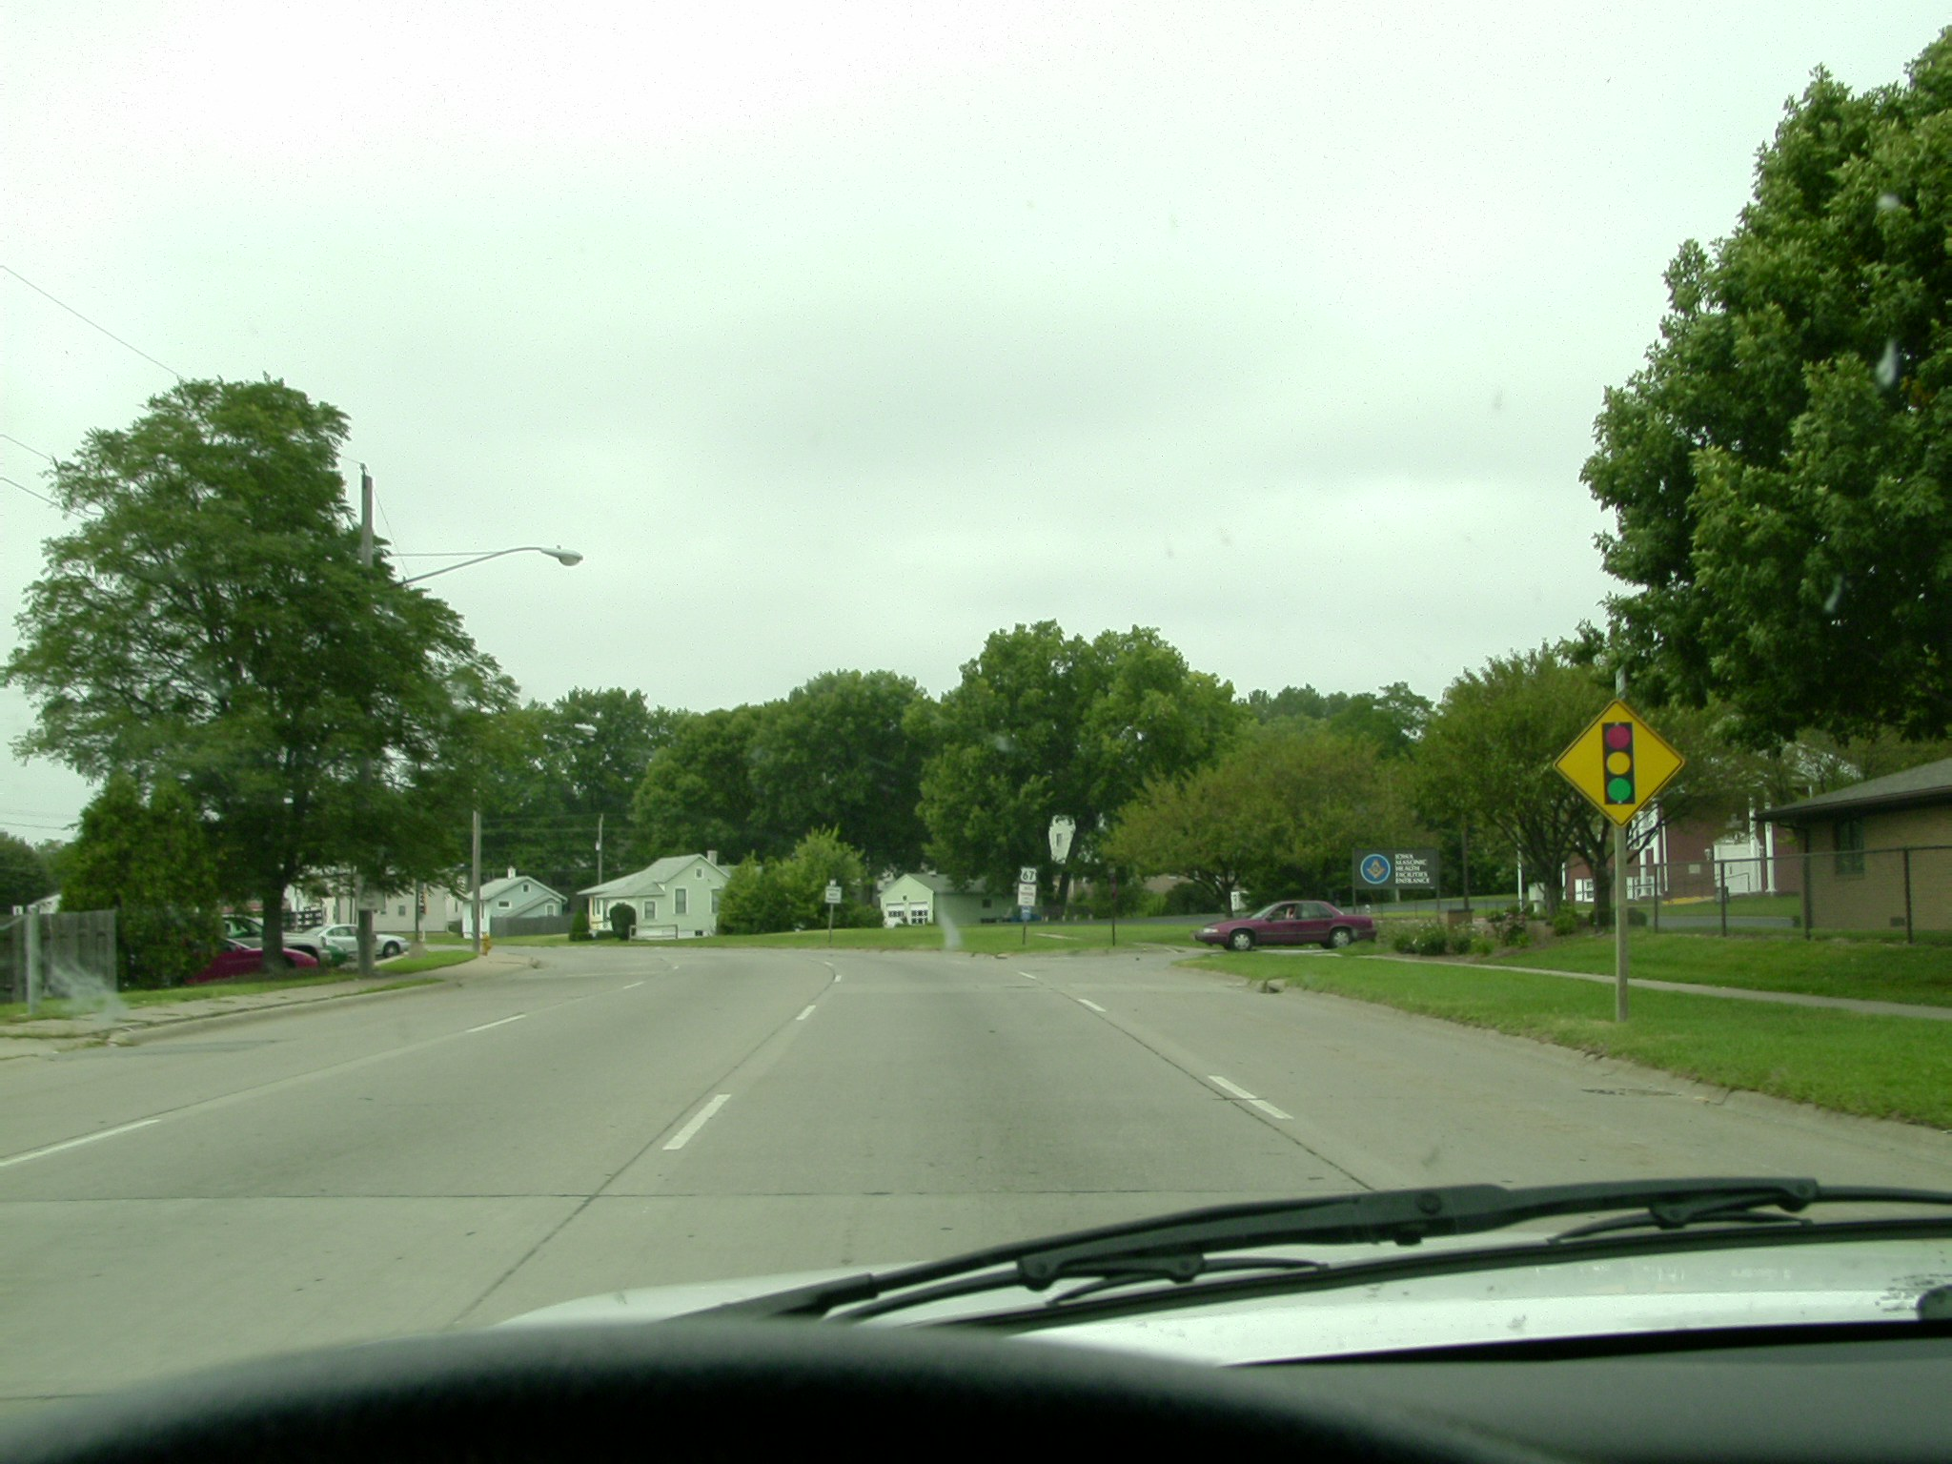
What are you expecting up ahead?

Slide 5
Signs, Signals and Road Markings
Traffic lights: position of lights and sequence
Traffic lights: position of lights and sequence
Traffic lights: position of lights and sequence
The most common type of traffic light has three lenses. Red is on the top, yellow in the middle, and green on the bottom. The lighting sequence is: green to yellow, yellow to red and red to green. The duration of each will depend upon the intersection.
However . . .

Slide 6
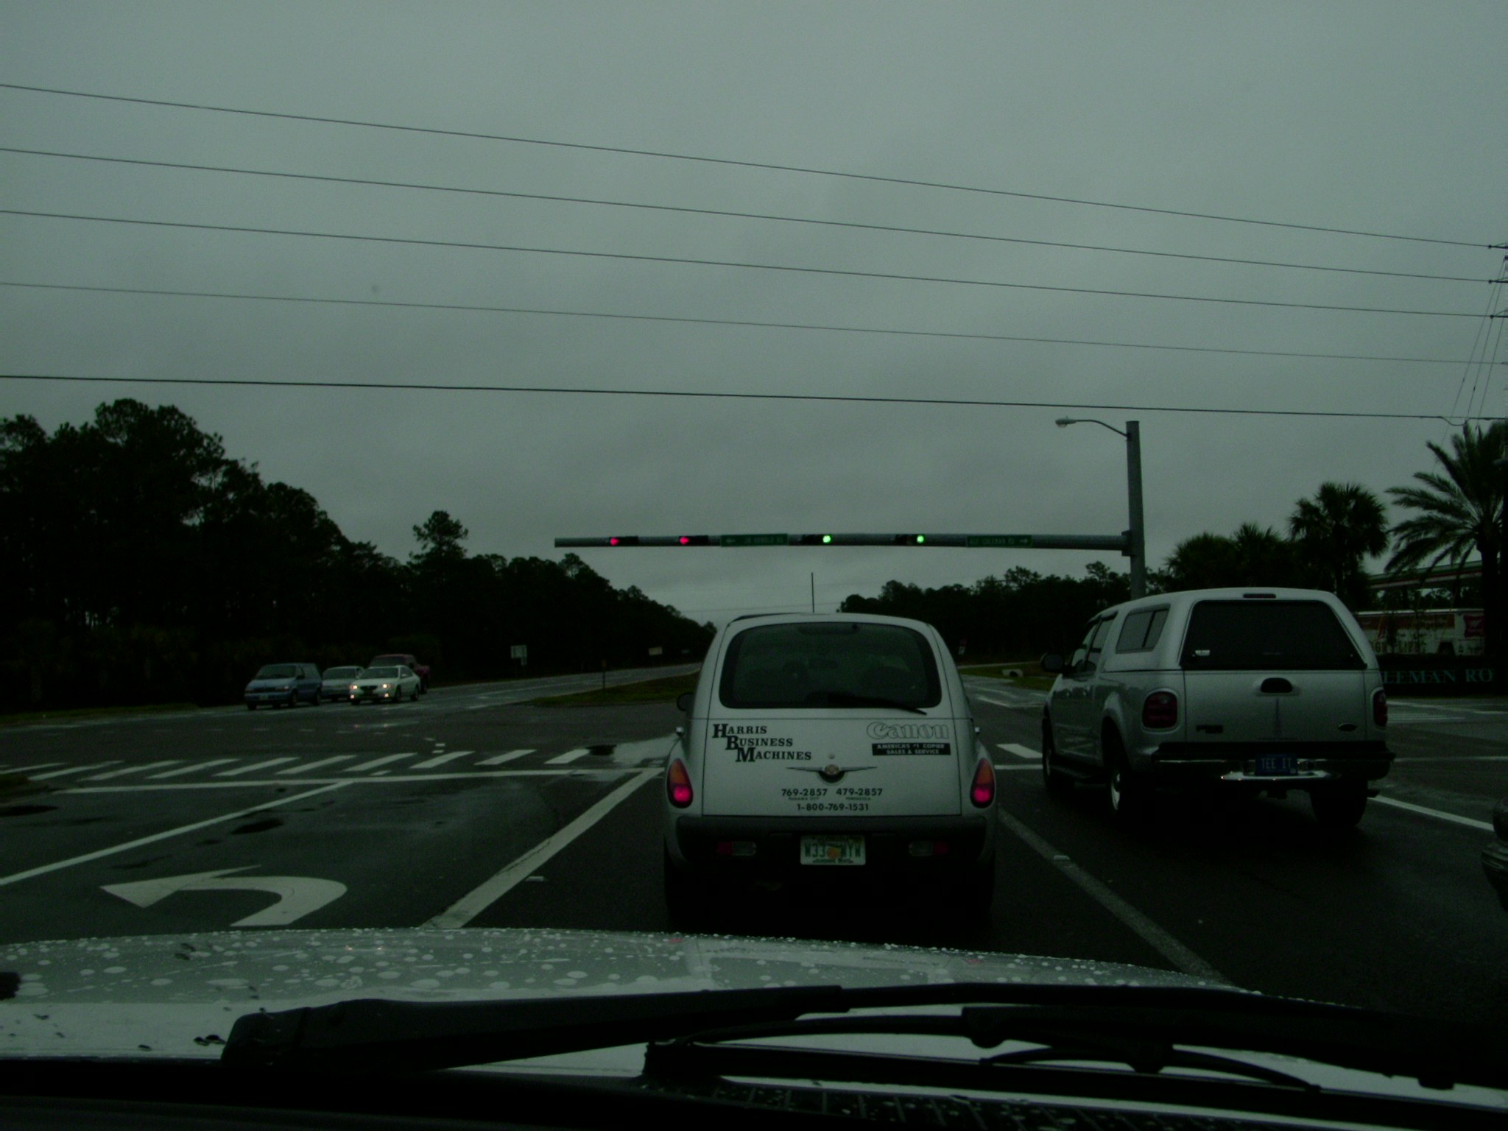
Signs, Signals and Road Markings
Sometimes you may see a horizontal arrangement of the signals

Slide 7
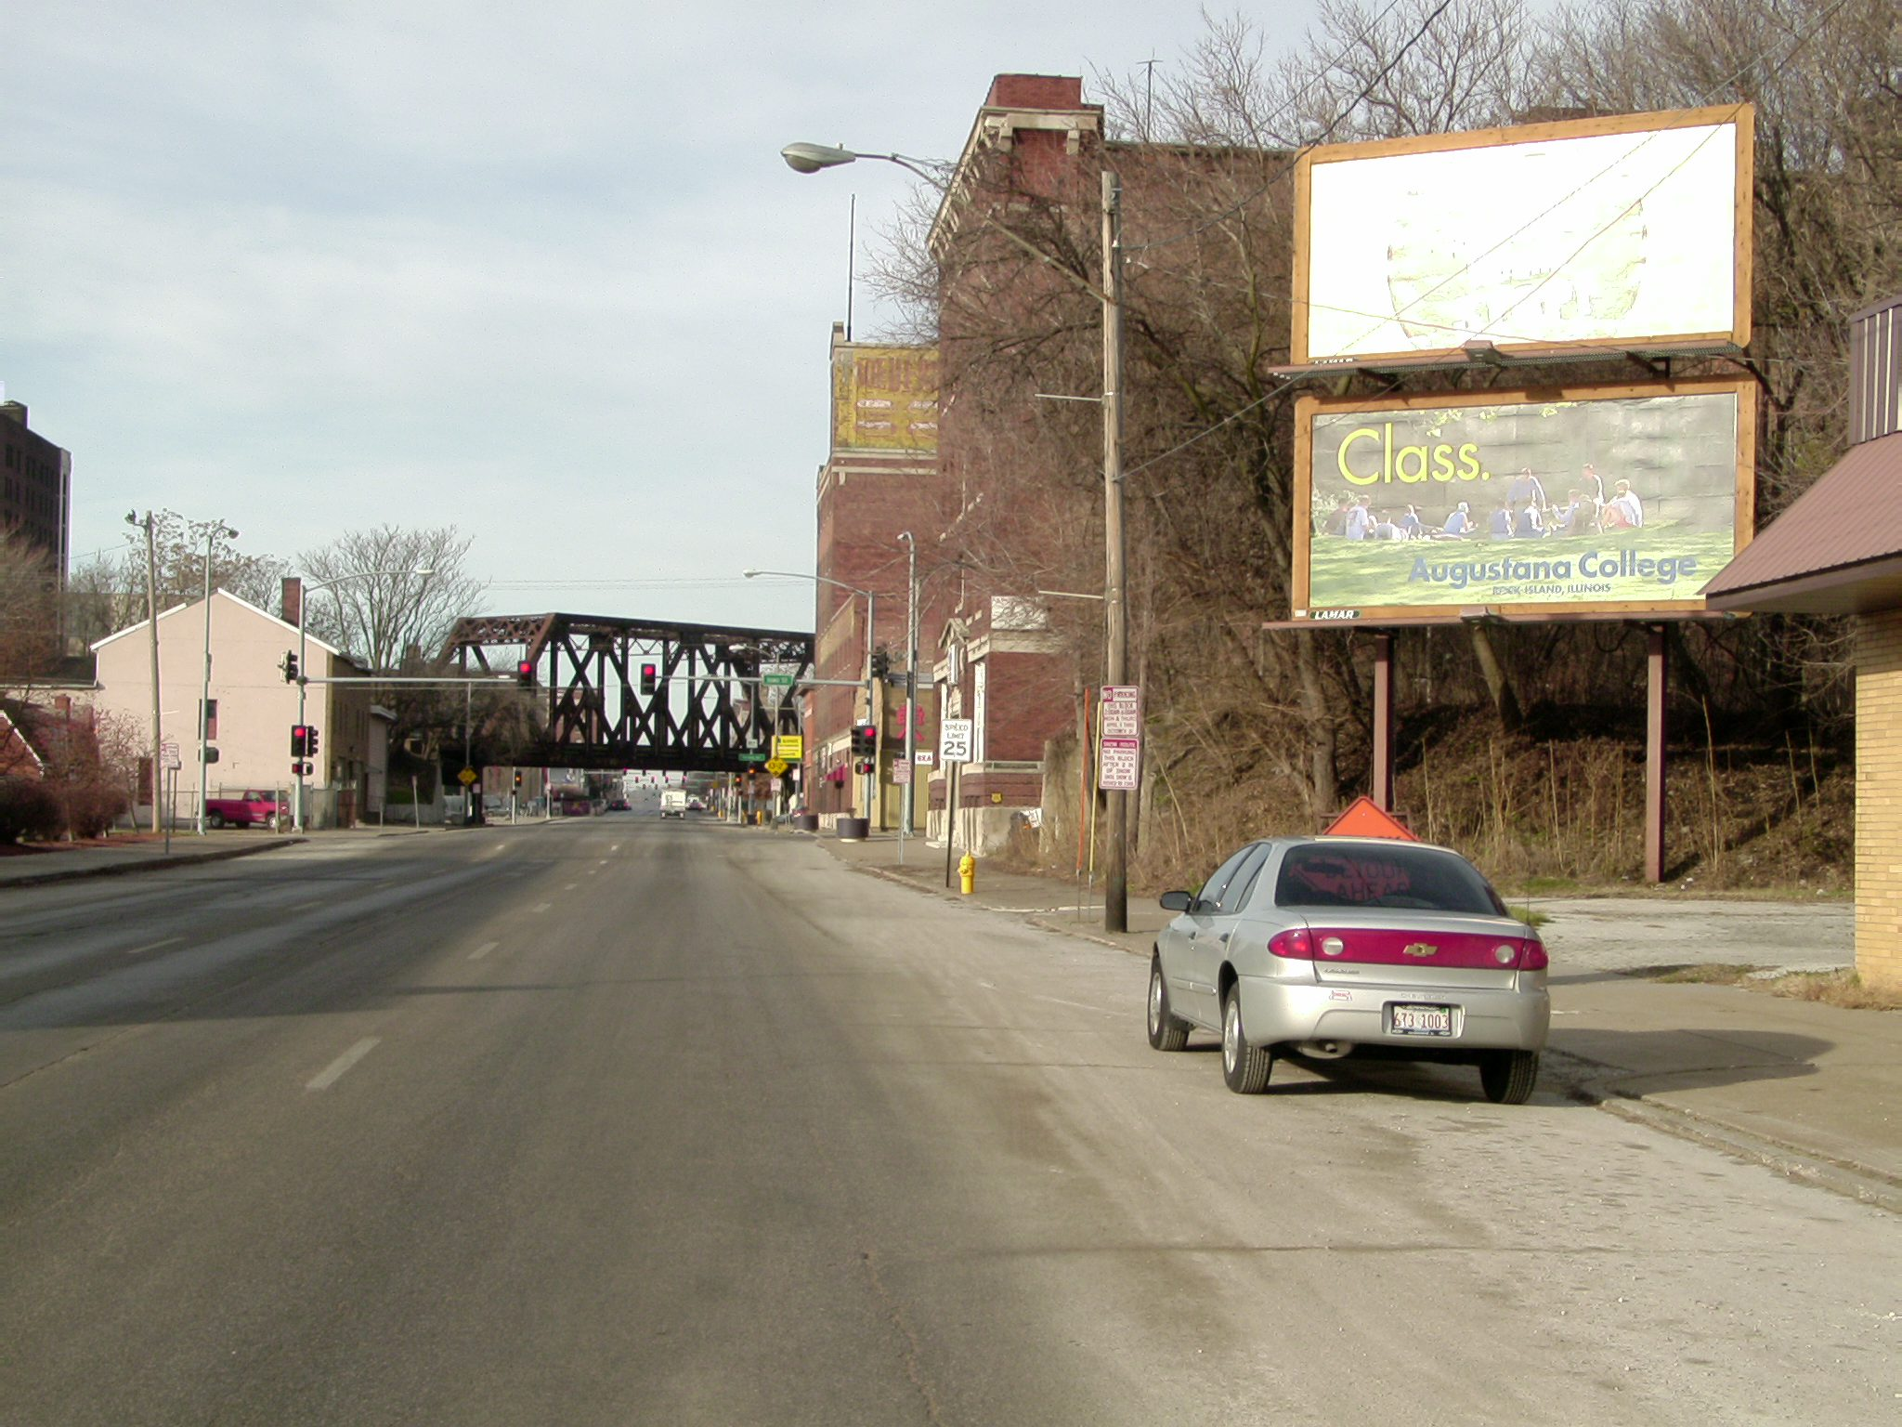
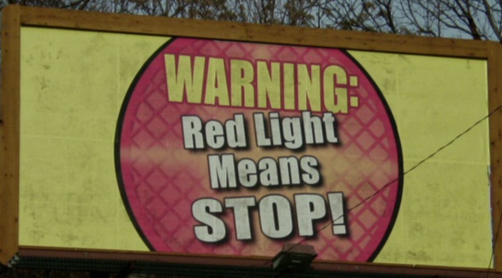
There is a traffic signal ahead, what must you do in this situation?

Slide 8

Signs, Signals and Road Markings
Traffic lights: solid red
A solid red light means to stop completely behind the limit line, crosswalk, or before entering the intersection. You must wait for the green light to proceed. If there is no prohibiting sign a right turn on red is allowed. If it is allowed, you must yield to all traffic and pedestrians.
NO
TURN
ON RED
If it is not allowed you must wait for the light to turn green.

Slide 9
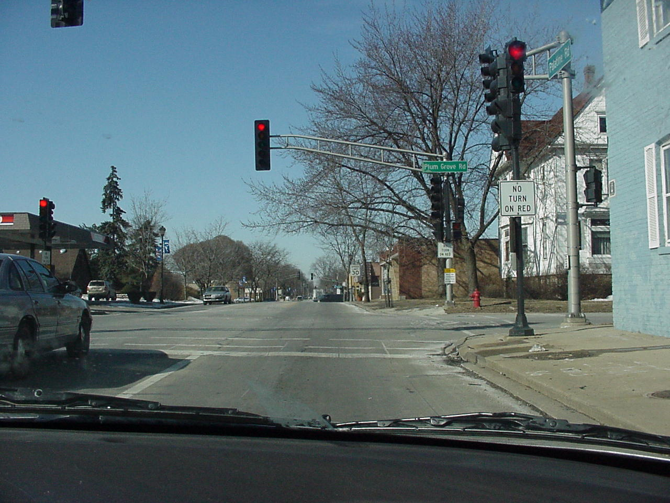
STOP
and
THINK
Why do
some
intersections
have this
sign?
Usually poor
visibility at the
intersection or
heavy traffic.
You want to turn right, what have
you noticed here?
No right turn on red allowed.

Slide 10
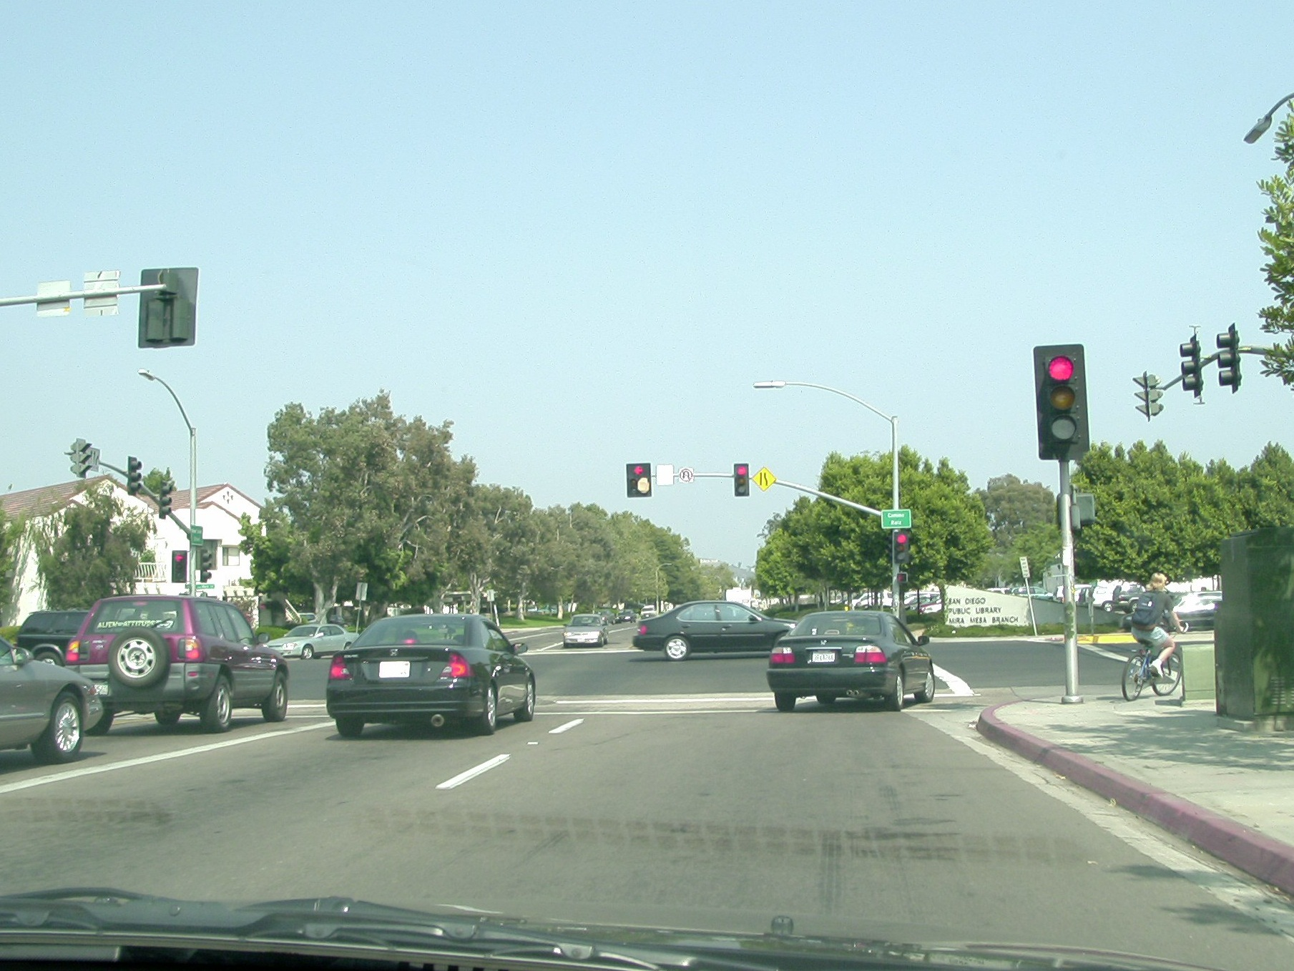
Right turn on red is allowed
(no prohibiting sign)
What have you noticed about
this right turn situation?

Slide 11
Signs, Signals and Road Markings
Traffic lights: solid red
Also, if there are no signs prohibiting it, you may turn left on a red light if you are both turning from and turning into a one way street, after yielding the right of way to pedestrians within the adjacent crosswalk and traffic using the intersection.

Slide 12
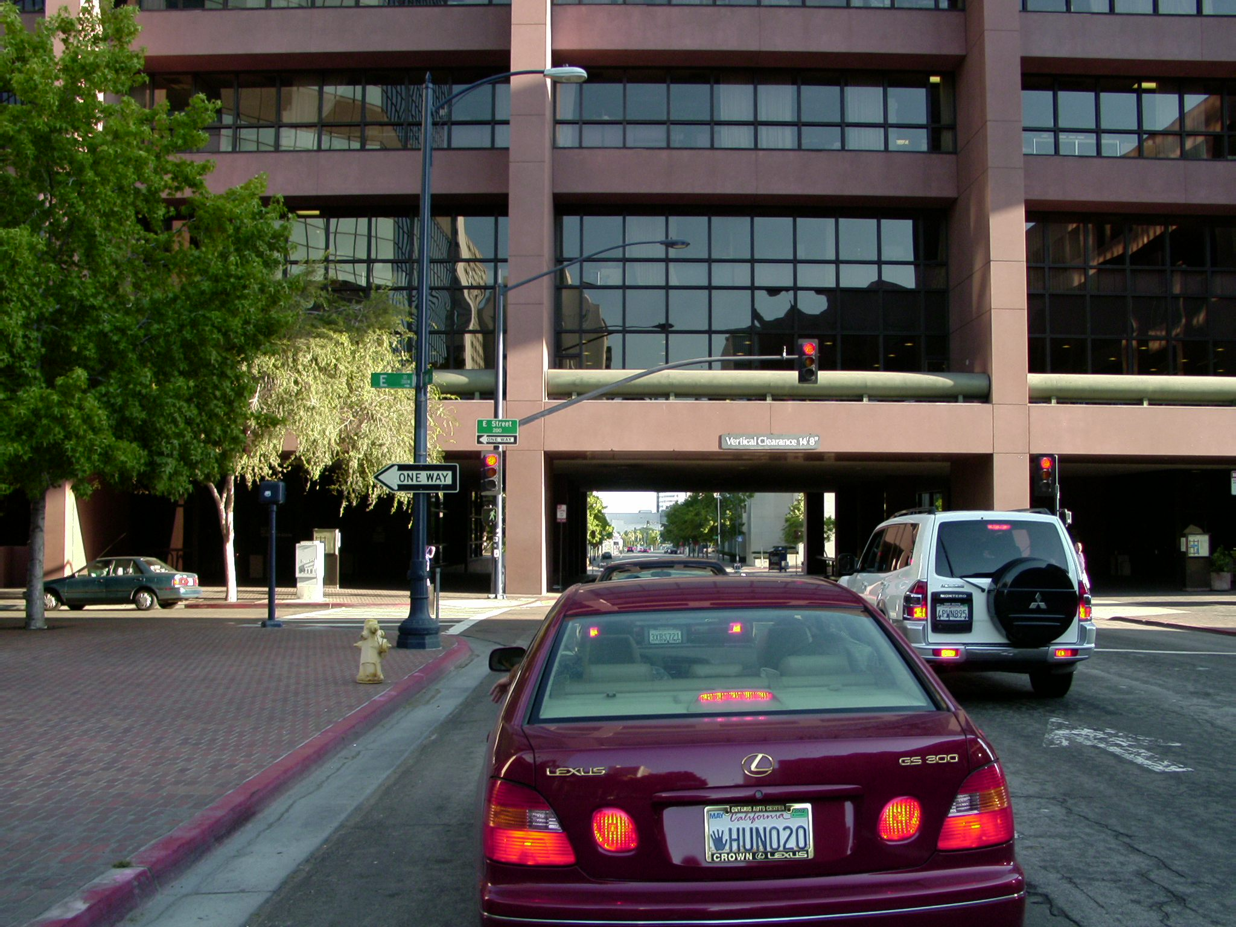
Is a left turn on the red
light allowed here?
Yes, from a one way street to another one way street.

Slide 13
Signs, Signals and Road Markings
Traffic lights: solid yellow
A solid yellow traffic light means that the light will soon change to red. When you see a yellow light, you should slow down and stop before entering the intersection, if you can do so safely.
If you must enter an intersection on a yellow light, it is important to watch out for cross traffic and vehicles starting right or left turns that might enter the intersection when the light changes.

Slide 14
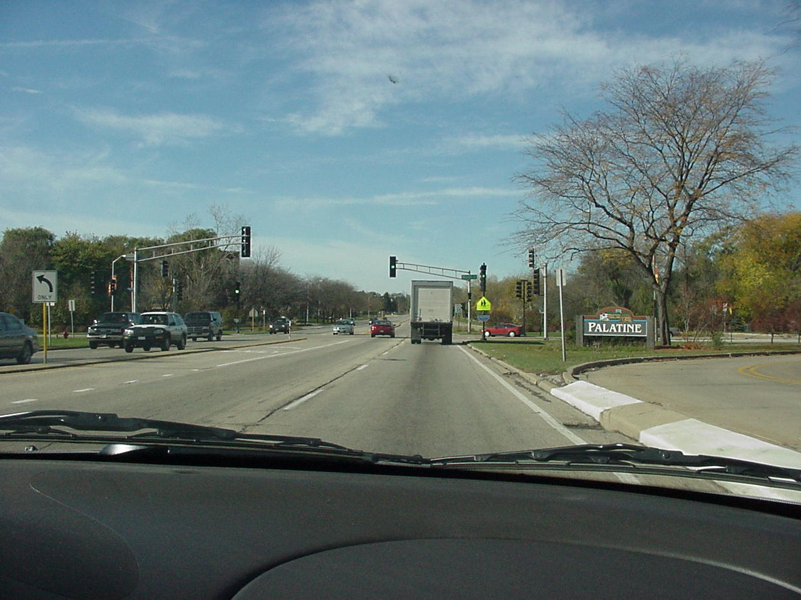
You are traveling at 45 mph, what should you start doing about now?
Once you have entered
the intersection do not
stop suddenly.
Coasting at the stale green light. (anticipating the yellow)
It’s good to mentally talk to yourself : “I can stop…I can stop… I can still stop…point of no return…I’m going.”

Slide 15
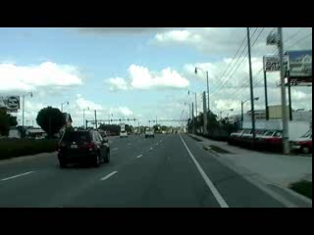
Let’s notice . . .
You are traveling at 45 mph, what should you start doing about now?
Coasting at the stale green light. (anticipating the yellow)
Its good to mentally talk to yourself : “I can stop…I can stop… I can still stop…point of no return…I’m going.”

Slide 16
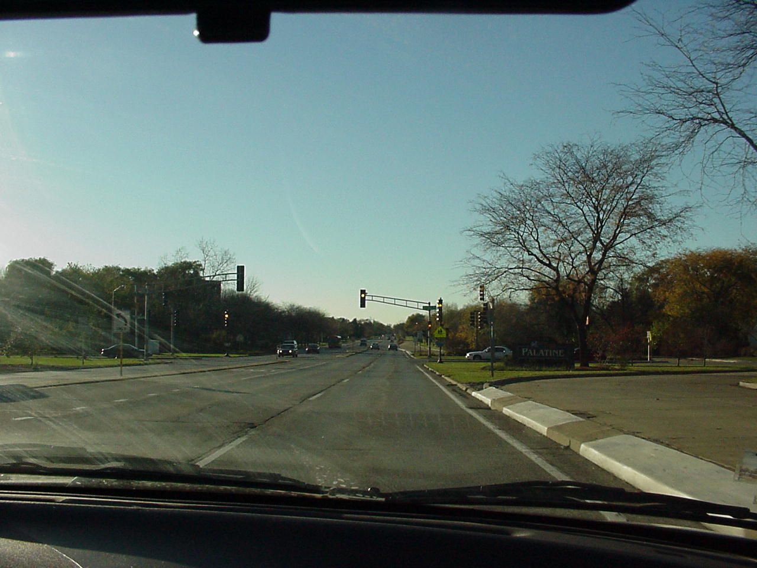
By talking to yourself this way, you’ll be ready to make the right decision if the light turns yellow.
STOP
and
THINK
What could
happen if you
forget that the
light could
unexpectedly
change?
You might
make the
wrong
decision.
This far back, we are definitely stopping

Slide 17
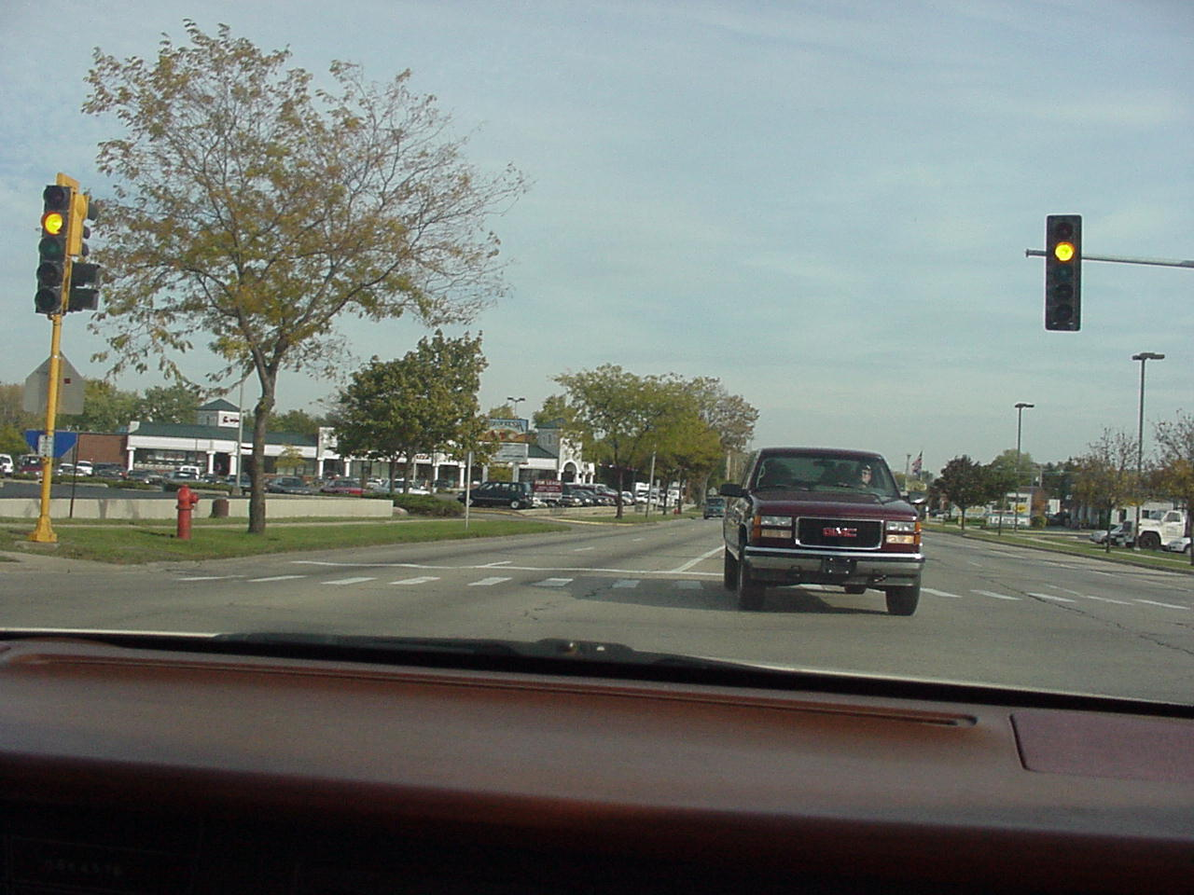
Here, you have entered the intersection, waiting to turn left, will you go now?
Yes, the light is yellow and you are at the point of no return.

Slide 18
Signs, Signals and Road Markings
Traffic lights: solid green
A solid green traffic light means that you may proceed straight through or make a turn after the intersection is cleared of vehicles, bicycles, and pedestrians.
You may make a right, left turn, or U turn on a green light, unless it is prohibited by a sign. However, you must yield the right of way to on-coming vehicles and bicycles, and pedestrians.

Slide 19
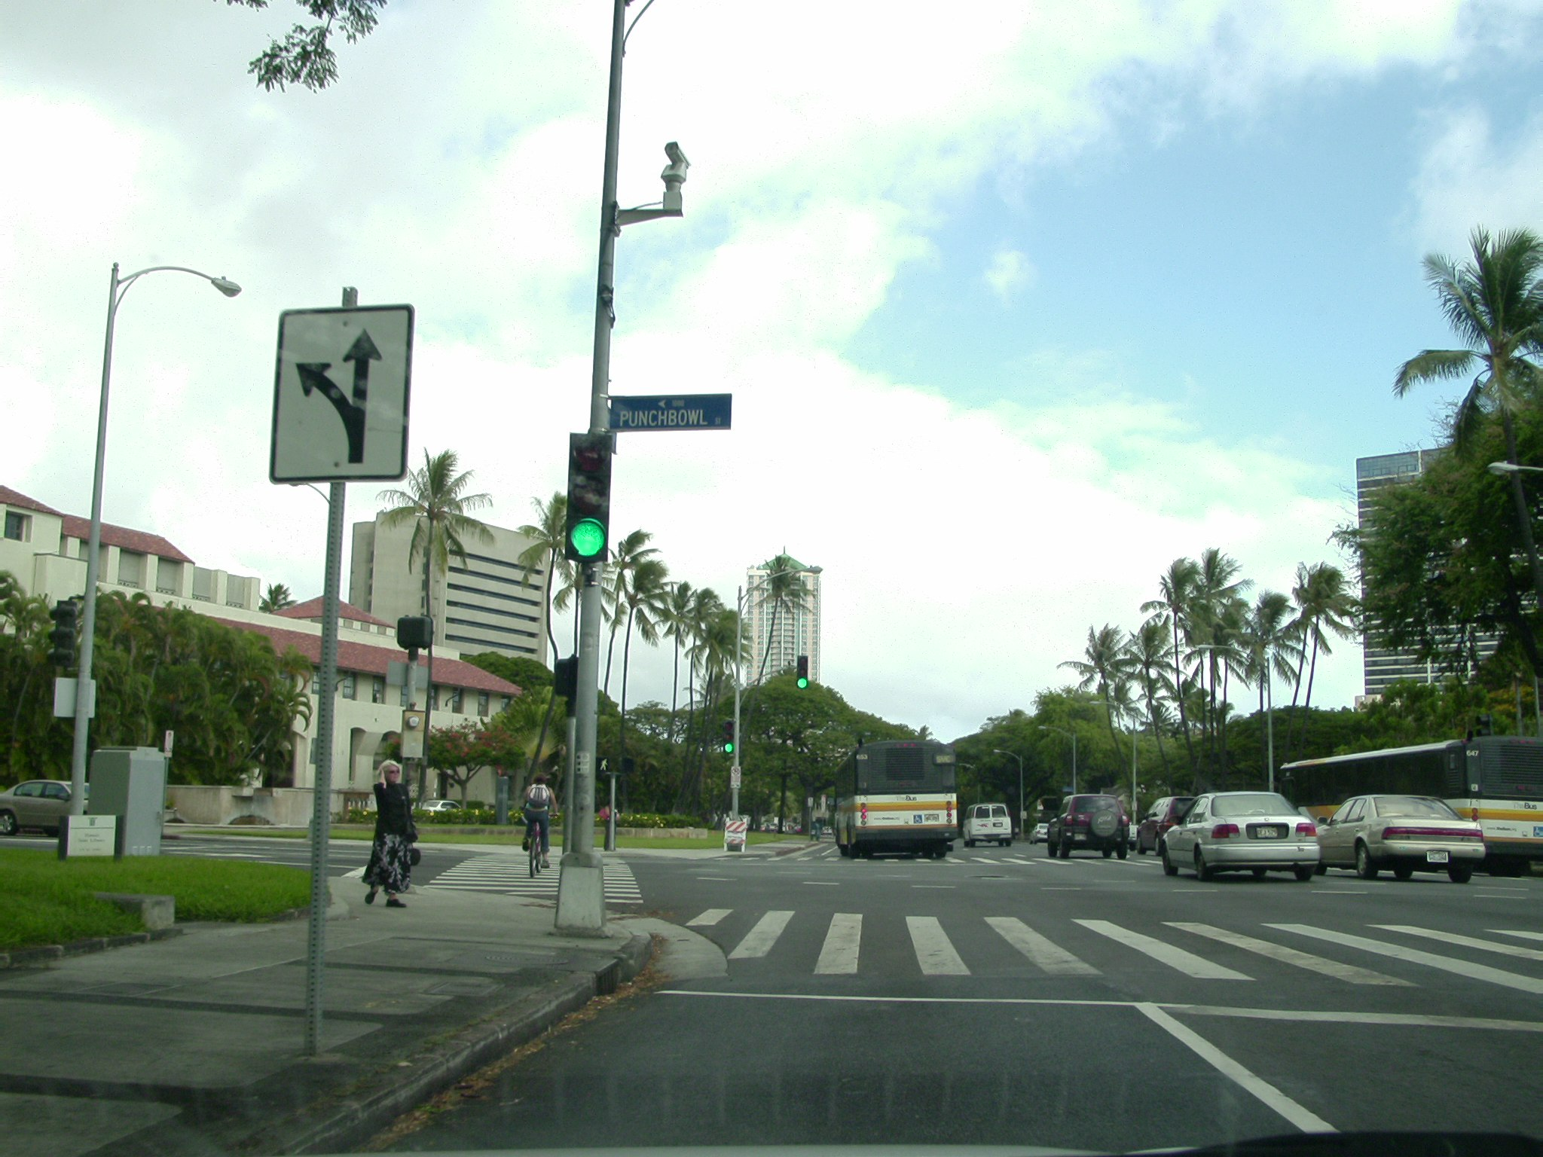
You want to turn left at this intersection. Should you now proceed?
No, someone is crossing the street.

Slide 20
Signs, Signals and Road Markings
Traffic lights: solid green, gridlock
Do not enter an intersection, even when the light is green, unless there is enough space to completely cross the intersection before the light turns red. If heavy traffic causes you to block cross-traffic, you can be cited for causing gridlock.
Gridlock means traffic at an intersection is so heavy that vehicles are unable to pass through or complete turns. They become stranded in the middle of the intersection.

Slide 21
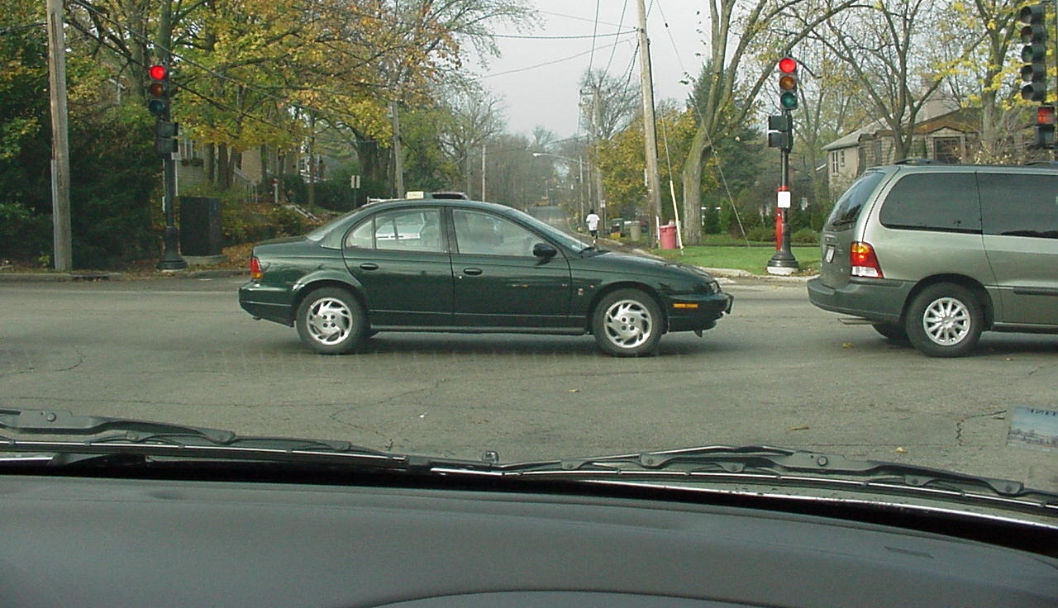
If the light turns green for us, this vehicle would be blocking traffic, causing gridlock.
T
These cars are completely stopped; waiting for traffic to start moving again. What mistake has this last driver made?

Slide 22
Signs, Signals and Road Markings
Traffic lights: red arrow
A red arrow means to stop behind the limit line, crosswalk, or intersection until the green arrow or green light appears. Horizontal red arrows are used to control traffic in left or right turn lanes. Vertical arrows are used to control a specific lane of straight through traffic.
A turn (including right or left) or other movement cannot be made in the direction of the red arrow, even after stopping first.

Slide 23
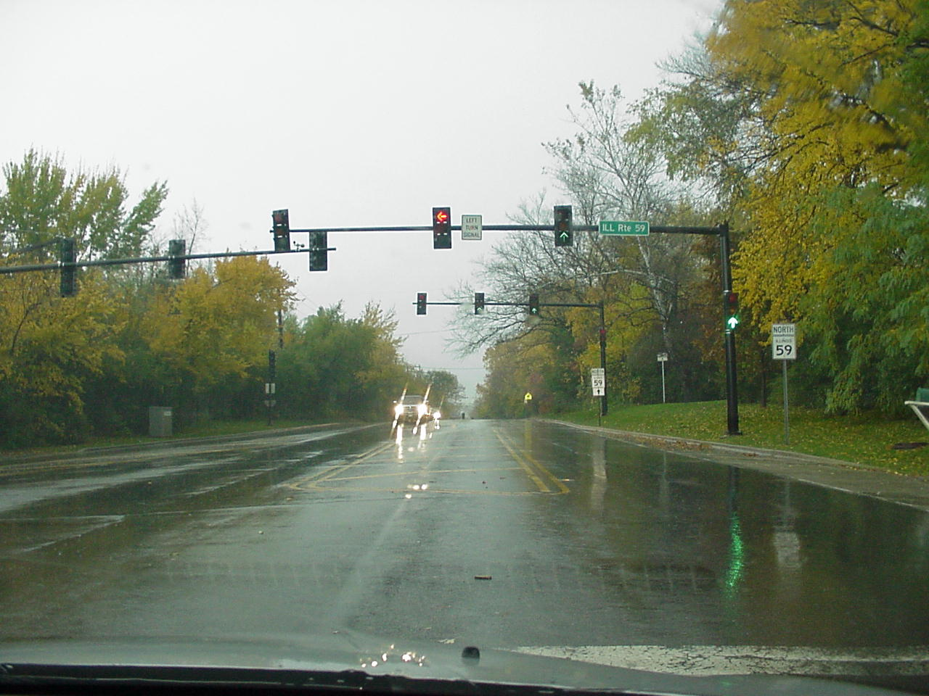
You are in the left turn lane. Can you move out into the intersection & complete your left turn after traffic clears?
No! You must wait for the green arrow.

Slide 24
Signs, Signals and Road Markings
Traffic lights: yellow arrow
A yellow arrow means you should be prepared to obey the next signal light that appears, which could be a solid green or red light, or a red arrow. If the yellow light is horizontal, it means that your protected turning period is about to end. These arrows are used to control traffic in left or right turn lanes. Vertical arrows control straight through traffic in specific lanes.
If you can not stop safely before entering the intersection on a yellow arrow, watch for cross traffic and drivers starting right or left turns.

Slide 25
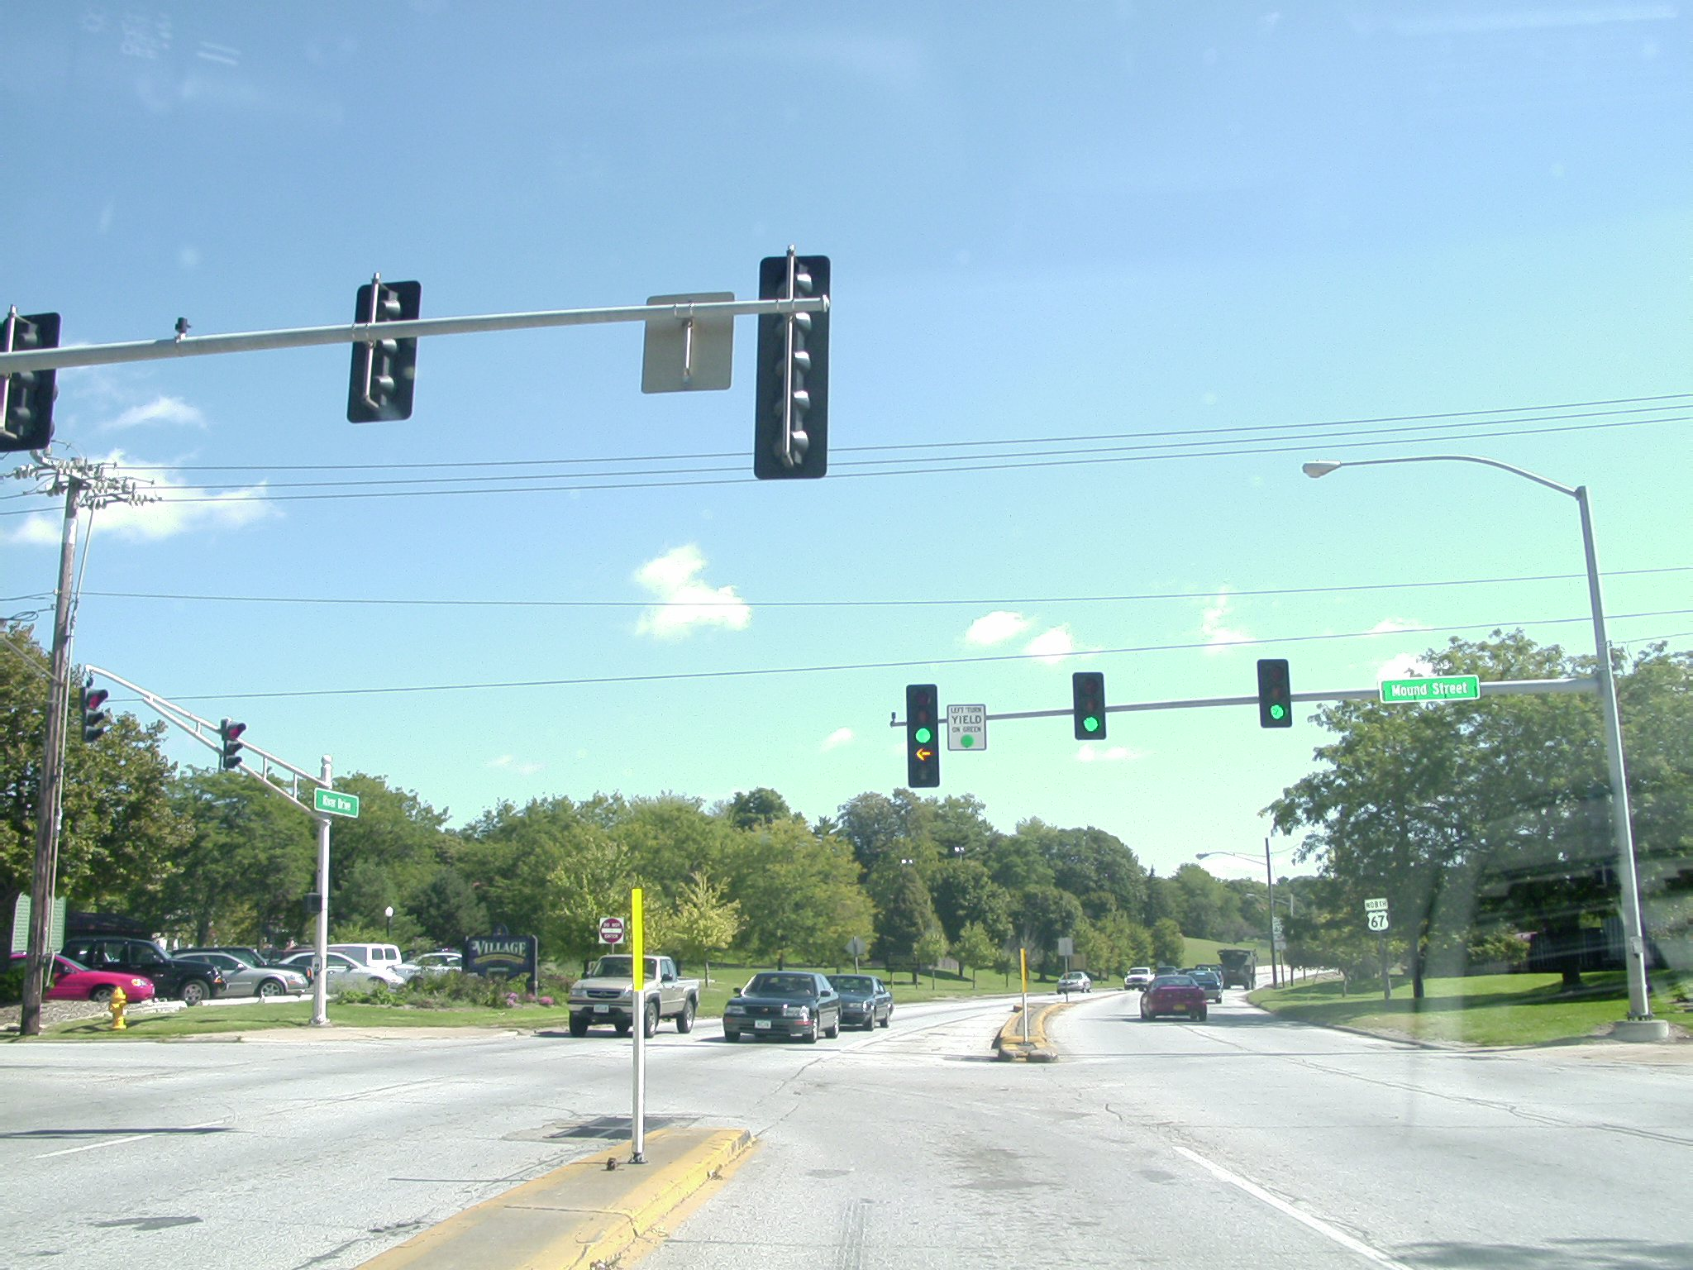

This yellow arrow is about to turn off, should you go ahead and finish your left turn?
No, you’ll need to wait for on-coming vehicles.
Let's notice . . .

Slide 26
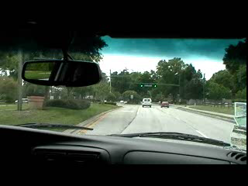
Left Turn – no protected arrow
you’ll need to wait for on-coming vehicles.

Slide 27
Signs, Signals and Road Markings
Traffic lights: green arrow
A green arrow means that you may proceed in the direction that the arrow points after you yield the right of way to any vehicle, bicycle, or pedestrian still in the intersection. Horizontal green arrows are used to control traffic in a left or right turn lane. Vertical green arrows control straight through traffic in a specified lane.
A horizontal green arrow pointing to the left or right means that you may make a protected turn, meaning that all other traffic is stopped with red lights

Slide 28
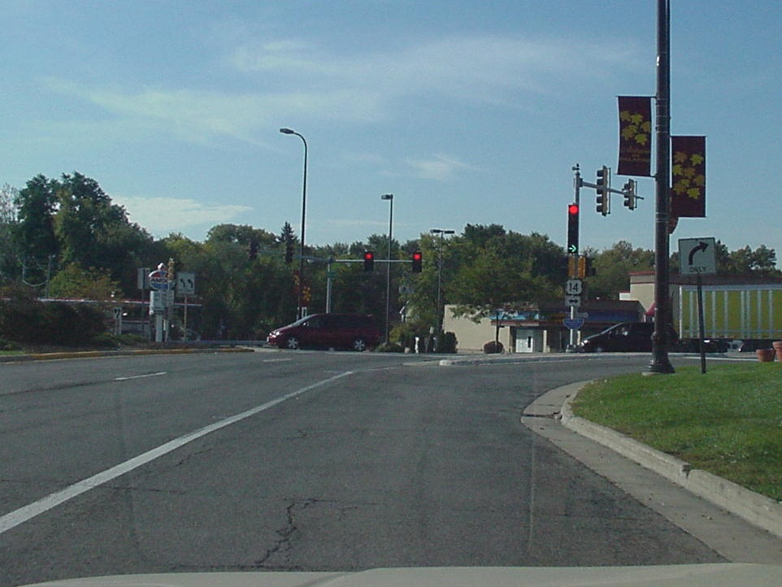
Will you have to stop first at this red light before turning?
(right arrow is on)
No . . . it's a protected turn

Slide 29
Signs, Signals and Road Markings
Traffic lights: flashing red
A flashing red signal light has the same meaning as a stop sign. You must stop completely behind the limit line, crosswalk, or intersection and yield the right of way to vehicles and pedestrians in the intersection before you proceed.
Traffic lights which are malfunctioning will sometimes flash red.

Slide 30
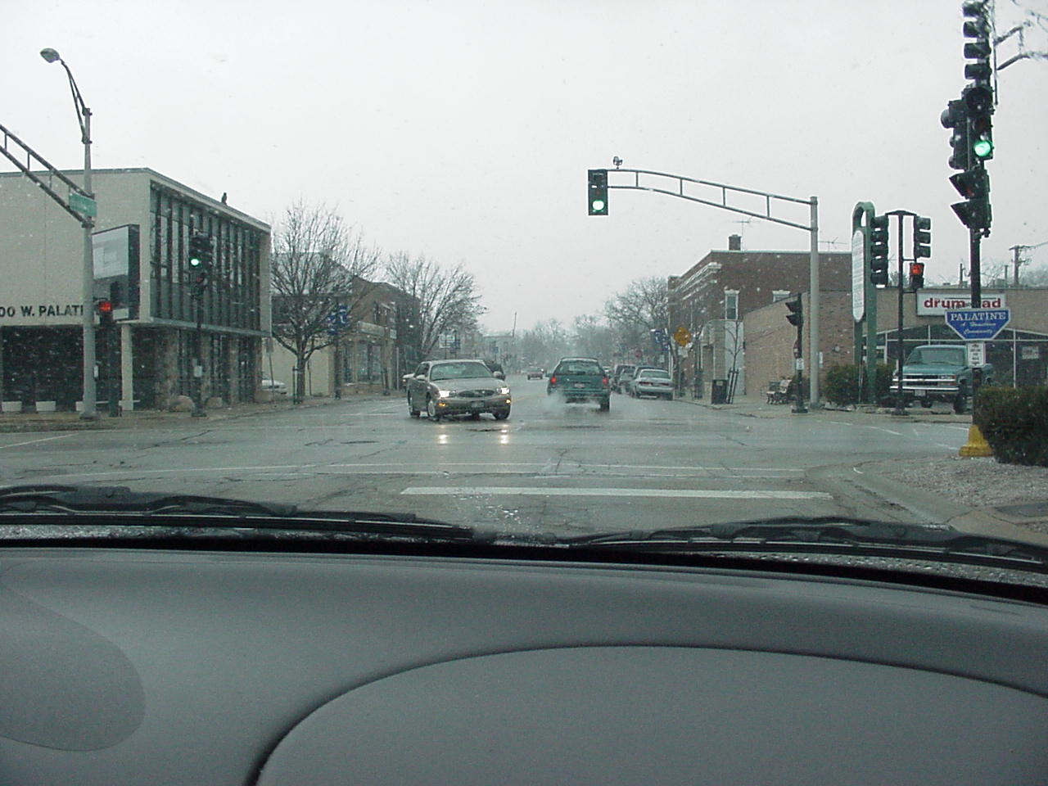



Treat it as a stop sign.
What must we do in this situation?

Slide 31
Signs, Signals and Road Markings
Traffic lights: flashing yellow
A flashing yellow signal light is a warning to slow down and be especially alert. You do not have to necessarily stop, but you should check traffic both ways at the intersection before proceeding through.

Slide 32
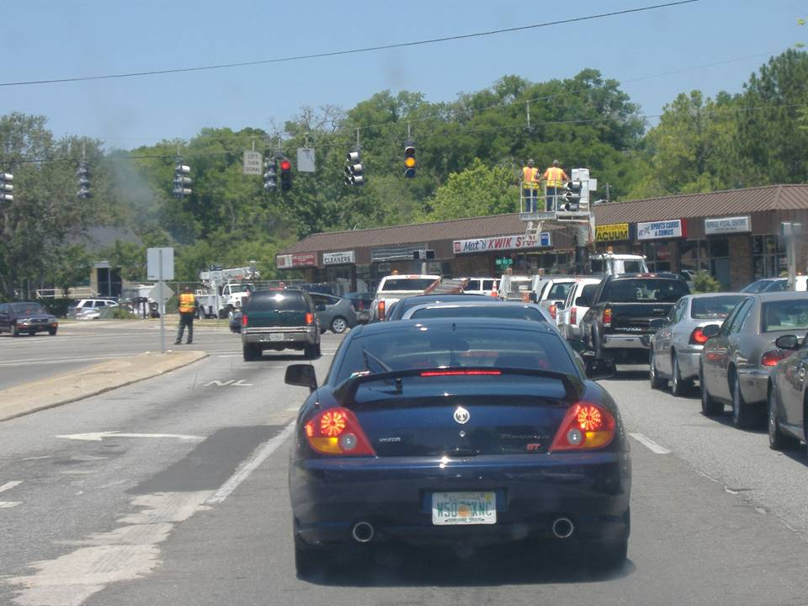
What should you do when there are signal malfunctions?

Slide 33
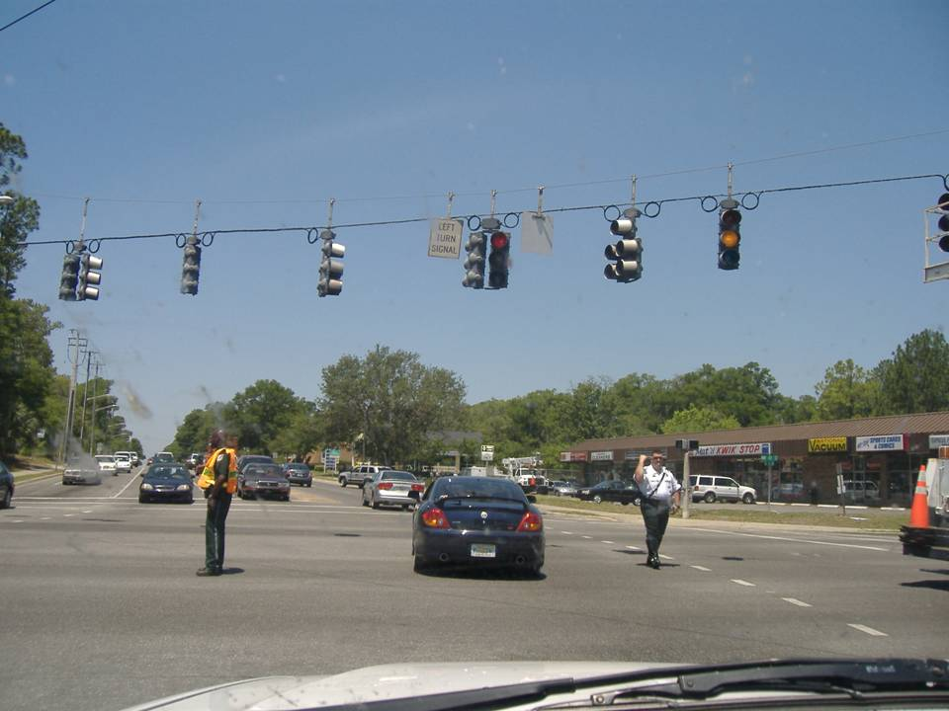
Follow the direction of the police officers

Slide 34
Signs, Signals and Road Markings
Traffic lights: not working; broken
If all traffic signal lights at an intersection are not working because of an electrical power failure, you must stop at the intersection behind the limit line, crosswalk, or at the corner. It should be treated the same as a stop sign. Only proceed when you know that all other turning and approaching vehicles, bicycles, and pedestrians will also be stopping.
Newly constructed
traffic lights will
often be covered
with plastic
or burlap.

Slide 35
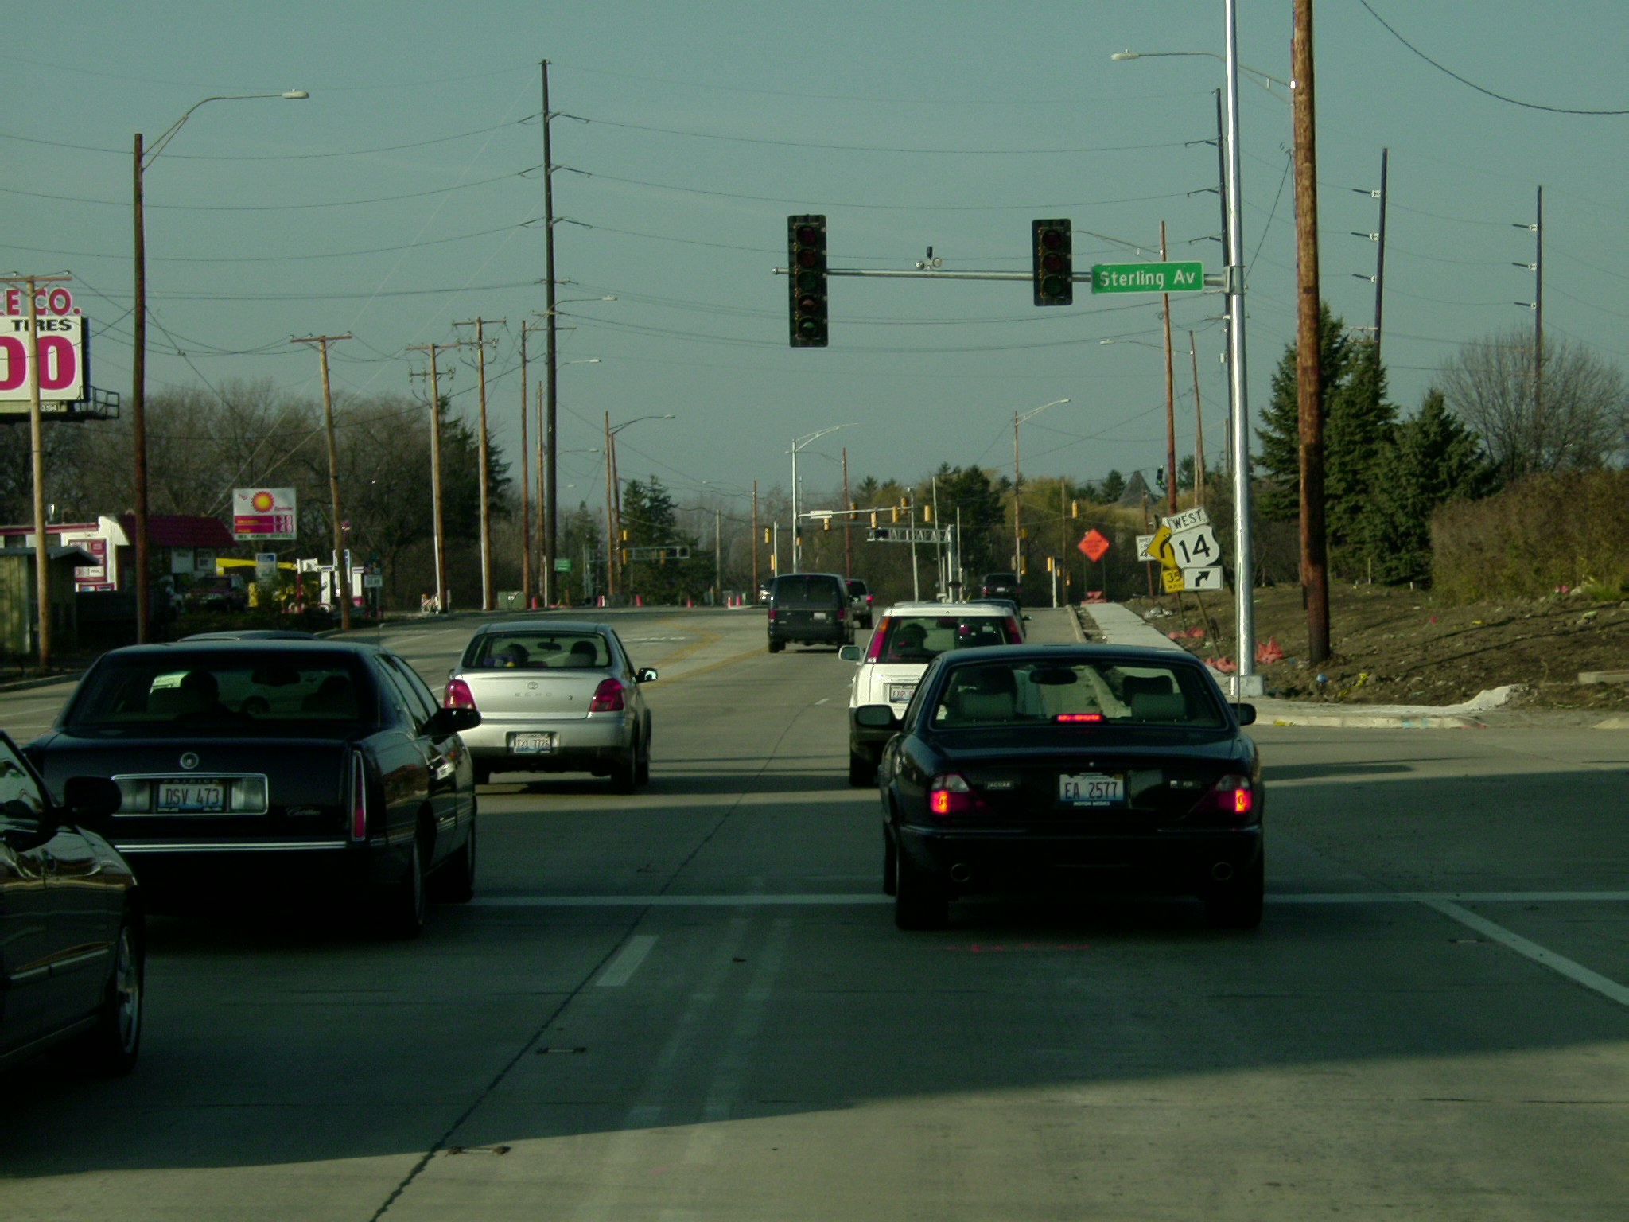
What must you do in this situation?
Stop at limit line. Traffic lights are not functioning.

Slide 36
Follow the direction of the police officers

Slide 37
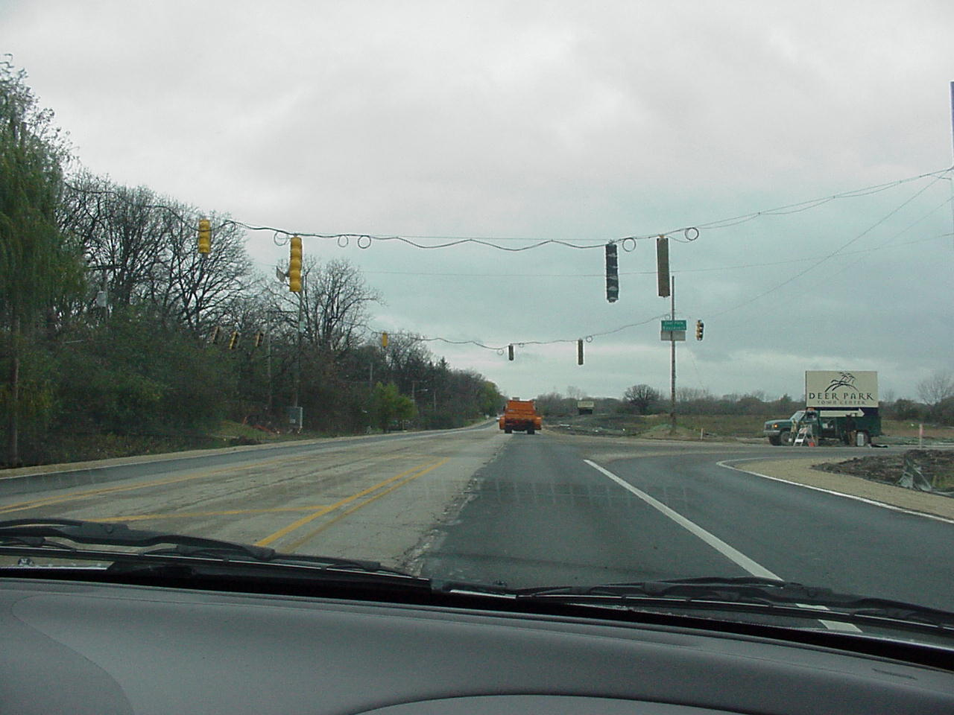
Will you have to stop at this traffic light?
No, they are not yet operational. (covered with burlap or plastic)

Slide 38
Signs, Signals and Road Markings
Traffic lights: at non-intersections
When traffic lights are erected at places other than an intersection (such as a crosswalk in the middle of a block or highway), you must obey the traffic signal. For red lights you must stop completely at the limit line, crosswalk, a special sign, or at the sign itself.

Slide 39
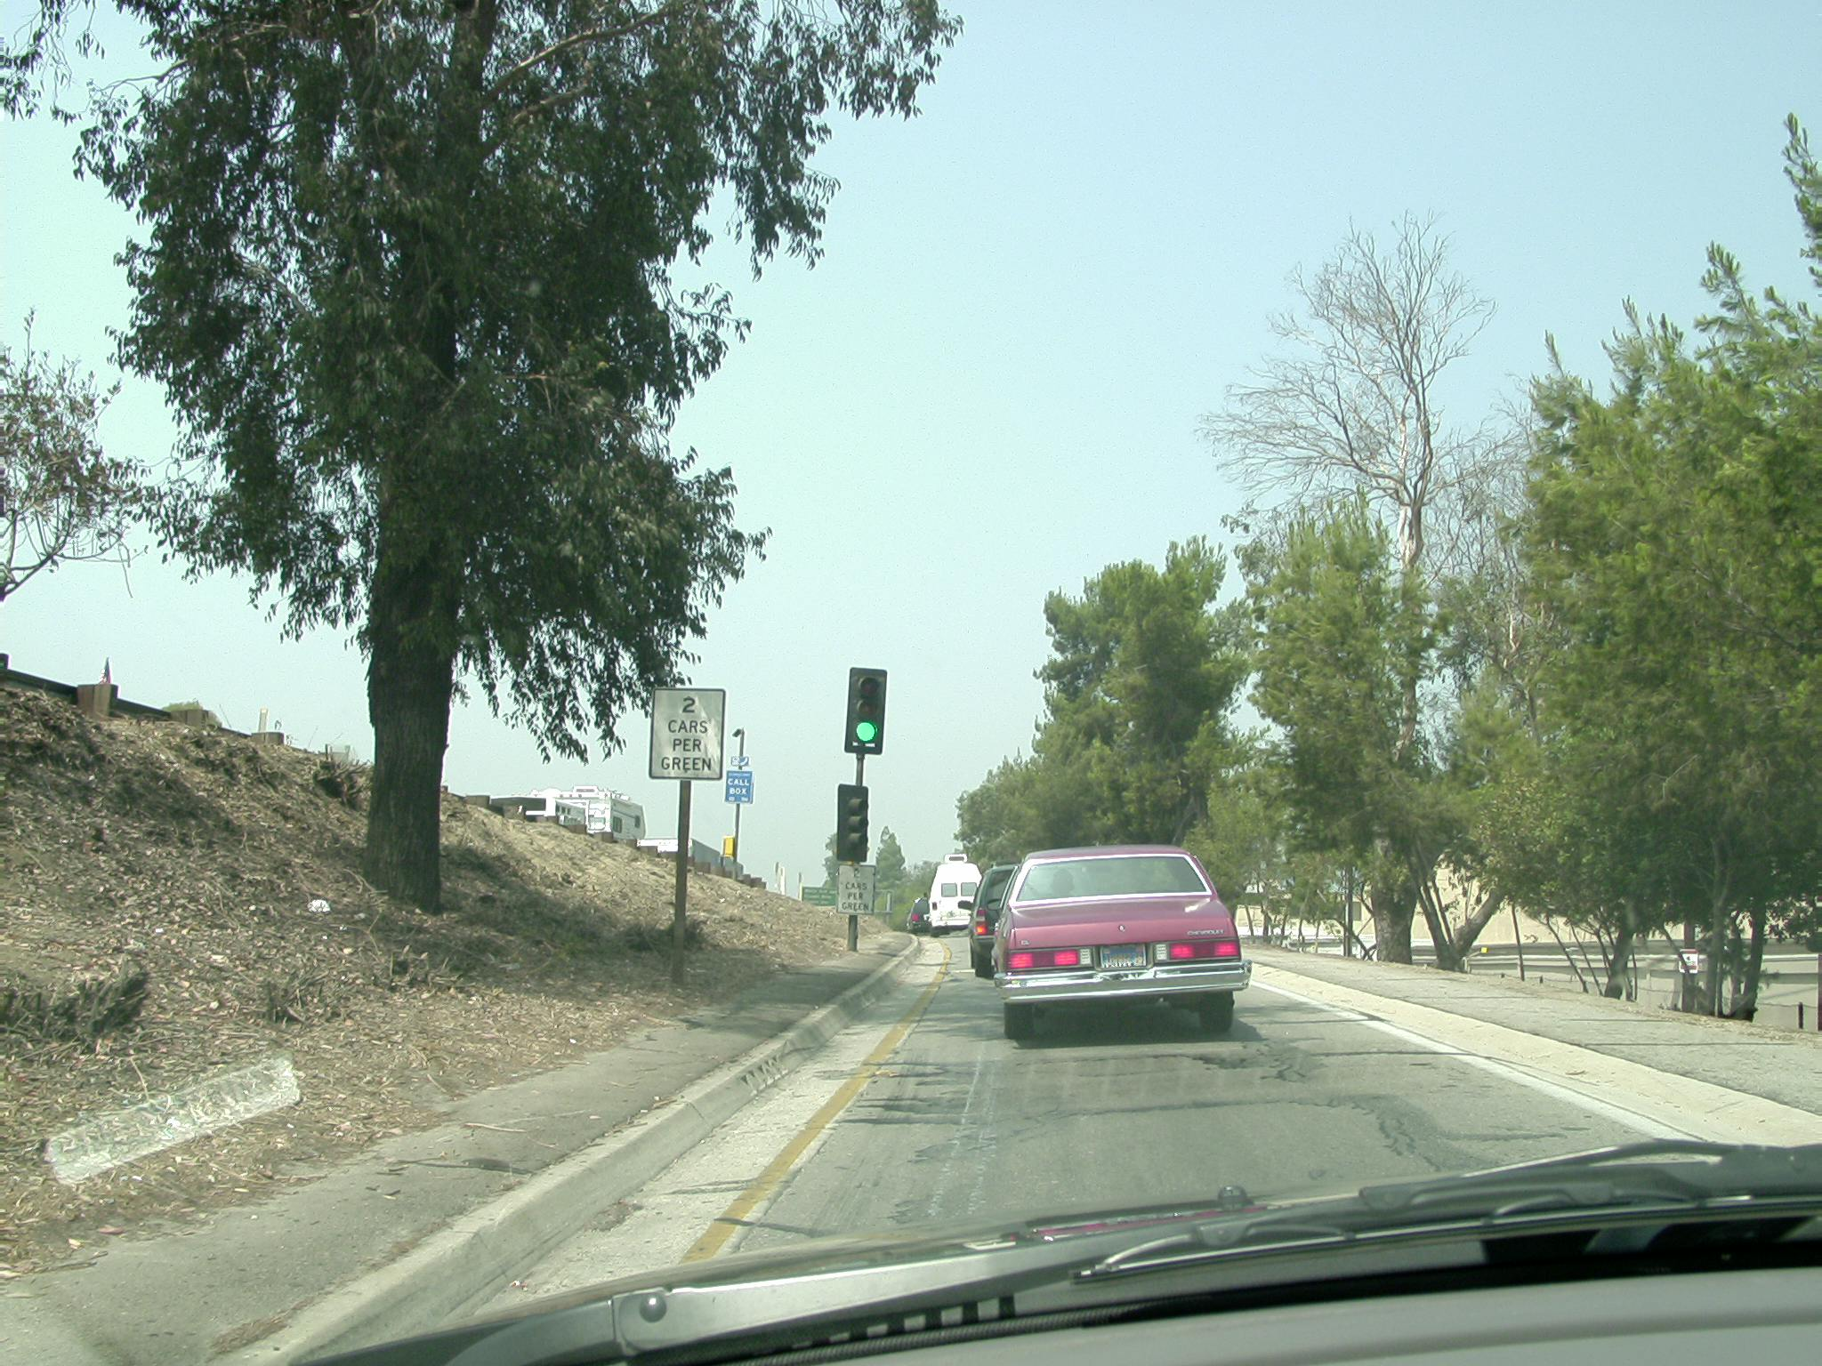
Non-intersection traffic lights
This type of signal which allows a
specified number of cars to proceed
is called “staggering.” These lights
turn very quickly.
Some signs are very specific.

Slide 40
Signs, Signals and Road Markings
Traffic lights: automated enforcement
Traffic signal automated enforcement devices (red light cameras) may legally be placed at limit lines, intersections, or other places where you are required to stop, (including railroad crossings) if the presence of the camera is clearly identified by signs in all directions, or if the signs are posted at major entrances to a city.
You have the
right to see the
photographic
evidence
of the violation

Slide 41
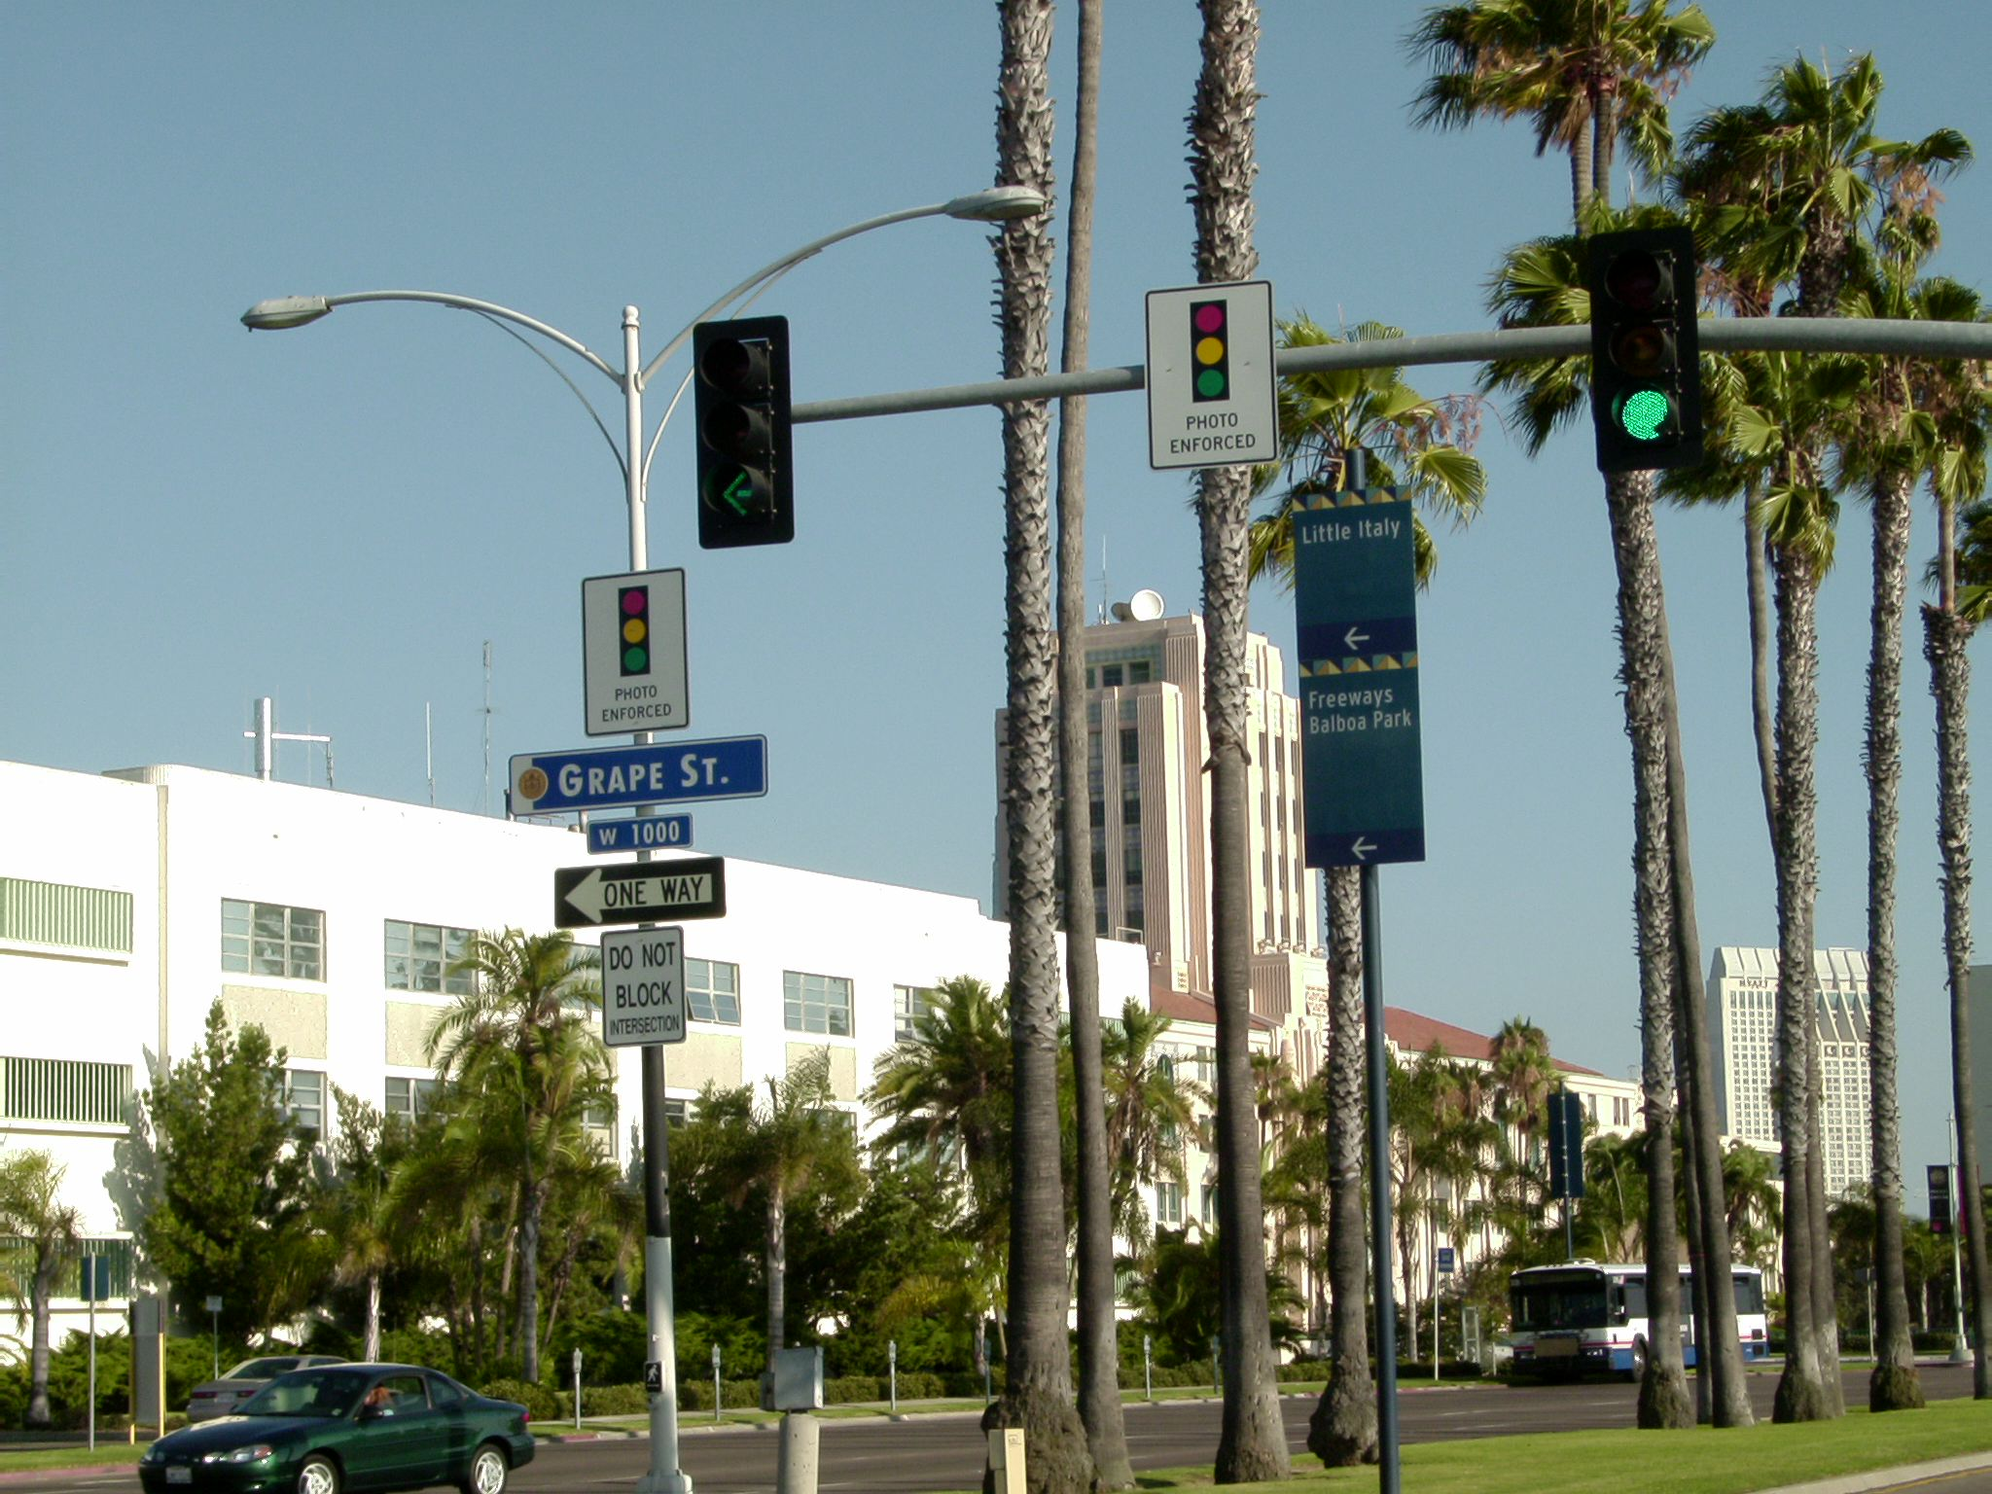

Slide 42
Signs, Signals and Road Markings
Traffic lights: lane control signals
Sometimes traffic lights are used to control certain lanes of traffic at places other than intersections. For example, toll plazas and on-ramps to freeways. The light configurations do not always include a yellow light; sometimes they go from red to green.
These
traffic
lights must
also be
obeyed

Slide 43
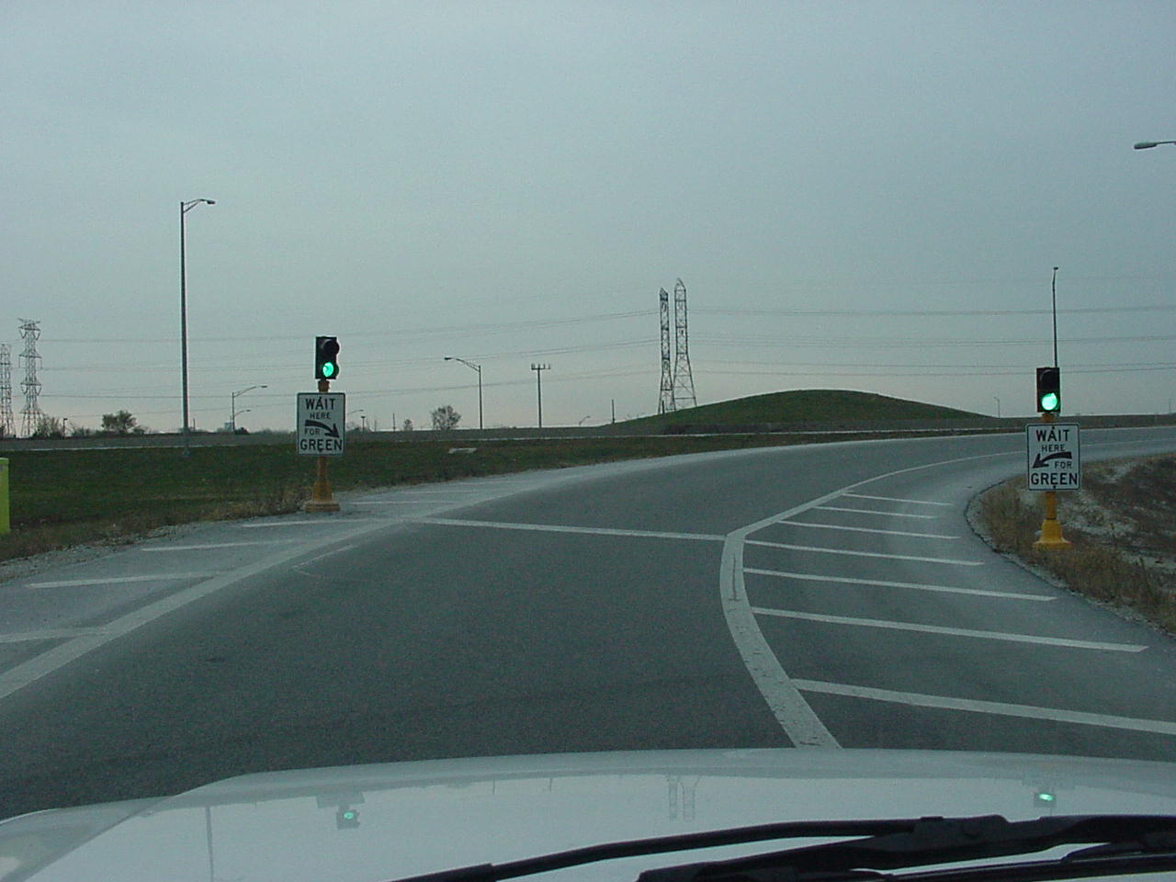
.
Non-intersection traffic lights
Again, what is the purpose of this type of ramp?
To control the rate of merging cars

Slide 44
Signs, Signals and Road Markings
Other lights: flashing red
Flashing red lights that are not traffic signals are sometimes used to warn you of an upcoming stop sign or of a railroad crossing.

Slide 45
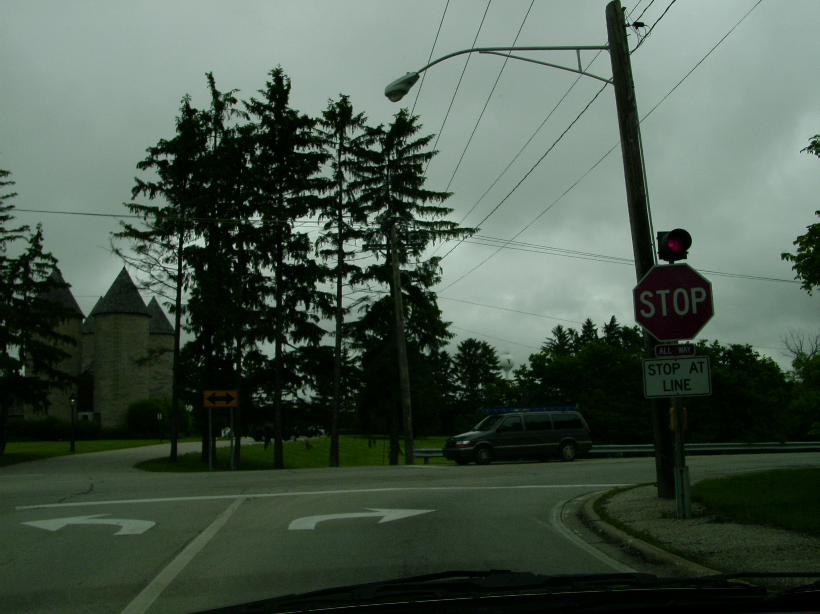

To get your attention a flashing red light will
be frequently mounted upon new stop signs
that were not there previously.

Slide 46
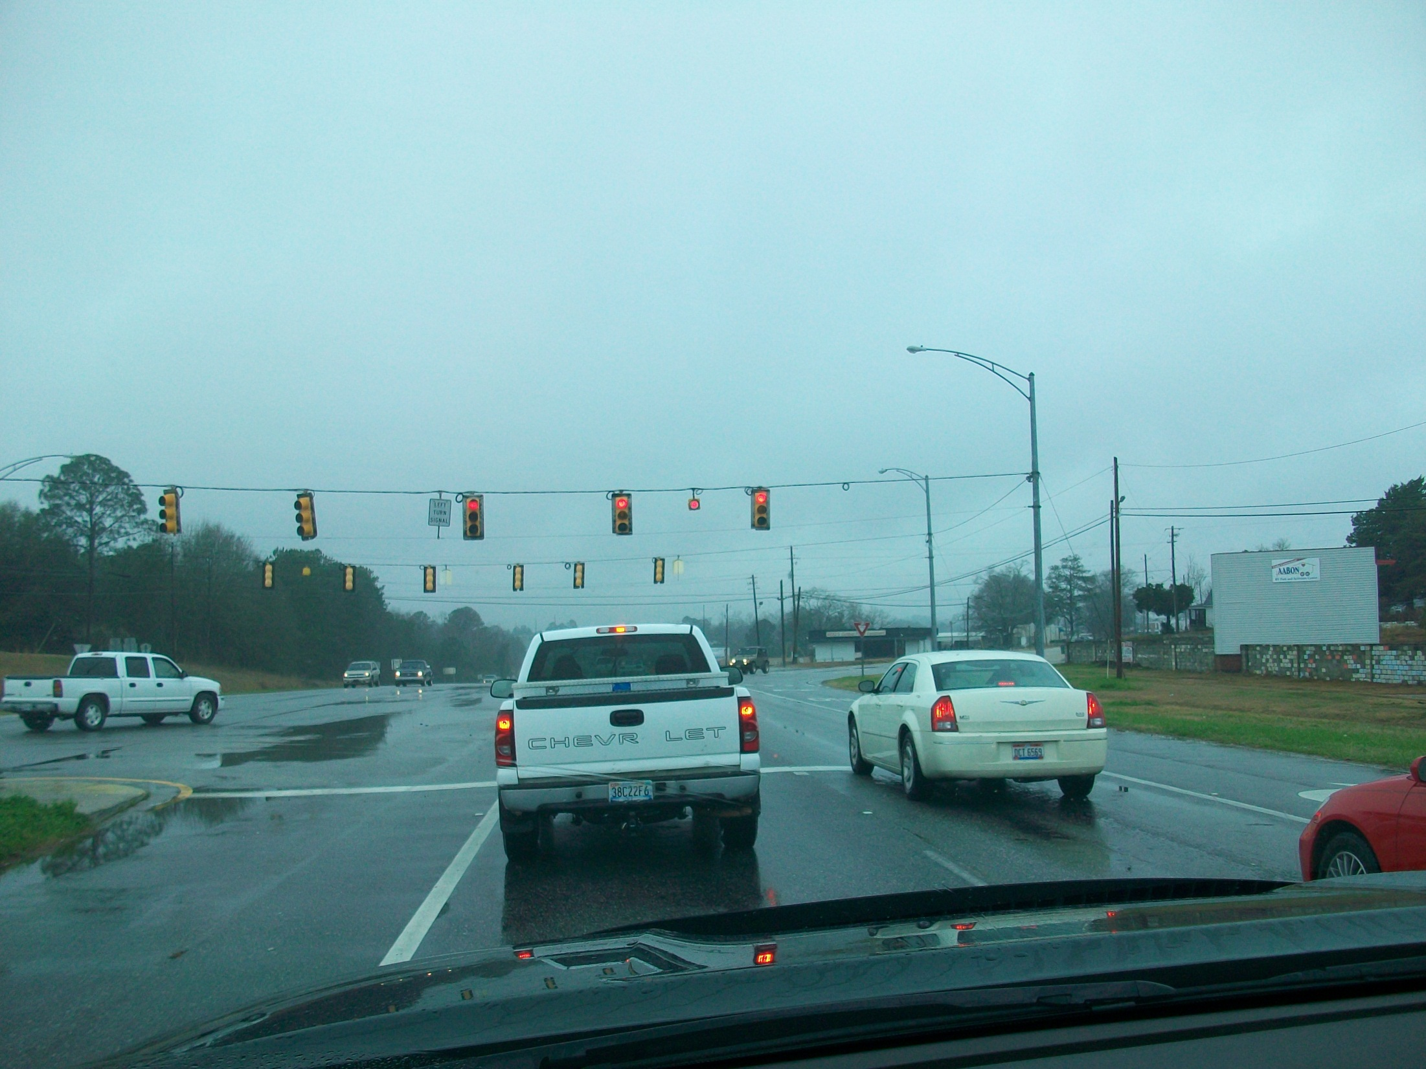
Also, sometimes they are mounted
on higher speed roads.
Let's notice . . .

Slide 47
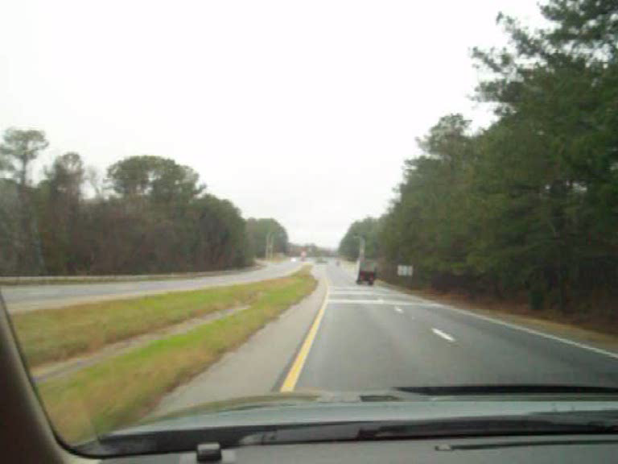
Also, sometimes they are mounted
on higher speed roads.
Let's notice . . .
Light just turned green

Slide 48
Signs, Signals and Road Markings
Other lights: flashing yellow
Flashing yellow lights that are not traffic signals are sometimes used to warn you of an upcoming signal light, pedestrian crossing, school zone, construction zone, or sharp turns ahead.

Slide 49
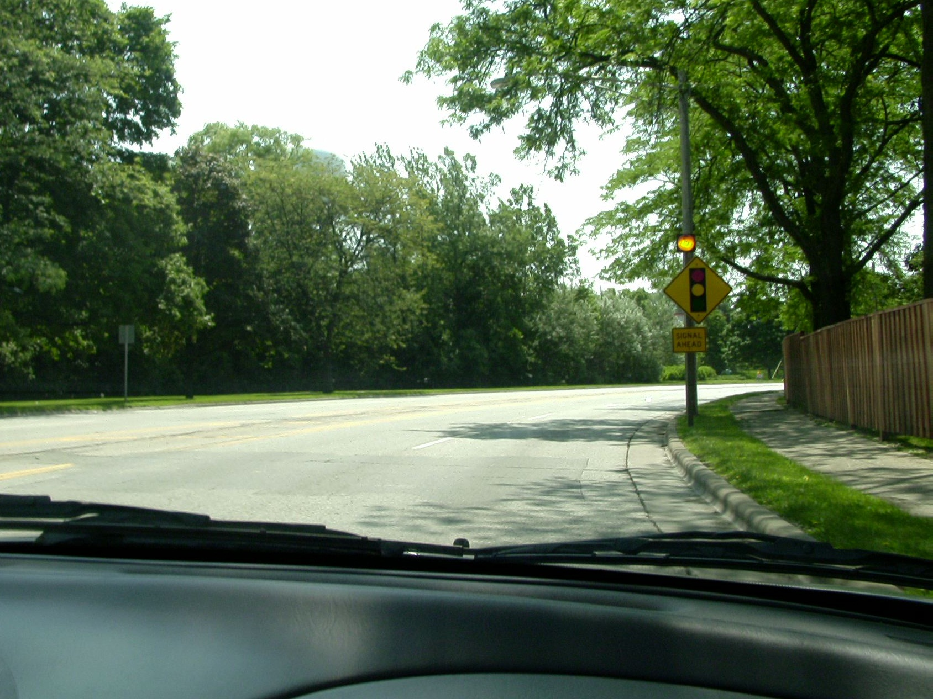

Why do you think a flashing yellow light is attached to this sign?
The signal is not yet visible.

Slide 50
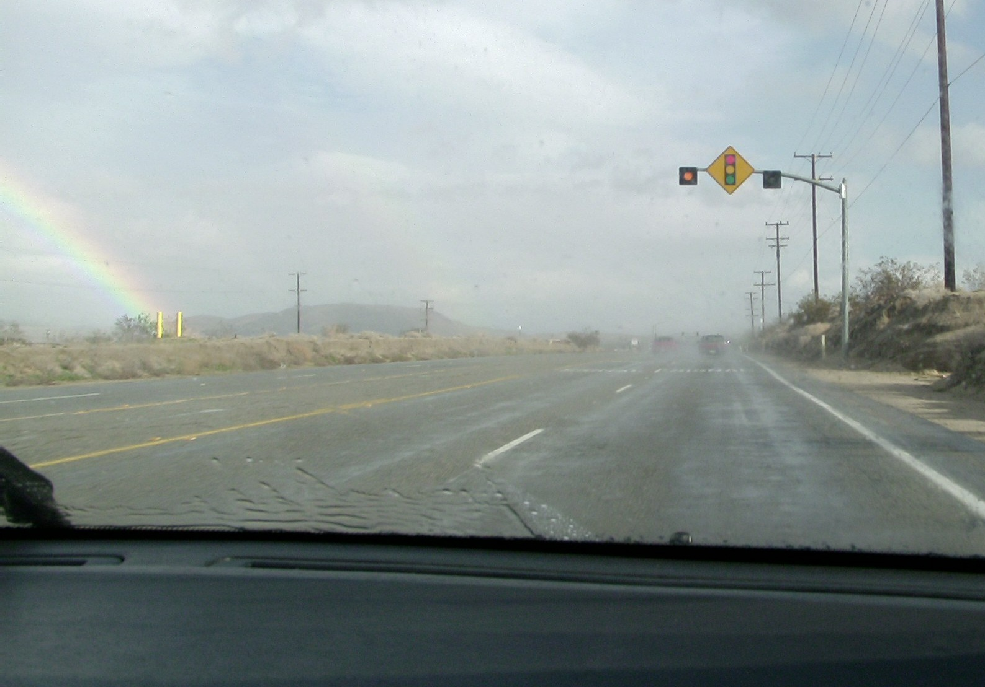
Why would slowing down now be a good decision?
Stopping distance increases on wet pavement

Slide 51
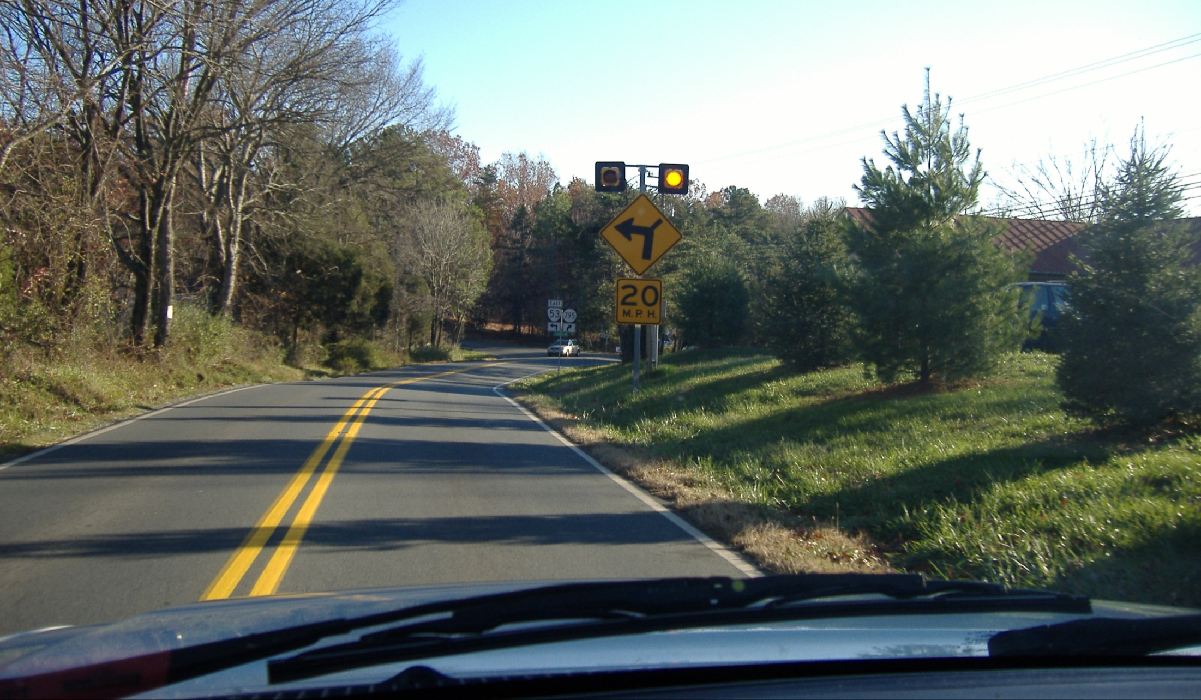
Why are the yellow lights flashing here?
Sharp turn ahead – they want your attention!

Slide 52
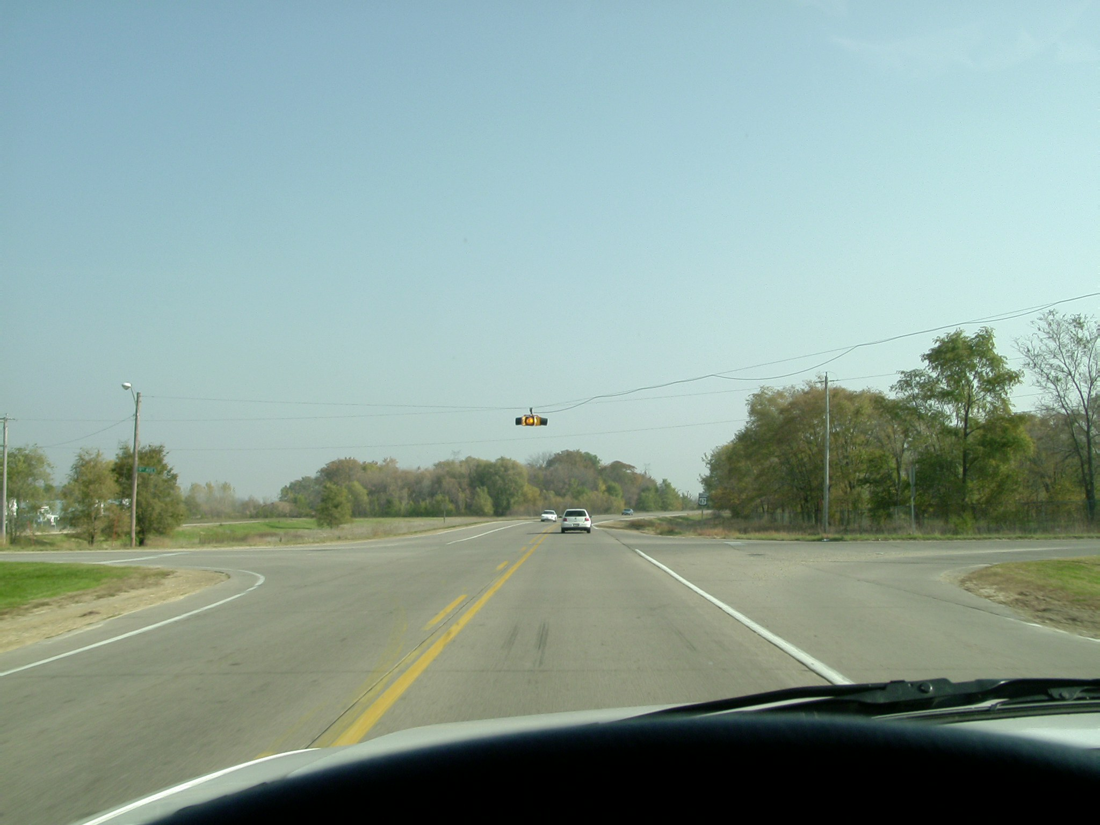
What is the purpose of this flashing yellow light?
Slow down…possible crossing traffic

Slide 53
Signs, Signals and Road Markings
Let’s now consider pavement markings

Slide 54
Signs, Signals and Road Markings
Pavement markings: introduction
Lines and other markings painted on the pavement are also used to control and direct traffic. Sometimes these lines will include reflective raised pavement markers which make the lines more visible, or the markers may be used to simulate the lines.
Yellow and white are the two most common colors of pavement markings. Lines with these colors have different meanings to help you determine where you are on the roadway.

Slide 55
Signs, Signals and Road Markings
Pavement markings: yellow lines (general)
Yellow lines parallel to the roadway mark the center of the roadway on which there is two way traffic.
Yellow lines are used in different configurations that have different meanings. We will notice a variety of these.

Slide 56
Signs, Signals and Road Markings
Pavement markings: yellow lines (solid)
If there is a single solid yellow line dividing lanes of traffic, you may not drive over this line to pass other vehicles.
you
- - - - - - - - - - - - - - - - -
You may cross over a solid yellow line to make a left turn at an intersection, to enter or exit a road or driveway, or to make a U turn, if it can be made safely and is not otherwise prohibited.

Slide 57
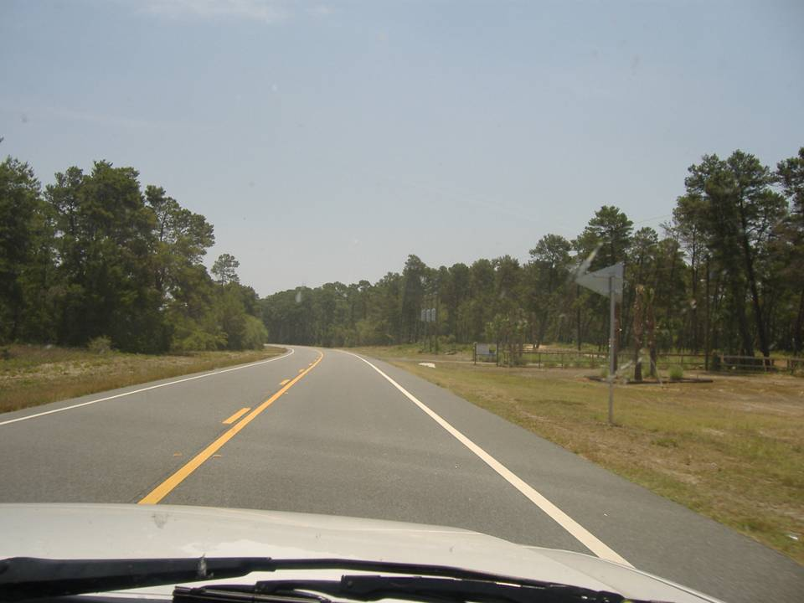
Why is passing not allowed ?
Solid yellow line

Slide 58
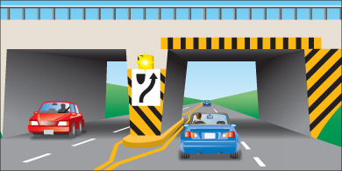
Signs, Signals and Road Markings
Pavement markings: yellow lines (solid)
On divided highways and some other roadways, a single solid yellow line will usually be used to indicate the leftmost boundary of the drivable roadway.
- - - - - - - - - - - - - - - - - -
you
You should not drive to the left of this yellow line.
Also, two solid lines painted on the pavement guide traffic away from fixed objects such as bridge piers or concrete islands. Yellow and black markings are also painted on the objects themselves as warnings.

Slide 59
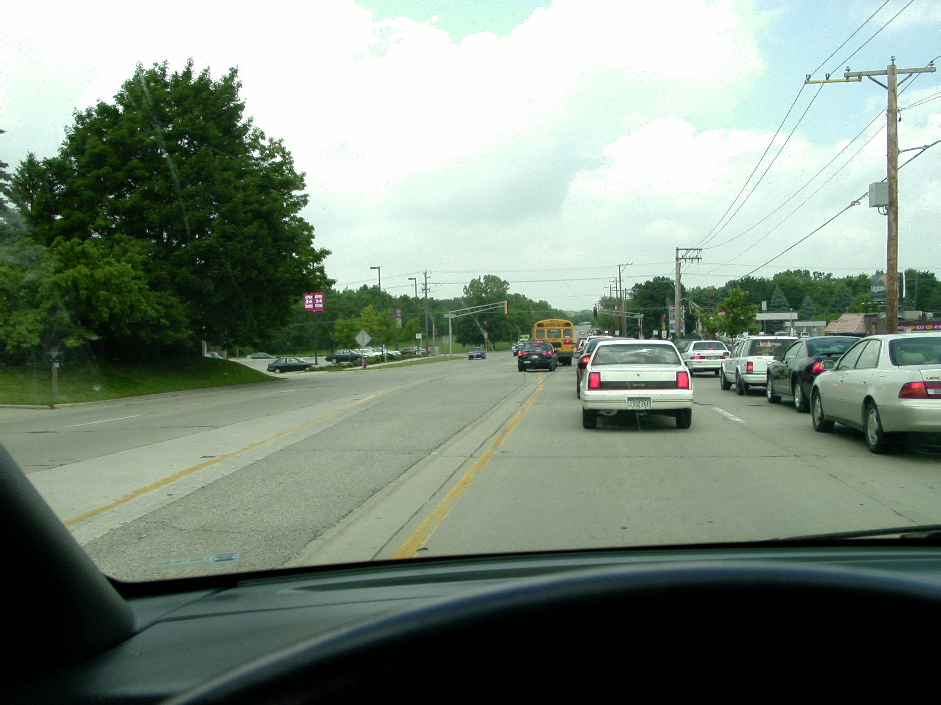
You want to turn left at the light. Would it be okay to use part of the median to move up into that turn lane?
STOP
and
THINK
Why did
they make
this illegal?
While driving
on the median,
another car
in front of
you may
also pull on to it
…crash!
No, its against the law. Crossing the yellow line.

Slide 60
Signs, Signals and Road Markings
Pavement markings: yellow lines (broken)
If there is a single yellow line dividing lanes of traffic, you may pass over this line to pass other vehicles and to make left turns if it can be done safely.
you
- - - - - - - - - - - - - - - - -

Slide 61
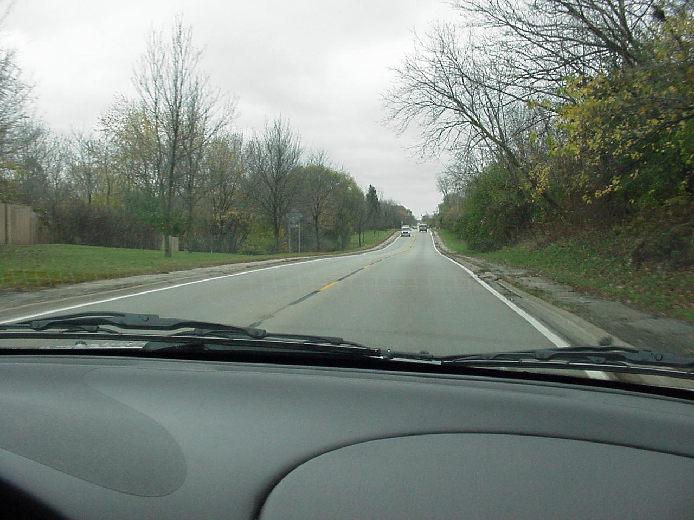
According to the pavement marking, is
passing permitted here?
Yes, but with on-coming
vehicles, it is not safe!

Slide 62
Signs, Signals and Road Markings
Pavement markings: yellow line markings; solid line
next to a broken line
If there are two yellow lines dividing lanes of traffic, and the line closest to your lane is broken, you may cross over it to pass vehicles ahead, if it is safe to do so.
you
- - - - -
- - - - - -
If the line closest to you lane is solid, you may not cross over it except to turn left into a driveway or alley.

Slide 63
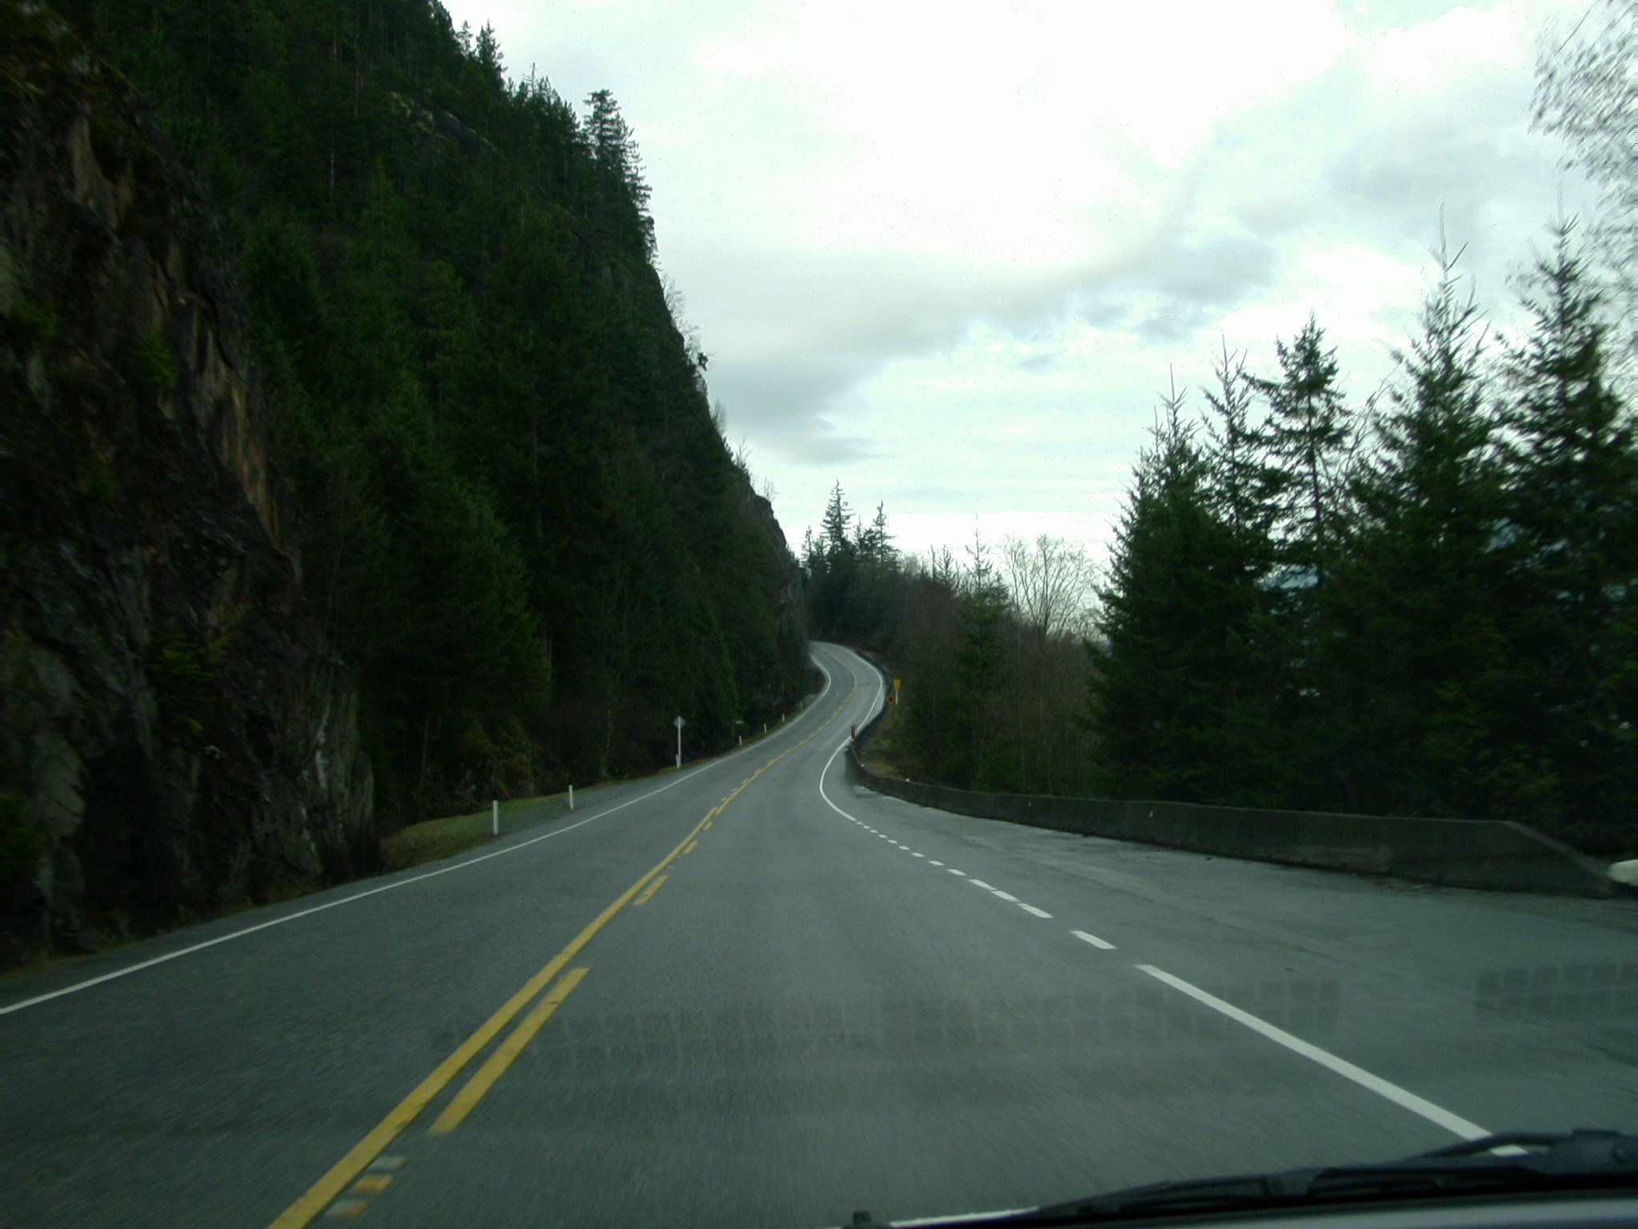
Is passing allowed here?
Only for a little longer, but it soon changes. It would not be safe to pass here.

Slide 64
Signs, Signals and Road Markings
Pavement markings: yellow line markings; double solid lines
If there are two solid yellow lines dividing lanes of traffic, you may not cross over them to pass another vehicle. You should never drive to the left of these lines.
you
You may cross over a double solid yellow line to make most left turns at intersections, or driveways, if it can be made safely and is not otherwise prohibited.

Slide 65
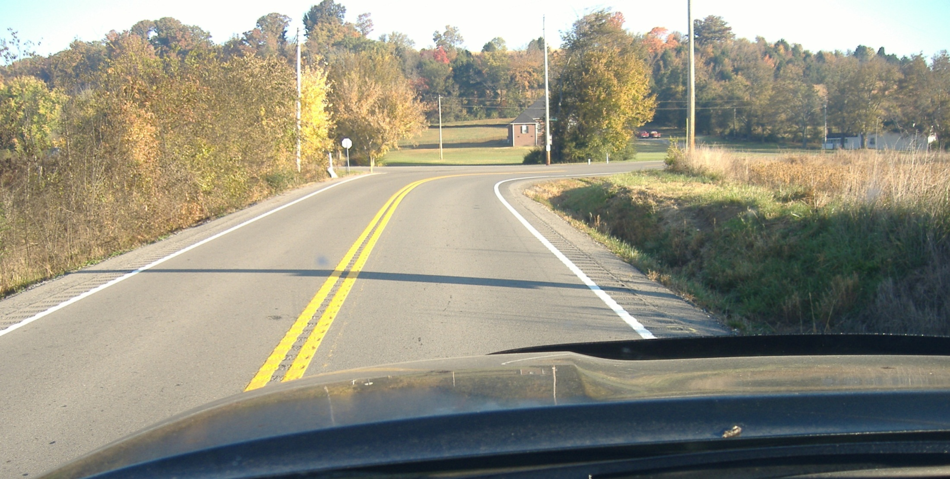
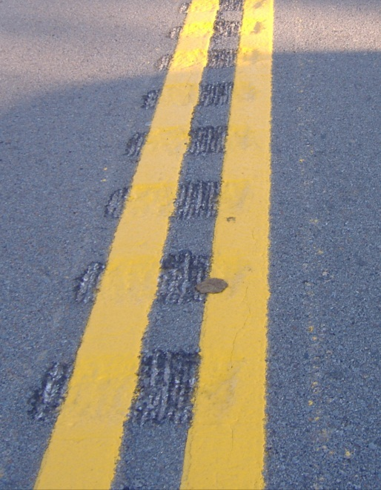
Why is it not allowed?
Curve ahead – poor visibility
Safety innovation:
Notice the grooved pavement
Why ?
No passing
either side
What does this double yellow line mean?

Slide 66
Signs, Signals and Road Markings
Pavement markings: yellow line markings; double solid lines
Two sets of solid double yellow lines that are more than two feet apart represent a wall or center divider. You may not drive on or over these lines for any reason.
- - - - - - - - - - - - - - - - -
you
- - - - - - - - - - - - - - - - -
You may only make a U turn or left turn on a street divided with these lines at an opening provided for turns.

Slide 67
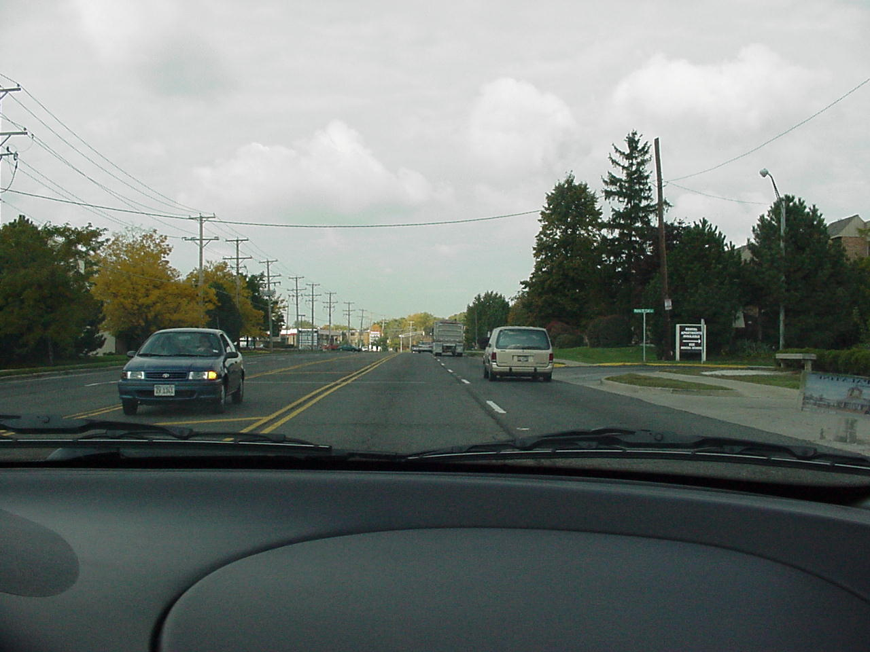
No. It’s illegal to cross two sets of double
yellow lines that are more than two feet apart.
This car is waiting here to turn left between the yellow lines. Is the position of this car legal?
YES or NO?

Slide 68
Signs, Signals and Road Markings
Pavement markings: yellow line markings; double solid lines
In some cases, one or more sets of parallel solid yellow lines are also used to separate carpool lanes from normal traffic lanes. (usually the lines are white) Do not cross over these lines to exit or enter the carpool lane.
carpool
lane
you
RESTRICTED
LANE
Wait until the lines are broken or for some other designated place to enter or exit the lane.
AHEAD

Slide 69
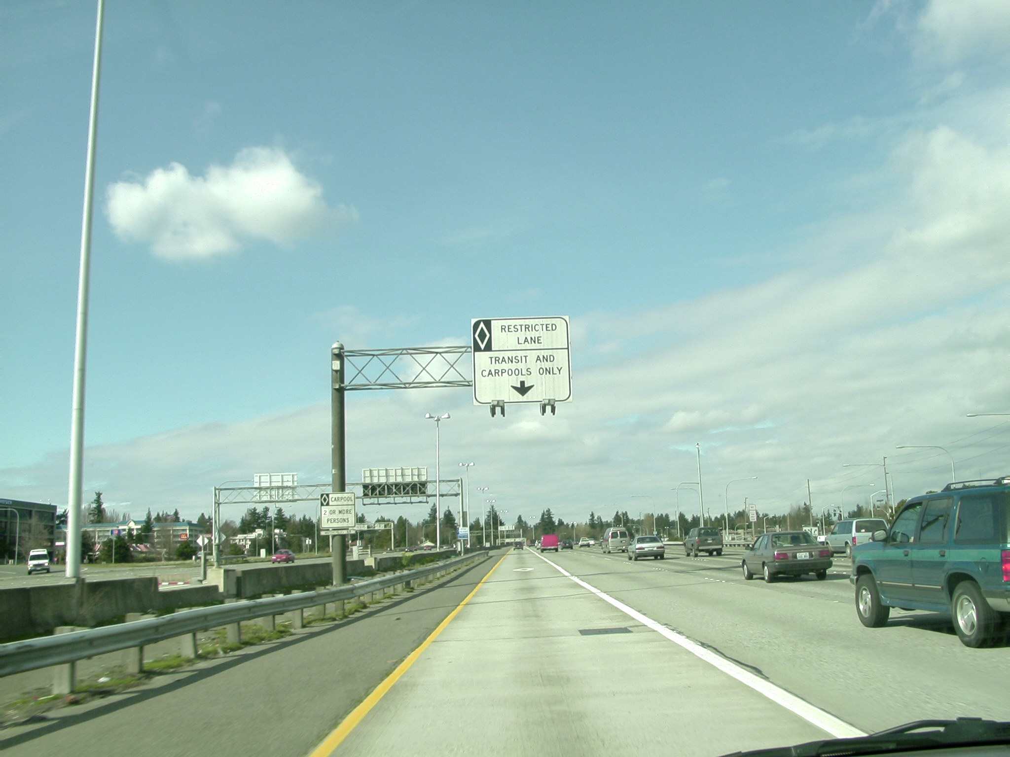
Would it be legal to enter or leave
this carpool lane at this time?
No, the solid line (white or yellow) restricts access at this time. Wait for the broken white line.
Diamonds painted in a lane
indicate that lane is for use
by buses and carpools only.
Using this lane requires a
minimum of 2 or 3 people
in your vehicle. (the sign
will specify how many)

Slide 70
Signs, Signals and Road Markings
Pavement markings: yellow line markings; center left turn lanes
A center traffic lane enclosed by double yellow lines on each side with inner lines broken may be used to start and complete left turns and start U turns from either direction of traffic, but cannot be used for passing.
you
You must signal and completely enter the lane before making your left hand turn. You must only drive in this lane for 200 feet. Don’t stop partway into the lane, with your vehicle blocking traffic. Watch out for vehicles coming from the opposite direction that are pulling into a center turn lane.

Slide 71
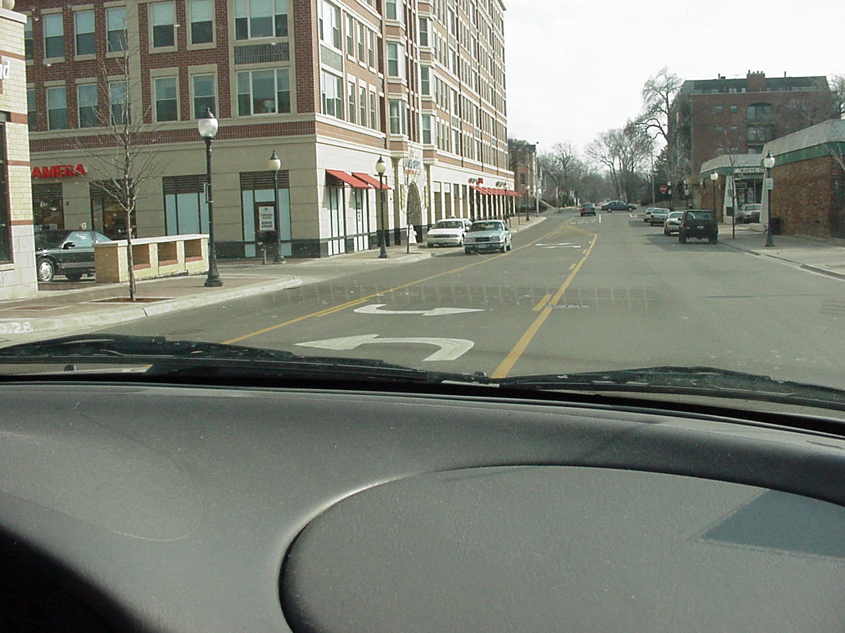

When are you allowed to cross
this solid yellow line?
When making a left turn

Slide 72
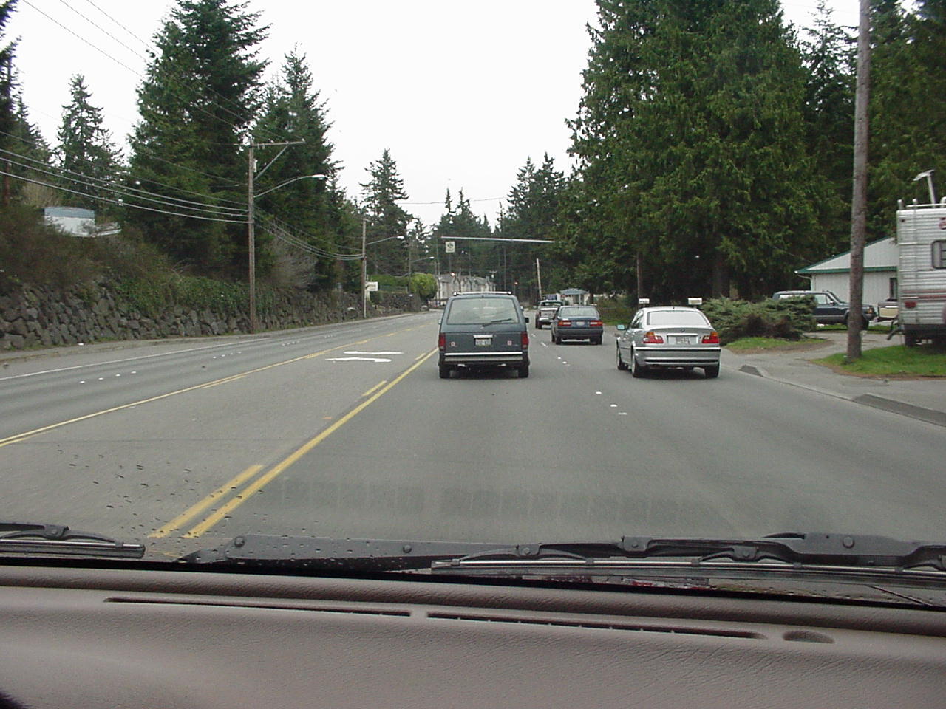
Signs, Signals and Road Markings
Pavement markings: yellow line markings; center left turn lanes
When turning left from a side street or driveway, you have the option to use this lane before completing your turn.
When you get to the lane, wait there until traffic clears; then proceed into the moving traffic lane.
This lane
But if traffic is clear in both directions, you can just make your left turn directly without stopping in the center turn lane.

Slide 73
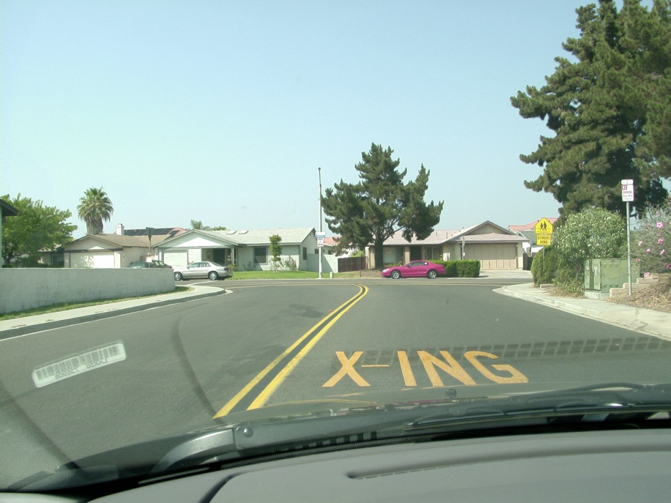

Signs, Signals and Road Markings
Pavement markings: yellow line markings; school crossing
Broad lines crossing the road are sometimes used to indicate a school crossing. Yellow markings on the pavement which may say “X-ING” will frequently be painted near school crossings.
You should carefully scan for children in these areas.

Slide 74
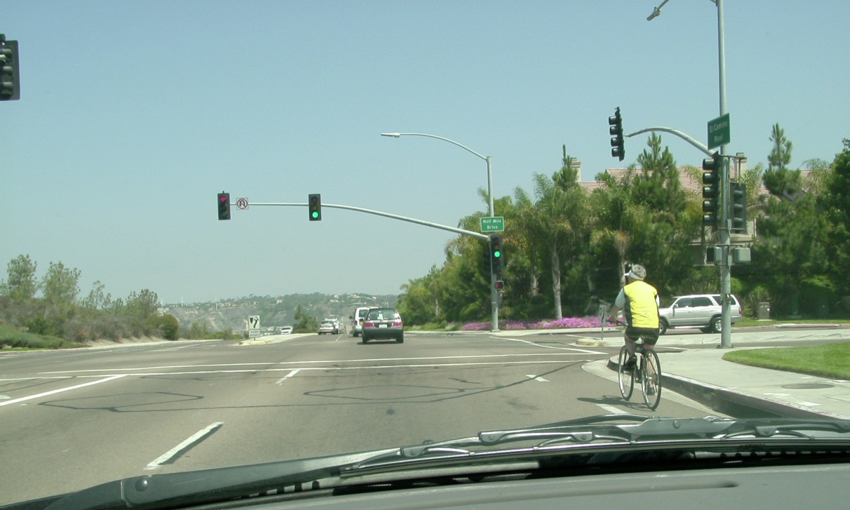
Signs, Signals and Road Markings
Pavement markings: general white lane markings
White lines which cross the roadway delineate crosswalks or limit lines.
Messages such as stop ahead or arrows directing traffic are often painted on the pavement in white.
White lane lines separate lanes traffic going in the same direction, including bicycle lanes from car lanes.

Slide 75
Signs, Signals and Road Markings
Pavement markings: white lane markings, solid and broken
A single or double solid white line dividing traffic lanes going in the same direction cannot be crossed for any reason.

Slide 76
Signs, Signals and Road Markings
Pavement markings: white lane markings, solid and broken
A single or double solid white line dividing traffic lanes going in the same direction cannot be crossed for any reason.
A single broken white line dividing lanes of traffic allow you to cross over the lane next to you.
_ _ _ _ _ _ _ _ _ _ _

Slide 77
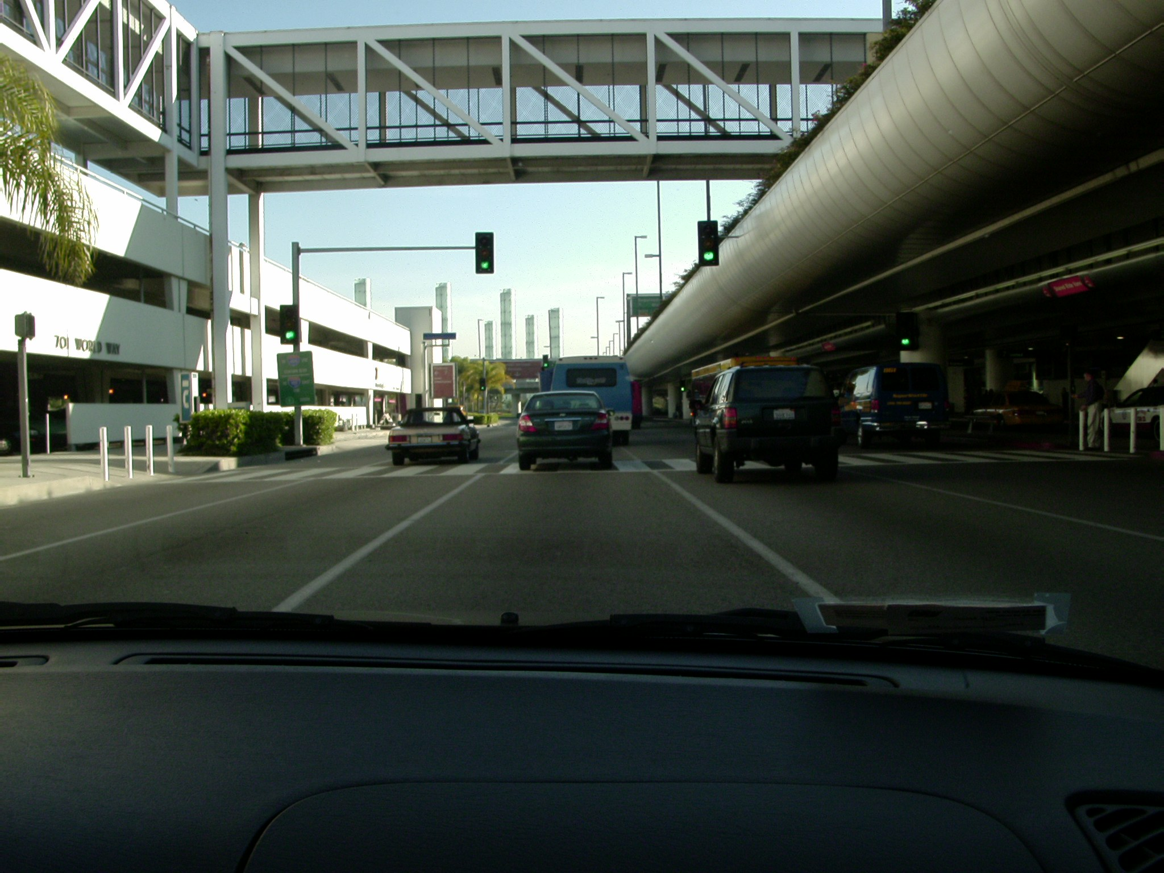
Change lanes
...solid white lines
What can you not do in this situation?

Slide 78
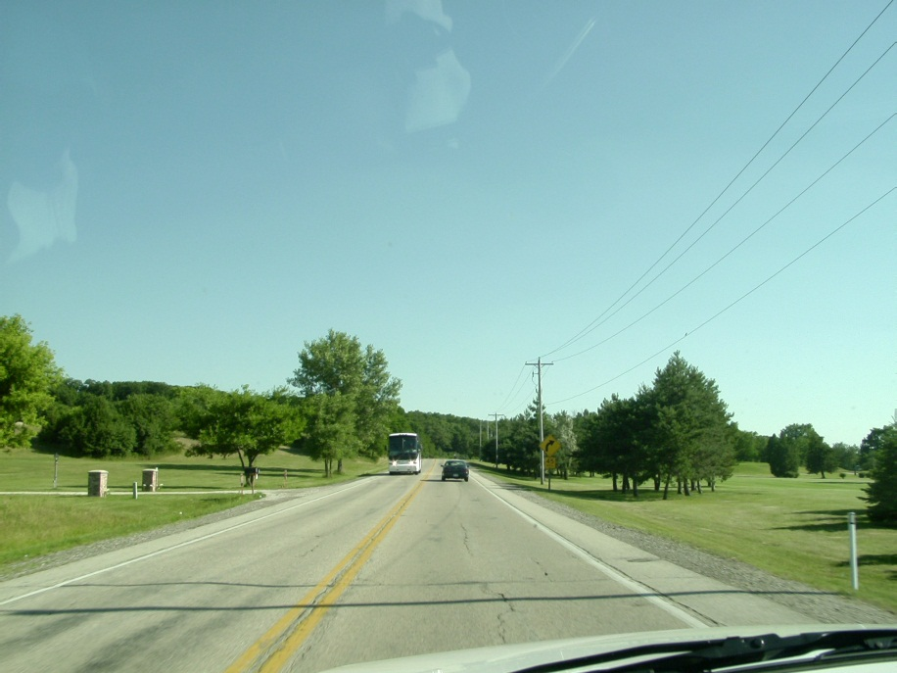
Signs, Signals and Road Markings
Pavement markings: white lane markings, solid
_ _ _ _ _ _ _ _ _ _ _ _
A single solid white line will usually be used to indicate the right boundary of the drivable roadway. You should not drive to the right of this line.
Does this mean you cannot use the shoulder
to go around this waiting left turner?

Slide 79
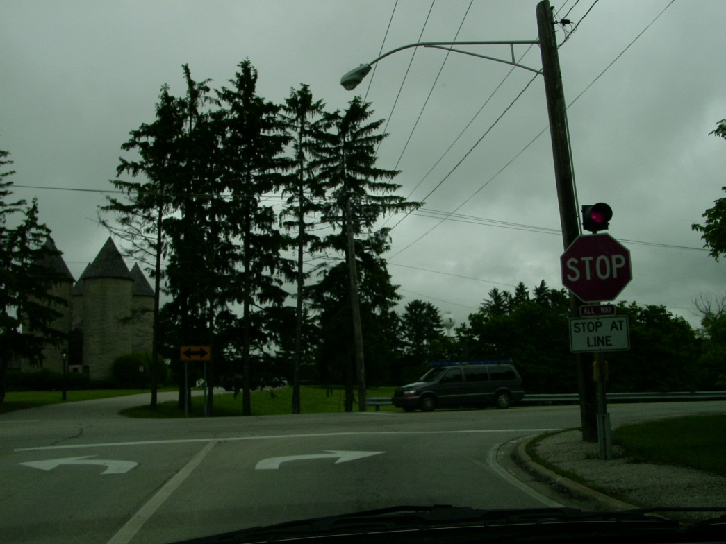
Signs, Signals and Road Markings
Pavement markings: white lane markings, solid
At this point, can we change lanes to the left lane for a left turn?
Thicker solid white lines are used to separate left and right turn lanes close to the intersection.
No, you cannot.
At this point you are committed to the lane you are in, you must make the right turn.

Slide 80
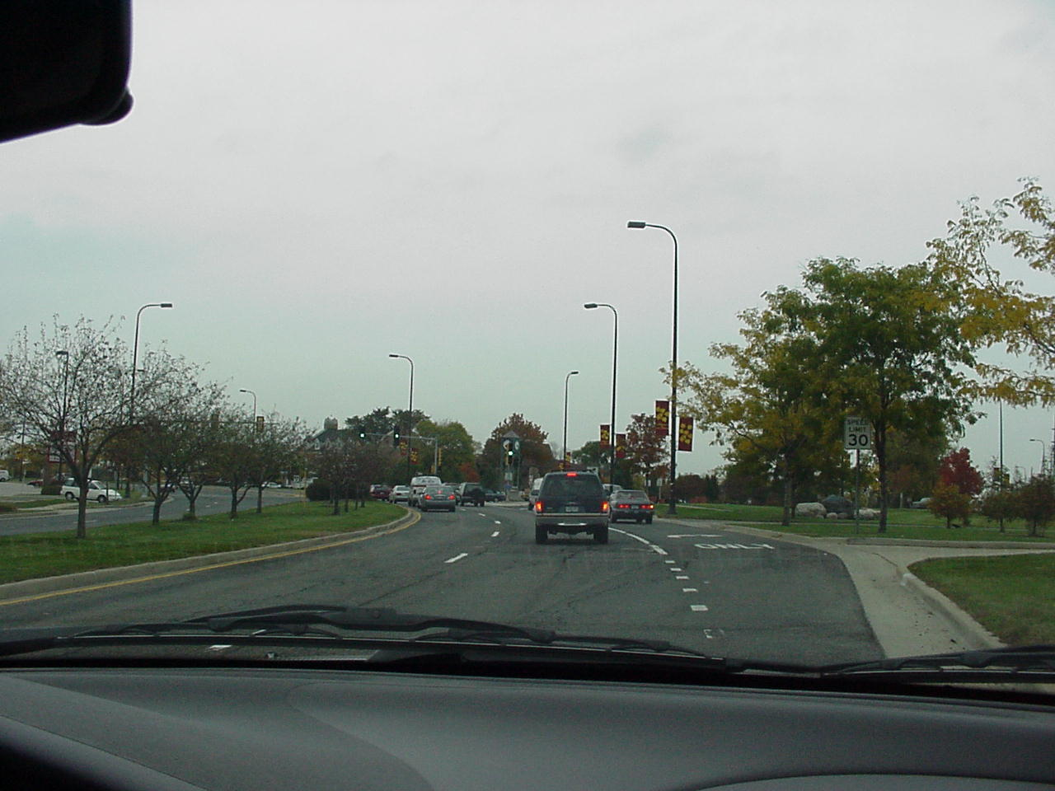
Signs, Signals and Road Markings
Pavement markings: white lane markings, solid
If you pass the part of the turn lane that has a broken white line or no line, you may not turn over the solid line to enter the turn lane.
Is this vehicle allowed to lane change
right to make a right turn?
No, it's too late.

Slide 81

Signs, Signals and Road Markings
Pavement markings: white lane markings, solid
If the lane you are driving in has smaller broken white lines, then the lane you are in is for exiting the roadway, merging into other lanes, or is ending.
What else should you be concerned about as you approach this exit?
The broken line will soon become a single solid white line or double white line which cannot be crossed.
Slowing down enough for the ramp.

Slide 82
Signs, Signals and Road Markings
Let’s finish this section considering a few more examples of white line markings.

Slide 83
Signs, Signals and Road Markings
Pavement markings: white lane markings,
crosswalks, limit lines
Pavement markings: white lane markings,
crosswalks, limit lines
- -
- -
Crosswalks are delineated with sets of broad white parallel lines which cross the road. They may have the painted words on the pavement: SLOW PED XING
- -
- -
_______
_______
_______
_______
- -
- -
- -
- -
Some crosswalks are called unmarked crosswalks (no painted lines). Whether painted lines or not, you must stop behind the crosswalk when stopping at intersection.

Slide 84
Signs, Signals and Road Markings
Pavement markings: white lane markings,
crosswalks, limit lines
Pavement markings: white lane markings,
crosswalks, limit lines
- -
- -
___
- -
- -
Thick solid white lines that cross the roadway are used to mark the limit line at intersections and the clearance line at RR crossings.
___
- -
- -
- -
- -
You must stop behind these lines when you stop at an intersection or railroad crossing. The limit lines at railroad crossings are often preceded by white painted letters on the pavement such as “R x R.”

Slide 85


Signs, Signals and Road Markings
Pavement markings: white lane markings,
crosswalks, limit lines
- -
- -
___
___
- -
Thick solid white lines that cross the roadway are used to mark the limit line at intersections and the clearance line at RR crossings.
- -
___
- -
- -
___
- -
x
- -
R R
You must stop behind these lines when you stop at an intersection or railroad crossing. The limit lines at railroad crossings are often preceded by white painted letters on the pavement such as “R X R.”

Slide 86

Signs, Signals and Road Markings
Pavement markings: white lane markings, words
Pavement markings: white lane markings, words
Large white letters and symbols are often painted on the road to warn you of upcoming signals, stop signs, changes in the lane, bicycle lanes, and crosswalks.
Keep an eye on the roadway surface for these messages when you are driving.

Slide 87

Let’s review with this video

Slide 88

Signs, Signals and Road Markings
Review time…how much do you remember?

Slide 89
1)1) True or False: If all traffic is clear, a right turn on red is allowed unless there are prohibiting signs. _______
True
1)2) A left turn on red is allowed if the turn is made from a ____way street to another _____ way street, unless prohibited by a sign disallowing it.
one
one
1)3) You are waiting in an intersection to turn left. The yellow light comes on, you should: ________________________
proceed after the intersection is clear
1)4) True or False: You can make a U turn at a green light intersection unless prohibited by a sign. _______
True
1)5) _________means that traffic at an intersection is so heavy that vehicles are unable to pass through or complete turns.
Gridlock
6) True or False: On a left red arrow, move up into the intersection and complete your turn after traffic clears.____
False

Slide 90
1) 7) A horizontal green arrow pointing to the right or left means you will be making a _________ turn, as all other traffic is stopped with red lights.
protected
1 8) A flashing red signal light means the same thing as a ____________. It could be the light is malfunctioning.
stop sign
9) True or False: You must yield when approaching a flashing yellow light. ______
False
a possible quick lane change in front of us
1) 10) If all the traffic signals at an intersection are not working (electrical failure) you must treat it as a _______.
stop sign
1) 11) This situation means you _____________
you
cannot pass
- - - - - - - - - - - - - - - - -
1 12) White broken lane lines separate traffic moving in the ______direction.
same

Slide 91
13) Yellow broken lane lines in the center of the pavement indicate that there is _____ way traffic.
two
1) 14) In this situation you will soon be allowed to:
you
- - - - - -
- - - - - -
pass
15) A single or double solid white line cannot be ________ for any reason.
crossed
1) 16) If approaching an intersection with white crosswalk lines that cross the road you must stop ________the lines when stopping at the intersection.
behind
17) Thick solid white lines that cross the roadway are used to mark the limit line at intersections and the clearance line at _____________.
railroad crossings

Slide 92
End of Signs, Signals and Road Markings

