Slide 1
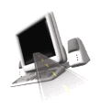

T H E D R I V E R S E D G E
I N T E R A C T I V E
slides and videos
Unit 1 - Signs / Shapes / Colors

Slide 2
Introduction
Purpose: An introduction to some of the general responsibilities associated with driving, the meaning of a drivers license, the importance of driver education.

Slide 3
An overview . . .
Having a driver license is a privilege, not a right. All drivers must have a drivers license to operate a vehicle of any kind on a public highway.
Other drivers and pedestrians will expect that you will follow the laws and rules of the road, be courteous, and not be under the influence of alcohol or drugs, or otherwise impaired while you are driving.

Slide 4
An overview . . .
If you are a minor, your parent(s) or guardian are responsible for the financial consequences of your driving. If you have a drivers license, they will expect you to drive safely.
Passengers in your car have put their safety in your hands, and expect that because you have a drivers license, you will drive safely.

Slide 5
An overview . . .
A vehicle is capable of causing extensive property damage, injury, and death, and should be handled with the caution you would show a dangerous weapon such as a gun.
Becoming a competent driver is a life-long learning experience, your Driver Education is just a beginning.
Let's now begin increasing
our understanding of the basics . . .

Slide 6


Signs, Signals and Road Markings

Slide 7
Signs, Signals and Road Markings
Purpose: To become acquainted with the purpose and meaning of traffic signs, signals and road markings.
Recognizing traffic signs
Part one - Traffic Signs

Slide 8
Signs, Signals and Road Markings
Purpose: To become acquainted with the purpose and meaning of traffic signs, signals and road markings.
Traffic signs are devices placed along, beside, or above a highway, roadway, pathway, or other routes to guide, warn, and regulate the flow of traffic, including motor vehicles, bicycles, pedestrians, equestrians, and other travelers.
They serve 3 different purposes:
(a) regulate traffic, movement, or parking
(b) to warn of potential dangers or changes in road condition
(c) to provide information and guidance
Recognizing traffic signs

Slide 9
Signs, Signals,
and Road markings
Traffic signs have shapes that denote specific meaning. The shapes allows you to know if you are faced with a regulation, a warning, information or guidance and sometimes the specific meaning of the sign.
This eight-sided octagon-shape is used exclusively for stop signs
Recognizing traffic signs
STOP
The driver should immediately recognize that it means stop.
Some may have this small supplemental plate which indicates whether other traffic must also stop.
4 - W A Y

Slide 10
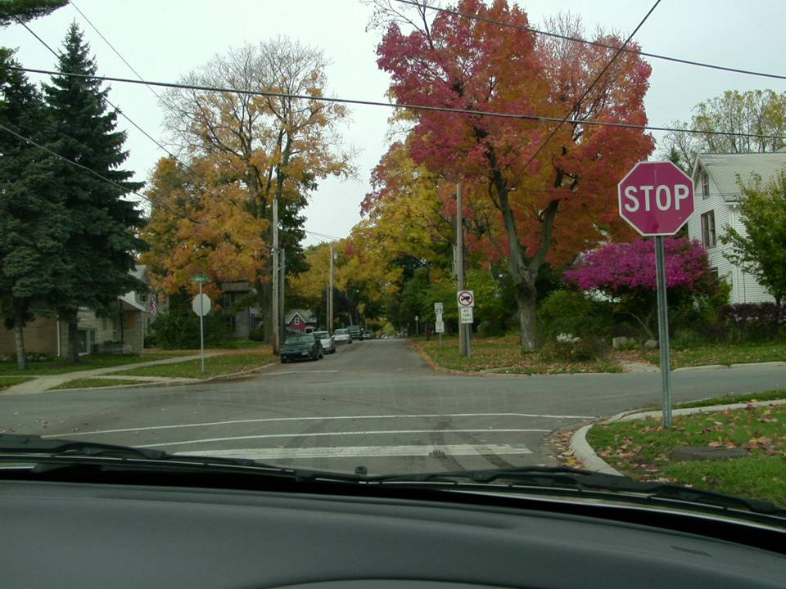

. . .Obviously after stopping
You are to . . .
Is it necessary to stop completely at a stop sign?
If you want to pass your drivers’ license test it is! You will often fail at the exam station if you “roll” a stop sign!

Slide 11
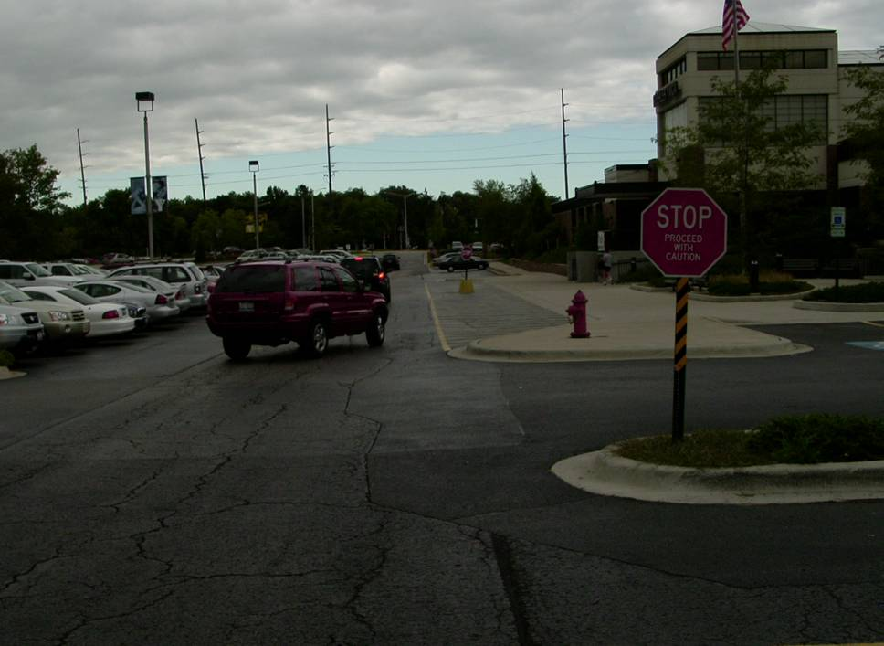
. . .Obviously after stopping
You are to . . .
Is it necessary to stop completely at a stop sign?
If you want to pass your drivers’ license test it is! You will often fail at the exam station if you “roll” a stop sign!

Slide 12

Stopping Points
Signs, Signals,
and Road markings

Slide 13
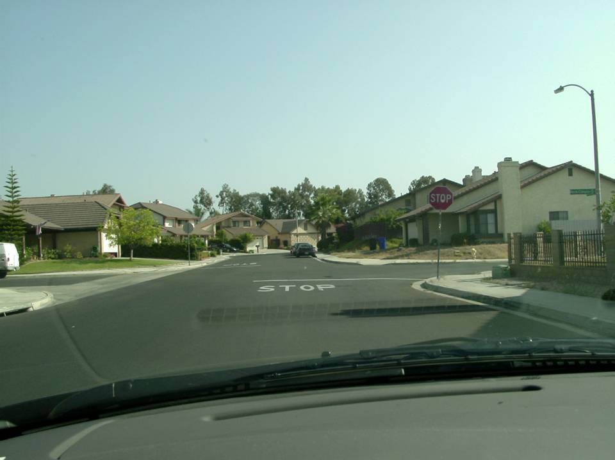
Most stops signs have
designated stopping points.
The front of the car.
What part of your car must stop before the thick white limit line?

Slide 14
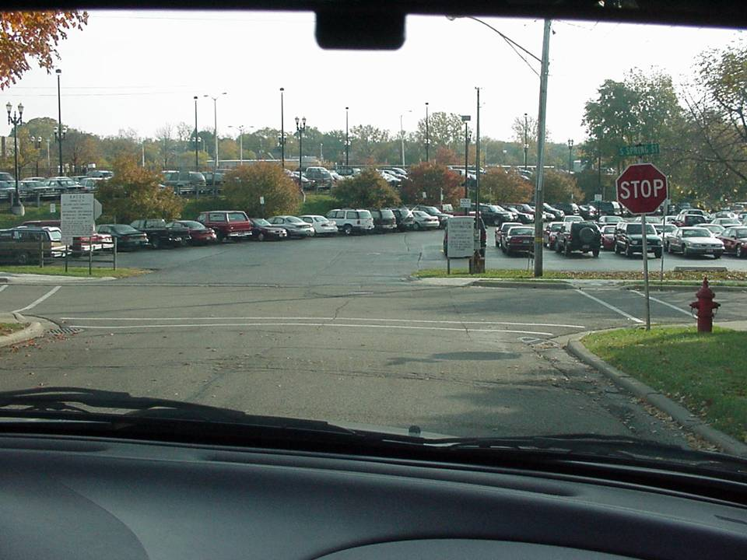
STOP
and
THINK
Why
should you
stop there?
In case
pedestrians
are present.
Where is your stopping point at this intersection?
With no white limit line, use the crosswalk lines.

Slide 15
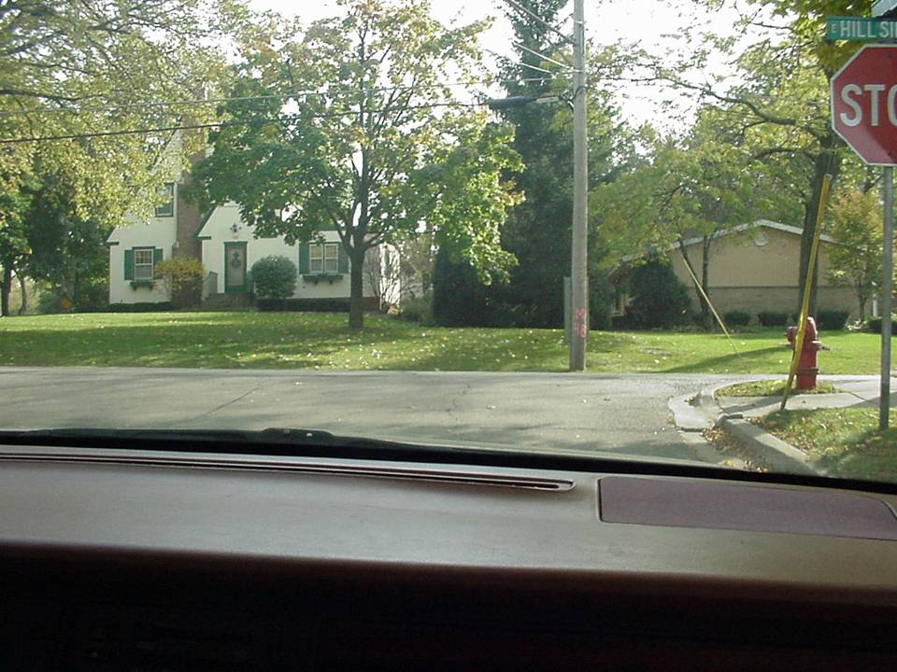
Here, there are no white limit lines at the stop sign. Where is your stopping point?
At the sidewalk.

Slide 16
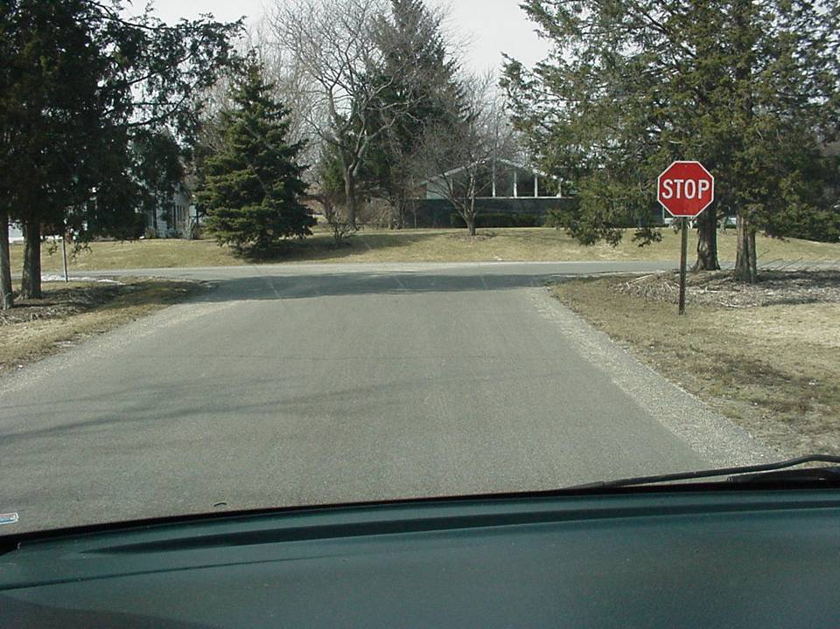
At this stop sign there is no stop line or sidewalk. Where is your stopping point here?
At a point where you can see, without getting into the intersection.

Slide 17
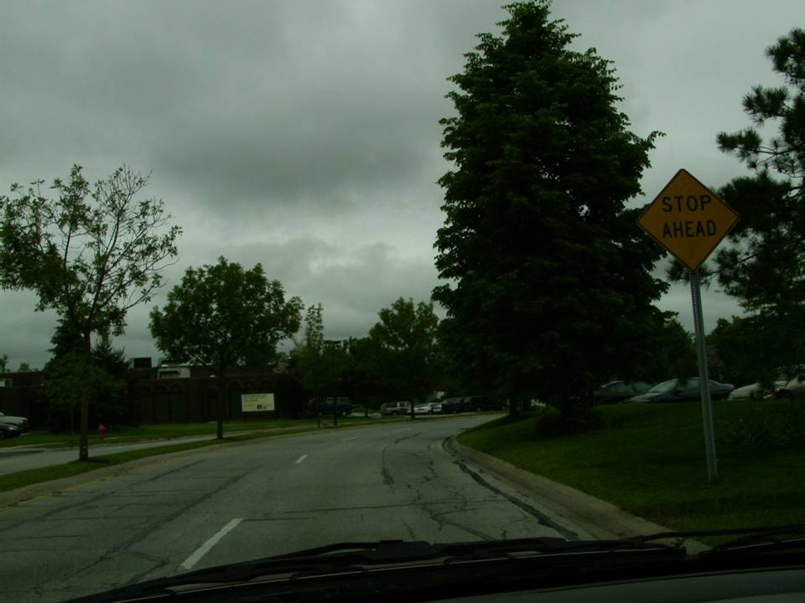
Get in the habit of
“saying the signs”
to yourself as you see them.
Any ideas on WHY this sign is placed here?
The curve and tree is obscuring the stop sign.

Slide 18
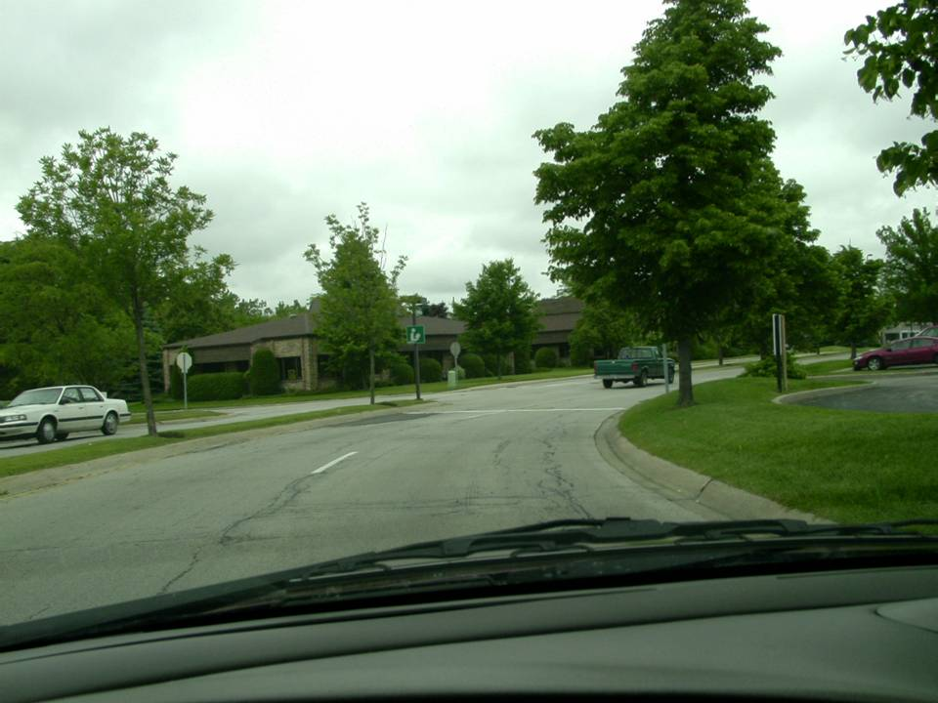
Where is the stop sign?
How do you know?
same curve...
WHITE STOP LINE

Slide 19
Can you identify the 4 stopping points in order?
Let's review
Thick white limit line
Crosswalk lines
Sidewalk
At a point where you can see without getting into the intersection.
Thought question: Besides allowing for pedestrians to cross, what is another reason for stopping at the line?

Slide 20
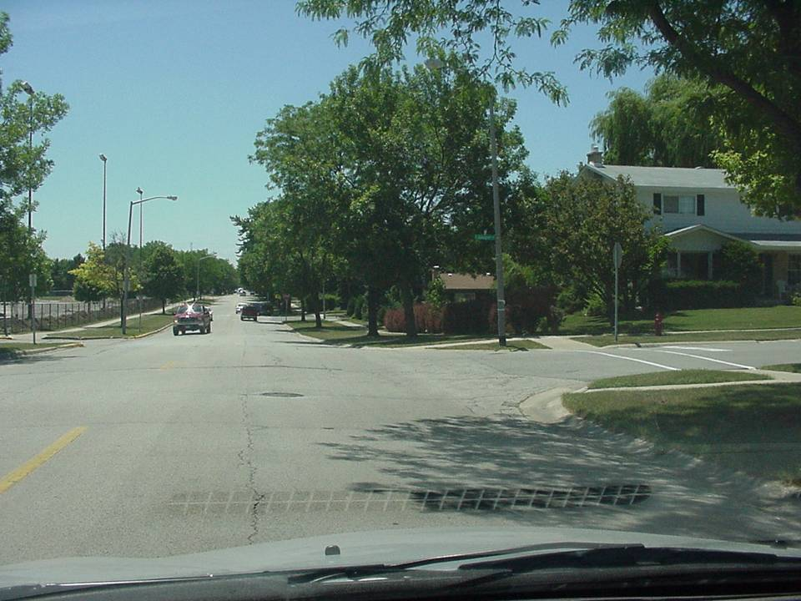

Always stop at
the designated
stopping point!
Cars that overshoot their stopping point may cause other drivers to over react. They may over brake, causing a rear-end collision.

Slide 21
Signs, Signals,
and Road markings
Traffic signs have shapes that denote specific meaning.
This shape is used exclusively for yield signs
The driver should immediately recognize that they are yield to other drivers or pedestrians. This may require slowing down and being ready to stop for other traffic including bicycles and pedestrians…as they have the right of way.

Slide 22
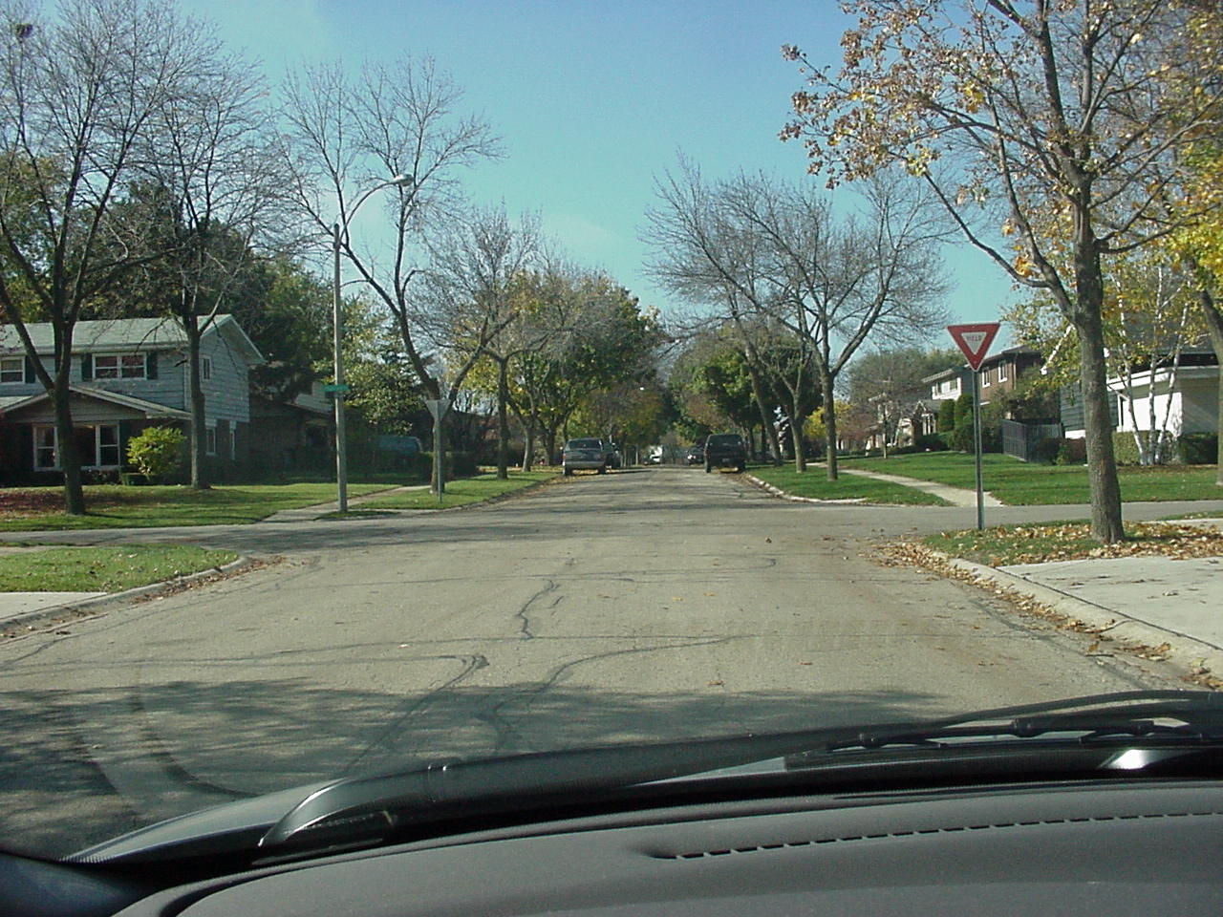

Following the letter of the law
could save you a lot of pain and suffering.
1000’s of accidents are caused by drivers failing to yield.
Failure to yield the right-of-way to others drivers is one of the top five causes of accidents in the U.S.

Slide 23
SLOW DOWN AND BEGIN CHECKING
AS EARLY AS POSSIBLE. You may have to stop.
What will you do as you approach this yield sign?

Slide 24
Signs, Signals,
and Road markings
Traffic signs have shapes that denote specific meaning.
This shape is used exclusively for Railroad Signs
The driver should immediately recognize that a railroad crossing is ahead and be prepared to stop if necessary.
R
R
X
This cross buck warns that the crossing is imminent.

Slide 25
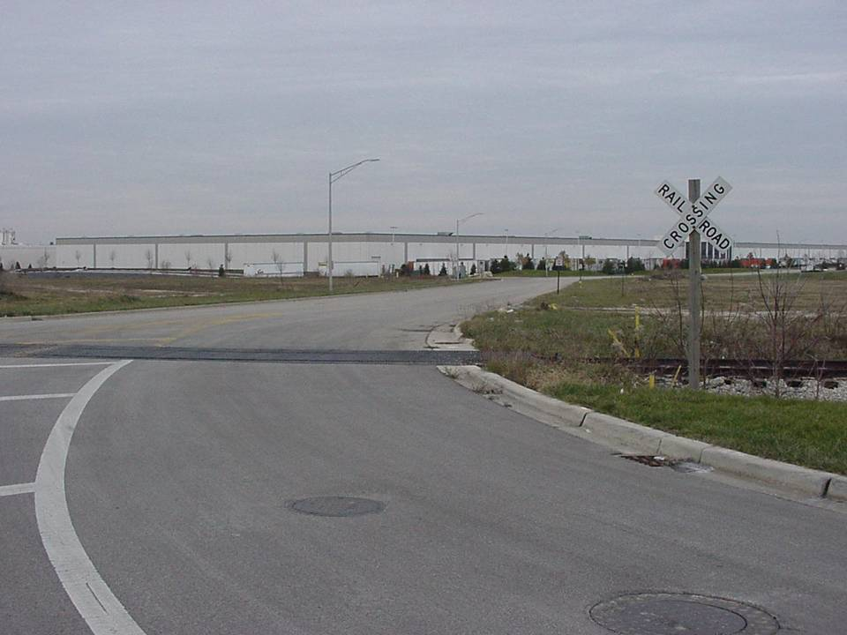

You need to be in the habit of slowing down and checking the tracks every time you cross them.
Eventually you’ll drive in areas where crossings do not have gates, bells and lights!
When approaching a railroad crossing
with no lights or gates and poor visibility
to either side, reduce speed to check the tracks
enabling you to stop if necessary.

Slide 26
Signs, Signals,
and Road markings
This shape is used exclusively for No Passing Zone
This type of sign is rare in some states, but is used in others. Passing is not allowed.
NO
PASSING
ZONE

Slide 27
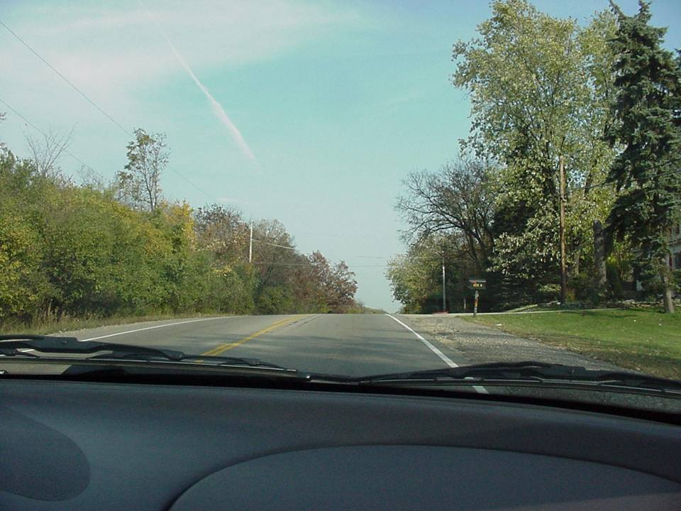
The hill prevents adequate visibility of the road ahead.
Besides the solid yellow line on our side what is another reason passing is not allowed?

Slide 28
Signs, Signals,
and Road markings
This shape is used exclusively for Warning Signs
The driver should immediately recognize that there is a potentially dangerous situation ahead.
Some examples would be intersections ahead, divided road ahead, merging traffic, winding road, and construction ahead.

Slide 29
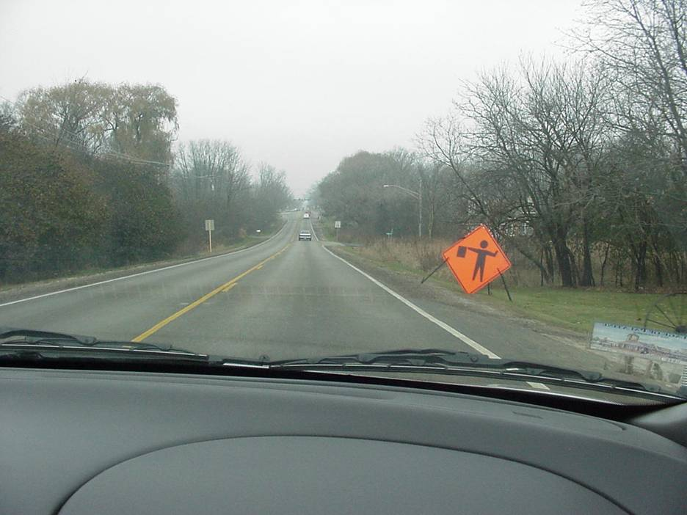

Flag person ahead
What are you expecting ahead?

Slide 30
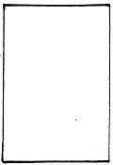
Signs, Signals,
and Road markings
This shape is used for regulatory signs
The driver should immediately recognize that these signs mean a regulatory or warning action that you must obey.
Some examples would be speed limit, keep right, and parking signs.

Slide 31
Signs, Signals,
and Road markings
This shape is used for regulatory, warning, and guide signs
Some examples would be do not enter, no parking and hospital.

Slide 32
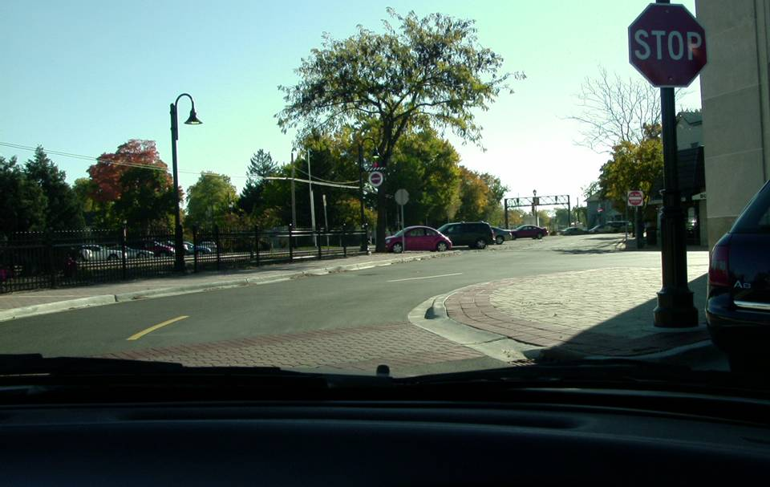


There’s no road to the left.
After stopping, what must you do?
TURN RIGHT
This sign means danger ahead
because you are going the wrong
way. The WRONG WAY sign tells
you that you are traveling the
opposite the direction of traffic.
You must stop and go back to the
road you were originally on,
when safe to do so.

Slide 33
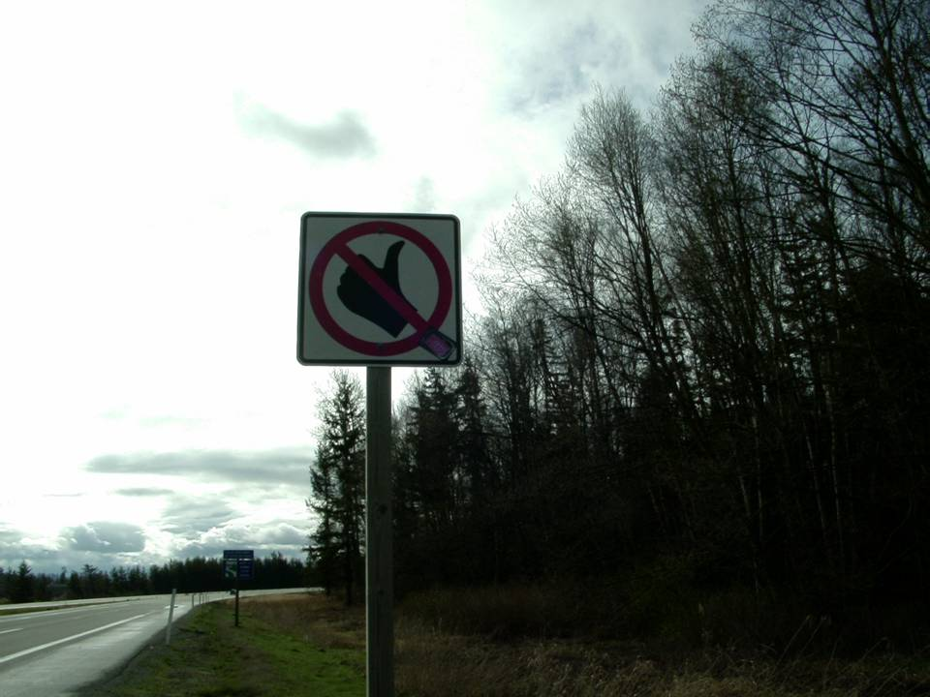

Any idea what this regulatory sign means?
No hitchhiking

Slide 34
Signs, Signals,
and Road markings
This shape is used for school zones
And applies on school days when children are present.

Slide 35
Signs, Signals,
and Road markings
This shape is used exclusively for slow-moving vehicles.
Extra caution must be exercised
as these vehicles can unexpectedly
stop or turn into quickly into your
pathway without warning.

Slide 36
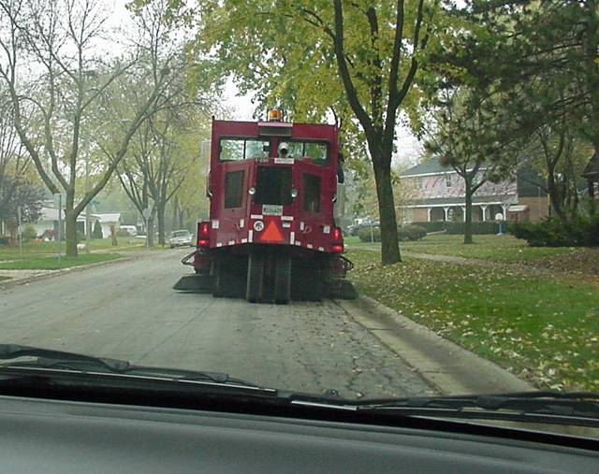
Extra caution must be exercised
as these vehicles can unexpectedly
stop or turn into quickly into your
pathway without warning.

Slide 37
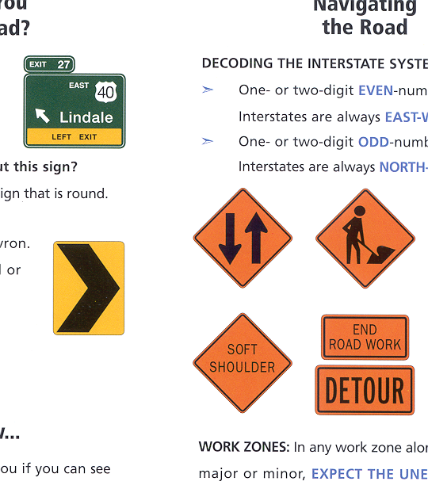
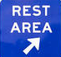
Rocky Mountain
State Park
Signs, Signals,
and Road markings
This shape is also used for regulatory, warning, and guide signs
Some examples would be recreational areas, destination signs, and rest areas.

Slide 38
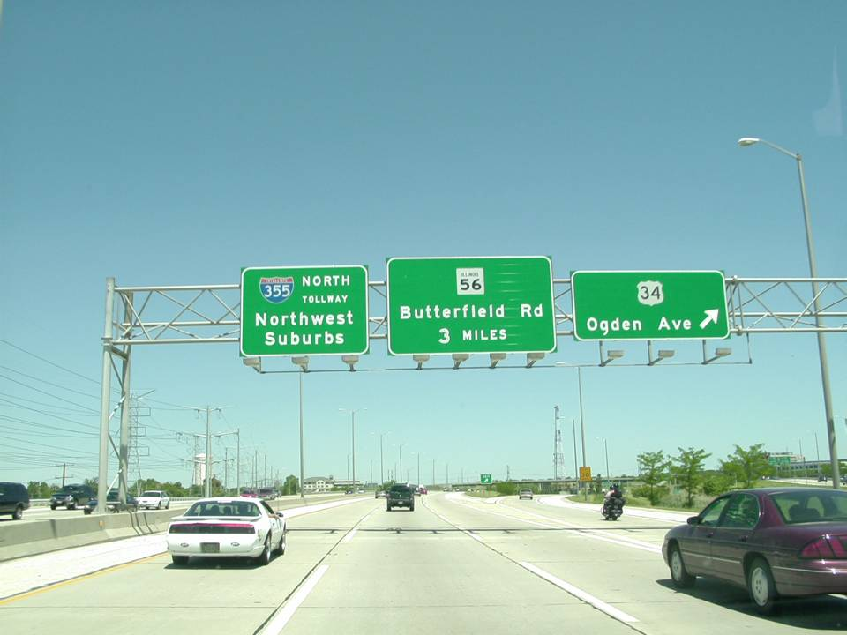
What are the three D’s of green color signs?
Destination
Distance
Direction

Slide 39

Signs, Signals,
and Road markings
These shapes are used for various route signs
Their colors and shapes denote specific meanings

Slide 40
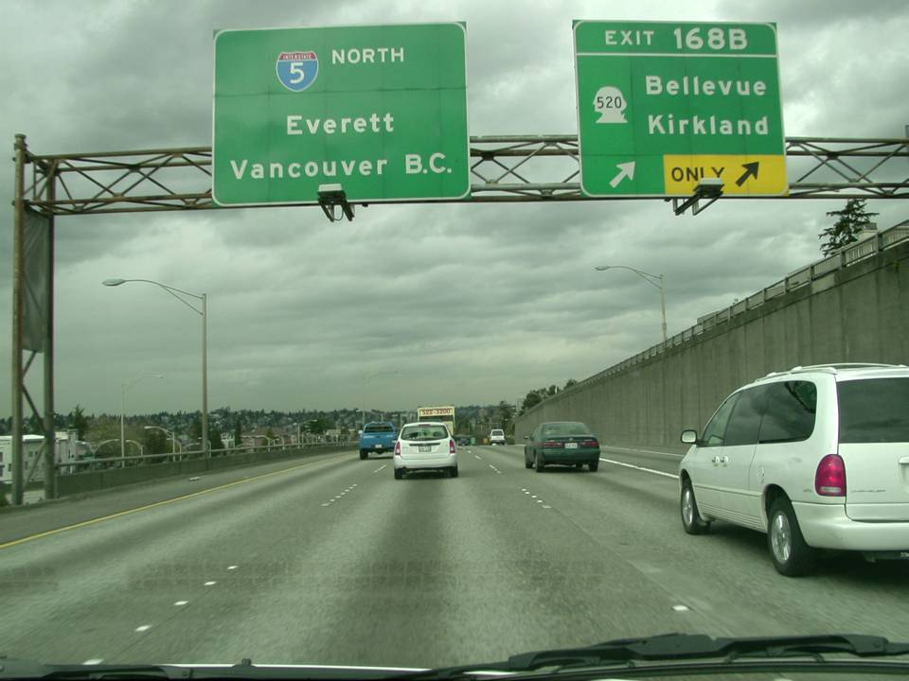
Washington
What state is this ?
Georgia
What state is this ?
Some state routes will take on a special shape or shape of the state.

Slide 41
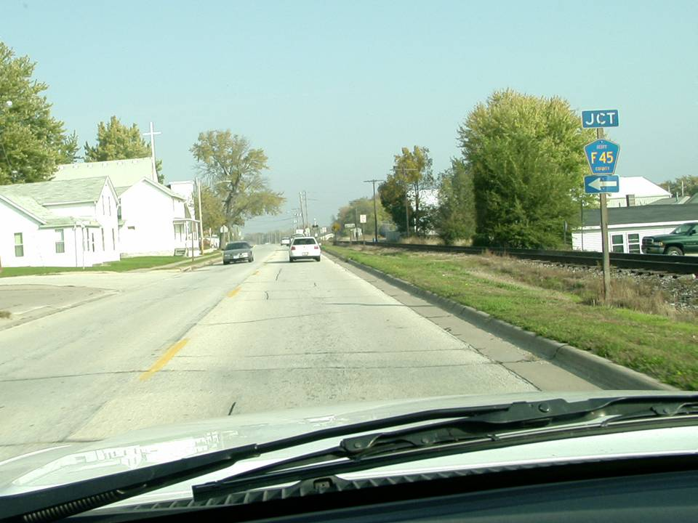
What type of route sign is this?
County route
(found primarily in rural areas)

Slide 42
Signs, Signals,
and Road markings
Before moving on…quiz yourself
on what was just covered

Slide 43
A) RAILROAD
B) DO NOT ENTER
C) STOP
D) WARNING

Slide 44
A) RAILROAD
B) DO NOT ENTER
C) STOP
D) WARNING
STOP
STOP

Slide 45
A) YIELD
B) SLOW MOVING VEHICLE
C) NO PASSING ZONE
D) WARNING

Slide 46
A) YIELD
B) SLOW MOVING VEHICLE
C) NO PASSING ZONE
D) WARNING

Slide 47
A) Railroad
B) Do not enter
C) Stop sign
D) Route sign
R

Slide 48
A) Railroad
B) Do not enter
C) Stop sign
D) Route sign
R
R

Slide 49
A) RAILROAD
B) STOP
C) DO NOT ENTER
D) NO PASSING

Slide 50
A) RAILROAD
B) STOP
C) DO NOT ENTER
D) NO PASSING

Slide 51
A) Regulatory
B) Warning
C) Guidance
D) Caution

Slide 52
A) Regulatory
B) Warning
C) Guidance
D) Caution

Slide 53
A) Hazard
B) Curve to the right
C) No passing zone
D) Slow moving vehicle

Slide 54
NO
PASSING
ZONE
A) Hazard
B) Curve to the right
C) No passing zone
D) Slow moving vehicle

Slide 55
A) Warning
School Zone
Regulatory
D) Railroad

Slide 56
A) Warning
School Zone
Regulatory
D) Railroad

Slide 57
A) regulatory
B) warning
C) school
D) yield

Slide 58
A) regulatory
B) warning
C) school
D) yield

Slide 59
A) YIELD
B) WARNING
C) HAZARD
D) SLOW MOVING VEHICLE

Slide 60
A) YIELD
B) WARNING
C) HAZARD
D) SLOW MOVING VEHICLE

Slide 61
A) County route
B) State route
C) Interstate route
D) US route

Slide 62
A) County route
B) State route
C) Interstate route
D) US route

Slide 63
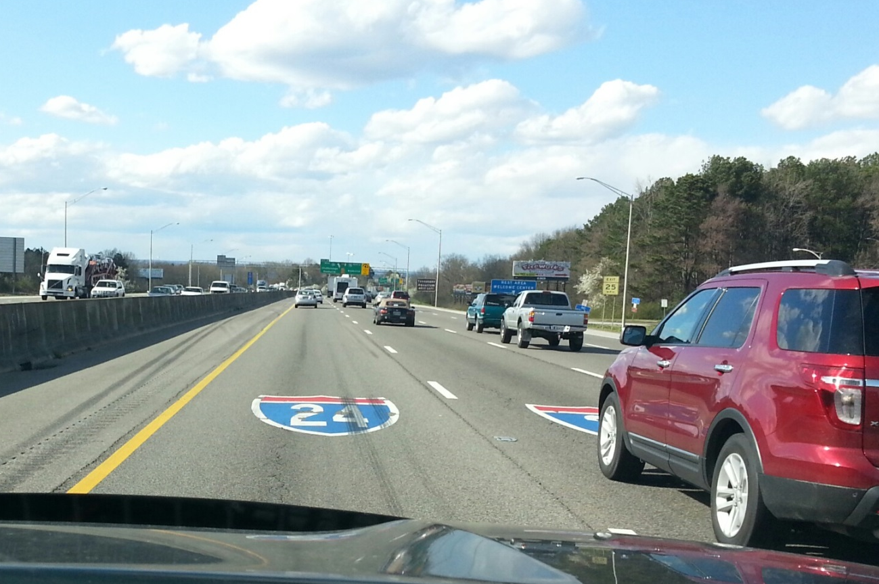

Slide 64
A) County route
B) State route
C) Interstate route
D) US route

Slide 65
A) County route
B) State route
C) Interstate route
D) US route
Let’s now continue with an understanding
of the various colors used on the signs

Slide 66
RED COLOR SIGNS
INTERSTATE
STOP
4 - W A Y
Red is used exclusively for STOP and Yield signs, Do not enter signs, wrong way signs, for symbols on certain regulatory signs and as part of Interstate and certain State route signs.
DO NOT
W R O N G
W A Y
ENTER

Slide 67




A red circle with a red line through it is also used to denote that something is not permitted. The picture inside the circle shows what you cannot do.
No Parking signs must be obeyed

Slide 68
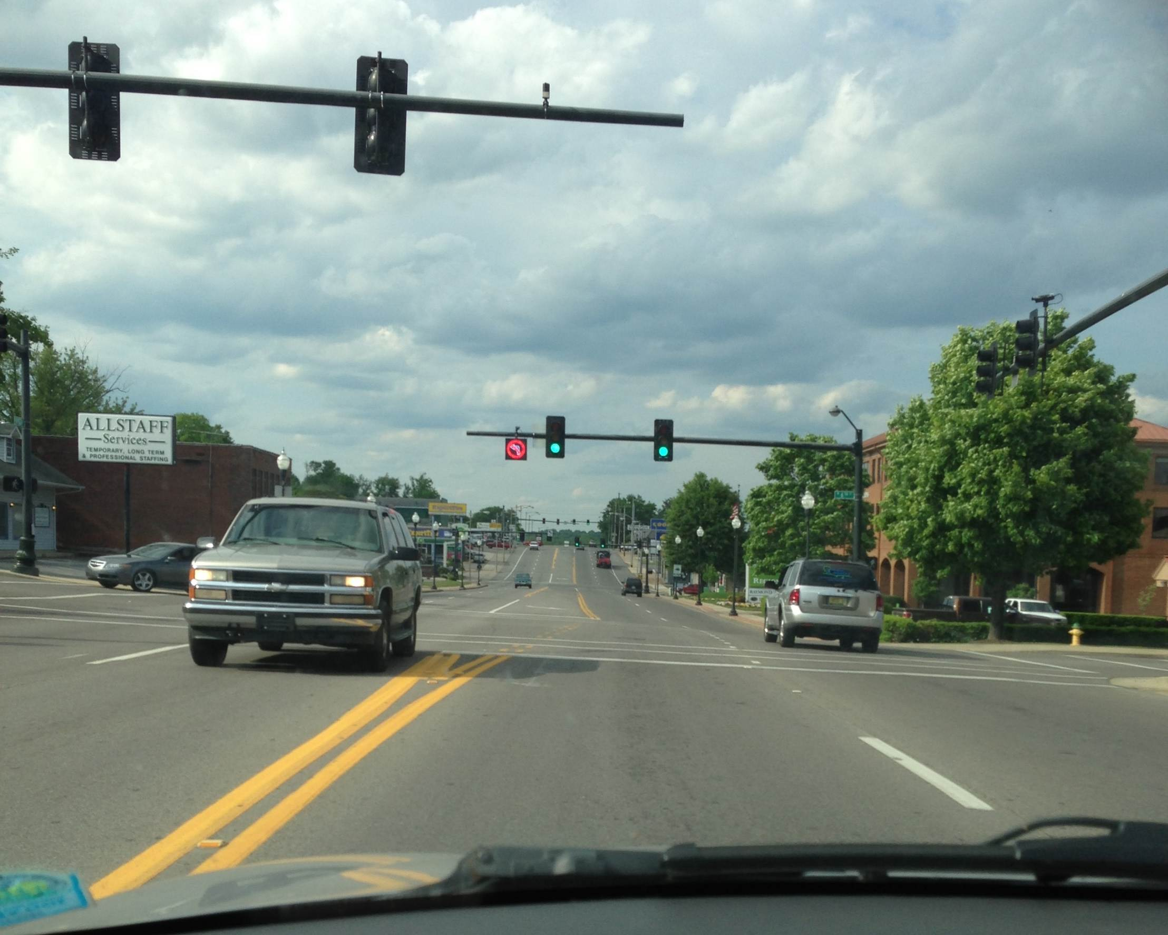
Also be aware that a prohibiting sign may light up

Slide 69
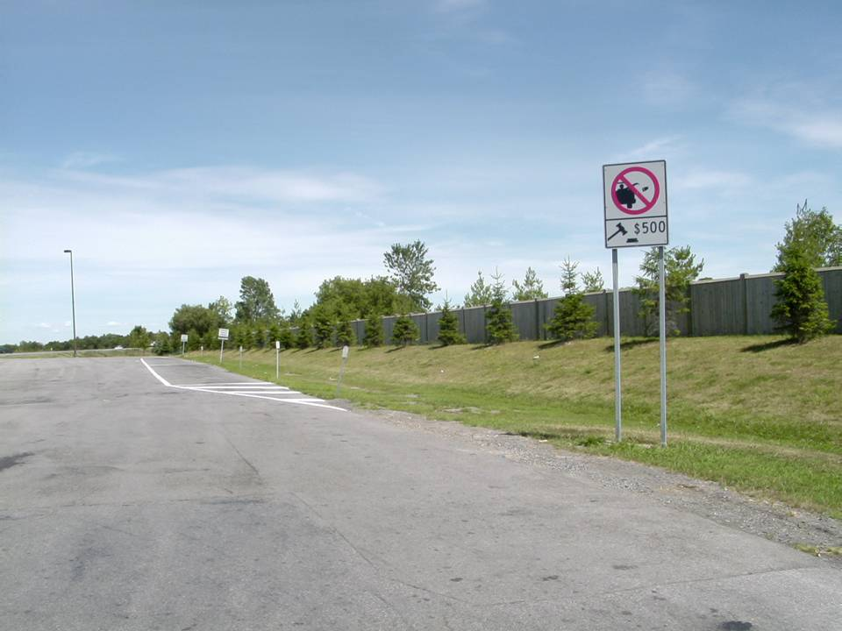
- $500 dollar fine for littering
What 2 things is this regulatory
sign telling you?

Slide 70

BLACK COLOR
ONE
WAY
Black is used as a background for ONE WAY, night speed limits, (in other states) also as a message color on signs with white, yellow, or orange backgrounds.

Slide 71
WHITE COLOR
White is used as a background for route markers, guide signs, and certain regulatory signs, and as message color on signs with brown, green, blue, black, and red backgrounds.
Rocky Mountain
State Park

Slide 72
ORANGE COLOR SIGNS
Orange color signs are used as a background color for construction and maintenance.

Slide 73
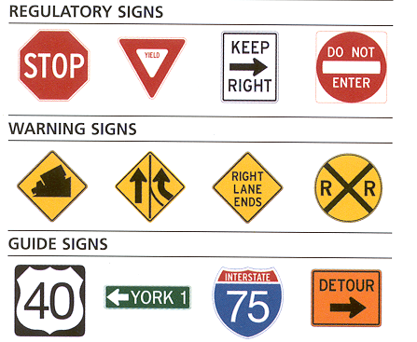
YELLOW COLOR SIGNS
Yellow signs are used as a background color for warning signs and some school signs. (except construction and maintenance signs)

Slide 74
GREEN
COLOR
SIGNS
Green color signs are used as a background color for guide signs, mileposts, and street names, and as a message color on permissive regulation and parking signs.
M I L E
4
FREEWAY
ENTRANCE
Parking
this exit

Slide 75
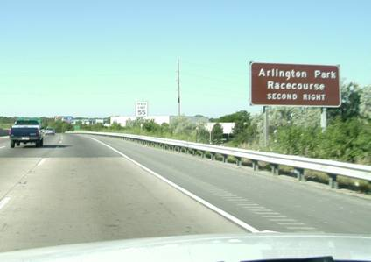
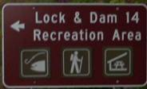
Rocky Mountain
State Park
BROWN COLOR
SIGNS
Brown color signs are used as a background color for guide and information signs that relate to points of recreational or cultural interest and on some street name signs.
What do these symbols mean?

Slide 76
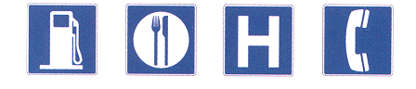
BLUE COLOR SIGNS
Blue color signs are used as a background color for traveler services, information signs, Civil Defense Evacuation Route Markers and some street name signs.
REST
AREA

Slide 77
FLOURESCENT YELLOW-GREEN SIGNS
FLOURESCENT YELLOW-GREEN SIGNS
Fluorescent Yellow Green is also used as a background for pedestrian, bicycle, and school warning signs.

Slide 78
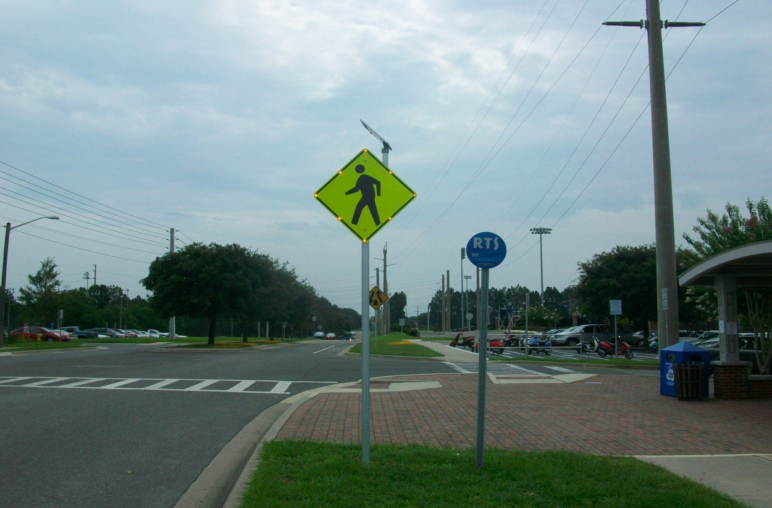
FLOURESCENT YELLOW-GREEN SIGNS
FLOURESCENT YELLOW-GREEN SIGNS
This sign has flashing yellow lights to get our attention

Slide 79
Signs, Signals,
and Road markings
Before moving on…quiz yourself
on what was just covered

Slide 80
RED COLOR SIGNS
A) Regulatory
B) Distance, direction, destination
C) Warning
D) Motorist services

Slide 81
A) Regulatory
B) Distance, direction, destination
C) Warning
D) Motorist services

Slide 82
Yellow color signs
A) Regulatory
B) Distance, direction, destination
C) Warning
D) Motorist services

Slide 83
A) Regulatory
B) Distance, direction, destination
C) Warning
D) Motorist services

Slide 84
GREEN COLOR SIGNS
A) Parks & Recreation areas
B) Distance, direction, destination
C) Warning
D) Motorist services

Slide 85
GREEN COLOR SIGNS
A) Parks & Recreation areas
B) Distance, direction, destination
C) Warning
D) Motorist services

Slide 86
BLUE COLOR SIGNS
A) Motorist services
B) Guidance
C) Warning
D) Construction

Slide 87
BLUE COLOR SIGNS
A) Motorist services
B) Guidance
C) Warning
D) Construction
REST
AREA

Slide 88
BROWN COLOR SIGNS
A) Parks & Recreation areas
B) Distance, direction, destination
C) Warning
D) Construction

Slide 89
Rocky Mountain
State Park
BROWN COLOR SIGNS
A) Parks & Recreation areas
B) Distance, direction, destination
C) Warning
D) Construction

Slide 90
ORANGE COLOR SIGNS
A) Motorist services
B) Guidance
C) Caution
D) Construction

Slide 91
ORANGE COLOR SIGNS
A) Motorist services
B) Guidance
C) Caution
D) Construction

Slide 92
Signs, Shapes and Colors
Quiz time…how much do you remember?

Slide 93
1)1) The eight-sided octagon shape is used exclusively for ______________.
Stop signs
1)2) What part of your car must stop at the white limit line? __________________
The front of the car
1)3) This triangle shaped sign is used exclusively for
_________ signs.
yield
1)4) At this sign, drivers must be ready to ______to other traffic as they will have the ____ __ ____.
yield
right of way
1)5) Round shaped signs are used exclusively for __________________
railroad crossing
6) This shape is used for ___ ________ _____
no passing zone
1)7) This diamond shape sign is used for _________
It is colored ______for general warnings and
_______for construction
warning
yellow
orange

Slide 94
8) This vertical rectangle is used for _________signs.
The three most used colors on these signs:
____________________________
It - It
regulatory
red
black
white
1 9) Green shaped signs like this are used as ______________signs.
destination
10) This route sign is often found in more than one state. This sign is a __________ route.
US Highway
a possible quick lane change in front of us
1) 11) This sign is also frequently seen crossing state borders. This sign is an _____________route.
Interstate
1) 12) This is a _____________ sign.
do not enter
1 13) This shape always means ___________.
school

Slide 95
14) Four regulatory signs that have red in them:
_____________________________________
Stop sign
Yield
Do not enter
No left turn (etc)
15) Brown color signs designate: ______________
parks and recreation areas
16) Blue color signs indicate: _____________
motorist services
1) 17) The newer school signs are what color? ____________
fluorescent green
18) This sign would be ______ color.
orange
19) This sign (with a picture inside) means: _________
prohibited
20) As you travel about the country, you may see a sign like this with a number in it. This is an example of a ______ route.
state

Slide 96
Signs, Shapes and Colors

Slide 97
Drivers Edge: Interactive slides and videos®
Copyrighted Driver Education School Literature
These electronic slide shows are produced by InterActive Enterprises. Microsoft PowerPoint ® was used to create the presentations. Each segment includes discussion questions and may include illustrations, photographs, videos, animations, etc. Contact us at for more information at: 2183 Doctor Robertson Rd. Spring Hill, TN 37174 Email with suggestions, comments, questions or for more information.
This slide show is a type of educational media and is copyrighted in regards to slide layout, text and arrangement. You may modify, delete, or add to for your own use but you may not redistribute. One set of slides per school or user may be copied to the computer’s hard drive. Networking in a computer lab is also allowed. See other restrictions in regards to graphics as required by agreements with graphic providers. RESTRICTIONS: “This product/publication includes images from Microsoft Design Gallery, Animation Factory, Corel MegaGallery and Corel Gallery 1,000,000 and Click Art which are protected by the copyright laws of the U.S., Canada and elsewhere. Used under license. These images are for viewing purposes only in this series and may not be saved or downloaded for other uses.
Other images used by permission are from: In-Motion magazine, General Motors; selected videos from the U. S. Dept. of Transportation (Moving Safely Across America) Many other images are from the public domain.
A limited warranty or guarantee is in effect upon initial receipt of this product. Any defective product will be replaced upon notification within 90 days of receipt of product.
Copyright © 2014 Interactive Enterprises
iae@charter.net

