Slide 1
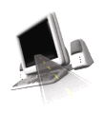

T H E D R I V E R S E D G E
I N T E R A C T I V E
slides and videos
Partial lesson
20 of 64 slides
Unit 8 – Vehicle Components and Systems

Slide 2
Vehicle Components and Systems
Purpose: Become acquainted with a vehicle’s main systems and components in terms of their purpose, safe and legal use, maintenance, and certain economic considerations. Includes vehicle purchase issues.

Slide 3
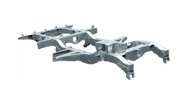
Vehicle Components and Systems
Vehicle Systems and components
Vehicle frame and body:
The purpose of a vehicle’s frame is to support the body, engine, and other components.
Vehicle Frame
The frame itself is supported by the wheels and tires through the vehicles suspension system.

Slide 4
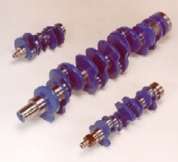
Vehicle Components and Systems
Vehicle Systems and components
The engine:
When you start your car: (a) power from your battery is used to operate a small electric motor called the starter motor, (b) the starter motor turns the flywheel and crankshaft of the engine so that the engine can attain sufficient momentum and speed to start and run on its own, (c) delivering rotational power to the crankshaft which supplies power to the remainder of the power train.
Battery
Spark Plug
Crankshaft
Engine

Slide 5
Vehicle Components and Systems
Vehicle Systems and components
The engine:
This power is ignited by exploding gas inside cylinders which drives pistons up and down, through connecting rods. Inside the pistons a mixture of compressed air and gas is delivered to the cylinders by a carburetor and intake manifold or a fuel injection system.
The moving parts of the engine must be lubricated. Oil which accumulates in your engine’s oil pan is pumped by the oil pump through an oil filter and then through tubes that deliver the oil to the moving parts to be lubricated.
Oil and Oil Filter

Slide 6
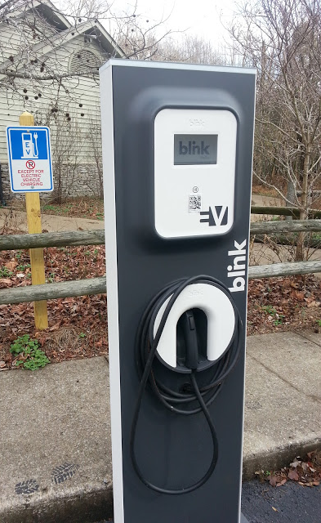
Vehicle Components and Systems
Vehicle Systems and components
The engine:
But some engine are also fully powered by electricity
Charging Station

Slide 7
Vehicle Components and Systems
Vehicle Systems and components
The fuel system:
Fuel and air is delivered to the engine through components which include: (a) the fuel tank which is used to store the gas, (b) a fuel pump which pumps the gas from the tank through a fuel line and furl filter to a carburetor or fuel injection system.
This fuel injection system or carburetor delivers the proper mix of air and gas to the cylinders by means of an intake manifold after passing through an air cleaner.
Question: What is the name of
the system that moves the
gasoline to the engine?

Slide 8
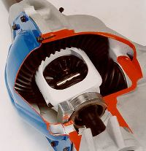

Vehicle Components and Systems
In a front wheel drive vehicle, the power is transmitted from the engine through a combination transmission-differential and then to the front wheels.
Vehicle Systems and components
The power train system:
A vehicle’s power train consists of components that generate and transmit power to the wheels.
In a rear wheel vehicle automatic vehicle, it includes: (a) the engine which generates the force, (b) the transmission which adjusts and controls the engine’s RPM and changes the gears, (c) the drive shaft which transmits forces from the transmission to the rear of the vehicle into the differential which allows the axels and back wheels to turn.
Differential
Drive shaft
Transmission
In a four-wheel drive vehicle, power is transmitted from the transmission to a transfer case which can transmit power to either the rear wheels only or to both the rear and front wheels.
Question: What is the name of
the system that transmits
power to the wheels?

Slide 9
Vehicle Components and Systems
Vehicle Systems and components
The exhaust system:
After gas is exploded in one of the cylinders it is released into an exhaust manifold which collects it and passes it to a catalytic converter which chemically reduces the quantity of harmful pollutants.
The gases are then passed by exhaust pipes through a muffler and resonator which reduce the noise.
The gasses are then moved to the tailpipe which vents the hot air away from the vehicle.
Muffler
Exhaust Pipes
Keep your exhaust system in good working order by noticing changes in noise, fumes, and rattling. These all signal problems. Eventually all vehicles need replacement exhaust components.
Question: What is the name of the
system that removes the emission
gases into the environment?

Slide 10
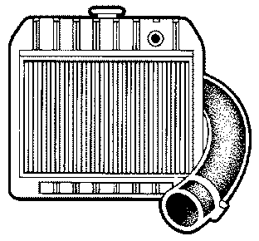
Vehicle Components and Systems
The radiator is cooled by a fan, and most have a recovery tank to capture coolant as it expands due to the heat, and returns it to the radiator when it cools.
Vehicle Systems and components
The cooling system:
Heat caused by the friction of moving engine parts and the explosion of gasoline is removed through the vehicles cooling system.
In this system, heat is absorbed by coolant flowing through passages inside the engine. The coolant is a mixture of water and chemicals that protect the cooling system from corrosion, lubricate the water pump, and prevent freezing.
It is stored in the radiator which transfers the heat to the outside environment.
Radiator
This coolant also allows your engine to heat up to its proper operating temperature and is controlled by a heat sensing valve called a thermostat.
Question: What is the name of
the system that prevents the
engine from overheating?

Slide 11
Vehicle Components and Systems
Vehicle Systems and components
Electricity is distributed throughout your vehicle by various electrical circuits for lighting, computers, radio, interior cooling, heating, etc.
The electrical system:
The battery is your vehicle’s primary source of electrical power. When you turn on your ignition switch to start your car, electricity is used to close another switch called a solenoid that transmits the large amount of current needed to turn the starter motor.
Once your engine is running, power is generated by the alternator, which also keeps your battery charged.
Then there is a voltage regulator, distributor, and coil which controls the amount of electricity needed by the spark plugs.
These circuits have fuses to disable a circuit that is drawing too much current so as to prevent a fire and protect the components that the circuit serves.
Question: What is the name of
the system that starts the motor?

Slide 12
Vehicle Components and Systems
When you turn the steering wheel in a power steering system, the hydraulic fluid is compressed inside a cylinder.
Vehicle Systems and components
The steering system:
A vehicle’s steering wheel is attached to a steering column or shaft which terminates in the steering box. Inside the steering box, the turning motion of the column is translated into lateral motion which is passed on to the wheels through a series of components which include ball joints, the steering arm, and steering knuckle.
In power steering systems, turning the steering wheel actuates a hydraulic system which amplifies the force necessary to rotate and move the linkages leading to the wheels.
With power steering there should be no “free play” in the wheel; and no more than 2 inches with cars without power steering.
This compressed fluid is then transmitted by hydraulic lines to a piston which amplifies the force making it easier to turn the wheels.
Question: What is the name of
the system that makes it
possible to turn the car?

Slide 13
Vehicle Components and Systems
There are are different designs for suspension systems involving various linkages, struts, joints, torsion bars, and so on.
Vehicle Systems and components
The suspension system:
The purpose of your vehicle’s suspension system is to connect the wheels to the frame and body and keep the movement of your wheels from being transmitted fully to the body of the vehicle.
This allows you to maintain control of the car in turns, when you hit potholes, and on rough roads. It makes riding in the car more comfortable.
Coil Springs and Shock Absorbers
Question: What is the name of
the system that helps ease
the jarring effect of potholes?
As the up and down movement of your wheels is absorbed by the springs in your suspension system, your shock absorbers keep the springs from continuing to bounce.

Slide 14
Vehicle Components and Systems
While thinking about the suspension, can anyone explain how potholes are formed, which inflict significant strain on the suspension?
Vehicle Systems and components
The suspension system:
The purpose of your vehicle’s suspension system is to connect the wheels to the frame and body and keep the movement of your wheels from being transmitted fully to the body of the vehicle.
This allows you to maintain control of the car in turns, when you hit potholes, and on rough roads. It makes riding in the car more comfortable.
Coil Springs and Shock Absorbers
Let’s now consider your
vehicle’s braking system.
As the up and down movement of your wheels is absorbed by the springs in your suspension system, your shock absorbers keep the springs from continuing to bounce.

Slide 15
Vehicle Components and Systems
Vehicle Systems and components
Hydraulic fluid is stored in a brake reserve normally located in the engine compartment.
The suspension system:
The purpose of your vehicle’s suspension system is to connect the wheels to the frame and body and keep the movement of your wheels from being transmitted fully to the body of the vehicle.
This allows you to maintain control of the car in turns, when you hit potholes, and on rough roads. It makes riding in the car more comfortable.
Question: What is the name of
the system that stops the car?
As the up and down movement of your wheels is absorbed by the springs in your suspension system, your shock absorbers keep the springs from continuing to bounce.

Slide 16
Vehicle Components and Systems
Vehicle Systems and components
Your parking brake uses a cable to engage the brakes or clamp down on the drive shaft, and will function even if your service brakes fail.
The braking system:
There are two types of brakes:
(a) drum brakes and (b) disc brakes
Drum brakes slow your vehicle by the friction of a brake shoe pushing against the drum which is rotating with the wheel.
Disc brakes slow your car by the friction of a caliper pressing against a disc which is rotating with the wheel.
Both drum and disc brakes convert friction force to heat and if the brakes get too hot, they cease to work because they cannot dissipate enough heat.
For both types of brakes, your stopping time is roughly proportional to the square of your speed. So, if you double your speed you increase your stopping distance by four times!

Slide 17
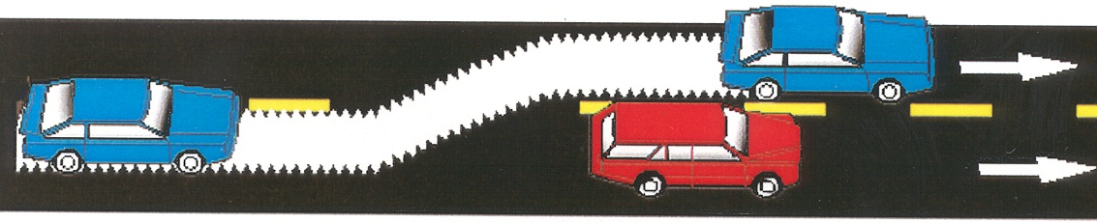
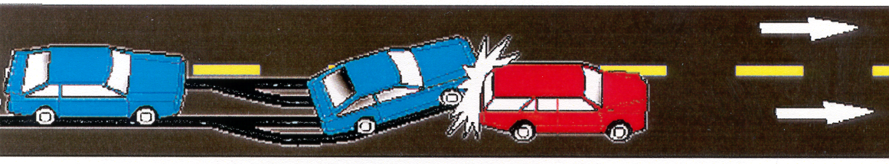
Vehicle Components and Systems
The purpose of the antilock braking system is to prevent the brakes from locking by first sensing that they are locking then automatically, rapidly releasing and applying pressure. If you do not have antilock brakes, you can avoid having your brakes lock manually, rapidly releasing and then reapplying pressure to your brake pedal.
Vehicle Systems and components
The braking system:
Brakes will only slow your car while there is friction between the moving parts of your brakes.
If the wheels are locked as in the case of a skid, the drums or discs are not moving and there will be no friction.
With ABS: wheels do not lock up…you have steering control.
Let’s now
consider
driver
controls
Without ABS: wheels lock up…no steering control.

Slide 18
Vehicle Components and Systems
Vehicle Systems and components
Vehicle maintenance: fuel system:
Leaks in your fuel system can cause fires and expose you to toxic gases. The leaks can occur in the fuel tank, fuel lines, fuel pump, carburetor, fuel injector lines and even by not having your gas cap secured attached.
If you smell gas you should immediately stop the car, turn off the engine and determine the problem. Your fuel system should be checked for leaks as part of regular maintenance.
Let’s now consider lights,
gauges and chimes
in more detail.

Slide 19
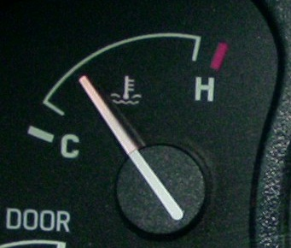
Vehicle Components and Systems
Vehicle Systems and components
The instrument panel: lights, gauges and chimes:
Certain gauges and lights are more important than others.
An easy way to remember the most important one is to learn: “boil, oil, and coil.”
The first and most important is the temperature or “boil”. When this warning light is on or the gauge moves into the red, it means the temperature of the engine is too high and the engine will overheat soon.
The proper response is to pull over and turn off the engine so it can cool down. It would be good to then get your cooling system checked.
Question: What should
you do if this needle
goes into the red zone?
Red zone

Slide 20
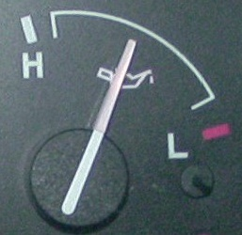
Vehicle Components and Systems
Vehicle Systems and components
The instrument panel: lights, gauges and chimes:
Certain gauges and lights are more important than others.
An easy way to remember the most important one is to learn: “boil, oil, and coil.”
Next, is the oil gauge or warning light. It signifies that the oil level is low. Without oil, the parts that need lubrication would heat up, expand and not move freely. This will cause permanent damage to the engine.
Question: What should
you do if this needle
gets any lower?
The proper response is to check and add oil to the recommended level. The vehicle should be checked out to find out why the oil level was low.
It’s a good idea to frequently check your oil level anyway.

Slide 21
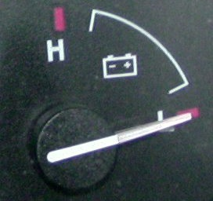
Vehicle Components and Systems
Let’s now consider the legal
use of safety equipment.
Vehicle Systems and components
The instrument panel: lights, gauges and chimes:
Certain gauges and lights are more important than others.
An easy way to remember the most important one is to learn: “boil, oil, and coil.”
“Coil” relates to the battery or alternator light or voltage gauge. If trouble is indicated, it means the battery is not being charged. This is the least urgent of the three warnings. The problem will eventually bring things to a stop, but it does not require immediate or emergency attention.
The proper response is to get the system checked out. It could be a bad battery, alternator, or other related electrical problem.
Question: What should
you do if this needle
drops into the red zone?
Generally the needle of a well charged battery will be in the center of the gauge.
Red zone

