Slide 1


T H E D R I V E R S E D G E
I N T E R A C T I V E
slides and videos
Partial lesson
18 of 48 slides
Unit 5 – Vehicle Maintenance

Slide 2

Vehicle Maintenance

Slide 3

Vehicle Maintenance
There are many things that you can do to keep your car in good condition, but there are some things that need to be left to mechanics.
This lesson will focus upon things the average person, with a little knowledge and desire, can do to help maintain their car in good operating condition.

Slide 4
What You Can Do
Vehicle Maintenance
Check your tire pressure
Rotate your tires
Check and change your oil
Check and fill various fluid levels
Replace air filter, fuses
Changing bulbs and lights
Change a flat tire, jump start a car

Slide 5
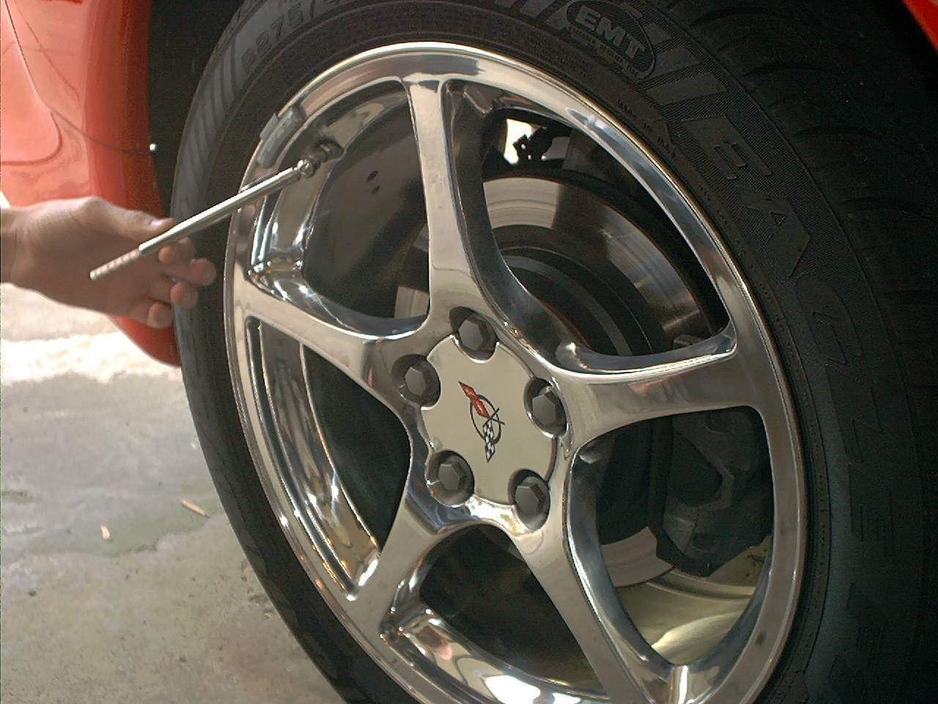
Checking
Tire Pressure
(check at every fuel fill up)
Vehicle Maintenance
To check your tire pressure first unscrew the air cap off of the tire rim.
Then use a pressure gauge to check your tire pressure and compare it to the sticker on the inside of the door.
If your tire pressure is low, you should add air to your tire as recommended.
What
do you
know
about
checking
tire
pressure?

Slide 6
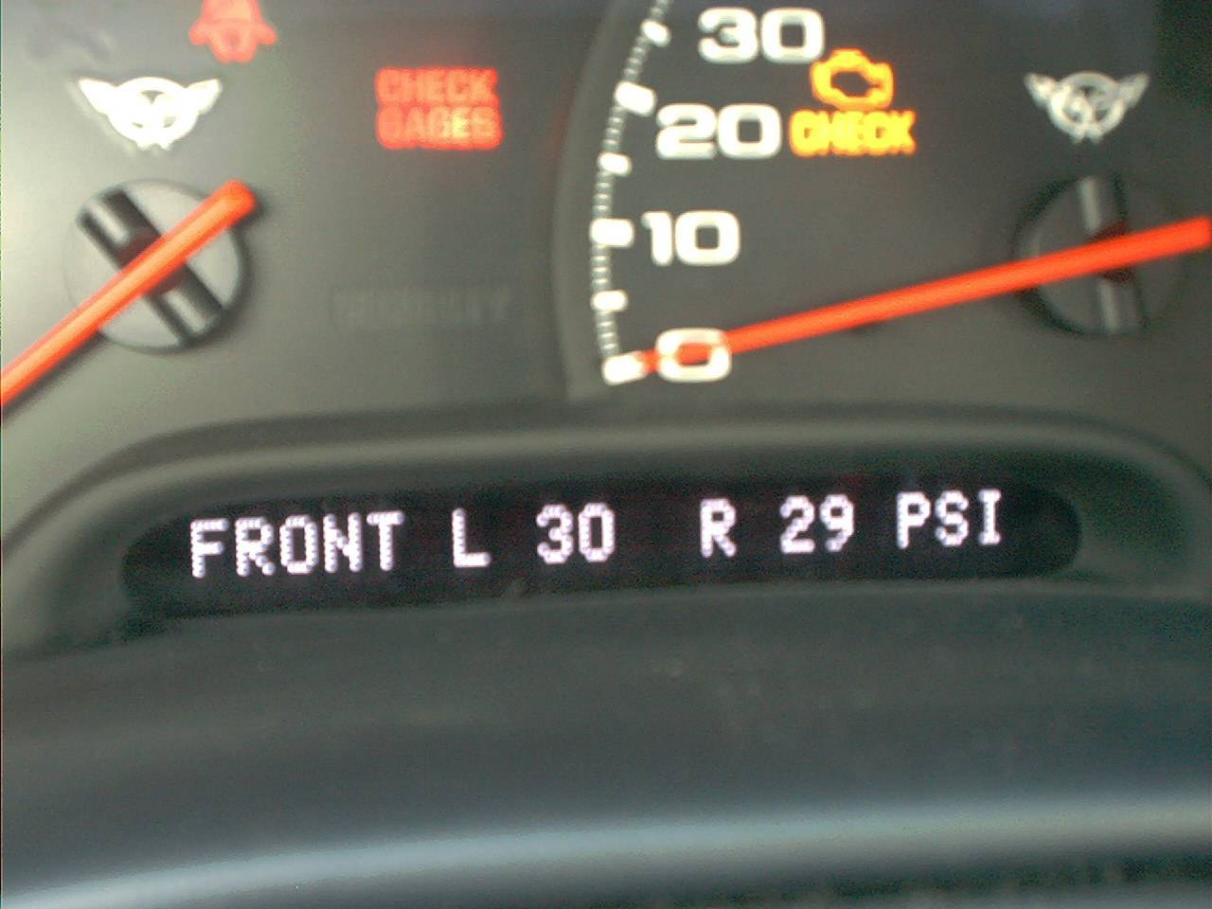
Checking
Tire Pressure
Vehicle Maintenance
Some newer cars will alert you when your tire pressure is low by displaying it on the dash board.
It is also a very convenient way to check your tire pressure.

Slide 7
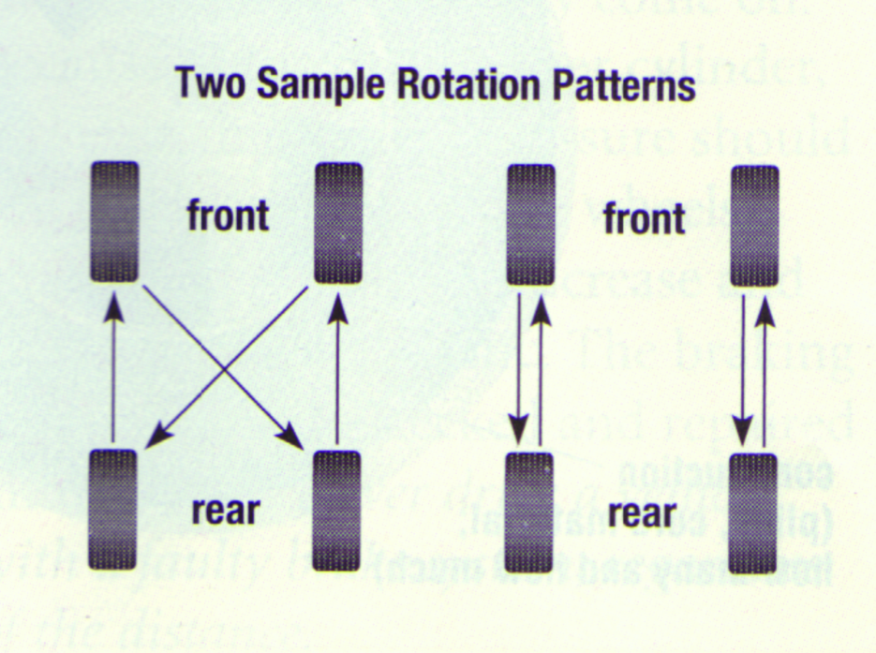
Tire Rotation
(usually about every 5000 miles)
Vehicle Maintenance
What
do you
know
about
tire
rotation?
Tire rotation will allow your tires to last much longer.
Refer to your vehicles users manual for the proper tire rotation patterns and for how often they should be rotated.
For you to do this job you’ll need these . . .

Slide 8
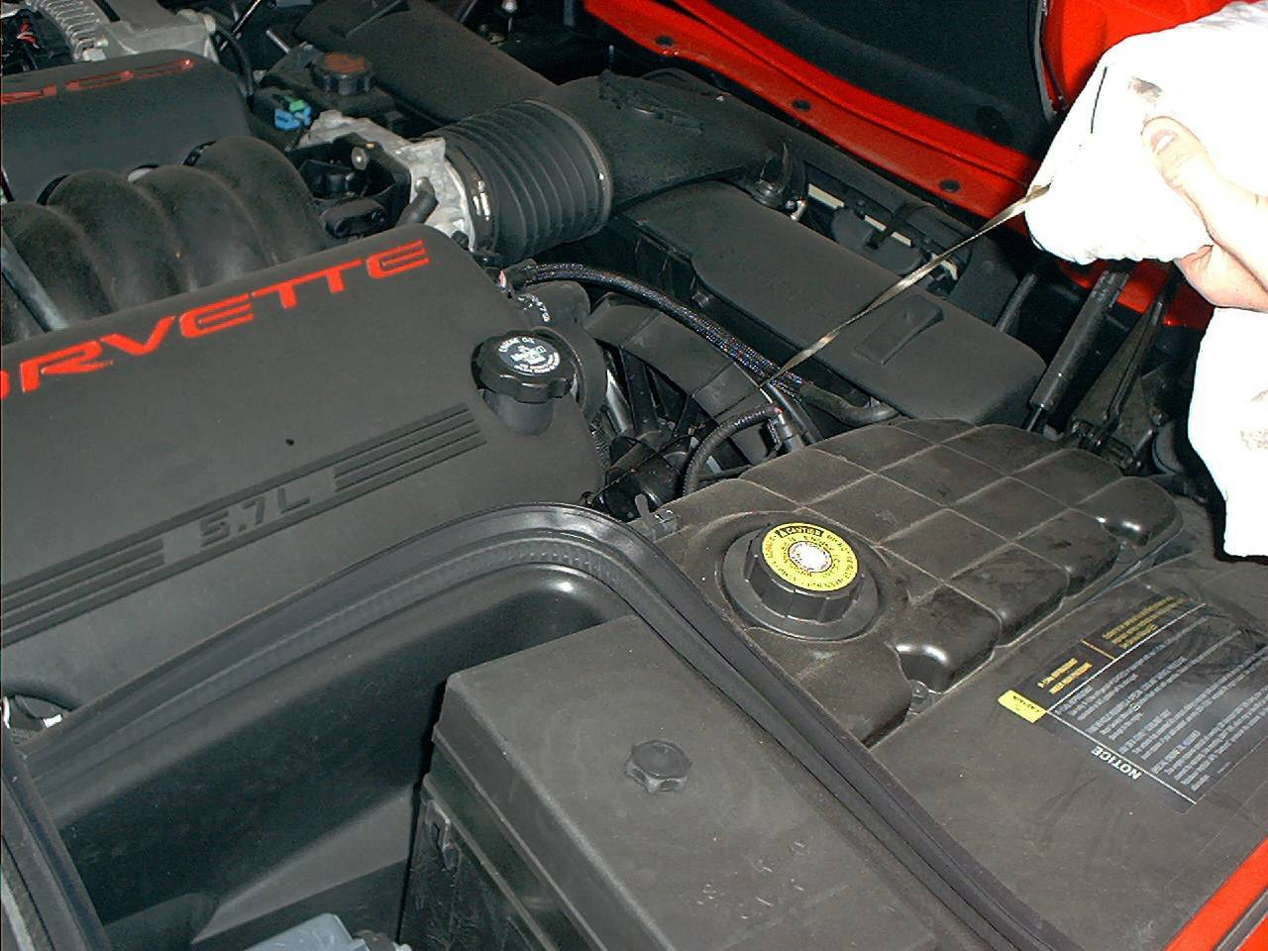
Checking
Your Oil
Vehicle Maintenance
To check your oil, first pop the hood.
Find your dipstick, pull it out and wipe it off with a rag.
Reinsert it. Then pull it back out and check the level of oil on the dipstick.
Add oil if you are 1 quart or more down from “full”
What
do you
know
about
checking
your
oil?

Slide 9
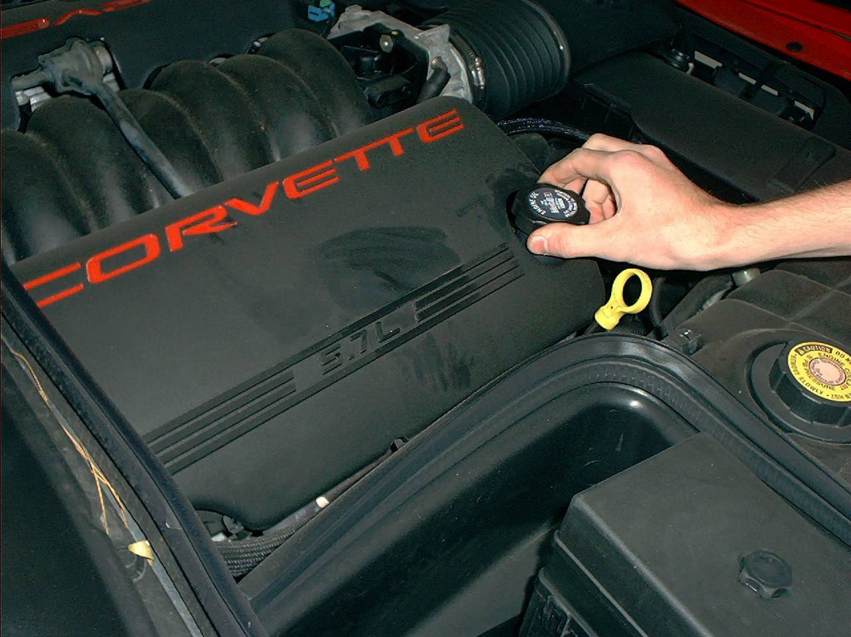
Adding oil
Vehicle Maintenance
First locate the oil fill cap under the hood.
Remove the oil fill cap.
Add the proper type of oil according to the owners manual for your car.
(an oil funnel will keep drips to a minimum)
How often should you
change the oil?

Slide 10
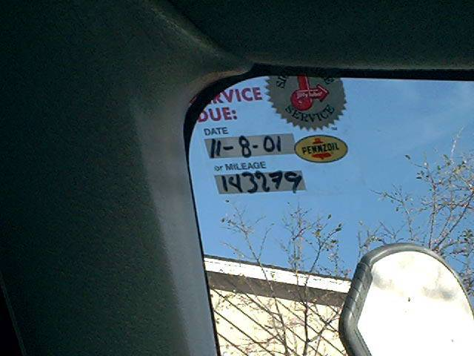
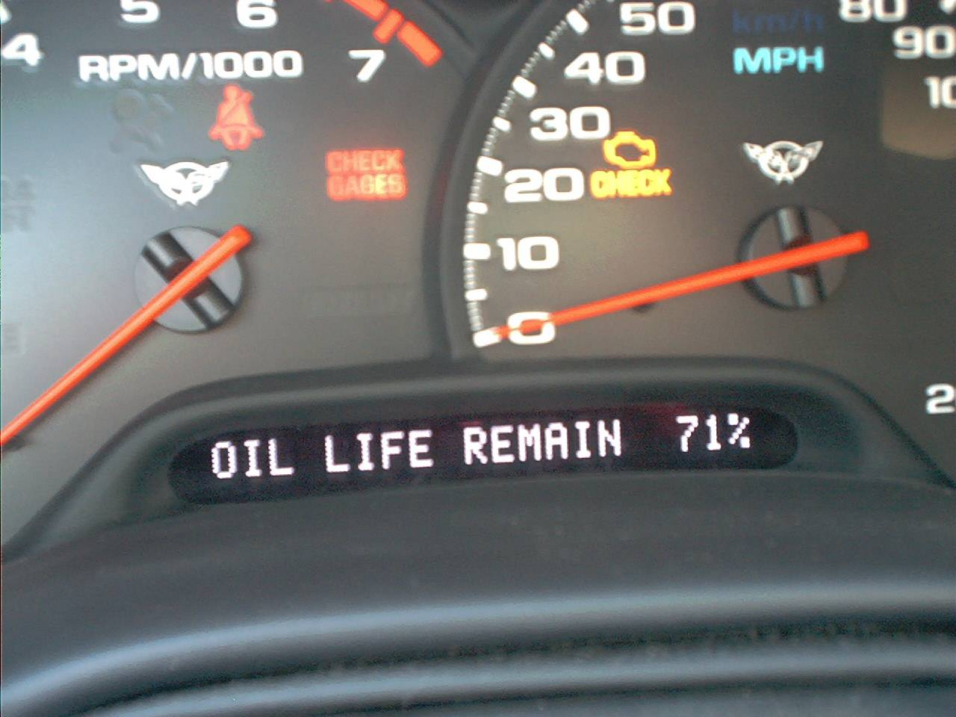
When To Change Your Oil
Vehicle Maintenance
About every 3,000 - 5,000 miles or 3 months
See owners manual for specifics

Slide 11
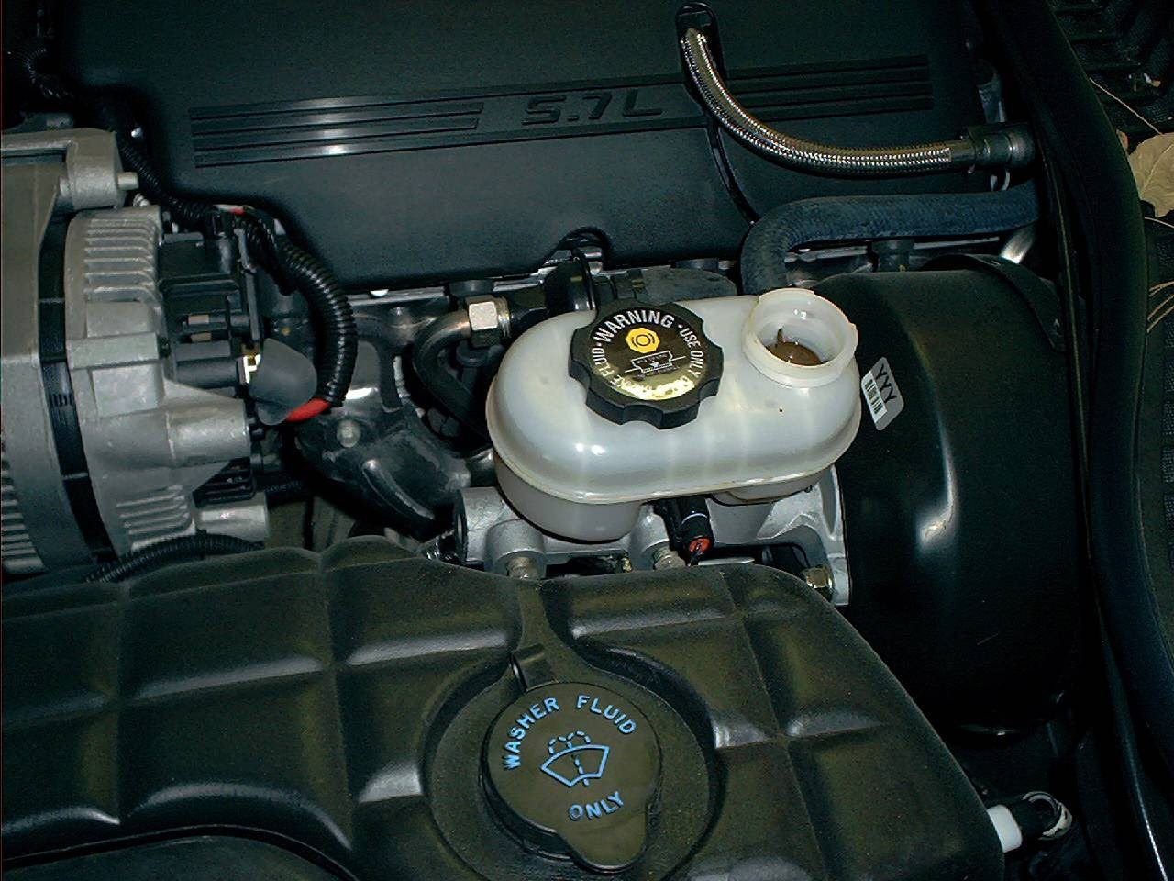
Checking
Brake Fluid
Vehicle Maintenance
To check and add brake fluid first locate the brake fluid reservoir under the hood.
What
do you
know
about
checking
the brake fluid?
Remove the cap off the brake fluid reservoir.
If the fluid level is under the minimum, add the recommended brake fluid to the reservoir.
What are warnings
of bad brakes?

Slide 12

Bad Brakes warning
Vehicle Maintenance
If your brake warning light is on and your parking brake is not set then you may have a problem with your braking system
If you notice a squealing noise when braking it could mean your brake pads are worn and need replacing.

Slide 13
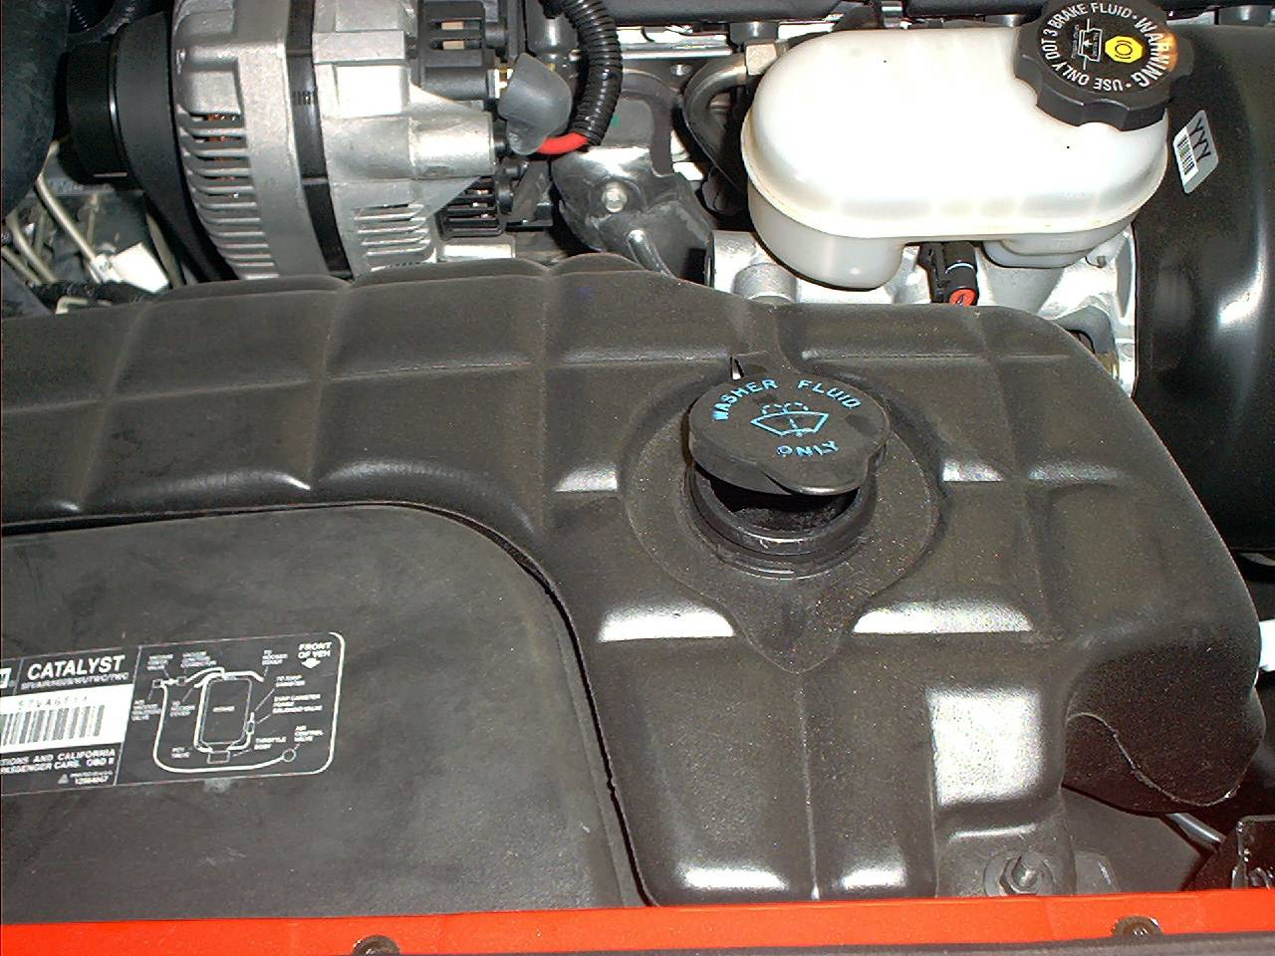
Checking
Windshield
Washer Fluid
Vehicle Maintenance
To check your windshield washer fluid first locate the washer fluid reservoir.
What is the
usual
color
is the
windshield
washer fluid?
Then pop the cap off of the windshield washer fluid reservoir.
If the fluid level is looking low top it off with washer fluid.

Slide 14
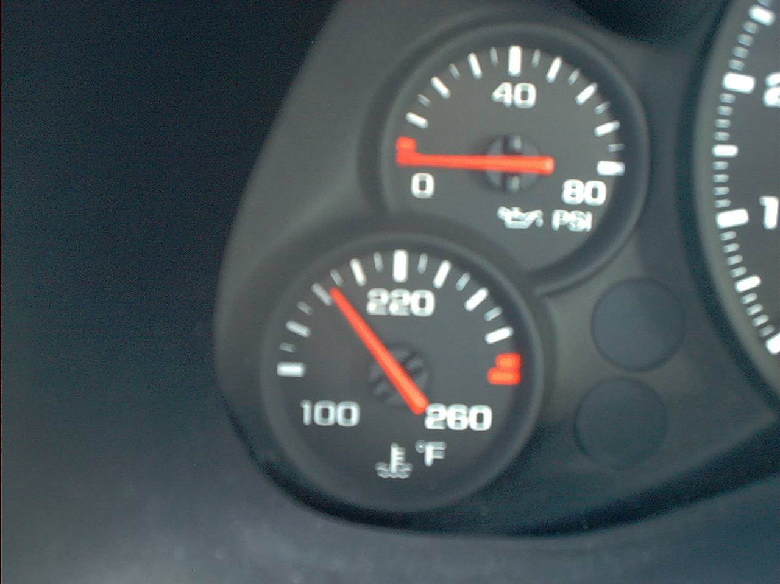
Engine
Temperature
Vehicle Maintenance
You should frequently check your temperature gauge while driving.
If your car begins to overheat, especially in hot weather you should turn on the heater and fan on high; if the engine temperature does not soon lower you should pull over and let your car cool down.
Gauge reads hot

Slide 15
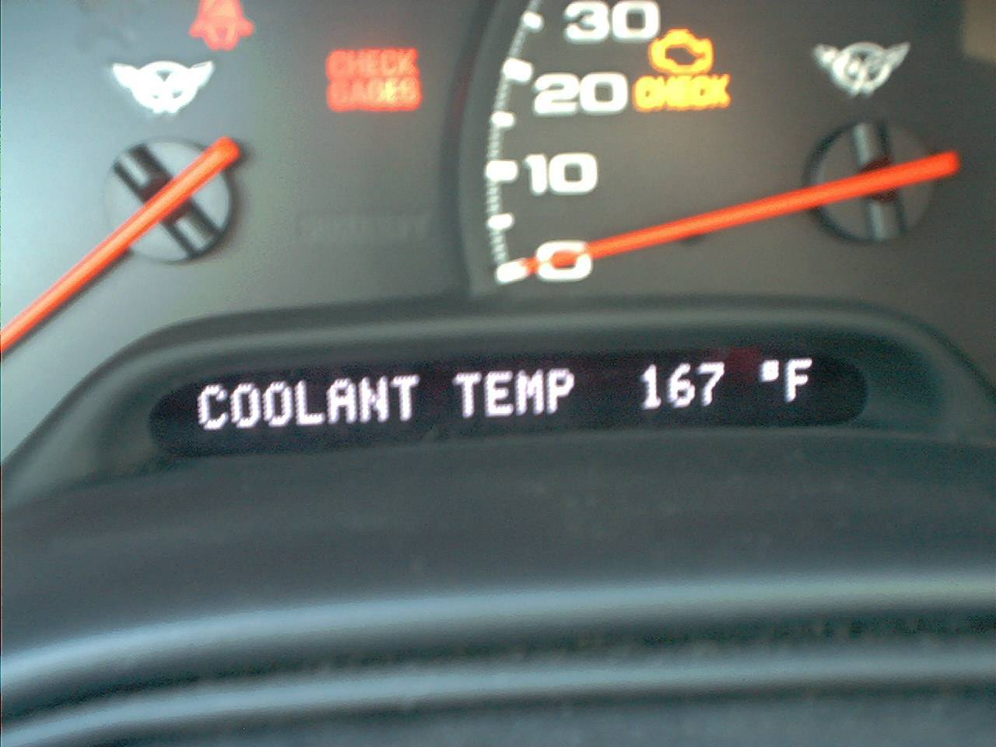
Engine
Temperature
Vehicle Maintenance
After the engine has safely cooled down (it may be an hour) remove the radiator cap.
If the fluid level is low add a 50/50 mix of anti-freeze and water.

Slide 16
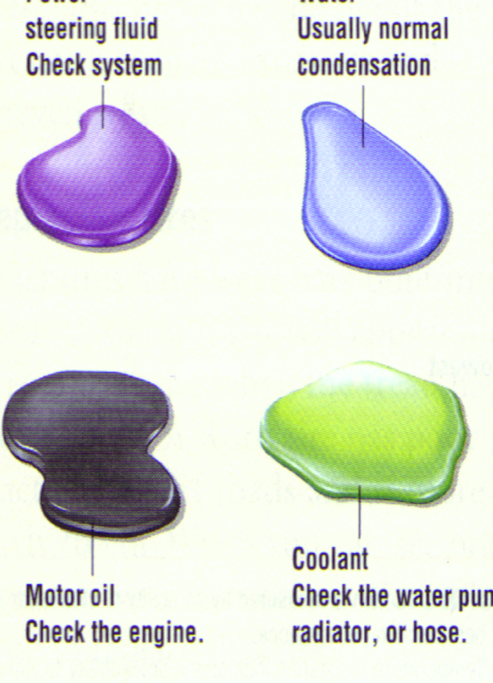
Know your fluids
Vehicle Maintenance
Power steering
fluid: check system
Water: usually
condensation
If you notice fluids under your car where it is normally parked, than you most likely have a leak which needs to be professionally checked out.
Coolant: check
water pump,
radiator or hose
Motor oil: check
under engine
Transmission fluid: check under
car…back part of engine

Slide 17
Changing bulbs
Vehicle Maintenance
If the fuse is not the problem it could be a burned out bulb.
It can be a simple or challenging procedure; see owners manual for bulb type.
Best to bring old bulb with you to auto parts store.

Slide 18
Things better left to professionals
(unless you’ve had special training and have access to the proper equipment)
Vehicle Maintenance
Major tune-ups: often require technical equipment
Engine problems: noises, fluid leaks; odors, broken belts, hoses, vibrations
Transmission problems
Rotating tires
Brake jobs
Radiator flushing
Air conditioning
Exhaust / steering system
Most electrical problems

Slide 19
Gasohol (ethanol)
Other considerations
What
do you
know
about ethanol
(Gasohol)
Gasohol is a mixture of 90% gasoline and 10% ethanol.
Ethanol is often made from corn by-products.
Gasohol has a higher octane and anti-knock properties than gasoline.
Gasohol burns slower and cooler than gasoline making it more economical and it results in reduced emissions.

Slide 20
Gasohol (ethanol)
Other considerations
Gasohol is more expensive and energy intensive to produce. Not suitable for all cars.
It can damage rubber seals and diaphragms in cars that are not compatible with it.
It is also toxic and corrosive; check owners manual to see if it is not recommended.

